Slide 1
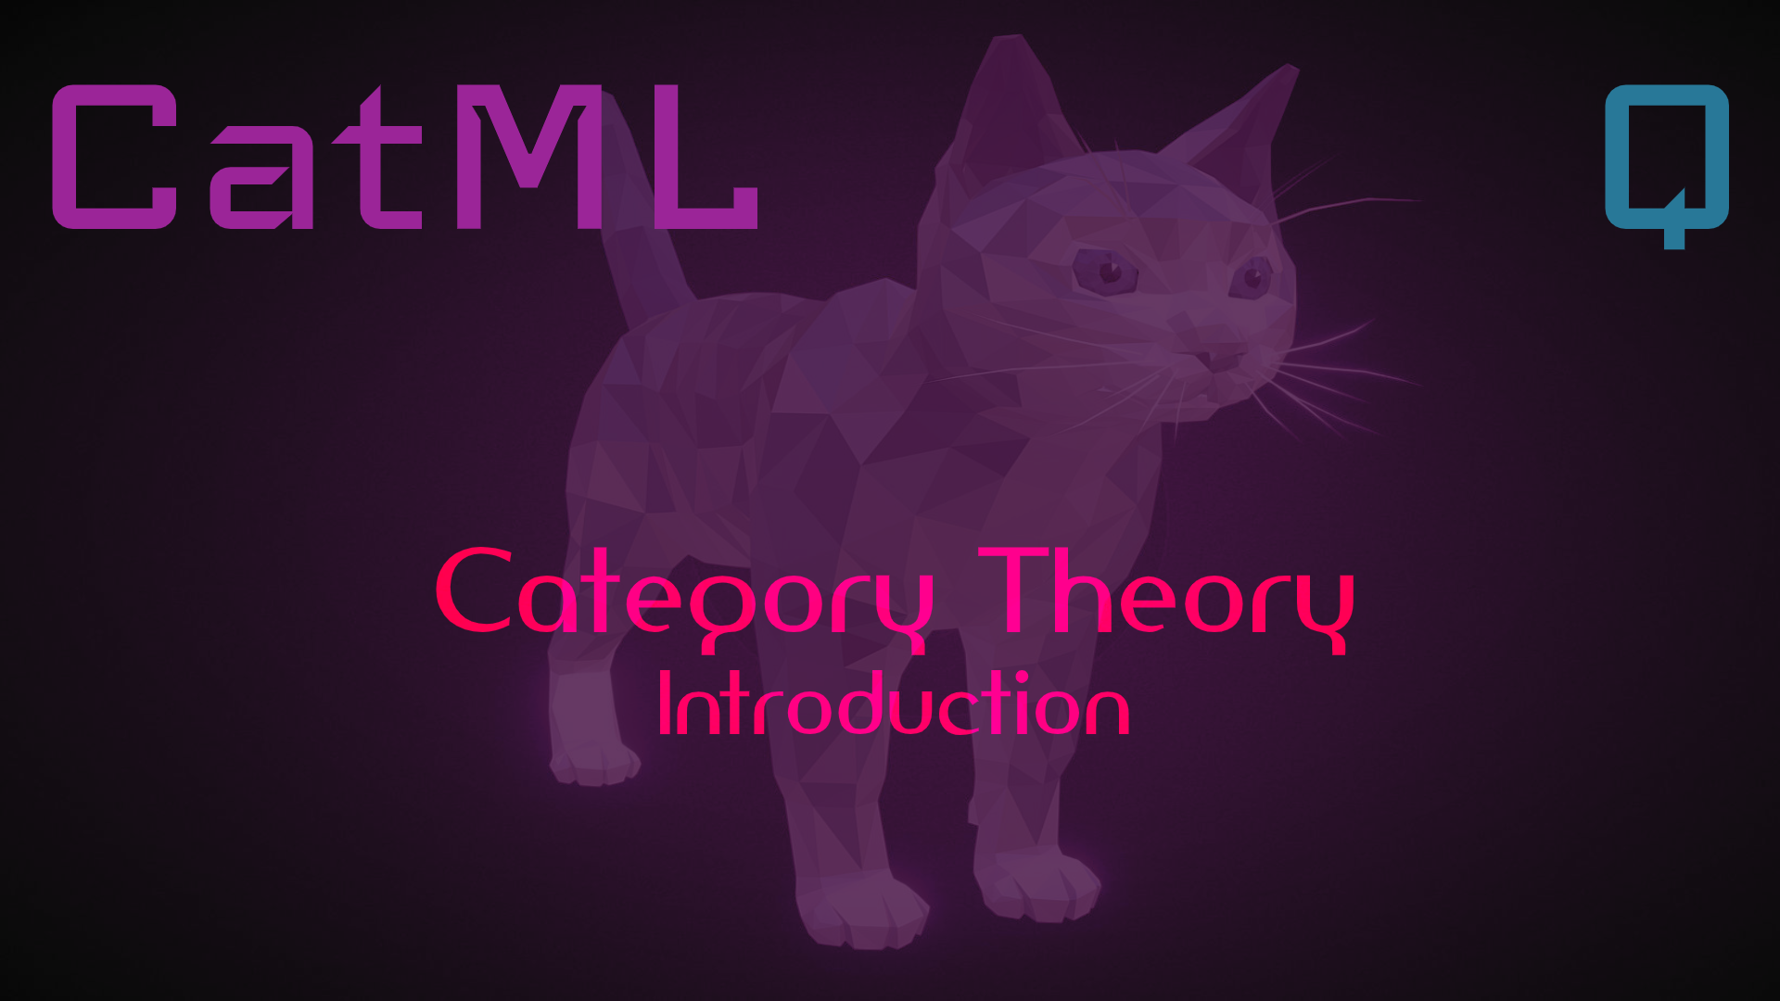
informal

Slide 2
In the beginning…

Slide 4
then there was some thing…
an object

Slide 5
We need to give it an identity
A

Slide 6
This is a relation
A
an identity arrow

Slide 7
Arrows connect objects
id_{A}
an identity arrow

Slide 8
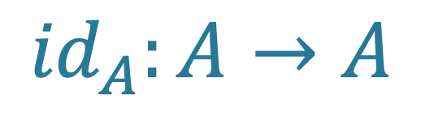
Equivalent Notation
id_{A}
A
A
A
$${id}_{A}:A→A$$

Slide 9
A category is a context
C
id_{A}
boundary | isolation

Slide 10
A category has a name (or two)
C
id_{A}
Disc(1)
Walking Object

Slide 11
Categories represent shapes
C
id_{A}
Disc(1)
One object with identity

Slide 12
Categories represent meaning
C
id_{A}
Disc(1)
I am

Slide 13
Categories represent patterns
C
id_{A}
Disc(1)
Whatever matches this shape,
is an object with identity (i.e., Disc(1))

Slide 14
… and then there were two objects
id_{A}
id_{B}

Slide 15
… and then there were two objects
A
B

Slide 16
… and a new category
A
B
Disc(2)
Pair

Slide 17

… and a new arrow
f
A
B
$$f:A→B$$

Slide 18
… and a new arrow
f
A
B
Arrow
$$f:A→B$$

Slide 19

Arrows compose
id_{A}
f
id_{B}
A
A
B
B
$${id}_{B}∘f∘ {id}_{A}$$
new arrow

Slide 20
Relations Between Categories
F
Disc(1)
Arrow
Cat
Treat categories like objects and create arrows between them. This forms a new category, Cat.

Slide 21
Match the pattern
Map every object and every arrow in Disc(1) to an object and an arrow in Arrow.
Arrows between categories are called functors.

Slide 22
Functors are like lenses
A view of Arrow through the lens F of Disc(1).

Slide 23
Functors are like lenses
The essence of Disc(1) is oneness.

Slide 24
This functor is like choice
It can only pick one object and one arrow.

Slide 25
This functor is like choice
It can only pick one object and one arrow.

Slide 26
This functor is like pair
It can only pick two objects and two arrows.

Slide 27
This functor is like pair
But there is still a choice involved.

Slide 28
Sameness is isomorphism
1
2
Pair
There are two ways to map Pair to Bool.
F
T
F
Bool

Slide 29
Sameness is isomorphism
1
2
Pair
1
2
But there are also two ways to map Bool to Pair.
F
G
T
F
Bool
T
F

Slide 30
Sameness is isomorphism
id
1
2
Pair
1
2
Bool and Pair aren’t the same, but they share an essential meaning and are interchangeable.
F
G
T
F
Bool
T
F
id

Slide 31

Functors compose
id
1
2
Pair
1
2
Functors are arrows in the category Cat. They must behave like all arrows.
F
G
T
F
Bool
T
F
$${id}_{Pair}∘G∘ {id}_{Bool}∘F$$
id

Slide 32
Functors can be objects, too
Arrows between functors are called natural transformations.
u
F
G
Fun
Treat functors like objects and create arrows between them. This forms a new category, Fun.

Slide 33
Natural transformation models polymorphism
safeHead: List a -> Option a
List and Option are endofunctors on the category of Types used in programming.
safeHead is a natural transformation between a list functor of arbitrary type and an option of arbitrary type
safeHead is a family of functions parameterized over Type (Integer, Boolean, String, …)

Slide 34
What’s the point?
We can identify objects
We can relate objects with arrows
We can isolate objects and arrows in category contexts
Categories are shapes, patterns, meaning
Functors are like lenses
Isomorphism is sameness
Natural transformation is polymorphism
unifying abstraction
for the building blocks of meaning

Slide 35
Next up
The incredible power of Generalized Algebraic Theories (GATs)
Define or extend a theory
Develop a syntax
  Symbolic notation (formula)
  Wiring diagram (graphical model)
  Domain-specific languages
Create instances
  Lambda, notebooks
  Function graphs
  Services
Present models
  Using syntax, define models (e.g., epidemiology, planning optimization)
Run simulations

Slide 36
Match the pattern
id_{A}
Disc(1)
F
f
id_{A}
id_{B}
Arrow

Slide 37
Match the pattern
id_{A}
id_{B}
Disc(2)
G
f
id_{A}
id_{B}
Arrow

Slide 38
Match the pattern
1
2
Pair
F
T
F
Bool

Slide 39
Diagram
Symbolic Expression
Simulation
Theory

Slide 40
Theory
Instance
Presentation
Implementation
Syntax
Diagram
Subtheory

