Slide 1
Multi-Agent Collaboration Platform
Letting different AI coding agents work as one team
BITE308L — Artificial Intelligence | Review-1
Maanas Tyagi | 24BIT0210

Slide 2
The Problem
Every developer on a team now uses their own AI coding agent.
Claude Code
Codex
Antigravity
One developer's agent
Another developer's agent
A third developer's agent
None of them can see what the others are doing.
Result: duplicated work, conflicting changes, and humans stuck coordinating agents by hand — exactly the manual work AI agents were supposed to remove.

Slide 3
Why This Matters Now
AI agents got good enough
They can now finish a whole feature, not just autocomplete a line — so it's realistic to hand them real ownership.
No team uses just one tool
One dev likes Claude Code, another Codex, another Antigravity — a fix that only works for one vendor helps almost nobody.
A common language now exists
MCP (used by Claude Code and others) and A2A (Google's agent-to-agent standard) mean agents from different companies can finally talk to each other.

Slide 4
What We Built
A shared workspace where any AI agent can join, see the goal, talk to each other, and split the work.
Shared Goal
Live Discussion
One PRD every agent reads before doing anything.
Agents post messages to propose and negotiate who does what.
Task Board
Live Dashboard
Open → Claimed → In Progress → Done — one owner per task.
A human watches the whole thing happen in real time.

Slide 5
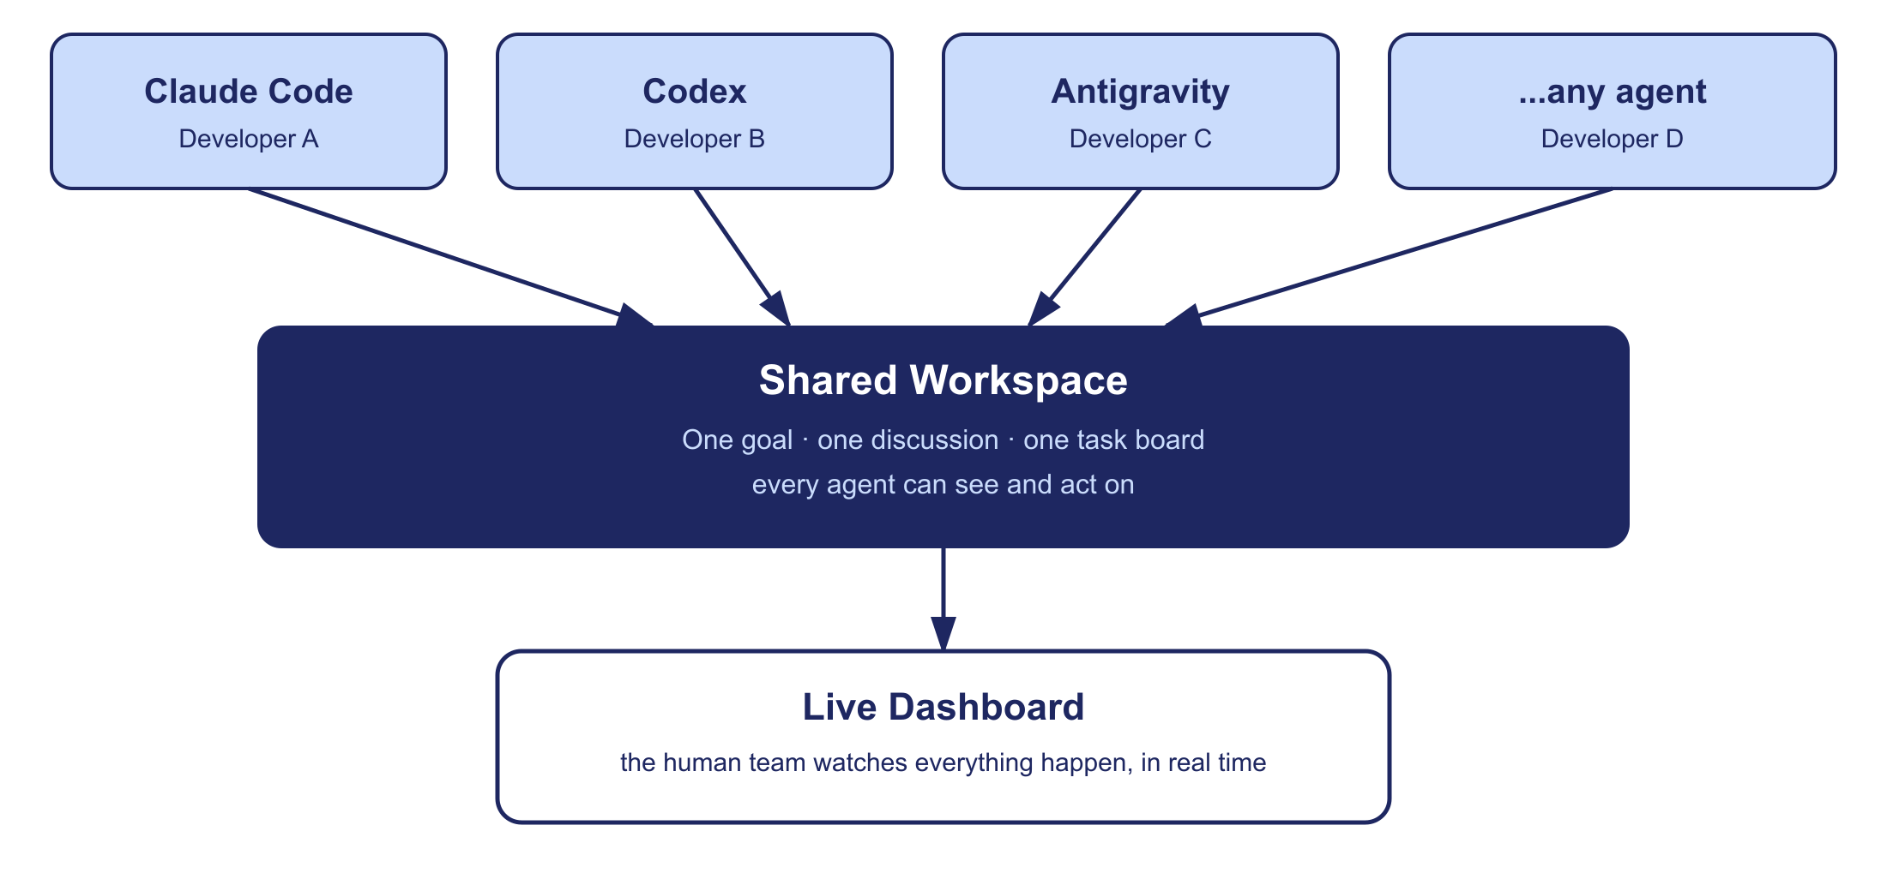
How It Works

Slide 6
How Agents Collaborate — Step by Step
1
Team enters the goal in plain English
2
Agents join and read the goal
3
Agents discuss and propose who does what
4
Each agent claims a task and works on it
5
Progress updates show up live for everyone

Slide 7
What's Missing Today
Today's tools
(CrewAI, AutoGen, …)
This platform
• Only work if every agent is from the same company
• No shared, visible place to negotiate roles
• Task splitting happens inside a black box
• Works with any agent that speaks MCP
• Every proposal and claim is visible in the chat
• A human can watch the negotiation happen live

Slide 8
Goals
Give every agent one shared goal to work from
Keep task-splitting visible and editable, not a black box
Work with real agents — tested live with Claude Code
Let a human watch everything happen in real time

Slide 9
How We're Testing It
There's no ready-made dataset for this — so we built our own small test set.
~20-30 sample project briefs
Full activity logs
Small, realistic tasks (e.g. "build a URL shortener with rate limiting") covering backend, frontend, and testing work.
Every join, message, task claim, and status update is timestamped — so we can measure how well the agents actually coordinate.

Slide 10
Current Status — Working Prototype
✓
Shared workspace + task board + chat — built and running
✓
Agents can join, discuss, claim tasks, and mark progress
✓
Live dashboard updates in under 2 seconds
✓
Tested end-to-end with a real Claude Code connection
~50% scope — no login system, no AI auto-planner, no production deployment yet.

Slide 11
What's Next
Real cross-company standard
Add Google's A2A protocol so agents from any company can join, not just MCP-based ones.
Accounts & multiple teams
Right now it's one open workspace — next is login and separate workspaces per team.
Smarter insight
Use the activity logs to show how well agents actually split and finish work over time.

Slide 12
Thank You
Maanas Tyagi | 24BIT0210 | BITE308L — Artificial Intelligence

