Slide 1

FACIAL EMOTION RECOGNITION USING CNN
Team Details
Team Number: C7
Sl.No | Student Name | USN | Roll No | Division
1 | Ananya Kulkarni | 01FE21BCS144 | 527 | E
2 | Swarna Patil | 01FE21BCS145 | 565 | E
3 | Amrutha Beedikar | 01FE21BCS198 | 324 | C
4 | Maanasi Shastri | 01FE21BCS210 | 327 | C
Guide: Dr. Sujatha C

Slide 2
REVIEW 2 COMMENTS:
Suggestions/Comments in Review-2 | Action Taken | Page No.
Work on preparing dataset. | Prepared the data using suitable balancing technique. | 6
Need to improve the accuracy. | Improved the accuracy | 15

Slide 3

PROBLEM STATEMENT
Develop a synthesizable AI model to perform image classification on facial emotions using a Convolutional neural network.
Classification model(CNN )
INPUT
OUTPUT
SURPRISE
OBJECTIVES:
Preprocess the images.
Construct and train a convolutional neural network(CNN) for the purpose of categorizing facial emotions in humans.
Test and Compare the synthesizable model's accuracy and efficiency with state-of-the-art techniques for facial emotion recognition.

Slide 4
OBJECTIVES ACHIEVED:
Preprocessing of the images using the most suitable balancing technique, i.e Random oversampling.
Construct and train a convolutional neural network(CNN) to categorize facial emotions in humans.
Comparing the model's accuracy and efficiency with state-of-the-art techniques for facial emotion recognition.

Slide 5
IMPLEMENTATION
The total number of train images after pre-processing is 50,505.
The total number of test images is 7,178.
The architecture used for implementation is the ResNet50-based Improved Convolutional Neural Network (ImprovedCNN).
Our model, ImprovedCNN, utilizes a pre-trained ResNet50 for feature extraction from facial expression images.
Batch normalization enhances stability in the 2048-dimensional feature vector.
A custom fully connected layer tailors the output to emotion classes.
Dropout prevents overfitting by deactivating input units randomly.
Softmax produces a probability distribution for emotion classes.
This architecture enables accurate emotion recognition from facial expressions.

Slide 6
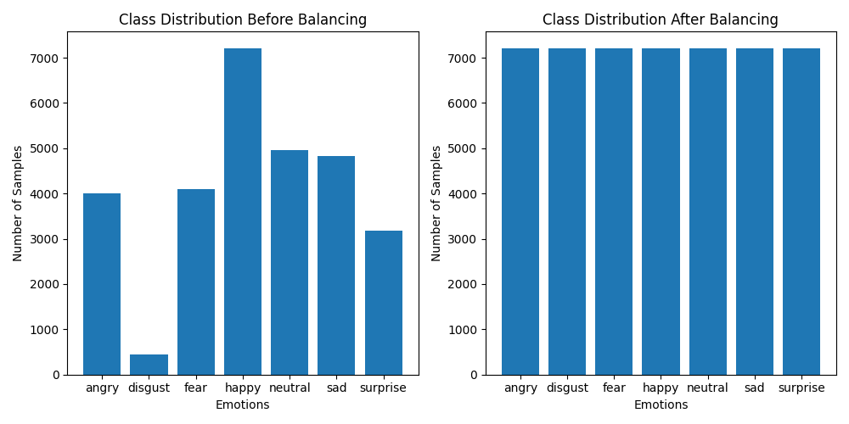
IMPLEMENTATION (continued…)
Data Preprocessing: Balancing of the train dataset using the oversampling method.

Slide 7
INITIAL MODEL IMPLEMENTATION:
Initial model training: 100 epochs, 33.38% accuracy, learning rate 0.0001
Strong performance in 'surprise,' 'happy,' and 'disgust' during evaluation.
Extended training to 250 epochs: 45.77% accuracy
Marginal improvement in 'angry,' 'neutral,' and 'sad’.
Further training at 250 epochs: 52.67% accuracy, learning rate 0.001
Continued strong performance in 'surprise,' 'happy,' and 'disgust’.
Extended training to 400 epochs: 52.51% accuracy
Slight improvements in 'angry,' 'neutral,' and 'sad' classes

Slide 8
CLASS-WISE OBSERVATIONS:
The model demonstrates high accuracy in classifying Happy expressions, achieving 41.61% accuracy.
Sad ,disgust and neutral expressions also show reasonable accuracy at 26.42% ,33.95 % and 24.5%, respectively.
Angry and Suprise expressions have lower accuracy rates, with 20.7% and 23.96%, respectively.
Fear exhibits an accuracy of 15.95%, indicating a lowest performance.
Further optimization may be explored to enhance accuracy, particularly in the disgust category.
CLASS NAME | TEST ACCURACY
ANGRY | 20.7%
DISGUST | 33.95%
FEAR | 15.95%
HAPPY | 41.61%
NEUTRAL | 24.5%
SAD | 26.42%
SURPRISE | 23.96%

Slide 9
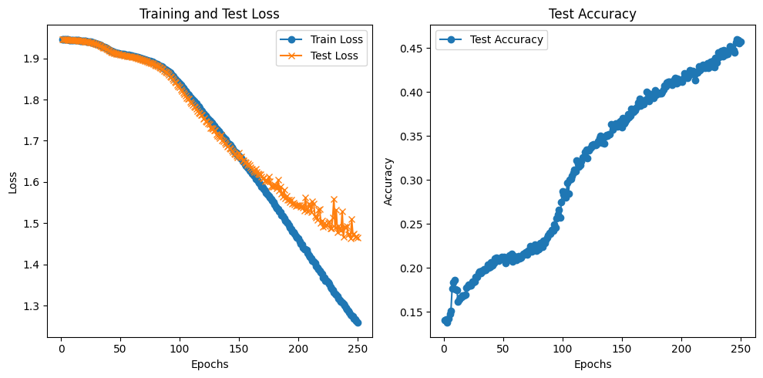
Loss and Accuracy curves:
Epochs: 250
LR: 0.001

Slide 10
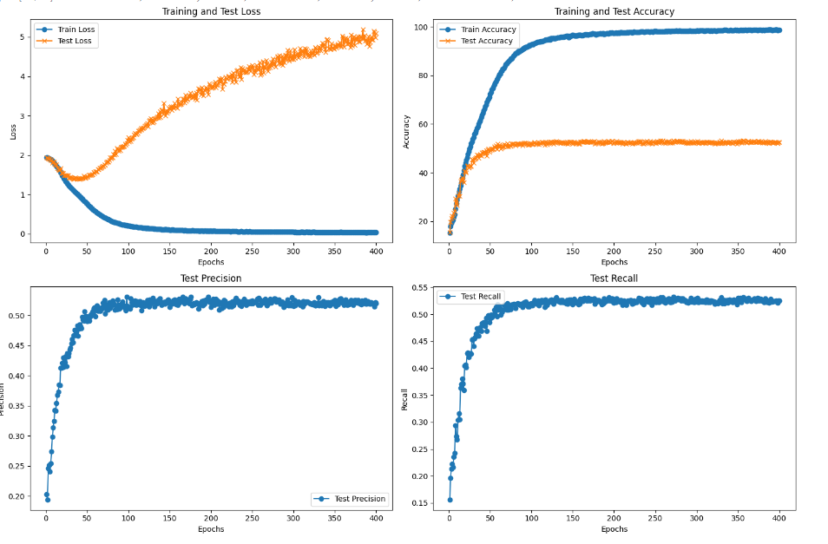
Loss, Accuracy, Recall, and Precision Curves:
Epochs: 400
LR: 0.001

Slide 11



OBSERVATIONS AND ANALYSIS:
Data Balancing Impact: Oversampling proved effective in balancing the dataset, showcasing positive outcomes in classes with both the highest and lowest sample numbers ('surprise', 'happy', and 'disgust’).
Effect of Training Epochs: Raising epochs from 100 to 250 moderately boosted overall accuracy (33.38% to 45.77%), but improvements plateaued, particularly for classes like 'angry,' 'neutral,' and 'sad.'
Stronger Performance in Specific Classes: There is a tendency for the model to confuse classes such as ‘angry’, ‘fear’, and ‘neutral’, often predicting them as ‘sad’.
Class: ‘angry’
Class: ‘fear’
Class: ‘neutral’

Slide 12
OBSERVATIONS AND ANALYSIS:
Limited Improvement for Certain Classes:
Extended training showed minimal performance improvement for classes 'angry,' 'neutral,' and 'sad.' This suggests complexity in discerning these classes, hinting at the need for diverse data or alternative approaches.
Potential Learning Plateau: Marginal overall accuracy improvement with a significant increase in epochs hints at a learning plateau. The model may be reaching its capacity for further improvement, encountering diminishing returns.
Therefore, we opted for a learning rate of 0.001 and extended to 400 epochs as the graph shows the model hasn't converged. This suggests the need for additional learning.

Slide 13
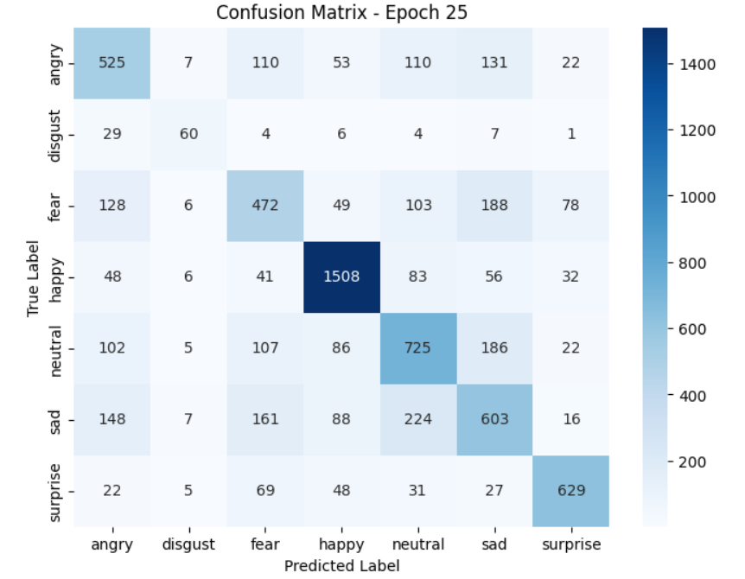
ResNet18 WITH IMPROVED CNN:
Number of epochs: 100/100
Learning rate: 0.001
CLASS | ACCURACY
ANGRY | 55.74%
DISGUST | 53.15%
FEAR | 45.41%
HAPPY | 85.74%
NEUTRAL | 55.64%
SAD | 49.96%
SUPRISE | 74.25%
Epoch [100/100], Train Loss: 1.4975, Train Accuracy: 63.47%, Test Loss: 1.5374, Test Accuracy: 62.76%, Test Precision: 0.6270, Test Recall: 0.6276.

Slide 14
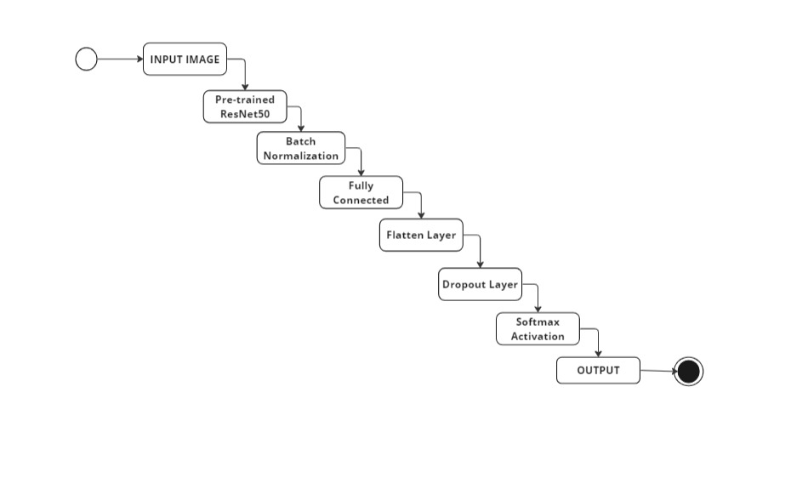
ResNet50 WITH IMPROVED CNN
Number of epochs: 25/100
Learning rate: 0.001

Slide 15
ResNet50 WITH IMPROVED CNN
Number of epochs: 25/100
Learning rate: 0.001
CLASS | ACCURACY
ANGRY | 55.22%
DISGUST | 58.56%
FEAR | 47.56%
HAPPY | 84.16%
NEUTRAL | 61.07%
SAD | 52.53%
SUPRISE | 76.90%
The model performs well in capturing diverse facial expressions, particularly excelling in recognizing 'happy' expressions.
However, attention to improving accuracy in certain classes like 'fear' may further enhance its overall performance.
Epoch [25/100], Train Loss: 1.5112, Train Accuracy: 62.28%, Test Loss: 1.5265, Test Accuracy: 64.38%, Test Precision: 0.6467, Test Recall: 0.6438

Slide 16

COMPARISION:
COMPARISON OF DIFFERENT CNN MODELS:
Model | Learning Rate | Epoch | Test Accuracy (%)
CNN with 3 conv layers | 0.0001 | 100 | 33.38%
CNN with 3 conv layers | 0.0001 | 250 | 45.77%
CNN with 3 conv layers | 0.001 | 250 | 52.67%
CNN with 3 conv layers | 0.001 | 400 | 52.50%
Resnet18 with Improved CNN | 0.001 | 100 | 62.71%
Resnet50 | 0.001 | 25 | 64.38%

Slide 17
COMPARISION:
COMPARISON OF OUR MODELS TO STATE-OF-ART:
FER MODEL | TEST ACCURACY() | TEST ACCURACY(OUR)
Light-FER | 69% | -
VGG-Net | Around 60% | -
ResNet-50 | Around 60% | 64.38%
CNN | Around 60% | 52.50%

Slide 18
CONCLUSION:
This implementation addresses the challenge of imbalanced class distribution in the testing dataset, employs an adapted ResNet18-based model named ImprovedCNN for emotion classification, and utilizes a robust training and evaluation process with metrics like loss, accuracy, precision, and recall.
The implementation includes an early stopping mechanism based on the test loss. If there is no improvement in the test loss for a certain number of consecutive epochs (controlled by the patience parameter), the training is stopped to prevent overfitting.

Slide 19
FUTURE SCOPE:
The model used for FER will be further trained with different neural networks to improve the accuracy compared to the state-of-art.
Usage of ensemble methods can be considered by combining predictions from multiple models. This can enhance overall model robustness and accuracy.
An interactive application or a website can be developed where users can input images, and the model predicts the corresponding emotion. This would involve deploying the trained model.
Extension of the model can be done to handle multi-modal inputs, such as combining facial expressions with voice analysis for a more comprehensive emotion recognition system.

Slide 20
References
[1] https://www.kaggle.com/datasets/chiragsoni/ferdata/data
[2] J. Yang, T. Qian, F. Zhang, and S. U. Khan, "Real-Time Facial Expression Recognition Based on Edge Computing," in IEEE Access, vol. 9, pp. 76178-76190, 2021, doi: 10.1109/ACCESS.2021.3082641.
https://ieeexplore.ieee.org/document/9438728
[3] Muhammad, Ghulam & Hossain, M. Shamim. (2021). Emotion Recognition for Cognitive Edge Computing Using Deep Learning. IEEE Internet of Things Journal. 8. 16894-16901. 10.1109/JIOT.2021.3058587.
https://www.researchgate.net/publication/356396496_Emotion_Recognition_for_Cognitive_Edge_Computing_Using_Deep_Learning

Slide 21
THANK YOU

