Slide 1

FACIAL EMOTION RECOGNITION USING CNN
Team Details
Team Number: C7
Sl.No | Student Name | USN | Roll No | Division
1 | Ananya Kulkarni | 01FE21BCS144 | 527 | E
2 | Swarna Patil | 01FE21BCS145 | 565 | E
3 | Amrutha Beedikar | 01FE21BCS198 | 324 | C
4 | Maanasi Shastri | 01FE21BCS210 | 327 | C
Guide: Dr. Sujatha C

Slide 2
REVIEW 3 COMMENTS
Suggestions/Comments in Review-2 | Action Taken | Page No.
Update the architecture diagram of ResNet 50 with Improved CNN | Updated | 14

Slide 3

PROBLEM STATEMENT
PROBLEM STATEMENT
Develop a synthesizable AI model to perform image classification on facial emotions using a Convolutional Neural Network.
Classification model(CNN )
INPUT
OUTPUT
SURPRISE
OBJECTIVES:
Preprocess the images.
Construct and train a convolutional neural network(CNN) model to categorize facial emotions in humans.
Test and Compare the synthesizable model's accuracy and efficiency with state-of-the-art techniques for facial emotion recognition.

Slide 4
OBJECTIVES ACHIEVED
Preprocessed the images using the most suitable balancing technique, i.e. Random oversampling.
Constructed and trained a Convolutional Neural Network(CNN) models to categorize facial emotions in humans.
Compared the model's accuracy and efficiency with state-of-the-art techniques for facial emotion recognition.

Slide 5

Software Engineering Requirements:
Functional requirements:
The user shall be able to input the grayscale facial images for emotion recognition.
The system shall classify a range of emotions such as happiness, sadness, anger, fear, etc., from the input images.
The system shall predict the emotions and generate scores/accuracies for all the emotion classes.
The user shall be able to view the performance analysis.
Non-Functional requirements:
The system should achieve a response time of less than 2 seconds for emotion recognition processing, ensuring minimal delay in emotion recognition to enhance user experience.
The emotion recognition system should achieve a minimum accuracy of 70% on standardized emotion recognition benchmarks.

Slide 6
USE CASE DIAGRAM:
Facial Emotion Recognition
Train Classification model
Inputs the facial Images
Classify emotions.
Performance analysis.
USER
Predicts the emotions.
SYSTEM

Slide 7




Dataset Description:
Facial emotion recognition
Dataset size: 56.51MB.
The dataset contains 35,914 grayscale images of faces.
The dataset consists of 7 classes. They are- happy, sad, disgust, angry, fear, neutral, and surprise.
The images in the dataset are approximately of the size 2KB each.
Angry
Fear
Surprise

Slide 8




Dataset Description (cont…)
The number of images for each feature is as follows-
angry – 4953 images
disgust - 547 images
fear - 5121 images
Happy - 8989 images
neutral - 6198 images
sad - 6077 images
surprise - 4002 images
Testing images – 20.06% [7,205 images]
Training images – 79.93% [28,709 images]
Sad
Happy
Disgust
Neutral

Slide 9
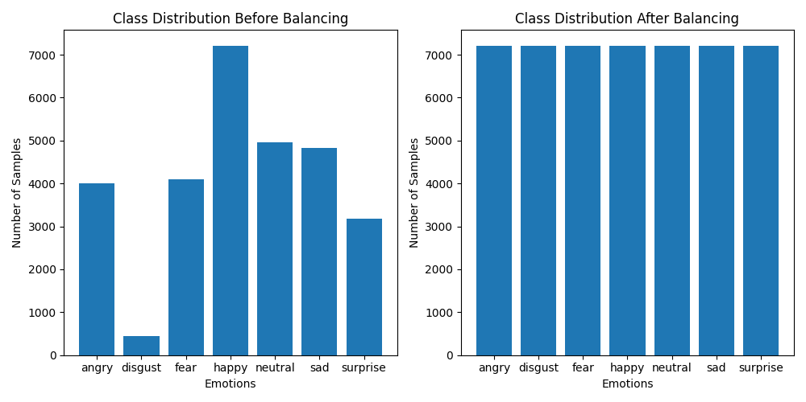
Dataset Description (cont…)
Data Preprocessing: Balancing of the train dataset using the oversampling method.

Slide 10
IMPLEMENTATION
The total number of train images after pre-processing is 50,505.
The total number of test images is 7,205.
The architecture used for implementation is the ResNet50-based Improved Convolutional Neural Network (ImprovedCNN).
Our model, ImprovedCNN, utilizes a pre-trained ResNet50 for feature extraction from facial expression images.
Batch normalization enhances stability of the feature vector.
A custom fully connected layer tailors the output to emotion classes.
Dropout prevents overfitting by deactivating input units randomly.
SoftMax produces a probability distribution for emotion classes.
This architecture enables accurate emotion recognition from facial expressions.

Slide 11
INITIAL MODEL IMPLEMENTATION
Initial model training: 100 epochs, 33.38% accuracy, learning rate 0.0001
Strong performance in 'surprise,' 'happy,' and 'disgust' during evaluation.
Extended training to 250 epochs: 45.77% accuracy
Marginal improvement in 'angry,' 'neutral,' and 'sad’.
Further training at 250 epochs: 52.67% accuracy, learning rate 0.001
Continued strong performance in 'surprise,' 'happy,' and 'disgust’.
Extended training to 400 epochs: 52.51% accuracy
Slight improvements in 'angry,' 'neutral,' and 'sad' classes

Slide 12
CLASS-WISE OBSERVATIONS
The model demonstrates high accuracy in classifying Happy expressions, achieving 41.61% accuracy.
Sad, disgust and neutral expressions also show reasonable accuracy at 26.42%,33.95 %, and 24.5%, respectively.
Angry and Suprise expressions have lower accuracy rates, with 20.7% and 23.96%, respectively.
Fear exhibits an accuracy of 15.95%, indicating the lowest performance.
Further optimization may be explored to enhance accuracy, particularly in the disgust category.
CLASS NAME | TEST ACCURACY
ANGRY | 20.7%
DISGUST | 33.95%
FEAR | 15.95%
HAPPY | 41.61%
NEUTRAL | 24.5%
SAD | 26.42%
SURPRISE | 23.96%

Slide 13
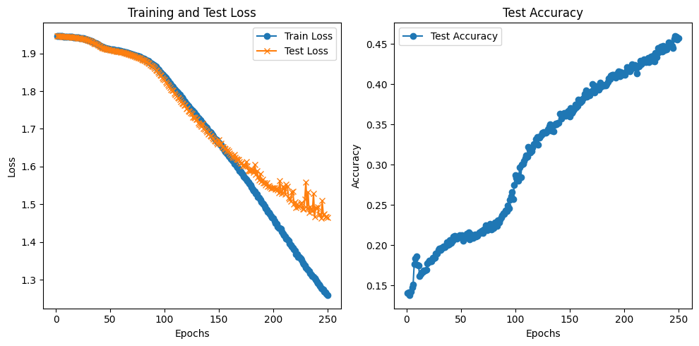
LOSS AND ACCURACY CURVES
Epochs: 250
LR: 0.001

Slide 14
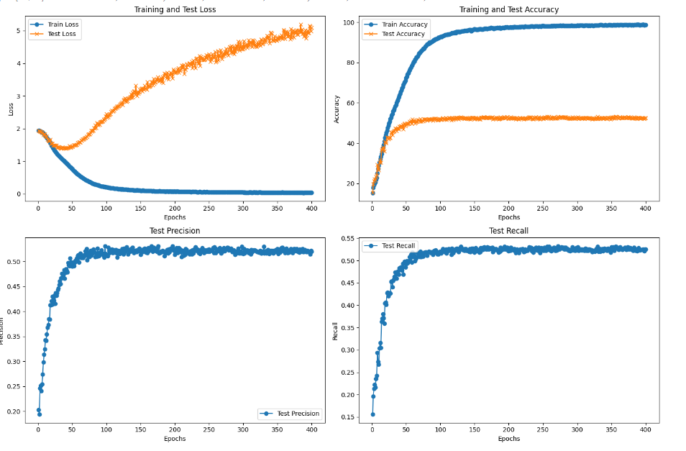
LOSS, ACCURACY, RECALL, AND PRECISION CURVES
Epochs: 400
LR: 0.001

Slide 15



OBSERVATIONS AND ANALYSIS
Data Balancing Impact: Oversampling proved effective in balancing the dataset, showcasing positive outcomes in classes with both the highest and lowest sample numbers ('surprise', 'happy', and 'disgust’).
Effect of Training Epochs: Raising epochs from 100 to 250 moderately boosted overall accuracy (33.38% to 45.77%), but improvements plateaued, particularly for classes like 'angry,' 'neutral,' and 'sad.'
Performance in Specific Classes: There is a tendency for the model to confuse classes such as ‘angry’, ‘fear’, and ‘neutral’, often predicting them as ‘sad’.
Class: ‘angry’
Class: ‘fear’
Class: ‘neutral’

Slide 16
OBSERVATIONS AND ANALYSIS (cont…)
Limited Improvement for Certain Classes:
Extended training showed minimal performance improvement for classes 'angry,' 'neutral,' and 'sad.' This suggests complexity in discerning these classes, hinting at the need for diverse data or alternative approaches.
Potential Learning Plateau: Marginal overall accuracy improvement with a significant increase in epochs hints at a learning plateau. The model may be reaching its capacity for further improvement, encountering diminishing returns.
Therefore, we opted for a learning rate of 0.001 and extended to 400 epochs as the graph shows the model hasn't converged. This suggests the need for additional learning.

Slide 17
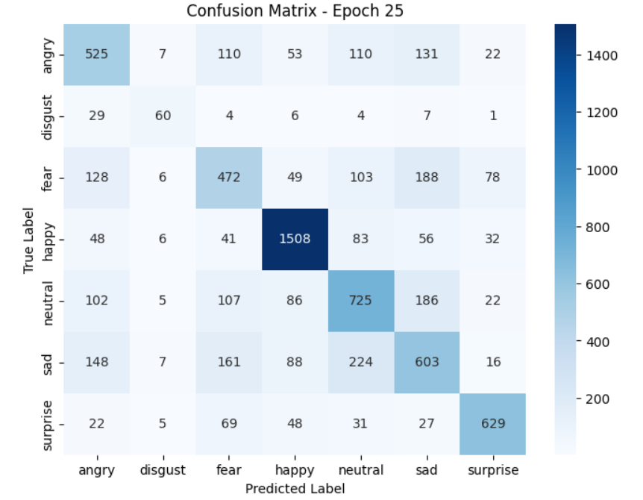
ResNet18 WITH IMPROVED CNN
Number of epochs: 100/100
Learning rate: 0.001
CLASS | ACCURACY
ANGRY | 55.74%
DISGUST | 53.15%
FEAR | 45.41%
HAPPY | 85.74%
NEUTRAL | 55.64%
SAD | 49.96%
SUPRISE | 74.25%
Epoch [100/100], Train Loss: 1.4975, Train Accuracy: 63.47%, Test Loss: 1.5374, Test Accuracy: 62.76%, Test Precision: 0.6270, Test Recall: 0.6276.

Slide 18
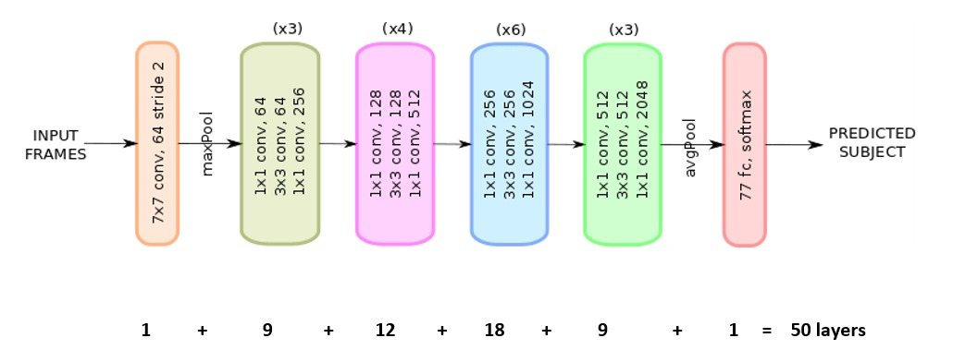
ResNet50 WITH IMPROVED CNN

Slide 19
ResNet50 WITH IMPROVED CNN(cont…)
CLASS | ACCURACY
ANGRY | 55.22%
DISGUST | 58.56%
FEAR | 47.56%
HAPPY | 84.16%
NEUTRAL | 61.07%
SAD | 52.53%
SUPRISE | 76.90%
The model performs well in capturing diverse facial expressions, particularly excelling in recognizing 'happy' expressions.
However, attention to improving accuracy in certain classes like 'fear' may further enhance its overall performance.
Epoch [25/100],
Train Loss: 1.5112, Train Accuracy: 62.28%, Test Loss: 1.5265, Test Accuracy: 64.38%,
Test Precision: 0.6467, Test Recall: 0.6438

Slide 20
COMPARISION
COMPARISON OF DIFFERENT CNN MODELS:
Model | Learning Rate | Epoch | Test Accuracy (%)
CNN with 3 conv layers | 0.0001 | 100 | 33.38%
CNN with 3 conv layers | 0.0001 | 250 | 45.77%
CNN with 3 conv layers | 0.001 | 250 | 52.67%
CNN with 3 conv layers | 0.001 | 400 | 52.50%
Improved Resnet18 | 0.001 | 100 | 62.71%
Improved Resnet50 | 0.001 | 25 | 64.38%

Slide 21
COMPARISION
COMPARISON OF OUR MODELS TO STATE-OF-ART:
TEST ACCURACY | Light-FER | VGG-Net | ResNet-50 | CNN
Light FER research paper[1] | 69% | 60% | 60% | 60%
OUR Model | - | - | 64.38% | 52.50%

Slide 22
CONCLUSIONS
The FER implementation using fine-tuned CNN models addresses the challenge of imbalanced class distribution in the testing dataset.
It employs an adapted ResNet50-based model named Improved CNN for emotion classification and utilizes a robust training and evaluation process with metrics like loss, accuracy, precision, and recall.
The implementation includes an early stopping mechanism based on the test loss. If there is no improvement in the test loss for a certain number of consecutive epochs (controlled by the patience parameter), the training is stopped to prevent overfitting.

Slide 23
FUTURE SCOPE
The model used for Facial Emotion Recognition FER will be further trained with different neural networks to improve the accuracy compared to the state-of-art.
Usage of ensemble methods can be considered by combining predictions from multiple models. This can enhance overall model robustness and accuracy.
An interactive application or a website can be developed where users can input images, and the model predicts the corresponding emotion. This would involve deploying the trained model.
Extension of the model can be done to handle multi-modal inputs, such as combining facial expressions with voice analysis for a more comprehensive emotion recognition system.

Slide 24
REFERENCES
[1] Facial emotion recognition dataset link: https://www.kaggle.com/datasets/chiragsoni/ferdata/data
[2] J. Yang, T. Qian, F. Zhang, and S. U. Khan, "Real-Time Facial Expression Recognition Based on Edge Computing," in IEEE Access, vol. 9, pp. 76178-76190, 2021, doi: 10.1109/ACCESS.2021.3082641.
https://ieeexplore.ieee.org/document/9438728
[3] Muhammad, Ghulam & Hossain, M. Shamim. (2021). Emotion Recognition for Cognitive Edge Computing Using Deep Learning. IEEE Internet of Things Journal. 8. 16894-16901. 10.1109/JIOT.2021.3058587.
https://www.researchgate.net/publication/356396496_Emotion_Recognition_for_Cognitive_Edge_Computing_Using_Deep_Learning
[4] Pascual, Alexander & Valverde, Erick & Kim, Jeong-in & Jeong, Jin-Woo & Jung, Yuchul & Kim, Sang-Ho & Lim, Wansu. (2022). Light-FER: A Lightweight Facial Emotion Recognition System on Edge Devices. Sensors. 22. 9524. 10.3390/s22239524.
https://www.researchgate.net/publication/366053953_Light-FER_A_Lightweight_Facial_Emotion_Recognition_System_on_Edge_Devices
[5] George, Anjith & Ecabert, Christophe & Otroshi, Hatef & Kotwal, Ketan & Marcel, Sébastien. (2023). EdgeFace: Efficient Face Recognition Model for Edge Devices.
https://arxiv.org/abs/2307.01838
[6] Sensors (Basel). 2020 Jan; 20(2): 342. Published online 2020 Jan 7. doi: 10.3390/s20020342PMCID: PMC7013584PMID: 31936089 Yassin Kortli,1,2,* Maher Jridi,1 Ayman Al Falou,1 and Mohamed Atri3
https://www.ncbi.nlm.nih.gov/pmc/articles/PMC7013584/

Slide 25
THANK YOU

