Slide 1

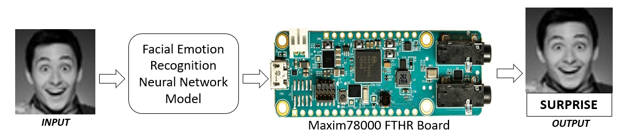
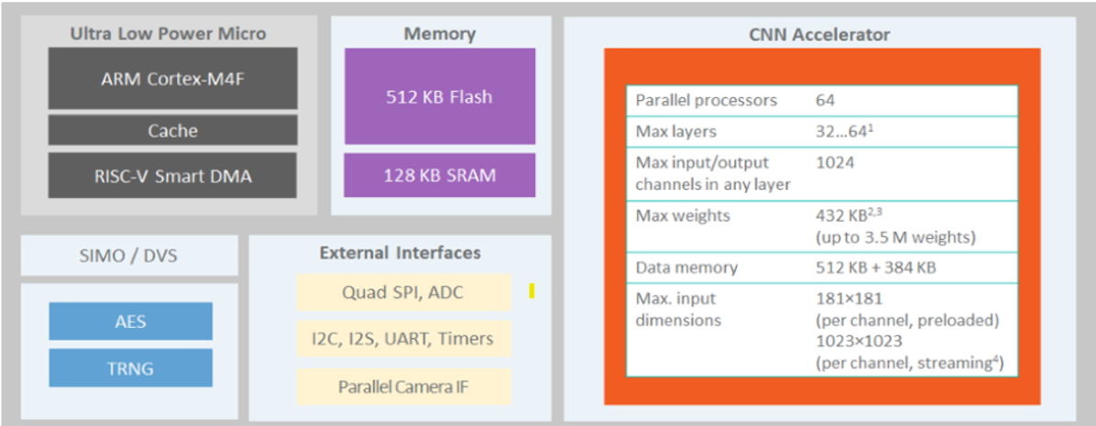
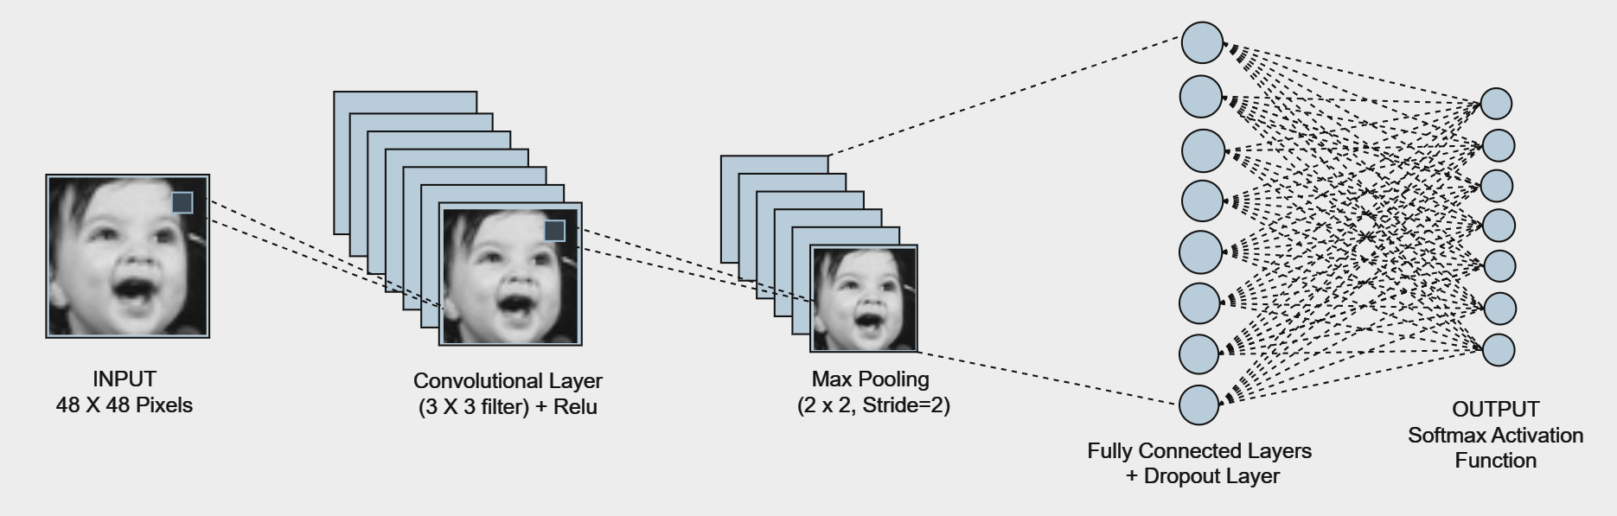
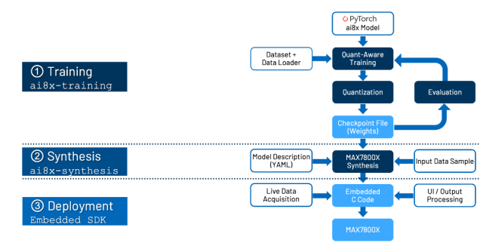
FACIAL EMOTION RECOGNITION SYSTEM
Maanasi Shastri, Swarna Patil, Ananya Kulkarni, Amrutha Beedikar
Guide: Dr. Sujatha C
Minor Project -2
23ECSW304
TM
Domain: Computer Vision
Problem statement:
Develop a deployable Facial Emotion Recognition model on an ultra-low power embedded system.
Architecture:
Development Board - MAXIM78000 FTHR BOARD:
Objectives:
Design a Deep Neural network-based energy-efficient Facial Emotion Recognition Model.
Deployment of the Facial Emotion Recognition Model on an ultra-low power embedded device.
Development process flow diagram:
Results & Discussions:
Conclusion:
Methodology:
Model Development: Design the model with PyTorch.
Training: Train with floating-point weights, then quantize for MAX78000 deployment.
Model Evaluation: Assess quantized model accuracy using an evaluation dataset.
Synthesis Process: Use the MAX78000 synthesizer tool to generate optimized C code from ONNX files, YAML model description, and input data. The tool generates C code for loading weights, performing inference, and validating results.
Results of CNN model for FER:
Overall Accuracy: 56.52% , No. of epochs: 50
Class-wise Accuracy: Angry: 50.73%, Disgust: 53.15%, Fear: 39.84%, Happy: 77.00%, Neutral: 47.04%, Sad: 44.59%, Surprise: 72.44%
The project successfully developed a Facial Emotion Recognition (FER) system, leveraging the MAX78000 microcontroller for optimized performance and energy efficiency. By integrating quantization techniques and utilizing a streamlined deployment flow, the model achieved impressive accuracy while maintaining low power consumption, making it suitable for IoT applications. The results underscore the potential of the MAX78000 for advanced embedded AI applications.
Performance Metrics:
Inference Time =1516 μs.
Inference Energy =
I * V * inference time =0.0237mJ.
Where, Current (mA), V: Voltage (V)

