Slide 1
EXPLORATORY DATA ANALYSIS COURSE PROJECT
PREDICT STUDENT PERFORMANCE
FROM GAME PLAY

Slide 2
Team Details
C Division
Team Number – 4
Team Members
Roll. No | Name | SRN
319 | Neha R Shanbhog | 01FE21BCS138
327 | Amrutha Beedikar | 01FE21BCS198
328 | Shrihari Hampiholi | 01FE21BCS204
330 | Maanasi Shastri | 01FE21BCS210

Slide 3
Contents
Problem Statement
Introduction
Objectives
Dataset Overview
Functional Requirements
Non-Functional Requirements
Data Cleaning
Data Visualization
Feature Engineering
Model Training
Conclusion
References

Slide 4
Problem Statement
To perform Exploratory Data Analysis, and to build a model that is capable of performing predictions of Student performance in a Game-Play having trained it on a huge data-set of already Student interactions with-in the game collected by "The Learning Agency Lab".
By Building a model on such a data-set, the work is going to help contribute to the advance research into knowledge-tracing methods for game-based learning. This is going to help the game developers to better understand and develop better User Interfaces for the gameplay.
This further is going to help Students to interact and absorb knowledge of a subject while they are playing a game, empowering game-based learning even more in the world out there.

Slide 5
Introduction
The objective of this project is to use the Time Series data generated by an online educational game "Jo Wilder and the Capitol Case" to determine whether players will answer questions correctly, which are asked during the game-play.
We have been given a training data-set, and a labelled data-set. Our task is to build a model that can predict the performance of new players, given their interactions with the game.
There are three question checkpoints (L-4, L-12, and L-22), each with a number of questions. At each checkpoint, we will have access to all previous test data for that section. We need to further build our model based on this data.

Slide 6
Objectives
Identify key features: Determining the factor which influences most in predicting the answer.
Understand feature distributions: Analyze the distributions of factors to identify any patterns or outliers.
Finding Irregularities: As the data-set is huge, we need to ensure that it is in accordance with how a natural game-play occurs in real life.
Explore relationships: Investigate the relationships between different features and the target variable.
Gain insights: Extract meaningful insights and observations that can guide subsequent analysis and modeling tasks.

Slide 7
Data Set Overview
There are 20 attributes given to us in the training data-set, that help us build our model.
There are 2 attributes given to us in the labelled data-set.
There are Numerical and Categorical variables involved in the training data-set.
The Training Dataset has 26296946 rows and 20 columns (attributes).

Slide 8
Attributes and their meaning of the Training Dataset
Column Name​ | Description​
session_id​ | The ID of the session the event took place in​
index​ | The index of the event for the session​
elapsed_time​ | How much time has passed (in milliseconds) between the start of the session and when the event was recorded​
event_name​ | The name of the event type​
name​ | The event name (e.g., identifies whether a notebook_click is opening or closing the notebook)​
level​ | The level of the game where the event occurred (0 to 22)​
page​ | The page number of the event (only for notebook-related events)​
room_coor_x​ | The coordinates of the click in reference to the in-game room (only for click events)​
room_coor_y​ | The coordinates of the click in reference to the in-game room (only for click events)​
screen_coor_x​ | The coordinates of the click in reference to the player’s screen (only for click events)​
screen_coor_y​ | The coordinates of the click in reference to the player’s screen (only for click events)​
hover_duration​ | How long (in milliseconds) the hover happened for (only for hover events)​
text​ | The text the player sees during this event​
Notes:
8

Slide 9
Continuation
Column Name​ | Description​
room_fqid​ | The fully qualified ID of the room where the event took place​
text_fqid​ | The fully qualified ID of the text​
fullscreen​ | Whether the player is in fullscreen mode​
hq​ | Whether the game is in high-quality​
music​ | Whether the game music is on or off​
level_group​ | Which group of levels - and group of questions - this row belongs to (0-4, 5-12, 13-22)​
fqid​ | The fully qualified ID of the event​

Slide 10
NULL Value Counts in the Training Dataset
Column Name | Missing Values Count | Percentage (%) of Missing Values
session_id | 0 | 0.000000
index | 0 | 0.000000
elapsed_time | 0 | 0.000000
event_name | 0 | 0.000000
name | 0 | 0.000000
level | 0 | 0.000000
page | 25,732,402 | 97.676567
room_coor_x | 2,073,272 | 7.880900
room_coor_y | 2,073,272 | 7.880900
screen_coor_x | 2,073,272 | 7.880900
screen_coor_y | 2,073,272 | 7.880900

Slide 11
Column Name | Missing Values Count | Percentage (%) of Missing Values
hover_duration | 24,294,702 | 92.232693
text | 16,679,807 | 63.387401
fqid | 8,274,415 | 31.429399
room_fqid | 0 | 0.000000
text_fqid | 16,679,702 | 63.386836
fullscreen | 0 | 0.000000
hq | 0 | 0.000000
music | 0 | 0.000000
level_group | 0 | 0.000000

Slide 12
Basic Requirements
Data loading: Loading the student performance prediction dataset into a suitable analysis environment.
Data cleaning: Handle missing values, duplicates, and inconsistencies in the dataset. Also finding unnecessary attributes, and cleaning them.
Descriptive statistics: Calculate summary statistics for numerical variables. To be able to make predictions to the nearest accuracy.
Visualization: Create visual representations to explore distributions, relationships, and trends.

Slide 13
Non-Functional Requirements
Efficiency: Conduct EDA tasks efficiently without excessive resource consumption. We are allowed to use 2 CPU’s, 8 GB RAM and no GPU virtually, as per the competition rules.
Accuracy: Ensure accuracy through data validation and thorough checks.
Interpretability: Present findings in a clear and interpretable manner using appropriate visualizations and explanations.
Documentation: Document the EDA steps, assumptions, and findings for future reference and reproducibility.

Slide 14
Functional Requirements
Real-time Prediction: The model should be capable of making predictions in real-time as students interact with the educational game. It needs to analyze the students performance data as they progress through the game and provide predictions as to whether or not they will answer
the questions correctly.
Understanding Students Behavior: The model should implement knowledge tracing methods to track the knowledge and learning progress of individual students. It should be able to assess the students understanding of the educational content and update its predictions accordingly.

Slide 15
Game-based Learning Integration: The model should be specifically designed to work with game-based learning data. It should effectively capture the learning patterns and behavior unique to game-based educational settings.
Scalability: The model should be scalable to handle large-scale datasets of game logs, as the competition is based on one of the largest open datasets of game logs.
Support for Collaboration: The model should enable collaboration with non-profits like The Learning Agency Lab, which focuses on developing science of learning-based tools and programs for the social good.

Slide 16
Data Analysis
Each record should be uniquely identifiable by the pair (session_id, index). This is because, having a duplicate would mean that there were 2 instances at the same time, which does not make any sense, logically speaking. But this DOES NOT hold true for all the records in the data-set.
As the general game progresses, for a given session_id the index should be monotonically increasing, which preserves the ordering nature of the events. But again, this property doesn't always hold true for all the records. This non-increasing nature of "index" is termed as "reversed index" phenomenon.

Slide 17
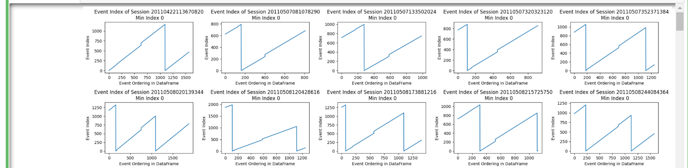
So, after going through the data-set we found that there are 258 sessions that have this "reversed index" phenomenon. And there are 142 among them that have the duplicate pairs of (session_id, index).
So to summarise, there are 258 sessions with the "reversed index" phenomenon, of which there are:
142 with duplicate pairs of (session_id, index)
116 without duplicate pairs of (session_id, index)
The above picture showcases the phenomenon we talked about. They are just a fraction of the 258 sessions' that exist.

Slide 18
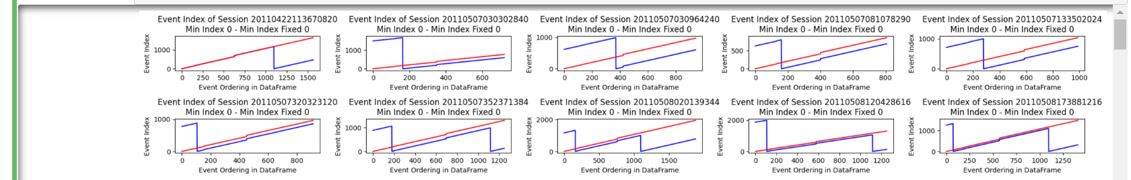
How do we fix this issue?
The blue line indicates the previous, abrupt increase and decrease in the
index column for a given session_id. We fit a red line, that is near continuous for all these sessions with reversed index phenomenon. Again, only a fraction of the result is shown above.

Slide 19
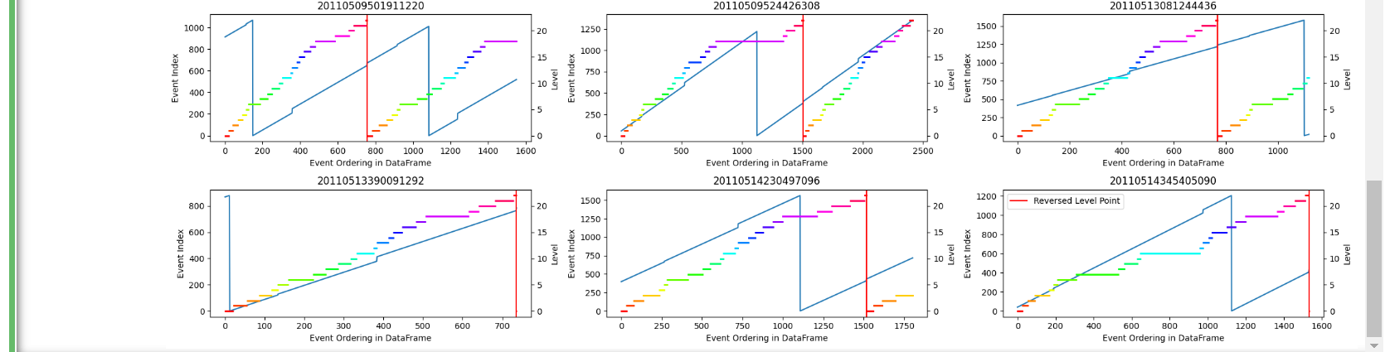
Reversed Level Phenomenon
Now, as the game progresses, we should see that the student’s current gameplay level should also increase / remain the same. But there are instances where the level just falls abruptly and then rises in between the game.
We can see this in the below figure. The horizontal coloured lines indicate one of the 22 levels, and as the game progresses, the student’s level falls down. This might indicate that the student is playing the game for the second time, but we are not entirely sure.

Slide 20
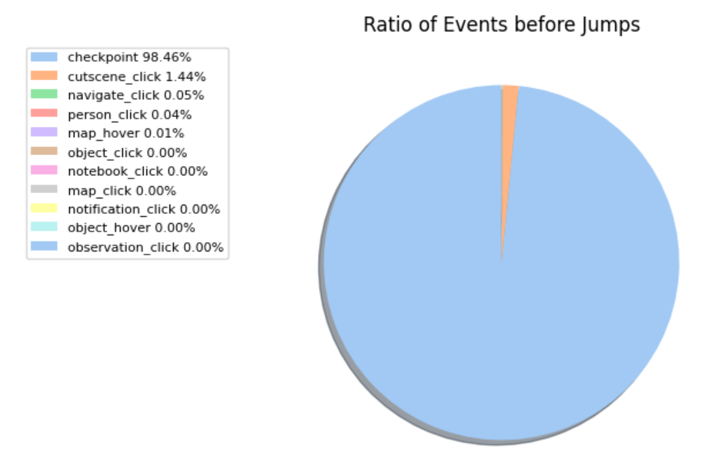
Analysing where the “index” jumps / drops abruptly.
Nearly all of the jumped index phenomena occur right after checkpoint.
As we know that index indicates the ordering of events and jumped index also preserves the ordering nature.
The below pie chart proves the above statement.

Slide 21
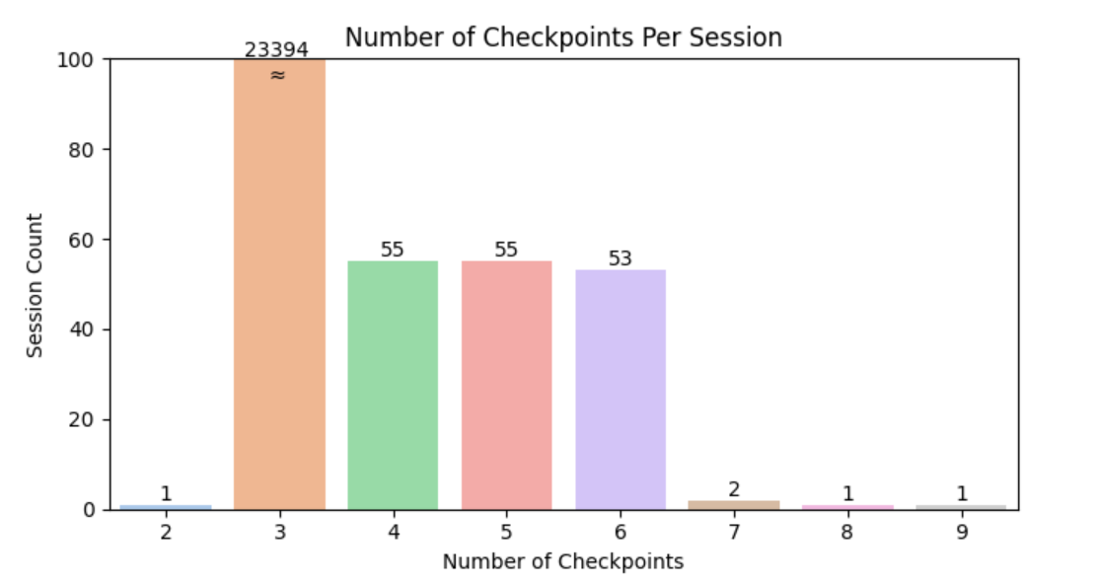
Analysing Checkpoints
According to the data description, each session should have 3 checkpoints.
But, it DOES NOT hold true for all the sessions. The below histogram shows
that there are 168 sessions that DO NOT have 3 checkpoints, but are having anywhere from [2, 9] except 3.

Slide 22
Reflecting on the data processed
After seeing the Exploratory Data Analysis we have done till this point, especially the "reversed index", "reversed level" phenomenon, we thought of looking back as to how much value do these analysis provide us moving forward with the model building.
To explain what we mean to say, there were 258 sessions with the reversed index phenomenon as we claimed and showed you before. BUT, in the whole dataset, we have 23562 sessions in total!
Also, there were only 6 instances where the "reversed level" phenomenon was observed, but there are again, 23562 sessions in total.
So, we decided to think and then stop proceeding further in this direction. We further decided to try out a different approach, that we start from the next slide. This experience taught us to rely on the majority of the data, and that sometimes, just sometimes we have to choose to neglect the minority in the data.

Slide 23
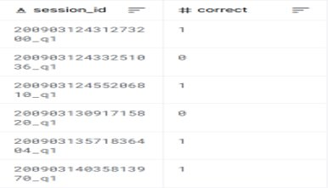
A new approach
We loaded the Train Dataset the same way we had the last time.
But we now loaded the Labelled Dataset differently. This dataset had 2 columns, one which indicated the session_id concatenated with the question number, and the other was whether the answer to the question given by the student was correct or not.
Below is a demonstration showcased:

Slide 24
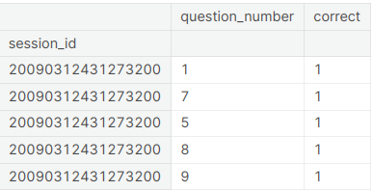
We decided to split the session_id concatenated with the q_no as 2 separate attributes. We also for the ease of merging, decided to index the Labelled Dataframe with the session_id itself.
We did it as below:

Slide 25
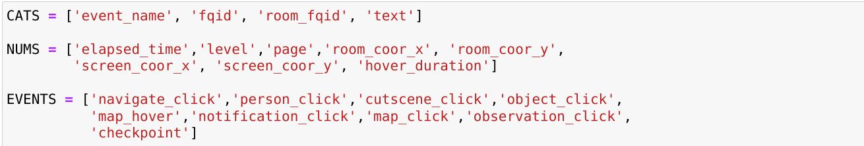
Feature Engineering
We now are going to show how we extracted the needful features that we thought would allow for a better model training process.
We split the attributes as "CATS", "NUMS" and "EVENTS", indicating "Categorical", "Numerical" and "Event Driven (textual)" attributes.
Our plan was to extract the number of unique instances that had occurred with-in different level groups while a Player was engaging a session. We realized that doing this would give a good measure to predicting the further questions.

Slide 26
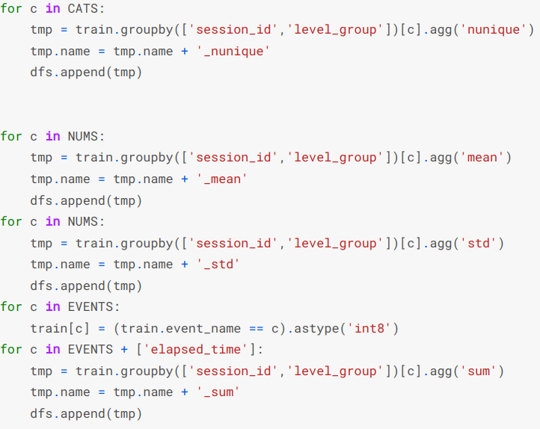
The plan was to find the unique number of each variable's instance for a specific (session_id, level_group).
This process makes 30 features. Each row is segregated, and uniquely identifiable based on the (session_id, level_group).

Slide 27
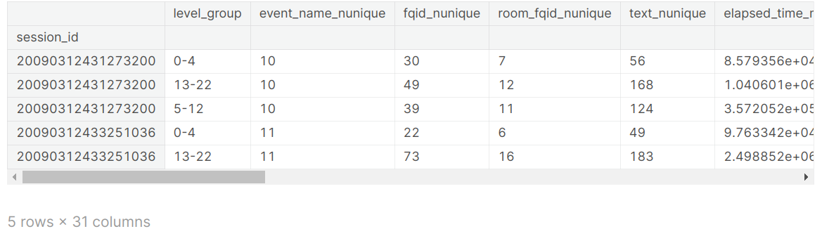
The head rows are retrieved below of the Feature Engineered Dataset.
We now have three (session_id, level_group) pairs for each session_id.
This helps us simplify things, in the sense that we can now train our model on the condition that:
Questions 1 to 3 are asked during the (0-4) LG.
Questions from 4 to 14 are asked during the (5-12) LG.
Questions from 15 to 18 are asked during the (13-22) LG.
The above assumptions are not very robust in reasoning, but we assumed this to be true, as we had given a try to the game.

Slide 28
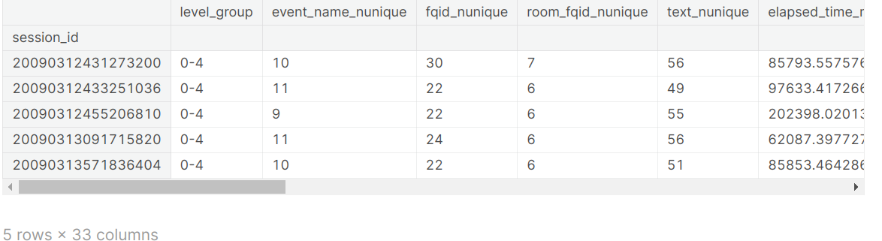
Now, we have finally reached a state where we can combine the labelled data and the analyzed data till now, to make a prediction model.
We now, for every level_group (from the df_train_featured) and question_number (from the labelled_df) pair, merge the two datasets according to the previously defined rule on the questions being asked on the specific group level.
This merges the two tables, and then provides a new table that has the (session_id, level_group, q_no, correct_answer) in the proper manner needed to feed the model as input.
The head of the resultant data-frame is shown below:

Slide 29
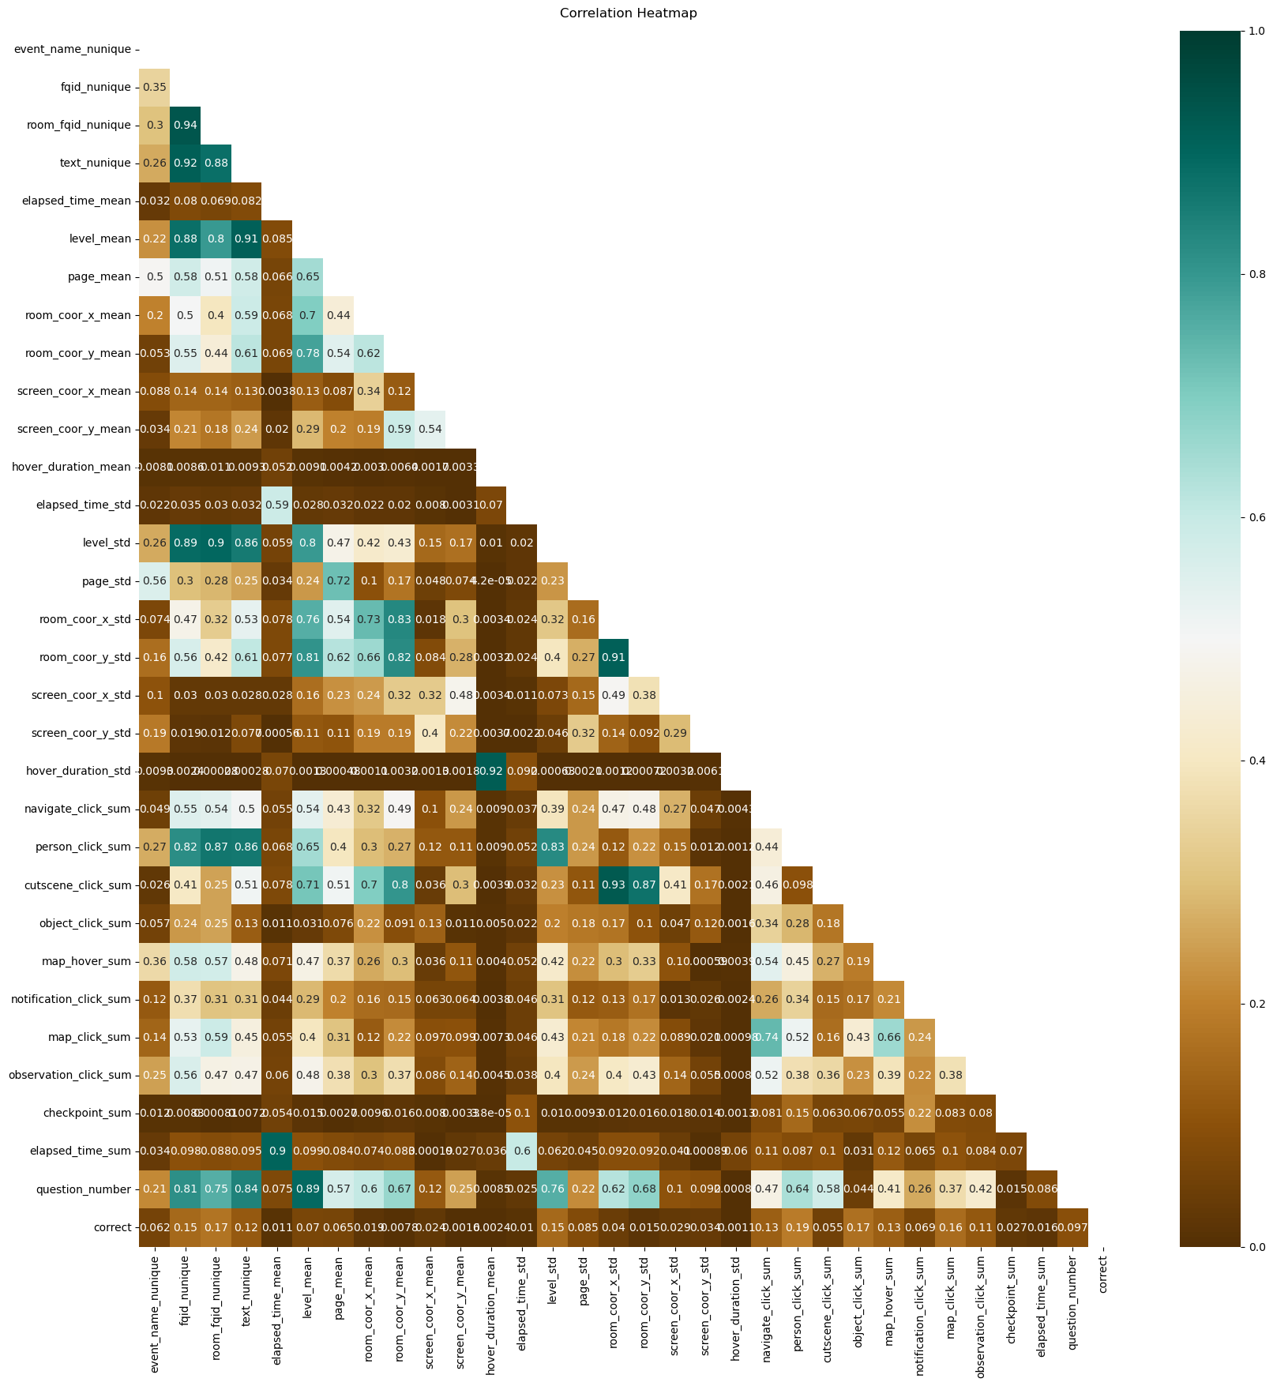
Now, we will perform correlation on all the attributes, with the help of the correlation matrix. We have represented this in the form of a heat-map.
Please click here for a detailed image

Slide 30
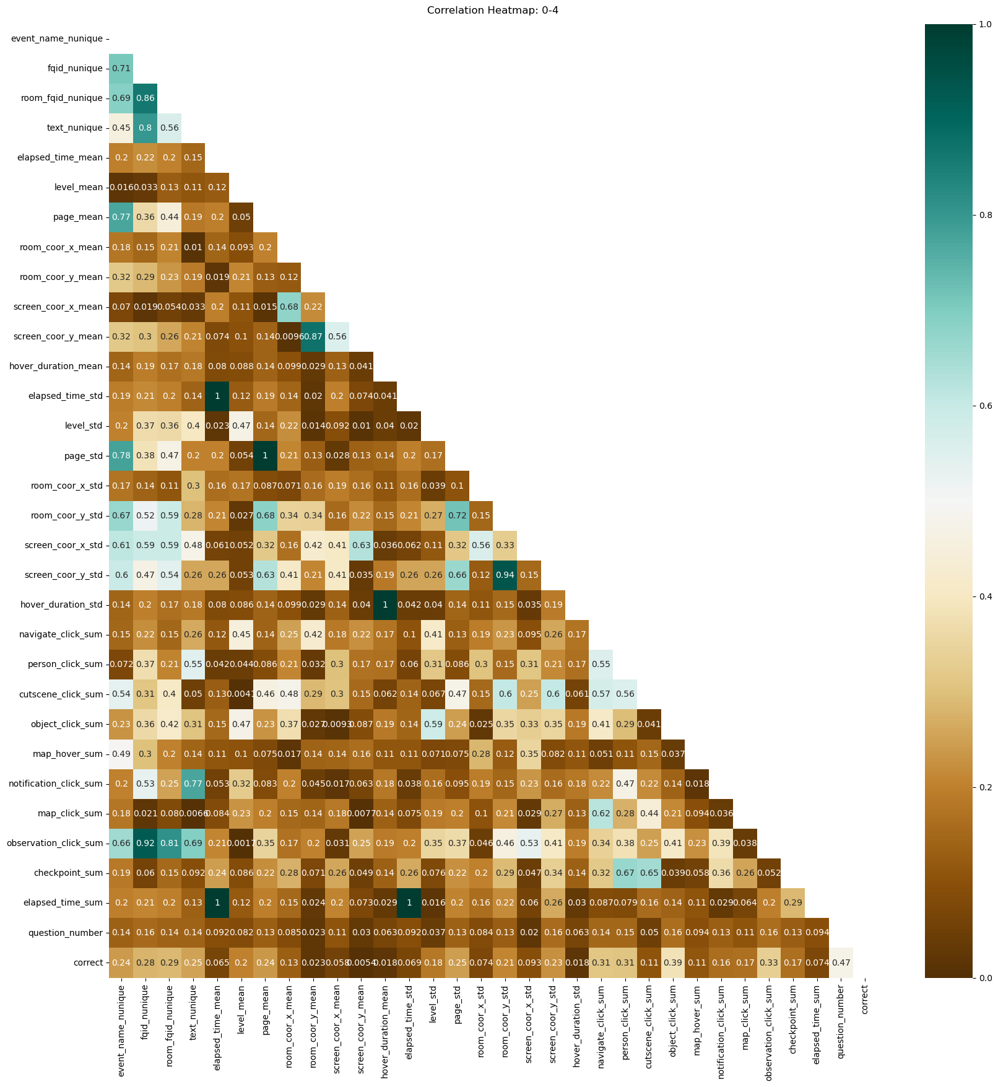
The previous was an overall heat-map for the "df_analysis", representing the correlation. But we also were interested in knowing how it would differ with-in level_group, so the heat-maps for those are as below.
Click here for detailed images
Level group 0-4

Slide 31
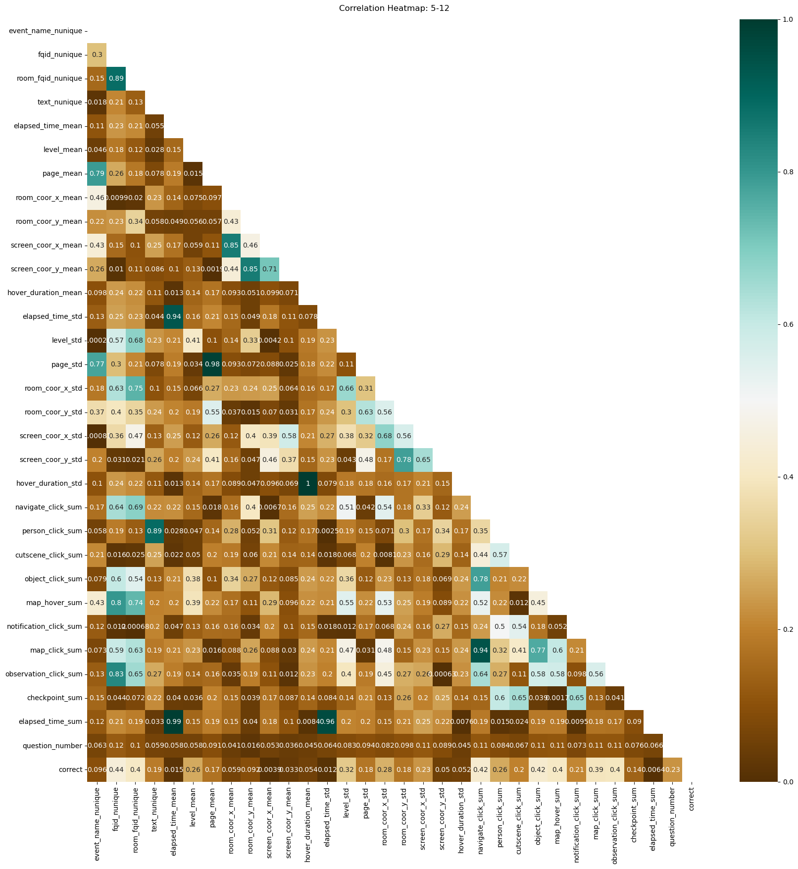
For level_group [5-12]

Slide 32
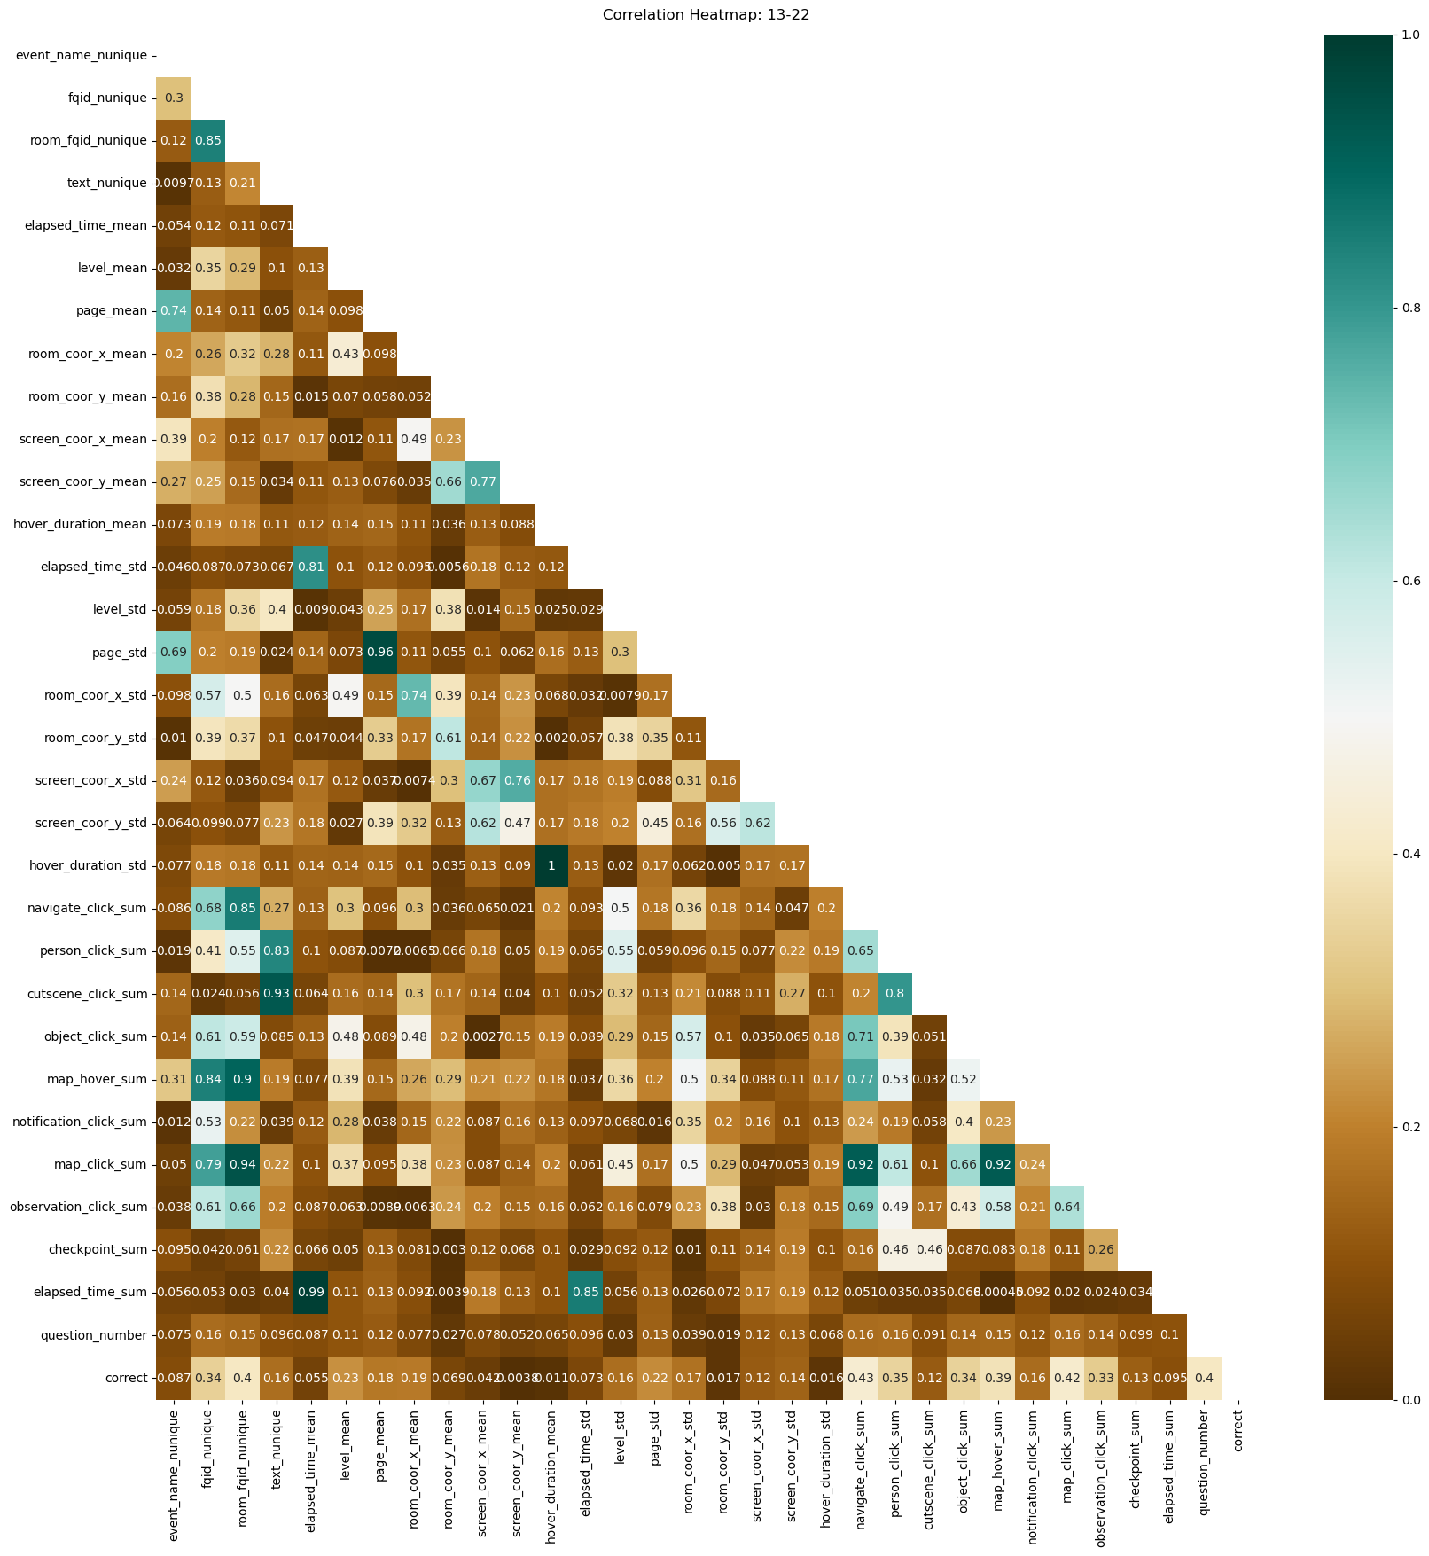
For level_group [13-22]

Slide 33
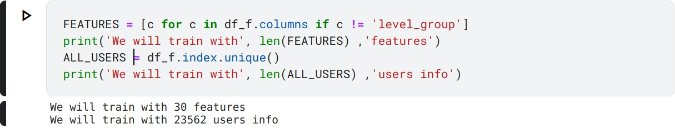
Model Training
As we need to predict whether the student will answer the question correctly or not, we will use Logistic Regression to do this, as it facilities the binary classification easily.
Q) On what features do we train our model?
A) We will train it on all the 30 features (except the level_group and the session_id as the latter is the index of the data-frame, and the former is not helpful because we have grouped accordingly already in the feature engineering).
We have 23562 users (sessions), on which we will train the model.

Slide 34
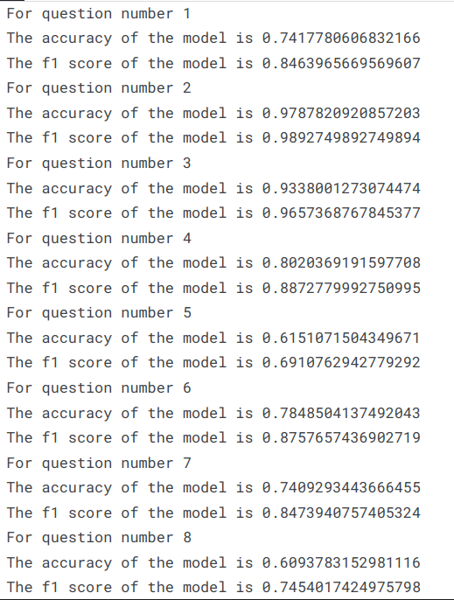
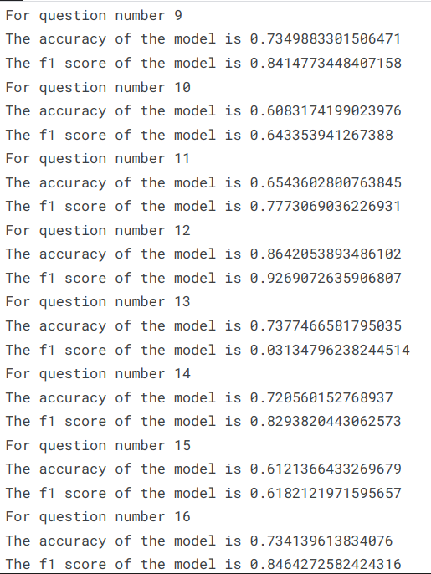
We trained the model for each question, so in the end we had 18 models.
We have opted for a K-fold Validation Process, where we train the model on the many available sub-sets of data. We have chosen the train sample to be 80% of the data for each sub-set. The model will be trained on the 80%, and then tested on the 20%.
After training using Logistic Regression on each question, we found that our model, on average, was able to predict 80% of the time correctly for any given data.
The individual analysis is given below:

Slide 35
Q) Why did we choose to have 18 models?
A) Each question was asked after having followed different kinds of events. So allowing the models to be trained individually allowed the prediction to be much accurate because the model does not have to care about "what events allowed for the answer of the question".
The f1 score is a very good measure for a Classification Model.
The f1 score is the weighted harmonic mean of precision and recall,
where precision is:
"What percent of our predictions were correct?"
And recall is:
"What percent of the positive cases did we catch?"

Slide 36
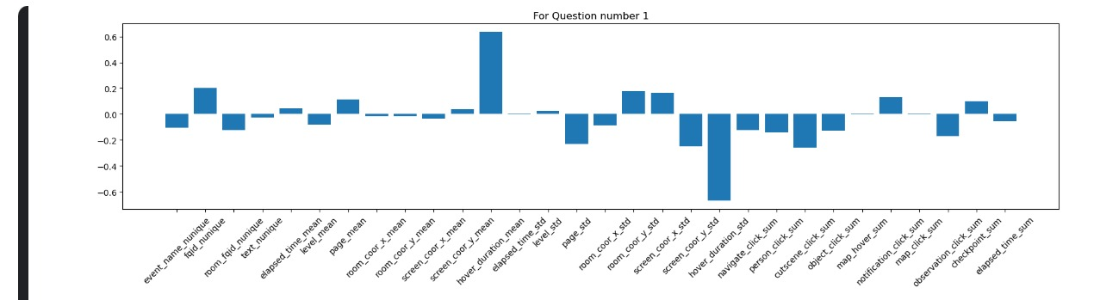
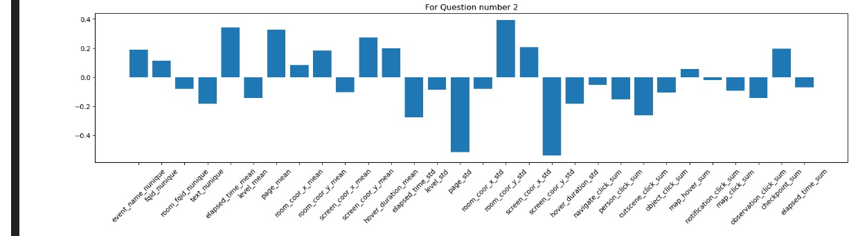
After having trained the models, we wanted to know what features were important, and what are not based on the Logistic Regression models that we had trained.
An example of 2 models trained on Q1 and Q2 is shown below. The other 16 graph plots can be found in the Notebook submitted for the competition.

Slide 37
Conclusion
As a part of this project, we were able to make logical decisions as and then necessary.
Initially when we began with the EDA process of analyzing the “reversed index”, “reversed level” and “duplicate pairs of (session_id, index)”, we were then thrown off-guard because we realized that it was not going to contribute majorly to the Model that we would be building later-on. But this experience taught us that we needed to look for a lot of angles before moving on, and then accordingly allocate time for each of the paths possible.
This course project has engrained in us deep insights on how to look at data, how to visualize it and then how one can choose to build an efficient model. We are grateful that we were given a Challenging Project.
We finally would like to thank our Course Instructors, Prof. Karibasappa K G and Prof. Sunil V G for having been there at all times for the help that we needed. We would also like to thank Ms. Shilpa Madam for being there at all times and helping us whenever we needed regarding the Course assignments and deadlines.

Slide 38
Resources and Acknowledgement
Predict Student Performance from Game Play Dataset [on Kaggle, organized by The Learning Agency Lab ]
To learn the required skills to be able to build the Model, perform Analysis, we referred these below channels: Krish Naik Dhaval Patel (codebasics) SciKit Learn

Slide 39
THANK YOU

