Slide 1

DSN2098: Project Exhibition – I
Review I, Presentation by:
25BCE10735 - Maanas Srivastava
25BCE10372 – Harsh Mangal
25BCE10743 – Sagar Sharma
25BCE11285 – Surya Pratap Singh Bais
25BCE11407 – Daksh Jain

Slide 2
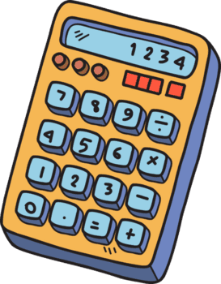


Project Introduction
PAPST - Particle Analysis Physics Simulation Tool)
Physics Calculator
Visual Simulator
Concept Builder
Calculates various
Physical Parameters
quickly
Provides intuitive
simulation of motion
of particles
Has additional
information to aid
learning

Slide 3
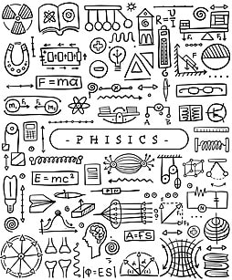
Problem Identification
Most students who take a physics course know all
the basic formulas and how to calculate the answer
to most nascent physical problems.
But very few of them actually develop
a physical intuition.
A true physical intuition is necessary to solve
complex problems or build intricate models, that
can accurately predict the nature of the universe.

Slide 4
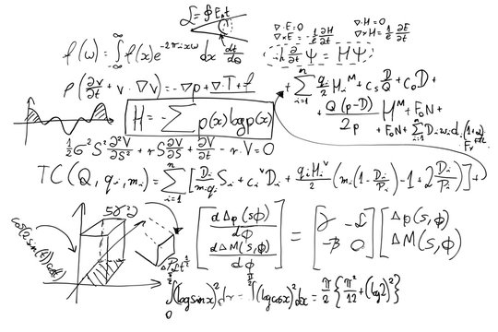

Problem Identification (Contd.)
The Gap boils down to the a few points discussed below:
1. Abstract Math vs Physical Intuition

Slide 5

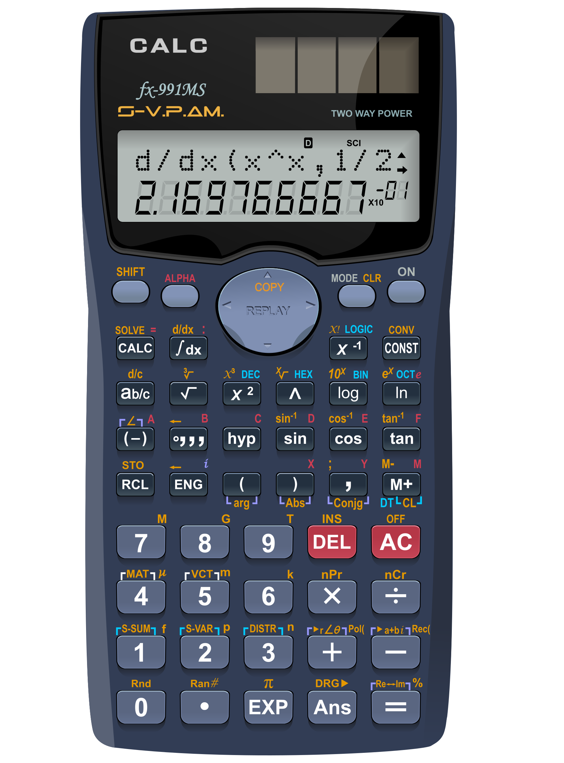
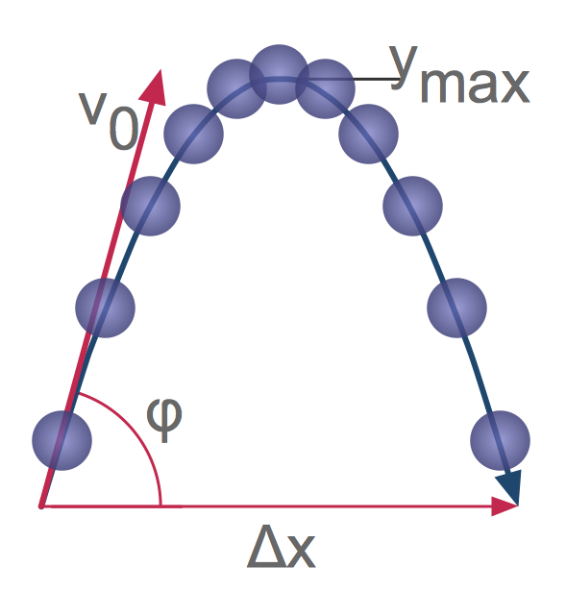
Problem Identification (Contd.)
2. Limitations of Standard Scientific Calculators

Slide 6
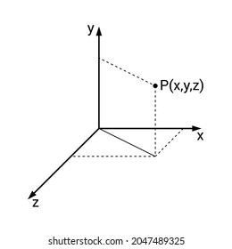
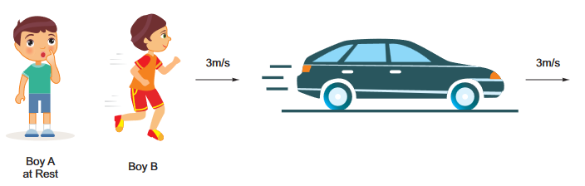
Problem Identification (Contd.)
3. Dimensional Disconnect

Slide 7
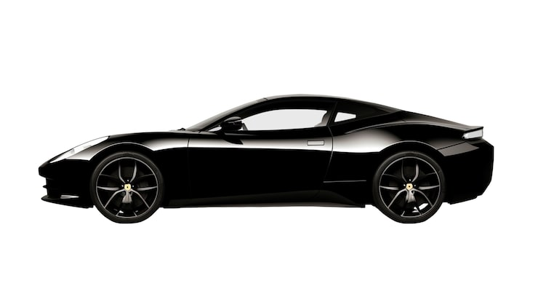
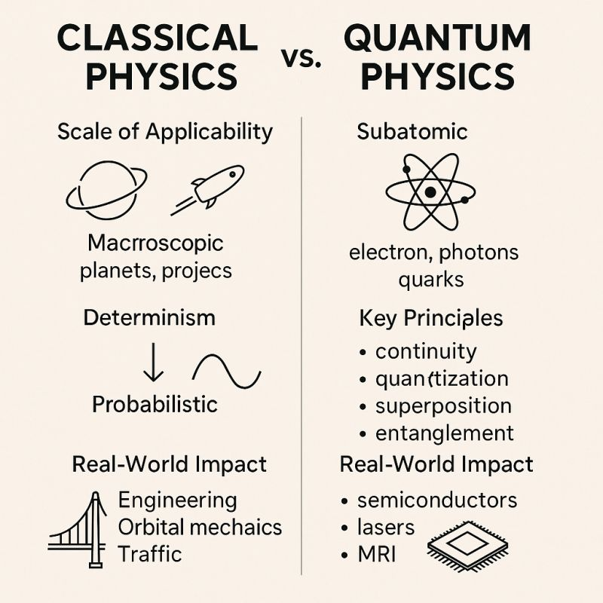

Problem Identification (Contd.)
4. The Macroscopic to Microscopic Bridge
Classical Mechanics,
Example: A Car
(Given by Newton)
Quantum Mechanics,
Example: Sub-atomic particles
(Given by Einstein)

Slide 8
Literary Survey
Analysis of current Physics Educational Software:
A. Interactive Web Simulators (PhET Colorado)
Pros
Cons
Has high educational value
Supports more topics
Great for qualitative learning
Web bound
Does not properly visualize
component-level vector math
No additional conceptual aid

Slide 9
Literary Survey (Contd.)
B. 2D Physics Sandbox Software (Algodoo, Physion)
Pros
Cons
High Graphical freedom
Support for rigid body dynamics
Toy-like interactions
Only supports 2D mechanics
No microscopic modules
Visual Sandbox is primary focus

Slide 10
Literary Survey (Contd.)
C. Computational Algebra Systems (MATLAB, Wolfram Mathematica)
Pros
Cons
Highly Accurate for 1 to 3 dimensions
Quantum Calculation support
Coding proficiency is needed
No GUI support immediately

Slide 11
Literary Survey (Contd.)
CLASSICAL CALCULATORS
High mathematical rigor
Abstract numerical data
WEB-BASED SIMULATORS
Intuitive Simulations
Qualitative Analysis
PAPST
Single desktop tool
to combining abstract
math and intuitive physics

Slide 12

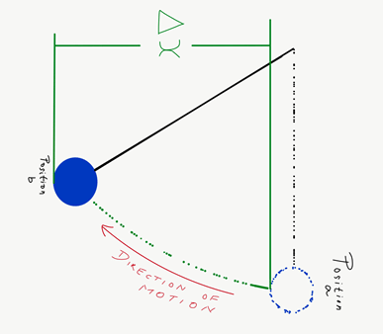
Objectives and Scope
Objectives
Unified Analytical Model
Development of a multi-variable
model that calculates various
static, kinematic and dynamic
parameters.

Slide 13
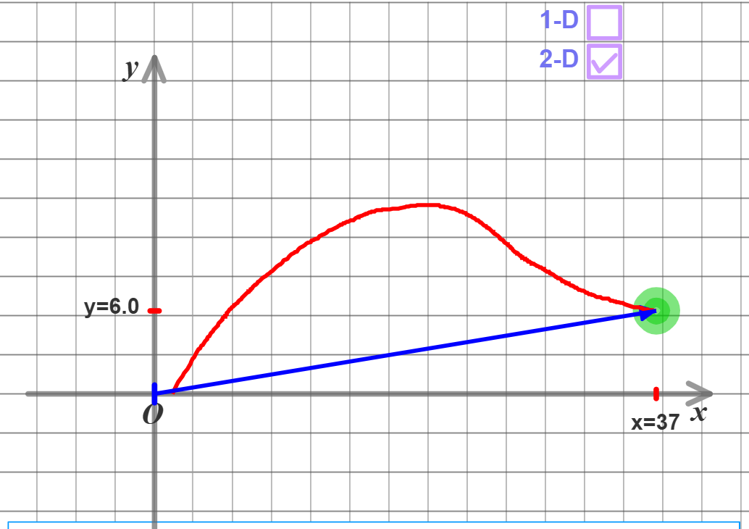
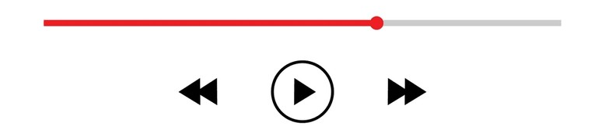
Objectives and Scope (Contd.)
2. Real-Time Physical Analysis
Integrate, along with the simulation,
a time scrubber (time slider)
to cleanly study the behaviour of
particle under observation up to
an accuracy of 0.1 seconds.

Slide 14


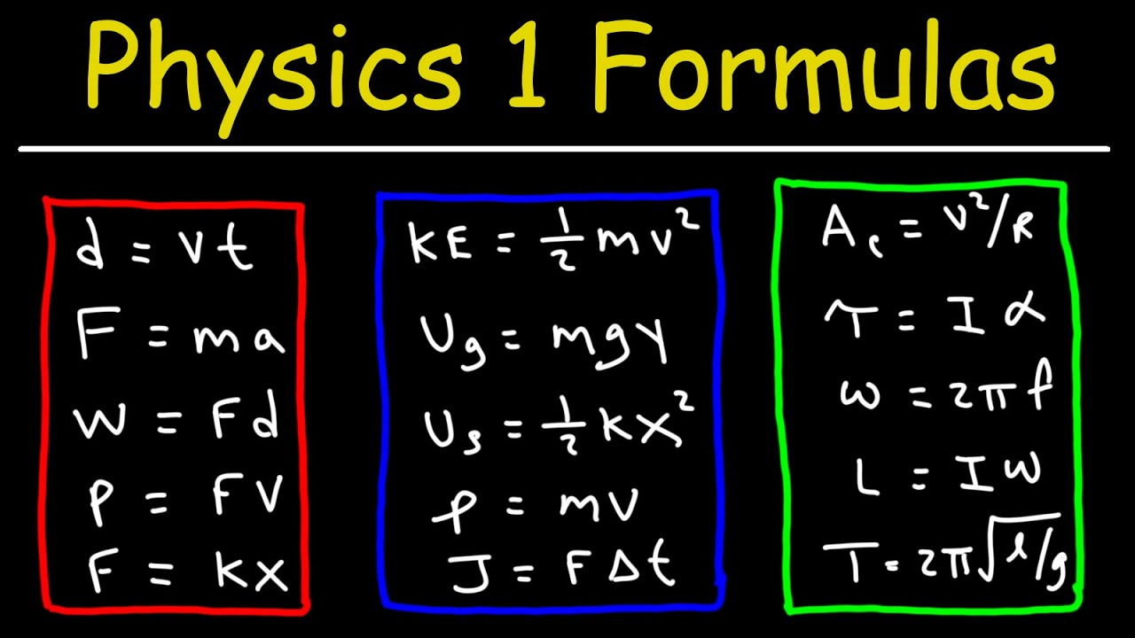
Objectives and Scope (Contd.)
3. Conceptual Aid
To add an (i) button next to calculated
parameters, which uses formal definitions,
formulas and analogies to further strengthen
conceptual depth of the user.

Slide 15


Methods and Proposed Solution
Resources, Modules and Language Used:
Tkinter
FigureCanvasTkAgg

Slide 16
Methods and Proposed Solution (Contd.)
Software Architecture:
LAYER 1: USER INTERFACE (Tkinter)
Case dependent, modular multi-window navigation system
Validation Handlers and conceptual popups
LAYER 2: NUMERICAL PHYSICS MODULE (Numpy)
Vector arithmetic for kinematics, dynamics and conservation of energy for collisions
Bohr Model for Electron and Photoelectric effect for Photon.
LAYER 3: SIMULATION MODULE (Matplotlib)
Simulation rendering using FigureCanvasTkAgg
Time slider based intuitive simulations to visualize motion

Slide 17
Methods and Proposed Solution (Contd.)
Mathematical Module:
Macroscopic Particle
Input Data (Initial Position, Velocity, Acceleration and Mass)
Standard Kinematical Equations
Classical Mechanical Equations
Equations of Energy and Conservation of Energy
Definitions and Analogies

Slide 18
Methods and Proposed Solution (Contd.)
Mathematical Module:
2. Microscopic Particle
Input Data (Radii, Energy state, Velocity and Atomic Number OR
Photon Energy and Work Function)
Bohr’s Model of the atom and it’s equations
Einstein’s study of the photoelectric effect and derived equations
Definitions and Analogies

Slide 19
Methods and Proposed Solution (Contd.)
GUI Workflow:
==========Particle Analysis Physics Simulation Tool==========
Macroscopic Objects
∟ Particle in 1 dimension
∟ Particle in 2 dimensions
∟ Particle in 3 dimensions
∟ 1 dimensional collisions
Microscopic Objects
∟ Electron (using Bohr's atomic model, in H-like atoms)
∟ Photons (study of the photoelectric effect)

Slide 20
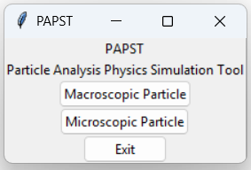
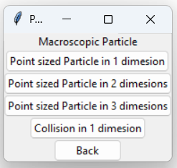
Methods and Proposed Solution (Contd.)
Early Prototype Screenshots:

Slide 21
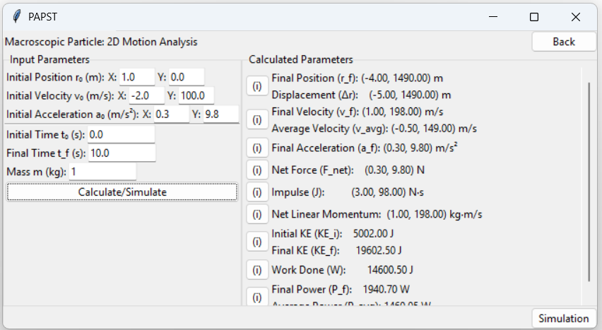
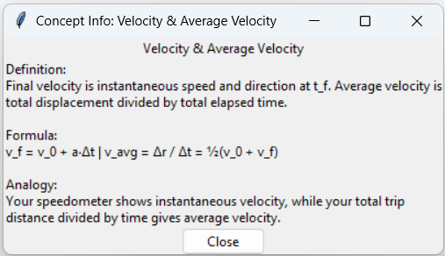
Methods and Proposed Solution (Contd.)

Slide 22
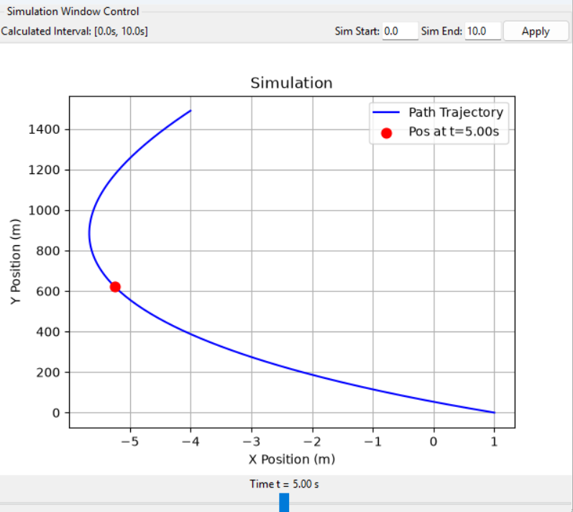
Methods and Proposed Solution (Contd.)

Slide 23
Project Link
Github Link: https://github.com/maanassrivastava/PAPST

Slide 24
End of Presentation
Thank You!

