Slide 1
Job Recommendation using Collaborative filtering
By,
Arun Ramaswamy(axr134330)
Rajasekar Subramanian(rxs134530)
Srivatsan Varadarajan(sxv133930) Senthil Maanick(mxm135730)

Slide 2
Motivation
Our job recommendation approach aims to provide recommendations based on collaborative filtering of users and jobs and it also calculates the accuracy of job prediction in relation to the existing results.[2][3][4]

Slide 3
Approach
In this approach, collaborative filtering is used to do the job and user based recommendation
We are operating on the following datasets for our recommendation process: apps.tsv, test_users.tsv, splitjobs.zip

Slide 4
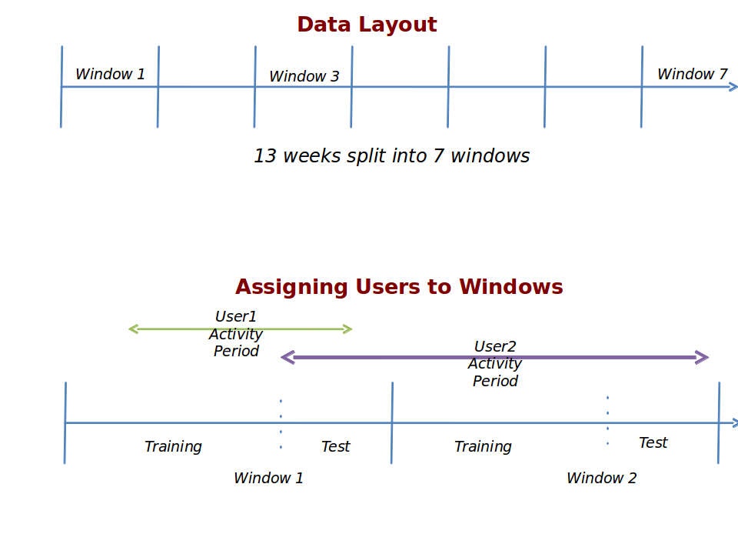
Approach

Slide 5
DataSet
apps.tsv contains information about applications made by users to jobs.
test_users.tsv contains a list of the Test UserIDs and windows
splitjobs.zip is a directory containing jobs1.tsv, jobs2.tsv, ... , jobs7.tsv, each of which contain all jobs in a given window.

Slide 6
DataSet
The dataset includes information about job postings during 13 weeks in 2012 (e.g., job title, description, requirements, posting date, closing date, etc.), the job seekers (e.g., location, education level and major, management experience, job history, etc.), and the user job applications history.
All job applications are sorted by application date, and all job applications submitted over a particular 6-day window are selected as training data. The test set for each user is formed using the first 5 job applications submitted during the subsequent 3-day period.
We only consider users with a minimum of 5 job applications in both the training and test period. In total, there are 843 such users; on average, each user has 14 training set job applications.
The candidate recommendation set consists of the union of all job applications in the test period; in total, there are 3,538 such job applications.
For each recommendation approach, candidate recommendations are ranked according to their mean similarity to the jobs in each user’s training set.

Slide 7
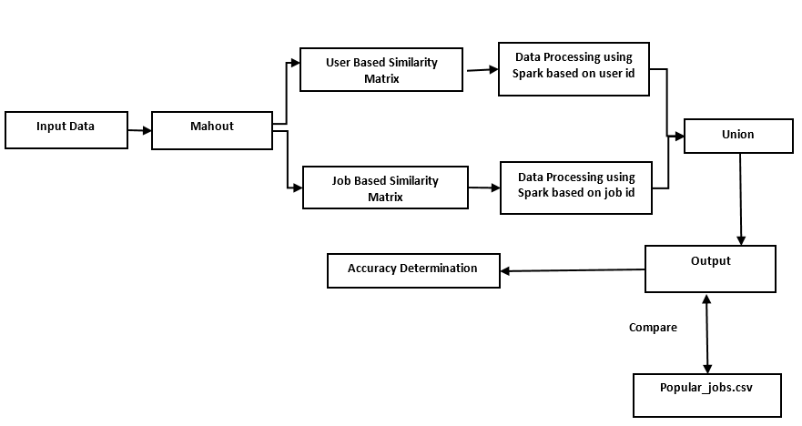
Architecture

Slide 8
Implementation
Implementation of job similarity matrix and user similarity matrix using Mahout.[4][5]
Extracting similar jobs from the above matrices based on users and jobs using Spark-Scala.[4][5]

Slide 9
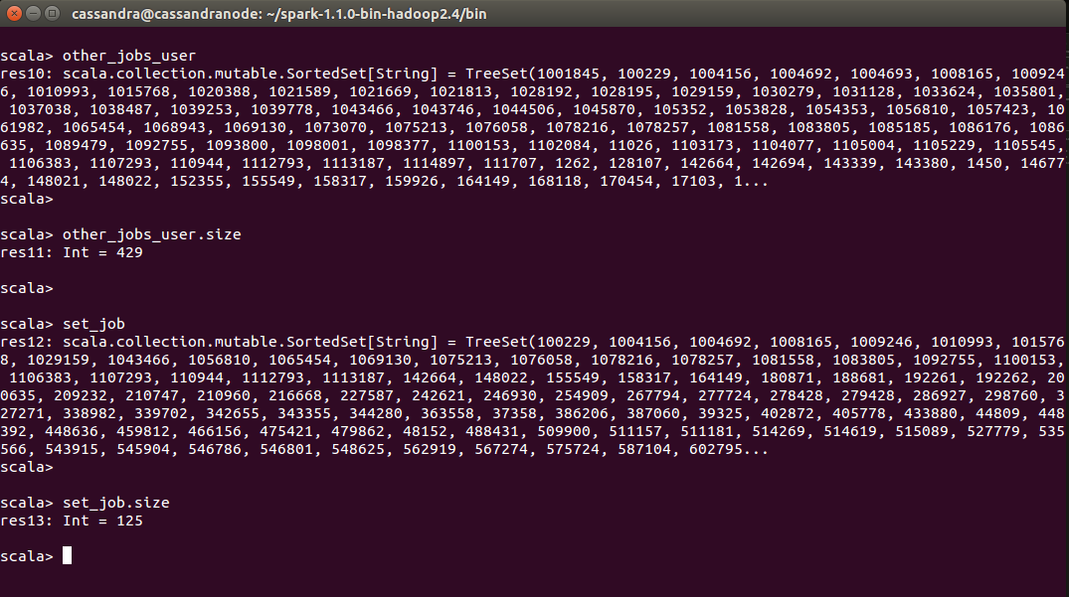
Screenshots of Application Execution

Slide 10
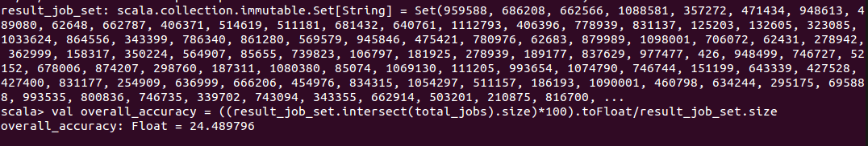
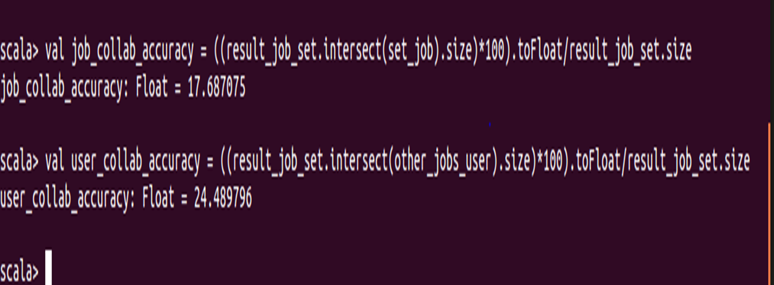
Screenshots of Application Execution

Slide 11
Results Discussion
The benchmark data has been extracted based on user demographic location. Hence its not an appropriate benchmark data
The complete data set is available only for few test users
http:www.fastml.com/kaggle-job-recommendation-challenge/

Slide 12
Future Work
We plan to extend our job recommendation framework by considering alternative content-based job representations; for example, by representing jobs based on the particular features of applicants. [13][14]
Moreover, we will apply collaborative-filtering style approaches to the task, and consider ways in which the various approaches may be combined to improve performance.

Slide 13
Big Data Technologies
Mahout 1.0
Scala 2.11.4
Spark

Slide 14
References
Mooney, R.J., Roy, L.: Content-based book recommending using learning for text categorization. Proceedings of the 5th ACM Conference on Digital Libraries, pp. 195–204 (2000)
Lee, J.S., Lee, J.C.: Context awareness by case-based reasoning in a music recommendation system. Ubiquitous Computing Systems, Vol. 4836 of Lecture Notes in Computer Science, pp. 45–58 (2007)
Paparrizos, I., Cambazoglu, B., Gionis, A.: Machine learned job recommendation. Proceedings of the 5th ACM Conference on Recommender Systems, pp. 325–328 (2011)
Yao, L., Helou, S.E., Gillet, D.: A recommender system for job seeking and recruiting website. Proceedings of the 22nd International Conference on World Wide Web Companion, pp. 963–966 (2013)
Rafter, R., Bradley, K., Smyth, B.: Automated collaborative filtering applications for online recruitment services. Proceedings of the International Conference on Adaptive Hypermedia and Adaptive Web-based Systems, pp. 363–368 (2000)
Hong, W., Zheng, S., Wang, H.: Dynamic user profile-based job recommender system. Proceedings of the 8th International Conference Computer Science and Education, pp.1499–1503 (2013)
Laumer, S., Eckhardt, A.: Help to find the needle in a haystack: Integrating recommendersystems in an IT supported staff recruitment system. Proceedings of the Special Interest Group on Management Information System's 47th Annual Conference on Computer Personnel Research, pp. 7-12 (2009)

Slide 15
References
Smyth, B.: Case-based recommendation. The Adaptive Web, Vol. 4321 of Lecture Notes in Computer Science, pp. 342–376 (2007)
Salton, G., Wong, A., Yang, C.S.: A vector space model for automatic indexing. Communications of ACM, Vol. 18, No. 11, pp. 613–620 (1975)
Salton, G., McGill, J.M.: Introduction to modern information retrieval. McGraw-Hill, Inc.(1986)
Nadeauand, D., Sekine, S.: A survey of named entity recognition and classification.Linguistic Investigations, Vol. 30, No. 1, pp. 3–26 (2007)
Porter, M.F.: An algorithm for suffix stripping. Readings in Information Retrieval, pp.313–316 (1997)
Burke, R.: Hybrid recommender systems: Survey and experiments. User Modelling and User-Adapted Interaction, Vol. 12, No. 4, pp. 331–370 (2002)
Gupta, A., Rothkrantz, L.J.M.: JobScan. Proceedings of the 13th International Conference on Computer Systems and Technologies, pp. 352-359 (2012)

