Slide 1



ARCHITECTURE · IMPLEMENTATION BRIEFING
AI SDLC Process: How We Will Work
The stages, what goes in and comes out of each, which work is manual and which is AI, how AI output is proven valid, the templates we fill, and how we roll it out.
Process Definition PD-AISDLC-01
15 templates + tracker
Context Pack /ai-context
Fixed Assets Suite · Web + Microservices · Mobile · Internal Web
Notes:
Purpose: walk the team through the process definition and agree how we implement it. This builds on the earlier framework session; today is about the concrete process, documents and roll-out.

Slide 2




AGENDA
From process to practice in six parts
The process in one picture
Stages, modes, AI boundaries, stage inputs and outputs
8 min
Three work types, three paths
New feature, change request, issue fix and service request
10 min
Proving AI output is valid
Four levels, ten techniques, the acceptance checklist
8 min
Documents and templates
Which document, at which stage, filled by whom
6 min
Common context
The Context Pack and the standard prompt
6 min
Implementing it here
Jira, Git, Jenkins, roles, roll-out, pilot, first 30 days
12 min
About 50 minutes plus questions. Every slide maps to a section of the process definition, so you can read the detail afterwards.
Notes:
Set expectation: detailed walkthrough. The document is the reference; this deck is the guided tour plus the implementation plan.

Slide 3

WHAT YOU ARE GETTING
Four artifacts, generated from one source so they never disagree
PROCESS DEFINITION
TEMPLATES T01 – T15
TRACKER X01
CONTEXT PACK
PD-AISDLC-01 · Word · 64 pages
Word · fillable
Excel · 9 sheets · live formulas
/ai-context · 27 markdown files
Ten stages with inputs, activities, outputs and the mode of each
Process flows for new feature, CR, issue fix and SR
Validation framework, governance and roll-out plan
One template per artifact, with guidance and examples
Clickable checklists and a sign-off block in each
T10 holds the ten gate checklists, one page each
RTM with an automatic coverage check
Gate log that flags reviewer = AI operator
Parity, waivers, Context Pack log, metrics
AI-INSTRUCTIONS.md plus CP-00 to CP-99 starters
Ten stage prompt templates, P-S0 to P-S9
Pull request template with both checklists
One source of truth: the stage definitions, checklists, prompts and templates are all generated from the same process data. Change it once and every artifact stays consistent.
Notes:
Stress that this is a complete kit, not just a document. The single-source point matters: the checklist in the document, in T10, in CP-60 and in the PR template is literally the same list.

Slide 4
01
The process in one picture
Stages, modes, AI boundaries, and what goes in and out of each stage

Slide 5
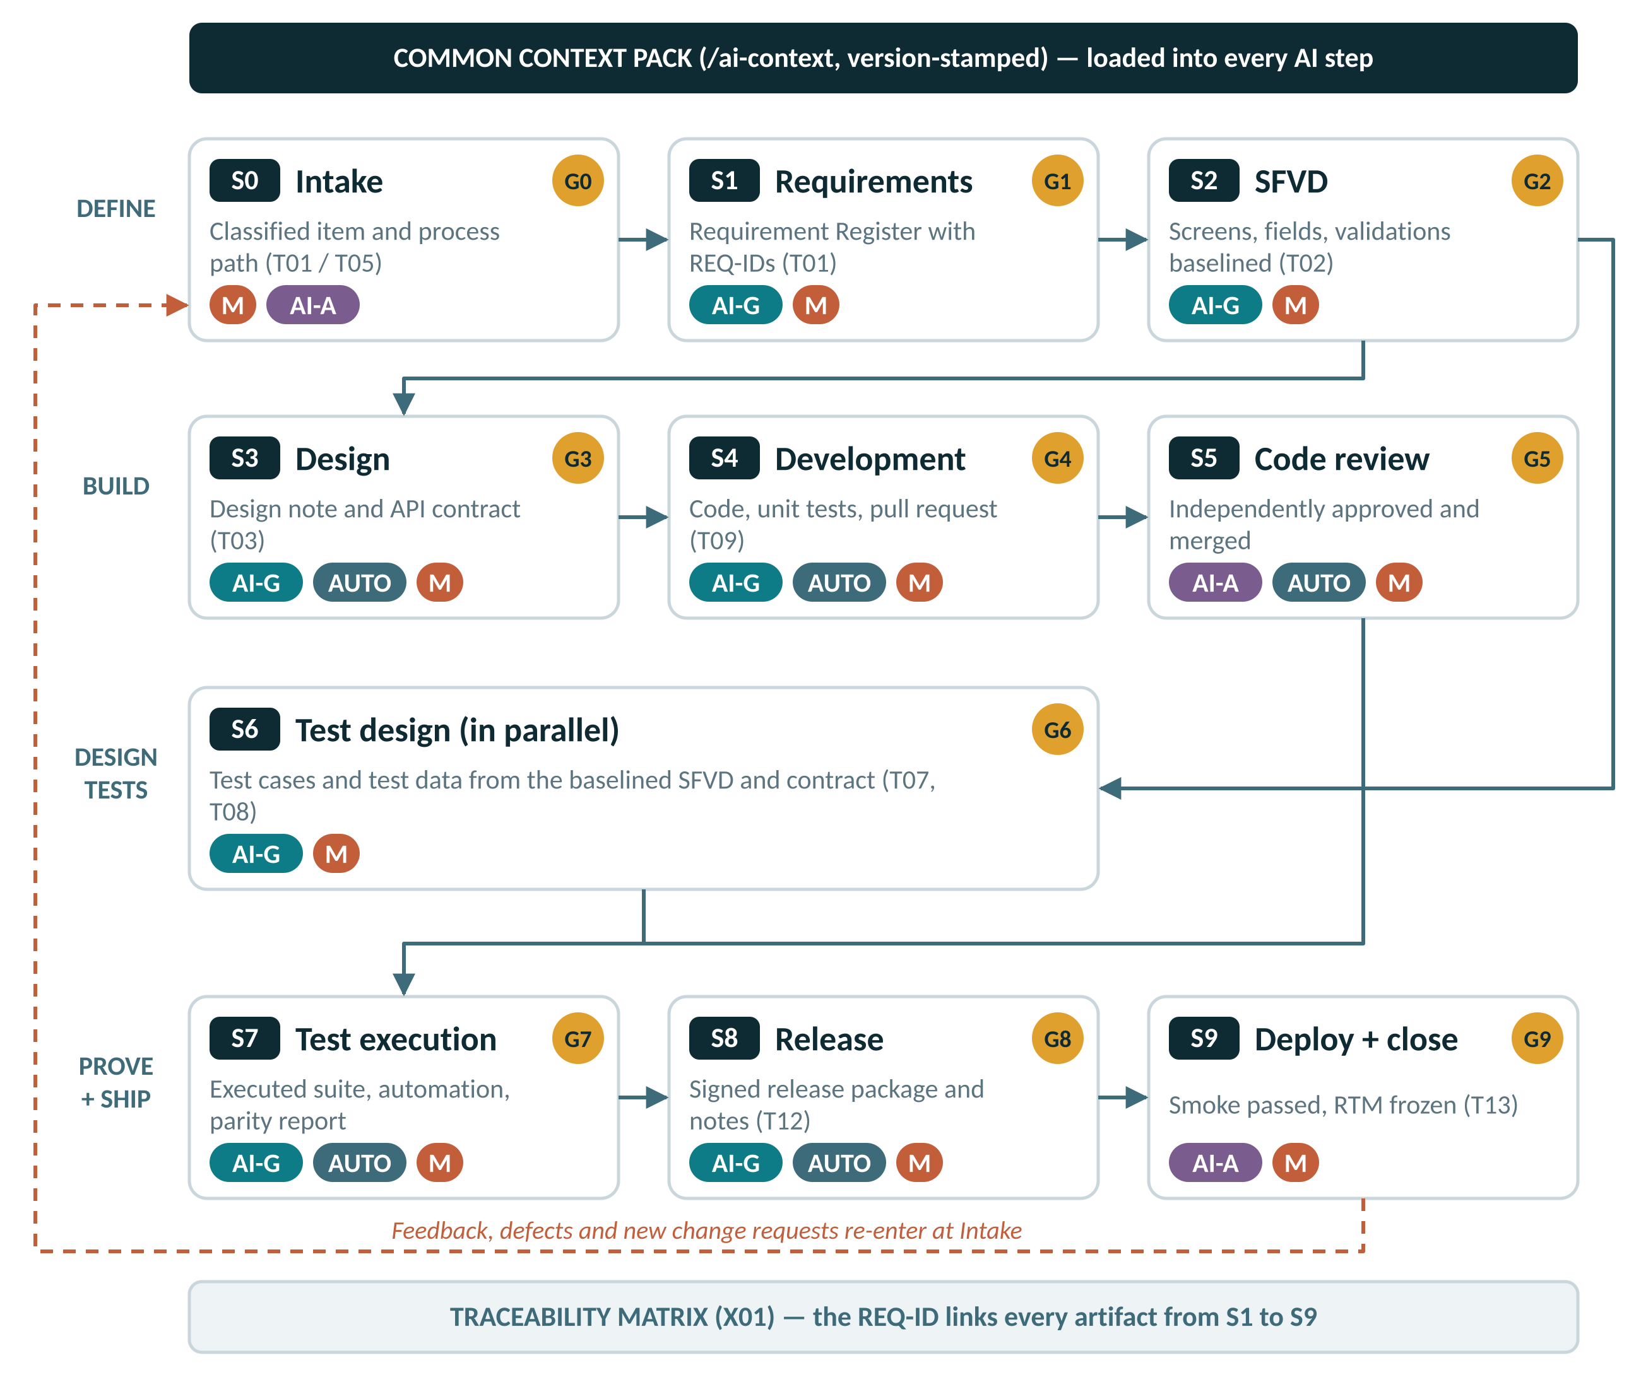
THE PROCESS IN ONE PICTURE
Ten stages, a gate after each, and two tracks that meet at test execution
HOW TO READ IT
Define (S0–S2) is sequential: intake, requirements, SFVD.
Build (S3–S5) and test design (S6) run in parallel from the moment the SFVD is baselined at G2.
Prove and ship (S7–S9) starts when code is merged (G5) and tests are approved (G6).
Every stage ends at a gate. No output is the next input until its gate is recorded in T10.
The Context Pack feeds every AI step; the RTM links every artifact by ID.
Defects and changes re-enter at intake, never mid-stream.
M
AI-G
AI-A
AUTO
AI-X
Notes:
Spend time here. Point at S6 running in parallel: this is a change from our old flow, where testers waited for code.

Slide 6
THE PROCESS IN ONE PICTURE
Five modes tell you who produces each thing and how hard to check it
Manual
Performed and owned entirely by a named person. AI is not used to produce the output.
Role checklist and gate (L2, L4)
M
AI-Generated
AI produces the draft from approved inputs and the Context Pack. A named person must validate it before it is used. It is never a deliverable as generated.
All four levels plus the universal checklist
AI-G
AI-Assisted
A person produces the output. AI is used only to summarise, search, scan or suggest. The person decides.
The person confirms every AI suggestion
AI-A
Automated
Deterministic tooling with no AI judgement: Jenkins pipeline, PMD, Sonar, OpenAPI diff, link-check jobs.
Result attached to the gate as evidence
AUTO
AI Not Permitted
AI must not be used for this activity under any circumstances.
Not applicable: AI must not be used
AI-X
A combined tag such as “AI-G → M” means AI drafts and a person validates, completes and owns the result.
Notes:
Every row in every stage table of the document carries one of these tags. That is how you answer “which parts are manual and which are AI” for any stage.

Slide 7



THE PROCESS IN ONE PICTURE
AI boundaries: generate and validate, assist only, or not at all
AI-GENERATED, THEN VALIDATED
AI-ASSISTED ONLY
AI NOT PERMITTED
Requirement register and acceptance criteria drafts
SFVD drafts
Design notes, OpenAPI contracts, migration drafts
Code and unit tests (except P1 / P2 fixes)
Test cases, test data and automation scripts
Release notes and runbook drafts
Fixes for P3 / P4 defects after RCA approval
Intake and log summaries
Duplicate and impact searches across the RTM and code
Code review aids: diff summary, deviation scan, duplicate detection
Regression selection suggestions for CRs
Defect description drafts
Post-deployment log summaries
Classifying work type or setting severity
Approving any gate, pull request or release
Answering its own open questions or assumptions
Root cause analysis for any defect
Fixes for P1 and P2 defects
Scripts that change cost, accumulated depreciation or NBV
Executing deployments, rollbacks or production data changes
Prompts containing production personal data, financial records or secrets
Creating new validation IDs, error codes or style classes outside the registry process
Notes:
The right-hand column is non-negotiable. Note especially: RCA is always manual, P1/P2 fixes are manual, and scripts that change financial values are manual.

Slide 8
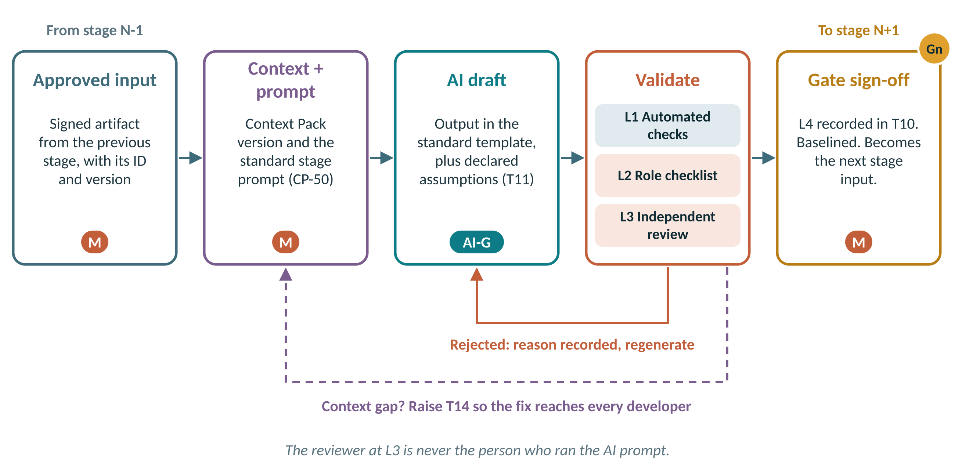
THE PROCESS IN ONE PICTURE
Every stage runs the same loop: input, prompt, draft, validate, gate
VALIDATE = FOUR LEVELS
L1
Automated checks
L2
Role checklist
L3
Independent review
L4
Recorded sign-off
Rejected? Record the reason and regenerate. If the cause was missing context, raise T14 so the Context Pack is fixed for every developer, not just you.
Notes:
This loop is the same in all ten stages. Learn it once.

Slide 9
THE PROCESS IN ONE PICTURE
Inputs, AI outputs and the human check for every stage
Stage | AI is given | AI produces | A person must check | Gate · signs
S0 Intake | Request, logs, current RTM | Intake summary, duplicate list (AI-A) | Nothing added or lost; person classifies | G0 · Delivery Mgr
S1 Requirements | Requirement note, glossary CP-00 | Register with REQ-IDs, criteria, questions | Every line traced; questions answered by business | G1 · Product Owner
S2 SFVD | Register, data dictionary, CP-21/23 | Screens, fields, validations, flows | No invented field, validation or error code | G2 · BA Lead
S3 Design | SFVD, OpenAPI specs, CP-20/22 | Design note, contract, migration draft | Boundaries, reuse, compatibility, rollback | G3 · Architect
S4 Development | SFVD, contract, CP-10/11/12/99 | Code, unit tests, config | Reuse searched; dev can explain every line | G4 · Tech Lead
S5 Code review | PR diff, Sonar, contract diff | Review aid only (AI-A) | Independent reviewer reads logic vs SFVD | G5 · Tech Lead
S6 Test design | SFVD, contract, CP-30/31 | Test cases and test data | Coverage counted; SME re-derives values | G6 · QA Lead
S7 Test execution | Approved suite, seed script | Automation scripts, defect drafts | 1:1 with cases; deliberate-fail check | G7 · QA Lead
S8 Release | Merged code, Jira scope, RTM | Release notes, runbook draft | Scope = notes = RTM; dry run passed | G8 · Delivery Mgr
S9 Deploy | Signed package, runbook | Log and metric summary (AI-A) | Smoke by QA; monitoring window clean | G9 · Delivery Mgr
Notes:
This is the one-slide answer to “inputs, outputs, manual versus AI”. Full detail per stage is in section 4 of the document, each with its own checklist.

Slide 10
02
Three work types, three paths
New feature, change request, issue fix and service request

Slide 11
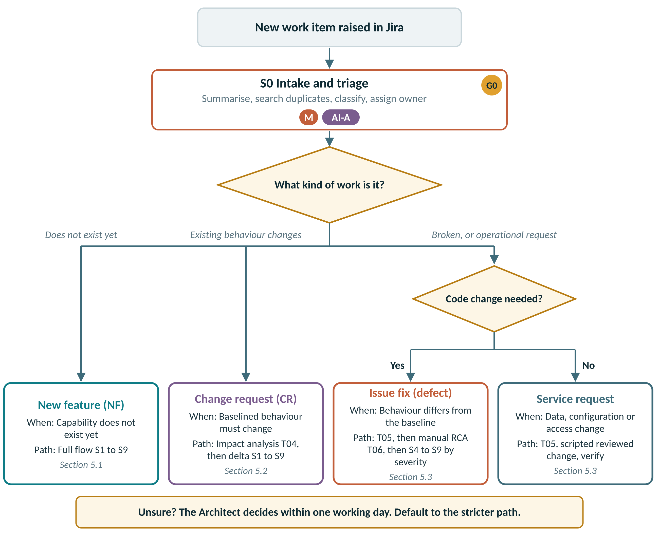
THREE WORK TYPES, THREE PATHS
Classify every item at intake; the work type decides the path
CLASSIFICATION RULES
Capability does not exist yet
NF
Baselined behaviour must change on purpose
CR
Product differs from the baselined SFVD
SR · defect
Data, configuration or access change, no code
SR · service
Matches SFVD but business wants different
→ CR
“Service request” that needs code
→ CR or defect
Unsure? The Architect decides within one working day. Default to the stricter path. AI may summarise a request but never classifies it.
Notes:
Misclassification is the most common way process gets skipped: calling a CR a bug avoids impact analysis. That is why classification is manual and disputes go to the Architect.

Slide 12
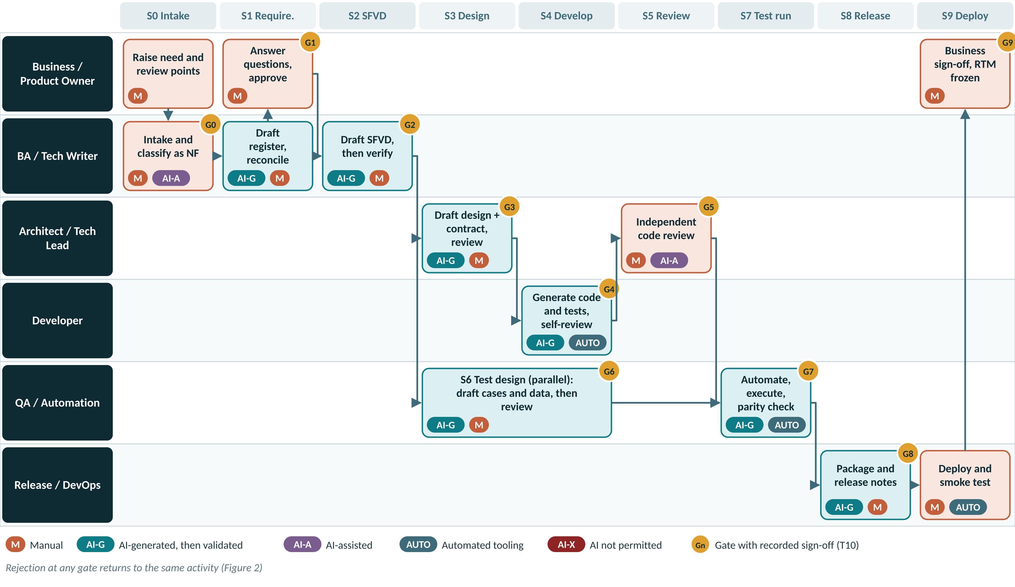
THREE WORK TYPES, THREE PATHS
New application or feature: all ten stages in full
NEW-FEATURE RULES
New module: register its prefix in CP-00 before S1
First feature on a new surface creates its golden example (CP-99)
New shared components go into CP-20 / 21 / 23 via T14 in the same release
Spikes may use AI freely; spike code never merges
NFR baselines fixed at S1
Notes:
Walk one requirement through the lanes. Note test design (S6) sitting under design and development, fed directly from the SFVD.

Slide 13
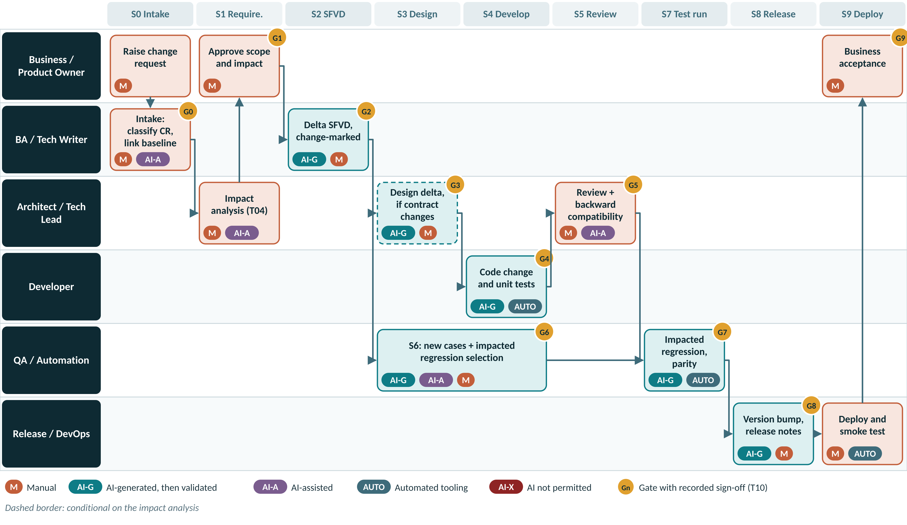
THREE WORK TYPES, THREE PATHS
Change request: impact analysis first, then delta stages
WHAT IS DIFFERENT
T04 impact analysis before approval; Architect confirms every AI-suggested impact
Minor vs Major: contract, schema, multi-surface, > 5 days or financial calc = Major
Changed REQ keeps its ID: DEP-REQ-214.r2
SFVD updated in place, change-marked
Regression chosen from the RTM; QA Lead confirms
Mobile N-1 must keep working
Financial rules: Finance decides prospective or retrospective
Notes:
The CR path is where we lost the most discipline: changes went straight to code. T04 is the control.

Slide 14
THREE WORK TYPES, THREE PATHS
Issues and service requests: triage decides; root cause is manual
Ticket raised
SERVICE REQUEST · no code
M
G5
G9
No
Classify SR type
Scripted, reversible change
Peer review + dry run
Execute + verify
G0
data · config · access · report
AI-X if it changes values
before / after evidence
change record; requester confirms
Triage (T05)
M
M
AI-G
M
M
reproduce, classify, severity
M
AI-A
DEFECT FIX · code change
G1
Yes
Failing test first
Root cause (T06)
Approve RCA
Severity decides
Code change?
reproduces the defect
written by the engineer
Architect for P1 / P2
whether AI may help
M
AI-X
M
M
P1 / P2 Manual fix only (AI-X) → two engineers + Architect review (G5) → targeted + regression (G7) → hotfix release (G8)
P3 / P4 AI-G fix allowed after RCA approval → independent review (G5) → regression pack (G7) → scheduled release (G8)
Every path ends at G9: deploy, smoke, extended monitoring (T13), then close — RTM and SFVD updated, the missed gate improved, context gaps raised on T14.
Notes:
Two key rules: the failing test comes before the fix, and the RCA names the gate that should have caught the defect. That is how the process learns.

Slide 15
THREE WORK TYPES, THREE PATHS
Severity sets the AI permission; service requests have their own controls
Severity | Definition | Response | AI permission | Review | Release
P1 Critical | Production down, financial misstatement (e.g. wrong depreciation posted to ledger), data loss or security breach | Immediate; hotfix | AI-X for RCA and fix. AI-A only to summarise logs. | Two engineers + Architect | Emergency change
P2 High | Major function impaired; workaround is costly or risky | Hotfix within SLA | AI-X for RCA and fix. AI-A only to summarise logs. | Two engineers | Hotfix release
P3 Medium | Function impaired; acceptable workaround exists | Next scheduled release | RCA manual. Fix AI-G permitted after RCA approval. | Independent reviewer | Scheduled release
P4 Low | Cosmetic or minor inconvenience | Planned | RCA manual (short form). Fix AI-G permitted. | Independent reviewer | Scheduled release
Service request type | Examples | Controls
Data correction | Fix asset master records, re-run depreciation for a period, correct location or custodian | Scripted, reversible, before/after evidence. Scripts that change cost, accumulated depreciation or NBV are AI-X; other scripts AI-G with peer review and dry run.
Configuration change | Asset class useful life, depreciation rate table, label template, approval limits | Change record with old and new values; peer review; verification in test first. AI-A only.
Access and role change | Add or remove users, roles, location access | Approved by data owner; executed by admin; AI-X.
Report or export tweak | Column order, filter default, format | If code changes: re-route as a CR. If configuration only: change record and verification.
Bulk master-data upload | New asset batch, transfer batch | Upload template validation; sample verification of 10% or 20 rows, whichever is greater. AI-A for validation summaries.
Notes:
A wrong depreciation posting is P1 even if the system is up: financial misstatement is the trigger.

Slide 16
THREE WORK TYPES, THREE PATHS
Every stage exists for every work type; only the depth changes
Stage | New feature | Change req. | Issue / SR | For a change request | For an issue or SR
S0 Intake | Full | Full | Full | Intake + baseline link | Triage form (T05)
S1 Requirements | Full | Delta | Conditional | Impact analysis (T04); new / revised REQ-IDs | RCA (T06) replaces requirements for defects
S2 SFVD | Full | Delta | Conditional | Affected sections, change-marked, version bump | Only if designed behaviour changes
S3 Design | Full | Conditional | Conditional | If contract, schema or cross-service change | If the fix changes a contract or schema
S4 Development | Full | Full | Full | Full | AI permission set by severity
S5 Code review | Full | Full | Full | Full + backward-compatibility check | Second reviewer for P1 / P2
S6 Test design | Full | Delta | Light | New cases + impacted regression selection | Failing test first + targeted regression
S7 Test execution | Full | Delta | Light | New + impacted regression + smoke | Targeted + regression pack
S8 Release | Full | Full | Conditional | Scheduled release | Hotfix path for P1 / P2
S9 Deploy | Full | Full | Full | Full | Full + extended monitoring
Notes:
Full, delta, conditional, light. “Conditional” always has a stated trigger — for example S3 runs for a CR only if a contract, schema or cross-service change is involved.

Slide 17
03
Proving AI output is valid
Four levels, ten techniques, one universal checklist

Slide 18
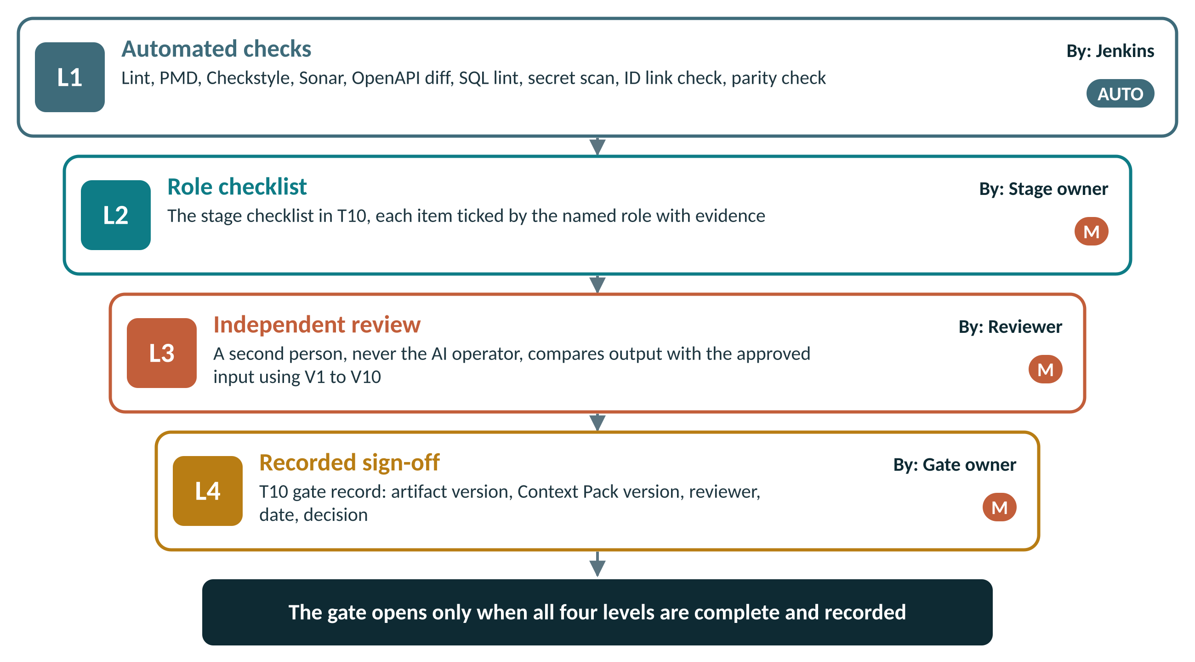
PROVING AI OUTPUT IS VALID
Four levels close every gate; three out of four is not a gate
WHERE EACH LEVEL IS RECORDED
L1
Jenkins result linked in T10
L2
Ticked checklist in T10
L3
Reviewer name in T10; must differ from the AI operator (X01 flags it)
L4
Decision in T10 and a row in the X01 Gate Log
Verification is standardised: the same four levels in all ten stages. Only the checklist contents change by stage, and those are fixed in T10 and CP-60.
Notes:
If anyone asks “how do we know the AI output is right?”, the answer is these four levels, recorded.

Slide 19
PROVING AI OUTPUT IS VALID
Ten techniques, each aimed at one way AI output goes wrong
V1
V2
V3
V4
V5
Source cross-check
Assumption register review
Registry lookup
Count reconciliation
Golden-example comparison
Catches: Invented content and omissions
Catches: Silent guesses presented as fact
Catches: Invented identifiers
Catches: Silent omission
Catches: Structure and naming drift
S0, S1, S2, S6, S8
Every AI-G stage
S2, S3, S4
S1, S2, S6, S7, S8
S2, S3, S4
V6
V7
V8
V9
V10
Deterministic tool checks
Independent re-derivation
Execution evidence
Explain-back
Regeneration consistency
Catches: Standards, quality and security defects
Catches: Wrong domain logic that looks right
Catches: Claims that were never run
Catches: Code or design nobody understands
Catches: Ambiguous inputs
S3, S4, S5, S8
S1, S6, S7
S4, S7, S9, SR
S3, S4, S5
S1, S2, S3 (optional)
How to apply each one is in section 6.2 of the process definition; every stage names the techniques its reviewer uses.
Notes:
V2, assumption review, and V3, registry lookup, catch most AI errors in documents. V8, the deliberate-fail check, catches automation scripts that assert nothing.

Slide 20

PROVING AI OUTPUT IS VALID
The universal checklist applied to every AI-generated artifact
Generated from an approved, versioned input; input ID and version recorded
Reuse verified: every referenced component exists and is actually used
Standard stage prompt template used; Context Pack version recorded
Structure follows the template; naming follows CP-11
AI Usage Declaration (T11) completed: tool, prompt template, sections generated
Domain rules spot-checked by independent re-derivation where financial values are involved
Assumption list present, and every assumption resolved by a person
No personal data, production data or secrets in the prompt or the output
Every output item traces to a source item; no orphan content
Reviewer is not the AI operator; sign-off recorded in T10
No invented identifiers: fields, validation IDs, error codes, APIs, classes, style classes
Recorded in T11 with the assumption register. Undeclared AI content fails the gate.
Block 8 of every prompt makes this possible: AI must list its assumptions and open questions, so the reviewer checks written claims instead of hunting for hidden ones.
Notes:
Read three of these aloud: no invented identifiers, reuse verified, reviewer is not the operator.

Slide 21
PROVING AI OUTPUT IS VALID
Fixed-asset rules: where AI output looks right and is wrong
Straight-line depreciation
Monthly charge; partial first period when the put-to-use date is mid-month; salvage value applied once
Written-down value
Rate applied to opening WDV; pro-rata on additions during the year; disposals removed from the base
Change of estimate
Change of useful life or method applied prospectively only, never restated
Impairment and revaluation
Subsequent depreciation recalculated on the revised carrying amount
Disposal and retirement
Depreciation stops from the disposal date; gain or loss computed on NBV
CWIP and capitalisation
No depreciation before the capitalisation date; capitalisation thresholds respected
Period boundaries
Financial year end, leap years, closed periods cannot be posted to
Rounding
Rounding rule and the treatment of the final-period residual
Labels and tags
Barcode or RFID format, uniqueness, re-print, transfer between locations
Physical verification and audit
Verification statuses, discrepancy handling, audit trail: who, when, old value, new value
Technique V7: a domain SME calculates at least two scenarios without looking at the AI output, then compares. Mandatory for any change to a financial calculation.
Notes:
These come straight from our domain. A WDV calculation with a pro-rata addition is exactly the kind of thing AI produces confidently and gets subtly wrong.

Slide 22
04
Documents and templates
Which document, at which stage, filled by whom

Slide 23
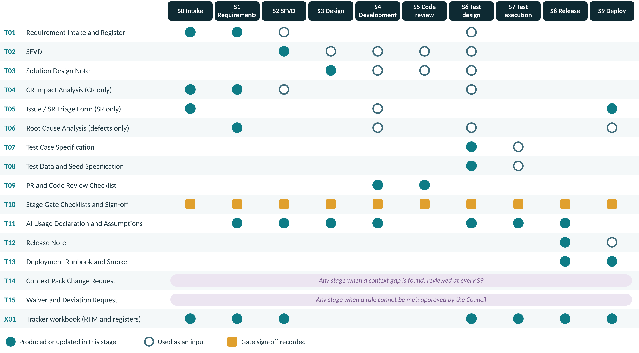
DOCUMENTS AND TEMPLATES
Which document is produced, used and signed at each stage
Notes:
Read one row across: T02 SFVD is produced at S2 and used by design, development, review and test design. Read one column down: everything S6 needs.

Slide 24
DOCUMENTS AND TEMPLATES
Fifteen templates and one tracker: what each is for and who fills it
T01
Requirement Intake and Register
T02
SFVD (Screens, Fields, Validations, Data)
T03
Solution Design Note
T04
Change Request Impact Analysis
Stage S0, S1
Stage S2
Stage S3
Stage S0, S1 (CR)
Business Analyst
Tech Writer
Tech Lead
Architect / BA
T05
Issue and Service Request Triage Form
T06
Root Cause Analysis
T07
Test Case Specification
T08
Test Data and Seed Data Specification
Stage S0 (SR)
Stage SR defect path
Stage S6
Stage S6, S7
Triage Lead
Developer + Tech Lead
QA Engineer
QA Engineer
T09
Pull Request and Code Review Checklist
T10
Stage Gate Checklists and Sign-off
T11
AI Usage Declaration and Assumption Register
T12
Release Note
Stage S4, S5
Stage All
Stage Every AI-G step
Stage S8
Developer, Reviewer
Gate owner
AI operator
Release Manager
T13
Deployment Runbook and Smoke Checklist
T14
Context Pack Change Request
T15
Waiver and Deviation Request
X01
AI SDLC Tracker Workbook (Excel)
Stage S8, S9
Stage Any
Stage Any
Stage All
DevOps
Anyone; approved by Council
Requester; approved by Council
BA, QA Lead, Council
Notes:
Tile colour shows how the template is mainly filled: teal AI-drafted then verified, rust manual, purple AI-assisted, dark red no AI at all (T06 root cause analysis).

Slide 25



DOCUMENTS AND TEMPLATES
X01 tracker: eight working sheets that flag problems automatically
RTM
Gate Log
AI Usage Log
Parity
Requirement → SFVD → API → PR → tests → release
One row per gate per work item
One row per T11 declaration
Approved = manual + automated + deferred
GAP when a requirement has no PR, no test or no pass
NO when the reviewer ran the AI prompt
Missing when AI output has no declaration
Cases missing when the count does not reconcile
Waivers
CP Versions
Defect to Gate
Metrics
T15 register with expiry
Context Pack releases and T14s closed
Which gate missed each defect
Live Council metrics
EXPIRED, or NO when longer than 90 days
Lead time in working days
Open preventive actions
On target / Action needed
Grey cells are formulas. Enter data only in white cells; row 5 of each sheet is an example. A nightly job can later feed the RTM from Jira, Git and the test tool.
Notes:
Red boxes show what each sheet flags on its own, without anyone having to look for it.

Slide 26
05
Common context
One Context Pack and one prompt structure for everyone

Slide 27
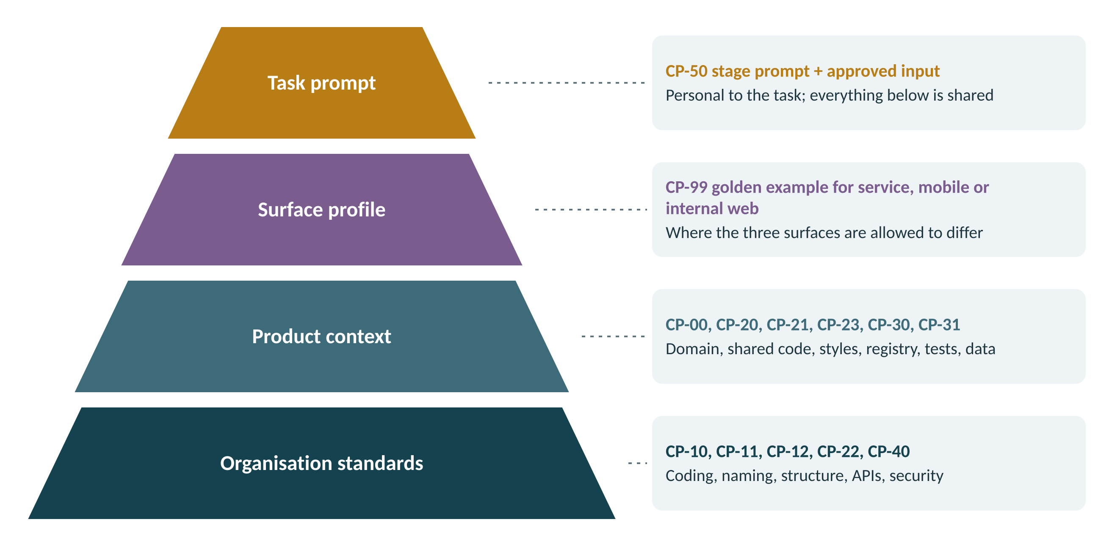


COMMON CONTEXT
One Context Pack, loaded the same way by every approved AI tool
HOW IT IS LOADED
/ai-context in the repository
Versioned and reviewed like code
AI-INSTRUCTIONS.md at the root
The binding rules, in one place
One pointer file per approved tool
Each tool loads the same rules
Every prompt
Stamps the CP version into T11 and the PR
Starter files are ready: 15 Context Pack files with “OWNER TO COMPLETE” blocks, 10 stage prompts and the PR template. Owners complete them in weeks 3 and 4.
Changes go through T14: pull request, two approvals, version bump, same-day note to all three surface teams.
Notes:
The pointer-file approach means we are not locked into one AI tool. Whatever is on the approved list reads the same rules.

Slide 28
COMMON CONTEXT
Fifteen files, each with a named owner
File | What it pins down | Owner
AI-INSTRUCTIONS.md | Root instruction file loaded by every AI tool; points to /ai-context and states the binding rules | Architect
CP-00 product-overview.md | Modules, surfaces, module prefixes, domain glossary (asset class, SLM, WDV, CWIP, NBV, impairment, label) | Architect
CP-10 coding-standards.md | Layering, exceptions, logging, transactions, audit trail, versioning policy | Architect
CP-11 naming-conventions.md | Packages, classes, methods, tables, columns, API paths, events, branches, commits, test IDs | Architect
CP-12 folder-structure.md | Canonical project skeleton per surface and where each kind of file goes | Architect
CP-20 shared-library-index.md | Every base class, utility, validator and component, with when to use it and the do-not-rewrite list | Tech Leads
CP-21 ui-style-guide.md | Design tokens, approved style classes, component catalogue for web and mobile | UI Lead
CP-22 api-contract-standards.md | REST conventions, versioning, pagination, error envelope, event naming | Architect
CP-23 validation-and-error-registry.md | Every validation ID and error code with message text; the only source for SFVD and code | Architect
CP-30 test-standards.md | Test case template, ID convention, negative-pattern library, automation and locator patterns, device matrix | QA Lead
CP-31 test-data-and-seed.md | Seed data structure, standard asset fixtures, masking rules, data builders | QA Lead
CP-40 security-and-compliance.md | Authorisation model, PII handling, audit log rules, secrets policy, AI data rules | Security
CP-50 prompt-templates/ | One approved prompt per stage, S0 to S9 | Architect + QA Lead
CP-60 review-checklists.md | The gate checklists from T10, so AI can self-check before a human reviews | Council
CP-99 golden-examples/ | One reference feature per surface (service, mobile, internal web) for AI to imitate | Tech Leads
Notes:
Owners: Architect for standards and API rules, Tech Leads for the shared library and golden examples, QA Lead for test standards and data, Security for CP-40.

Slide 29
COMMON CONTEXT
The standard prompt: same eight blocks for everyone, every stage
1
ROLE
perspective + surface
Example — P-S2 (SFVD)
2
CONTEXT
CP version, binding
ROLE: Senior technical writer, Fixed Assets suite
(profile: internal web)
CONTEXT: Load /ai-context at CP v1.3. Binding.
INPUT: Register DEP-RR v1.0, DEP-REQ-210..218
TASK: SFVD sections for these screens only
CONSTRAINTS: Only data-dictionary fields, CP-23 IDs,
CP-21 classes. Missing? List it. Never invent.
OUTPUT: Template T02 sections 3 to 7
TRACE: REQ-ID on every screen, field, validation
SELF-CHECK: standards, reuse, ASSUMPTIONS,
OPEN QUESTIONS. Never answer your own.
3
INPUT
approved IDs + versions
4
TASK
one deliverable only
5
CONSTRAINTS
reuse; never invent
6
OUTPUT
the template to fill
7
TRACEABILITY
IDs on every item
8
SELF-CHECK
assumptions + questions
All ten stage prompts are written: ai-context/CP-50-prompt-templates/P-S0.md to P-S9.md. Copy, fill the angle brackets, run.
Notes:
Demo suggestion: run the same requirement with and without blocks 2, 5 and 8 and compare the output live.

Slide 30
06
Implementing it here
Tools, roles, governance, roll-out, pilot and the first 30 days

Slide 31




IMPLEMENTING IT HERE
Five tools to configure so the process is enforced, not just written
JIRA
GIT
JENKINS
TEST TOOL
DOC REPOSITORY
Issue types: Epic (NF), Change Request, Service Request, Bug
Fields: Work Type, Module, Severity, AI Usage, CP Version
Statuses mirror the gates; each transition needs a T10
Branch: <type>/<ID>-<desc>
Commit: [ID] summary — hook rejects missing IDs
PR template = T09 with AI usage block
≤ 400 lines per PR
PR pipeline: PMD, Sonar gate, coverage, duplication, OpenAPI diff, secret scan, ID check
Release pipeline: RTM link check, parity check
Warning mode until day 60
REQ-ID link on every case
Automation flag and regression tag
Export feeds X01 parity and RTM
/AI-SDLC/templates holds T01–T15
/<module>/<release>/ per baseline
File names carry ID, template and version
Owners: Jira admin and Delivery Manager · Tech Leads for Git hooks · DevOps for Jenkins · QA Lead for the test tool · Architect for the document repository.
Notes:
This is where the process stops being a document. Every one of these is a small configuration change; together they make skipping a step visible.

Slide 32
IMPLEMENTING IT HERE
Jira workflow: each status change is a gate with a T10 attached
Intake
Requirements
Specification
Design
In development
G0
G1
G2
G3
G4
In review
In test
Release ready
Deployed
Closed
G5
G6 + G7
G8
G9
RTM frozen
Rule | Detail
Transition condition | The target status cannot be entered until the T10 record for the previous gate is attached
Skips | Design may be skipped only for a Minor CR or an SR without contract change; the skip is recorded on the issue
Test design | A sub-task that opens at G2 and closes at G6, so it runs in parallel with design and development
Reporting | Gate transitions export to the X01 Gate Log; the Council reviews it monthly
Notes:
Ten statuses, ten gates. If the Jira admin can only do one thing in week 1, it is this workflow.

Slide 33
IMPLEMENTING IT HERE
Jenkins: deterministic checks that run on every pull request and release
Pull request pipeline
Build + unit tests
PMD / Checkstyle
Sonar quality gate
Coverage + duplication
OpenAPI diff
Secret scan
ID check
Release pipeline
RTM link check
Parity check
Version + checksum
Promote (after G8)
Check | Threshold | Mode until day 60 | From day 60
Standards and naming | Zero violations in new code | Warn | Block merge
Sonar quality gate | Zero blocker or critical | Warn | Block merge
Coverage and duplication on new code | Agreed by the Council at kick-off | Warn | Block merge
OpenAPI diff | No breaking change without version bump | Warn | Block merge
Commit and PR IDs | Every commit carries a valid ID | Block from day 1 | Block merge
RTM link and parity | All in-scope REQs passed; parity reconciles | Warn | Block release
Notes:
Starting in warning mode is deliberate: the pilot tunes thresholds against real code before anything blocks. The one exception is the ID check, which is cheap and blocks from day one.

Slide 34
IMPLEMENTING IT HERE
What changes for each role from the first pilot sprint
Role | Start doing | Stop doing | Templates
Business Analyst | Run the S1 prompt; reconcile every line; get business answers to AI questions | Pasting requirements into a free-form prompt | T01, T04, T11
Technical Writer | Look up every field and ID in the dictionary and CP-23 | Accepting new error codes from AI | T02, T11
Architect / Tech Lead | Merge the contract before code; own CP files; decide classifications | Approving designs without a reuse check | T03, T04, T10, T14
Developer | Use P-S4; search CP-20 first; declare AI use in the PR | Merging code you cannot explain | T09, T11
Reviewer | Review only work you did not generate; enforce reuse | Approving on a green pipeline alone | T09, T10
QA / Automation | Start test design at G2; reconcile counts; deliberate-fail check | Waiting for code before designing tests | T07, T08, T10
Release / DevOps | Reconcile scope = notes = RTM; smoke by QA | Deploying without a named rollback owner | T12, T13
Notes:
Ask each role in the room to read their own row. This is the practical behaviour change.

Slide 35

IMPLEMENTING IT HERE
Governance and the numbers we will watch
METRICS (LIVE IN X01)
AI GOVERNANCE COUNCIL
RTM completeness
100%
Architect (chair), QA Lead, Delivery Manager, Security Lead
Weekly, 30 minutes: open T14 and T15 items, gate exceptions, pilot feedback
Monthly: 10% audit of AI-assisted merges against T10; metrics review
Quarterly: refresh golden examples and prompts; review thresholds
Waivers via T15 only, maximum 90 days, never for schedule pressure alone
Automation parity
100%
Gates with evidence
100%
AI use declared (T11)
100%
Unresolved assumptions at a gate
0
Reviewer = AI operator
0
Review findings per AI PR
Falling
Escaped defects per release
Falling
Context Pack lead time
≤ 5 days
Baselines are measured in the pilot month. Targets marked “Falling” are judged on direction, not an absolute number.
Notes:
The Metrics sheet in X01 calculates these live from the other sheets; nobody builds a report by hand.

Slide 36
IMPLEMENTING IT HERE
Roll-out: twelve weeks to an enforced process, delivery never stops
0
1
2
3
4
Mobilise
Foundation
Pilot
Enforce
Sustain
Weeks 1–2
Weeks 3–4
Weeks 5–8
Weeks 9–12
Ongoing
Approve PD-AISDLC-01
Name the Council
Create /ai-context
Publish templates
Owners complete CP v1.0
Jira, Git, Jenkins configured (warn)
X01 set up per product line
Role training
One NF, one CR, one SR end to end
Weekly retrospective
Tune thresholds and prompts
CP v1.1
Gates blocking
All new work on the process
First monthly audit
Quarterly refresh
Monthly metrics
Existing modules adopt as touched
Exit: Readiness items 1–6 done
Exit: All readiness items done
Exit: Three pilots closed at G9 with full evidence
Exit: Audit ≥ 90% checklist compliance
Exit: Metrics on target two quarters
Delivery continues throughout. New work adopts the process from the pilot; existing modules adopt it as they are touched.
Notes:
The only hard stop is the move to blocking gates at week 9, and only after the pilot has tuned them.

Slide 37
IMPLEMENTING IT HERE
The pilot: three real work items, one per work type
NF
New feature
CR
Change request
SR
Issue or SR
Choose
Choose
Choose
A small feature on a surface without a golden example yet, so the pilot also produces CP-99 for it
A Major CR that touches a calculation or contract, to exercise T04, delta SFVD and regression selection
One P3 defect and one data-correction SR, to exercise manual RCA and scripted change
Success looks like
Success looks like
Success looks like
All ten stages
Golden example created
Cycle time per stage baselined
T04 completed before approval
SME re-derivation done
Mobile N-1 verified
Failing test before fix
RCA names a missed gate
Before / after evidence
Weekly pilot retro: every rejection, waiver and context gap becomes a change to the Context Pack, a prompt or a checklist before week 9.
Notes:
Between them, the three pilots must touch all three surfaces: microservices, mobile and internal web.

Slide 38
IMPLEMENTING IT HERE
The first 30 days: owners and dates
# | Action | Owner | By
1 | Approve PD-AISDLC-01 and name the four Council members | Architect, Delivery Manager | Week 1
2 | Create /ai-context and copy the starter pack; commit AI-INSTRUCTIONS.md | Architect | Week 1
3 | Publish T01–T15 and X01 in the document repository | Architect | Week 1
4 | Configure Jira issue types, fields and gate statuses | Jira admin, Delivery Manager | Week 2
5 | Enable branch naming and the commit-message ID check; install the PR template | Tech Leads | Week 2
6 | Approved AI tool list and AI data rules in CP-40 | Security Lead | Week 2
7 | Complete CP-10, CP-11, CP-12, CP-22, CP-23 | Architect | Week 3
8 | Complete CP-20 shared library index and CP-21 style guide | Tech Leads, UI Lead | Week 3
9 | Complete CP-30 and CP-31; seed fixtures scripted | QA Lead | Week 4
10 | Add Jenkins quality and release stages in warning mode | DevOps | Week 4
11 | Role-based hands-on training (one session per role) | Architect, QA Lead | Week 4
12 | Select the three pilot items and agree success criteria | Product Owner, Council | Week 4
Notes:
Every line has one owner. This table is the readiness checklist from section 11.1, put into a calendar.

Slide 39

CLOSING
What we need from you this week
1
Read your role’s sections of PD-AISDLC-01
DECISIONS FOR THE COUNCIL
Section 1.3 lists them. Raise questions before approval.
Approve PD-AISDLC-01 v1.0
Coverage and duplication thresholds
The approved AI tool list
Pilot items and start date
P1 / P2 defect boundary confirmed
2
Owners: start your Context Pack files
Every file has OWNER TO COMPLETE blocks and a week 3–4 deadline.
3
Propose a pilot item
One NF, one CR, one SR; between them all three surfaces.
The process is written, the templates are ready and the tooling plan is clear. What makes it real is every one of us using it on the next piece of work.
Notes:
End on the asks. Collect pilot proposals before people leave.

