Slide 1
Unit 3:Inter Process Communication
Prepared By :
Rikita Chokshi
Assistant Professor
CSPIT-CE
CHARUSAT University, Changa
References : Operating System Concepts By Galvin
Modern Operating System By Tanenbaum

Slide 2
Contents of the unit
Race Conditions, Critical Section, Co-operating Thread/ Mutual Exclusion
Hardware Solution, Strict Alternation, Peterson’s Solution
The Producer Consumer Problem, Semaphores, Event Counters, Monitors
Message Passing and Classical IPC Problems: Reader’s & Writer Problem, Dinning Philosopher Problem.

Slide 3
Inter Process Communication
Types of Process: Independent & Cooperating Process

Slide 4
IPC
What is IPC?
Why IPC?/ Advantage of IPC/the reasons to provide an environment that allows process cooperation :
Information sharing
Modularity
Computational Speed
Convenience
How IPC can be achieved?/Two Ways for providing an IPC :
Shared Memory
Message Passing

Slide 5
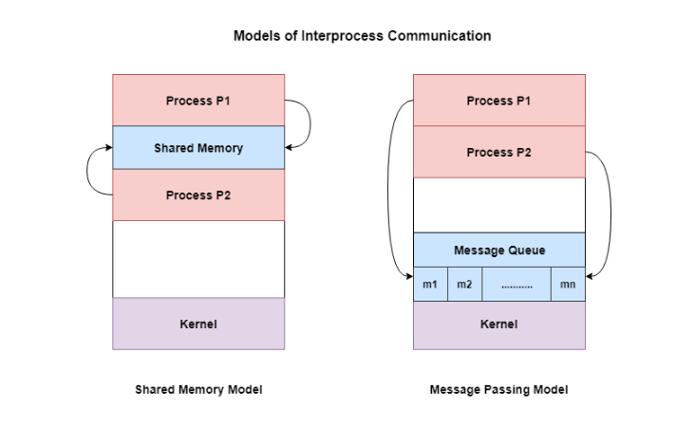
Models for IPC:

Slide 6
Scenario
Critical Section:
A situation where several processes access and manipulate the same data
Program 0
Program 1
{
Counter++;
}
{
Counter--;
}
Int Counter=5
Shared Variable
What will be the output if these two program executes?
Possible output

Slide 7
Race Condition
The outcome depends on the order in which the access take place.
Prevent Race Condition:
By Synchronization
Ensure only once process at a time manipulates the critical data
No more than one process should execute in critical section at a time.
Race Condition in Multicore.

Slide 8
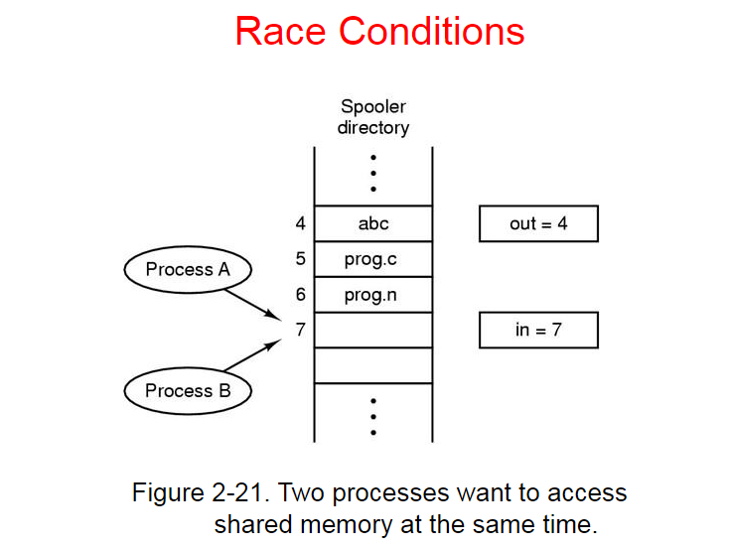

Slide 9
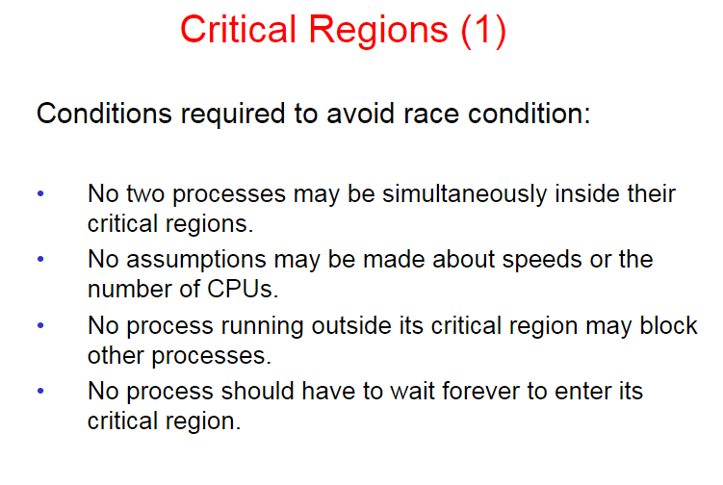
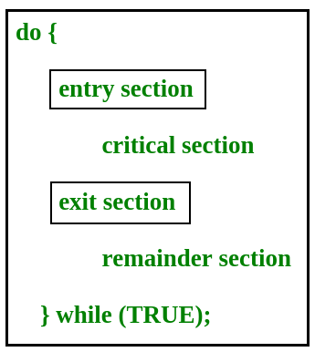

Slide 10
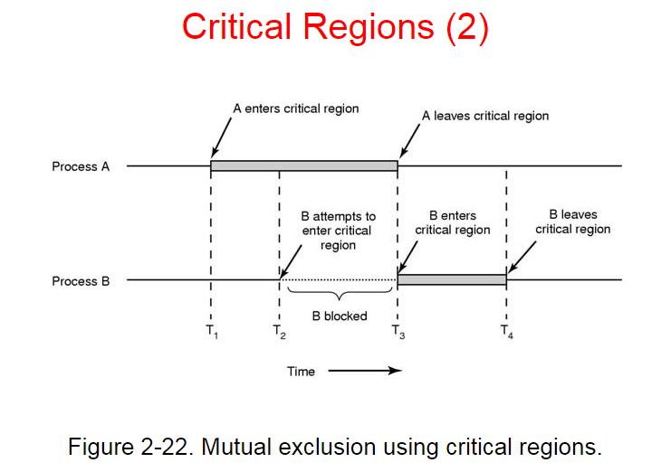

Slide 11
Solution for Critical Section Problem
Solution should satisfy the following requirements:
Mutual Exclusion:
No two process may be simultaneously inside their critical region.
Progress:
No process running outside its critical region may block other processes.
No starvation(Bounded wait):
No process should have to wait forever to enter its critical region.

Slide 12
Proposals for achieving Mutual Exclusion
Disabling Interrupts
Lock variables
Strict Alteration
Peterson’s solution
TSL instruction

Slide 13
Disabling Interrupts
When Interrupts are disabled, context switch won’t happen.
Requires privileges:
User process generally cannot disable interrupts.
Disadvantage:
Not suited for multicore systems
Process has power to disable the interrupt. (If process does not turned it on?)
Process 1
Process 2
{
Disable Interrupts()
Critical section
enable Interrupts()
}
{
Disable Interrupts()
Critical section
enable Interrupts()
}

Slide 14
Lock Variables
Shared Lock variable, initially 0.
When a process wants to enter its critical region, it first tests the lock.
If the lock is 0, the process sets it to 1 and enters the critical region.
0 means, no process is in its critical region.
1 means, some process is in its critical region.
Violate the Mutual Exclusion.
Suppose process1 reads the lock as 0 and tries to set as 1.Process 2 sets the lock to 1 mean time. (2 processes end up in critical section.)

Slide 15
Hardware Locks: TSL(Test and Set Lock)
While(test_and_set (&lock));
Critical section
lock=false;
Boolean test_and_set (Boolean *target)
{
Boolean r=*target;
*target=TRUE;
return r;
}
lock
target
r
false
1000
false
true
true
true

Slide 16
Strict Alternation
Process 0:
While(True){
While(turn!=0); /*Loop*/
Critical_region();
turn=1;
Non-critical_region;
}
Process 1:
While(True){
While(turn!=1); /*Loop*/
Critical_region();
turn=0;
Non-critical_region;
}
Software mechanism
Implemented in user mode
Restricted only for two processes
Initially turn=0.
Four cases
Violates Progress
Busy Waiting: Continuously testing a variable until some value appears.
Waste CPU cycle
Spin lock : Lock that uses busy waiting.

Slide 17
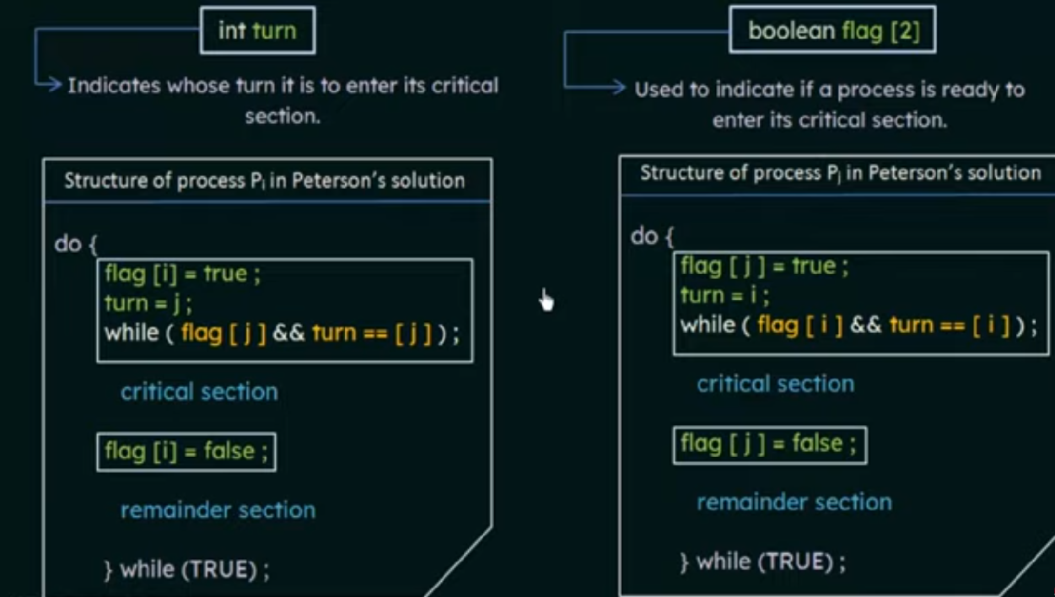
Peterson’s Solution
Software based solution
Restricted to two processes
Shared Variable : turn, flag

Slide 18
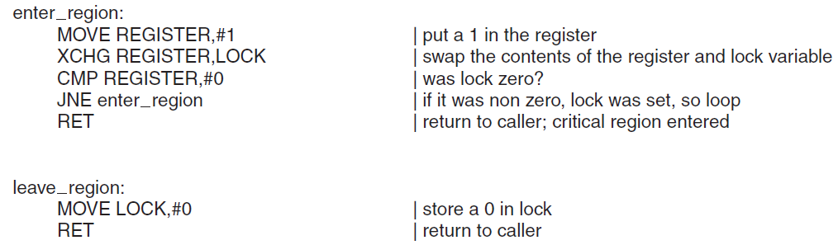
Intel x86 CPUs use XCHG instruction

Slide 19
Busy waiting
Busy waiting, also known as spinning, or busy looping is a process synchronization technique in which a process/task waits and constantly checks for a condition to be satisfied before proceeding with its execution.
In busy waiting, a process executes instructions that test for the entry condition to be true, such as the availability of a lock or resource in the computer system.

Slide 20
Busy waiting
There are two general approaches to waiting in operating systems:
firstly, a process/task can continuously check for the condition to be satisfied while consuming the processor – busy waiting.
Secondly, a process can wait without consuming the processor. In such a case, the process/task is alerted or awakened when the condition is satisfied. This is known as sleeping, blocked waiting, or sleep waiting.

Slide 21
Sleep and Wakeup
Why Sleep and Wakeup?
Solution of Busy waiting(Waste CPU Cycle).
Priority Inversion Problem:
H= High Priority process, L=Low Priority process.
H will run whenever it is in ready state.
L in its critical region, H becomes ready to run. H now begins busy waiting, but since L is never scheduled while H is running, L never gets the chance to leave its critical region, So H Loops forever.
Sleep is system call which blocks the caller, that is, be suspended until another process wakes it up.

Slide 22
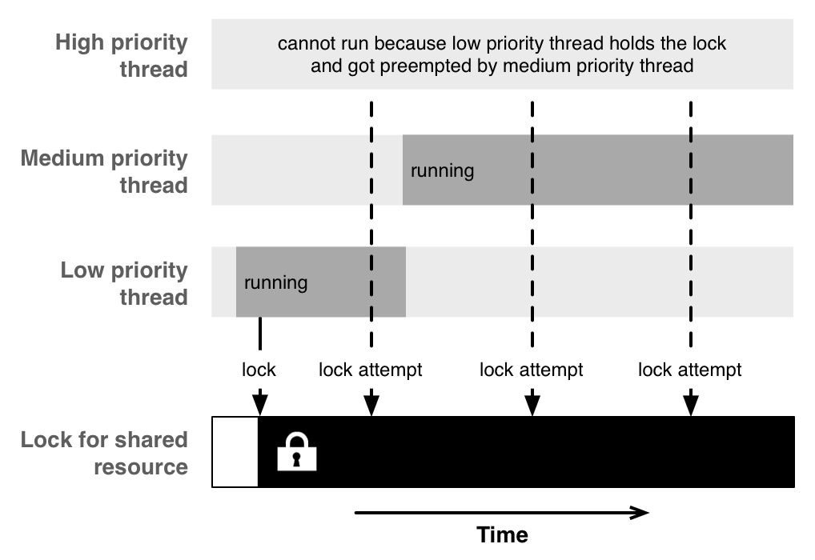

Slide 23
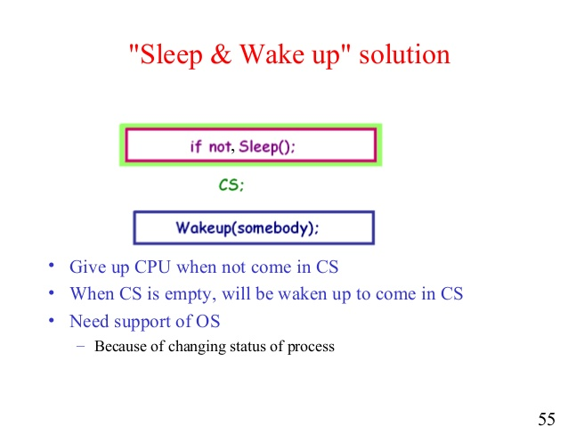

Slide 24
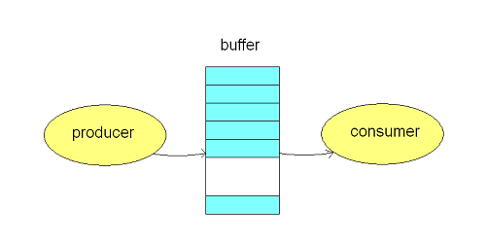
Producer-Consumer Problem(Bounded Buffer Problem)
We have a buffer of fixed size.
A producer can produce an item and can place in the buffer.
A consumer can pick items and can consume them.
We need to ensure that when a producer is placing an item in the buffer, then at the same time consumer should not consume any item.
In this problem, buffer is the critical section.

Slide 25
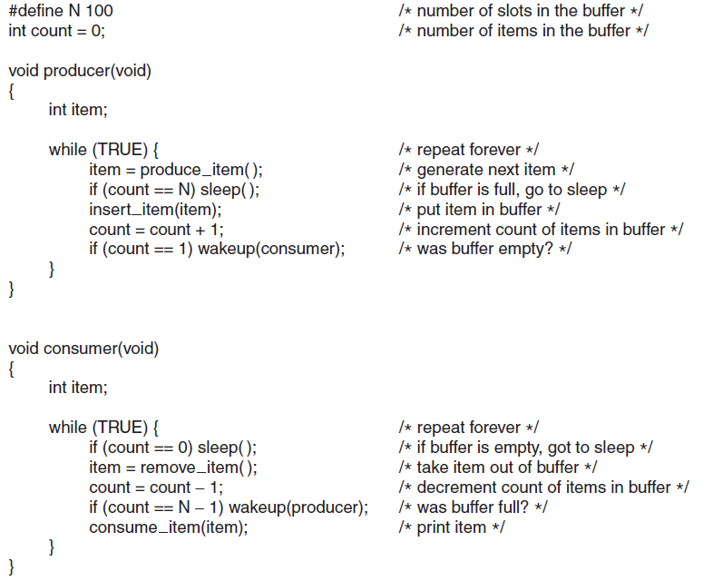
Producer-Consumer Problem (Bounded Buffer Problem)
Missing Wakeup call:
Buffer is empty.
Consumer checks value of count which is 0.
Before sleep the producer generate item and increment count by 1 and execute the wakeup system call.
Now consumer will execute sleep system and mean while producer fill up the buffer and go to sleep.
Both will sleep forever.
Context Switch

Slide 26
Semaphore
Semaphore is a variable is used to solve critical section problem and to achieve process synchronization in the multi processing environment.
The two most common kinds of semaphores
Counting semaphore can take non-negative integer values
Binary semaphore can take the value 0 & 1. only.

Slide 27
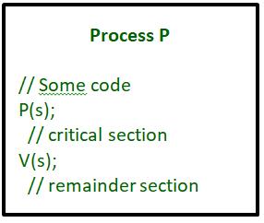
Semaphore
2 operations on Semaphores:
P operation is also called wait, sleep or down operation
V operation is also called signal, wake-up or up operation.
Both operations are atomic and semaphore(s) is always initialized to one.
A critical section is surrounded by both operations to implement process synchronization.
Uses of Semaphores:
Achieve Mutual Exclusion
Deciding order of execution
Managing Resource

Slide 28
Semaphore Implementation
Could now have busy waiting in critical section implementation
Void down(int *s)
{
while(*s<=0);
*s--;
}
Void up(int *s)
{
*s++;
}

Slide 29
Semaphore Implementation with no Busy waiting
With each semaphore there is an associated waiting queue
Each entry in a waiting queue has two data items:
value (of type integer)
pointer to next record in the list
Two operations:
block – place the process invoking the operation on the appropriate waiting queue
wakeup – remove one of processes in the waiting queue and place it in the ready queue

Slide 30
Semaphore Implementation with no Busy waiting
wait(semaphore *S) {
S->value--;
if (S->value < 0) { add this process to S->list;
block(); //Sleep
}
}
signal(semaphore *S) {
S->value++;
if (S->value <= 0) { remove a process P from S->list;
wakeup(P); //wakeup process
}
}

Slide 31
Bounded buffer problem
n buffers, each can hold one item
Semaphore mutex initialized to the value 1
Semaphore full initialized to the value 0
Semaphore empty initialized to the value n

Slide 32
Producer Consumer using Semaphore
1;
N;
0;
Void producer (void)
{ int item;
While(TRUE){
item = produce_item();
down(&empty);
down(&mutex);
insert_item(item);
up(&mutex);
up(&full);
}
}
Void consumer (void)
{ int item;
While(TRUE){
down(&full);
down(&mutex);
item = remove_item();
up(&mutex);
up(&empty);
consume_item(item);
}
}

Slide 33
Structure of producer consumer problem
Producer
do {
... /* produce an item in next_produced */
...
wait(empty);
wait(mutex);
... /* add next produced to the buffer */
...
signal(mutex);
signal(full);
} while (true);
Consumer
do {
wait(full);
wait(mutex);
... /* remove an item from buffer to next_consumed */
...
signal(mutex);
signal(empty);
...
/* consume the item in next consumed */
... } while (true);

Slide 34
Gate Example
A shared variable x, initialized to zero, is operated by four process w, x, y, z. Process w and x increment x by one, while process y, z decrement x by two. Each process before reading perform ‘wait’ on semaphore ‘s’ and signal on ‘s’ after store. If semaphore ‘s’ initialized to two, find what is the maximum possible value of x if all process complete execution?
Answer: 2

Slide 35
Gate Example
A counting semaphore was initialized to 10. Then 6 P (wait) operations and 4V (signal) operations were completed on this semaphore. The resulting value of the semaphore is
(a) 0 (b) 8 (c) 10 (d) 12 Ans: option(b)

Slide 36
Gate Example
The following program consists of 3 concurrent processes and 3 binary semaphores. The semaphores are initialized as S0=1, S1=0, S2=0.
How many times will process P0 print '0'?
At least twice
Exactly twice
(c) Exactly thrice
(d) Exactly once
Ans: option (a)
Process P0 | Process P1 | Process P2
while (true) { wait (S0); print (0); release (S1); release (S2); } | wait (S1); Release (S0); | wait (S2); release (S0);

Slide 37
Problems with semaphores
Deadlock – two or more processes are waiting indefinitely for an event that can be caused by only one of the waiting processes
Let S and Q be two semaphores initialized to 1
P0 P1
wait(S); wait(Q);
wait(Q); wait(S);
... ...
signal(S); signal(Q);
signal(Q); signal(S);
Starvation – indefinite blocking

