Slide 1
2D Mesh Results
For 23-07-2025 Meeting
Swayam Kuckreja

Slide 2
Check if (2D) mesh works with Ferrite.jl

Slide 3
How to vary mesh refinement?

Slide 4
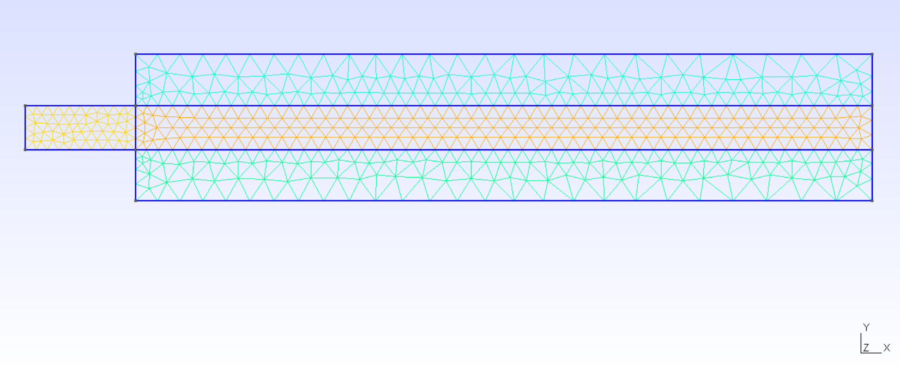
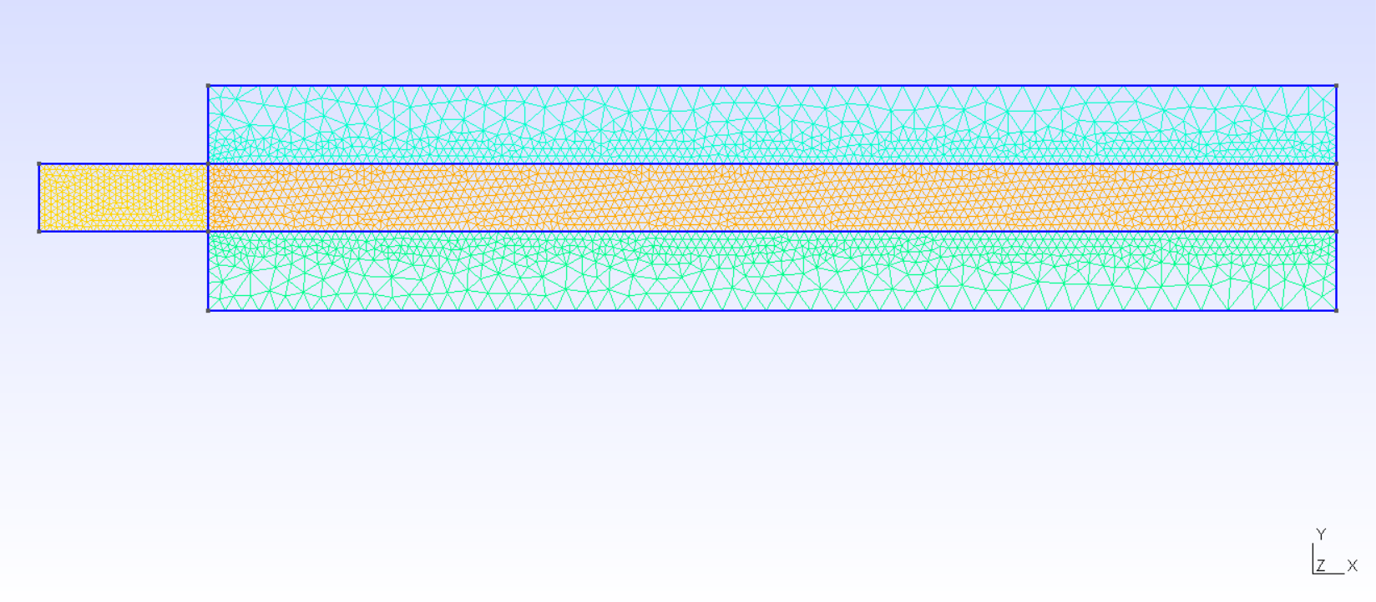
Triangular mesh COARSE (1200 elements)

Slide 5
Triangular mesh DEFAULT (6000)

Slide 6
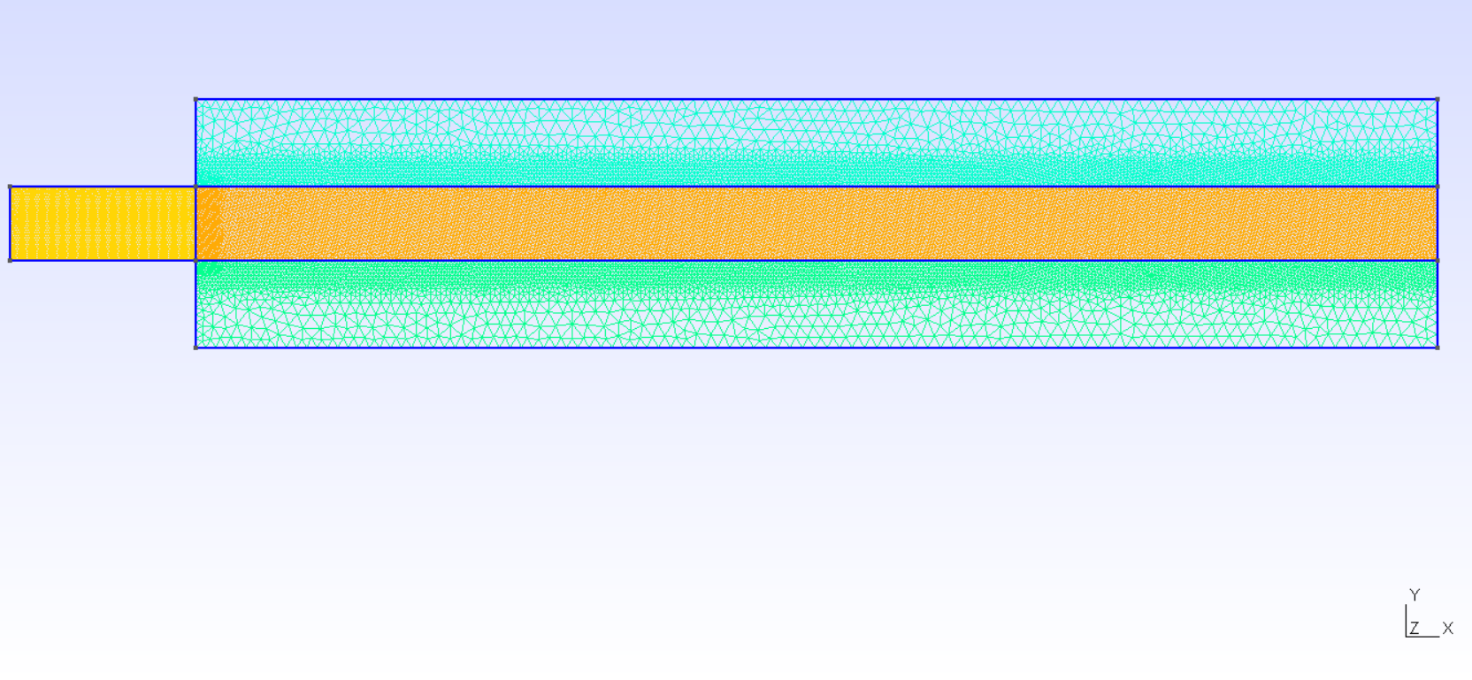
Triangular mesh FINE (38000)

Slide 7
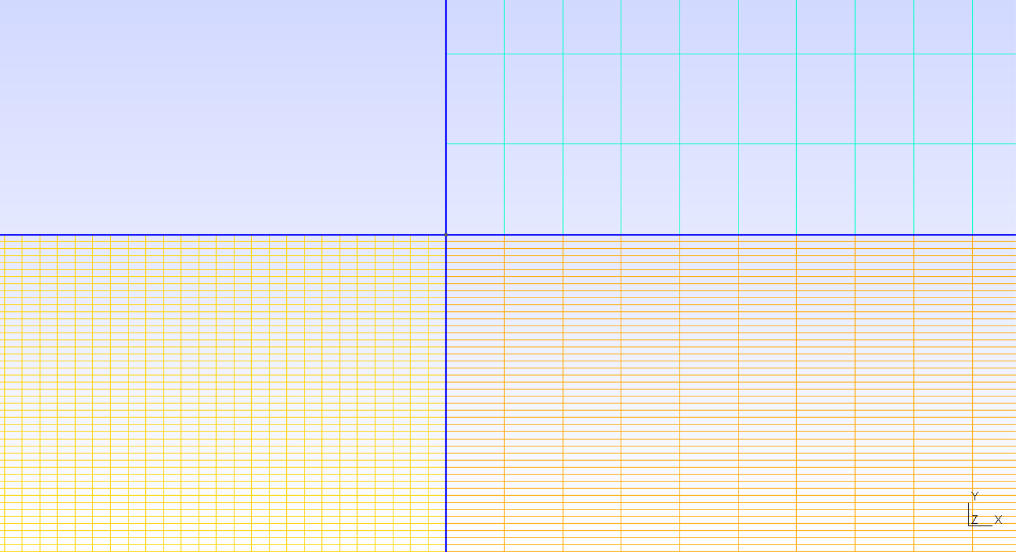

Slide 8
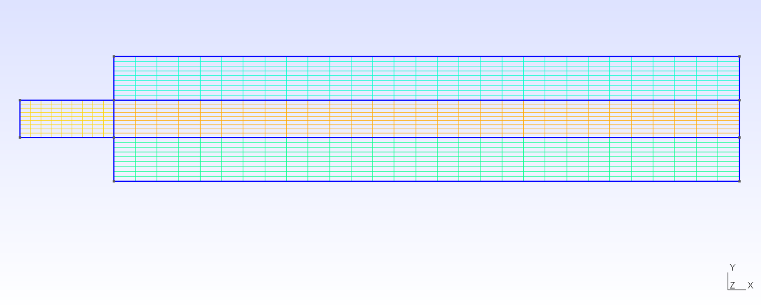
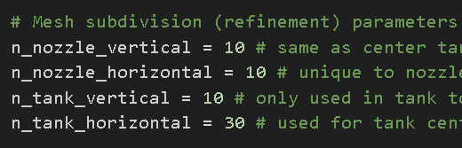
Quad mesh COARSE (1000 elements)

Slide 9
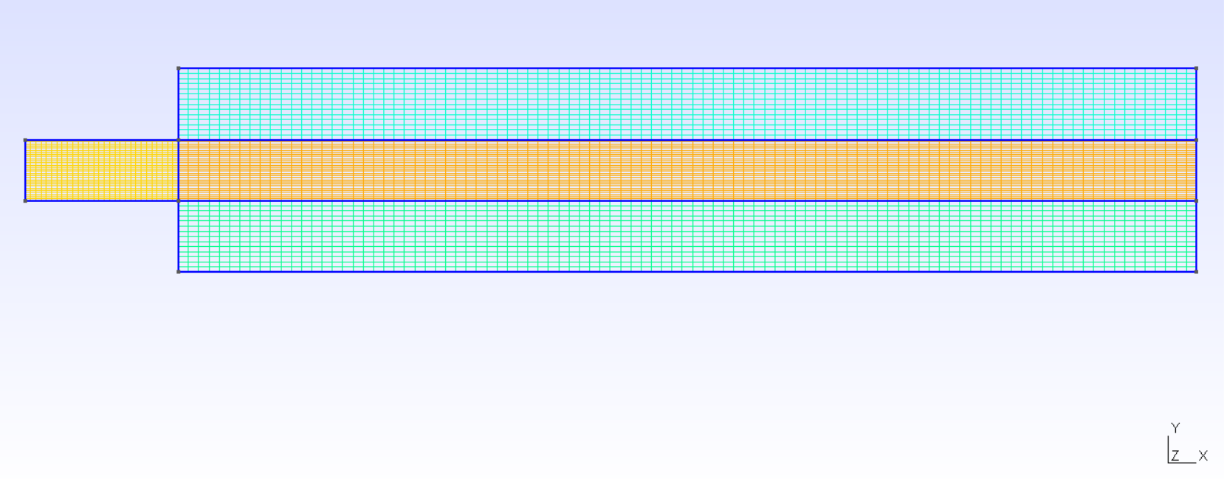
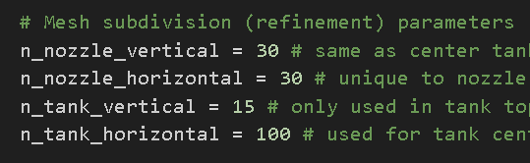
Quad mesh DEFAULT (7000 elements)

Slide 10
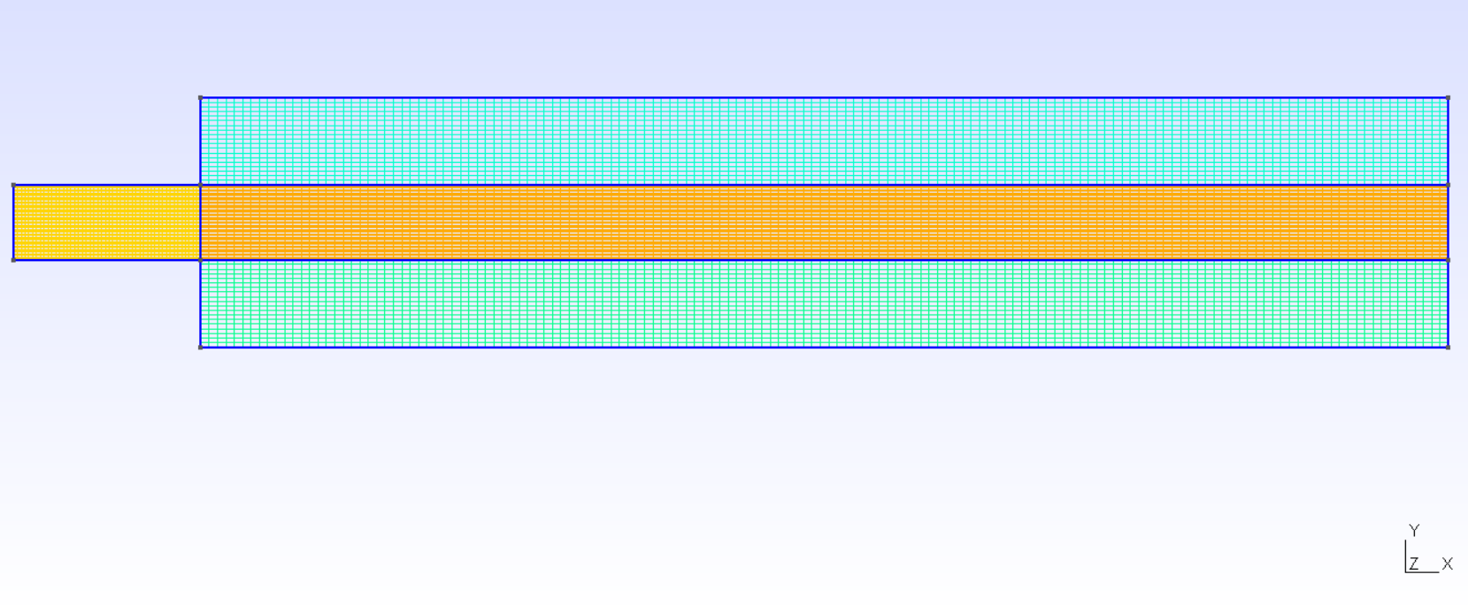
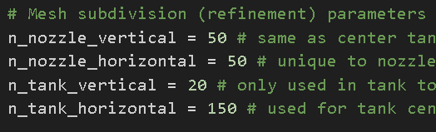
Quad mesh FINE (16000 elements)

Slide 11
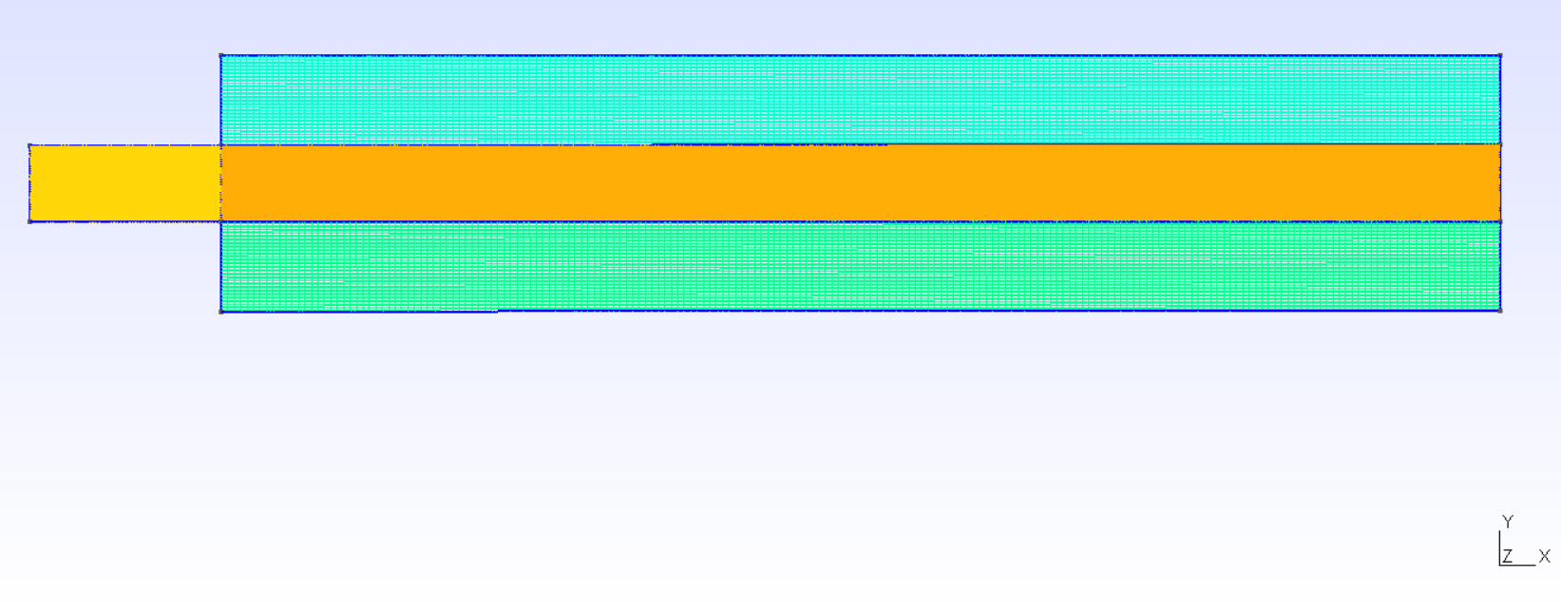
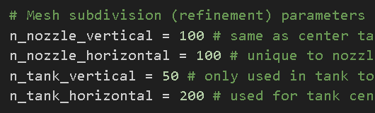
Quad mesh VERY FINE (50000 elements)

Slide 12
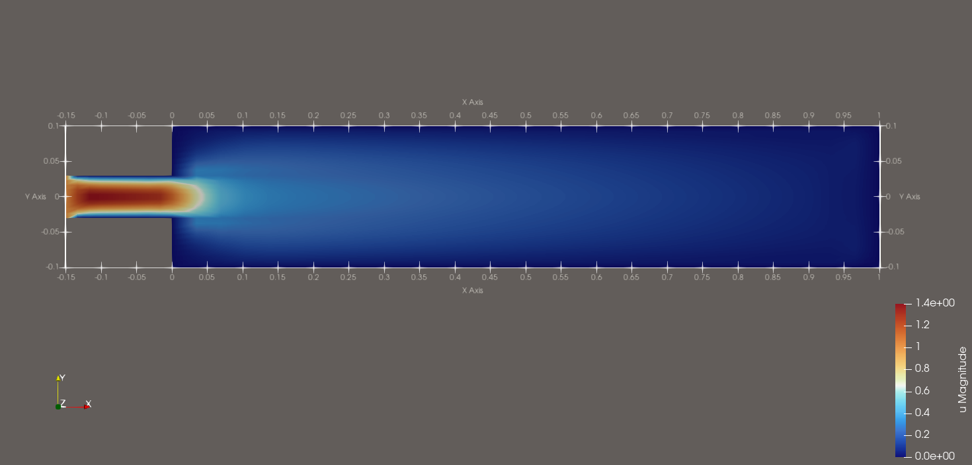
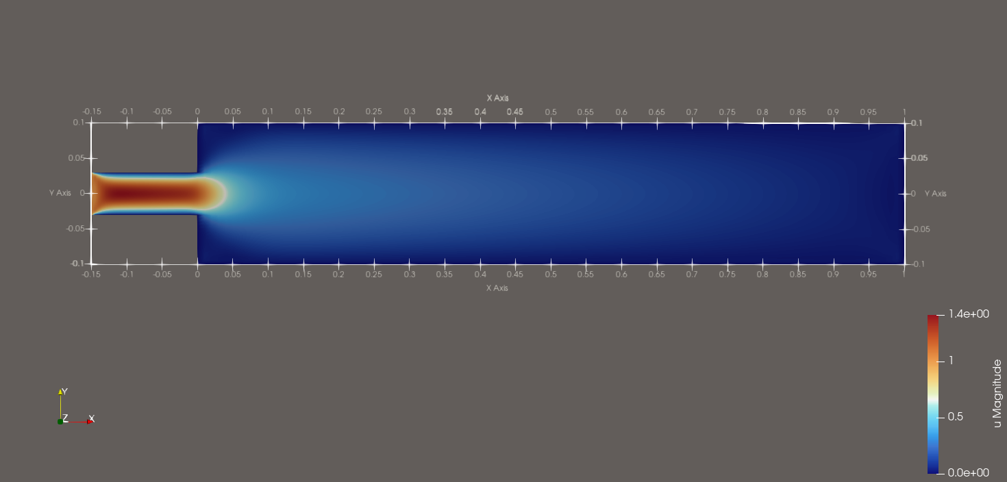
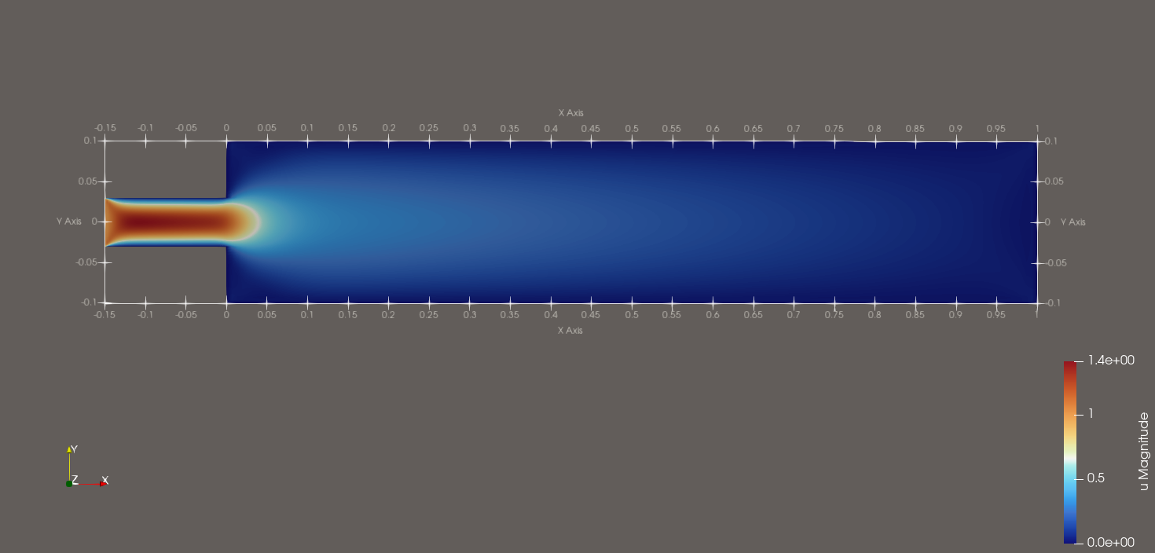

Slide 13
Coarse Quad

Slide 14
Default Quad

Slide 15
Fine Quad

Slide 16
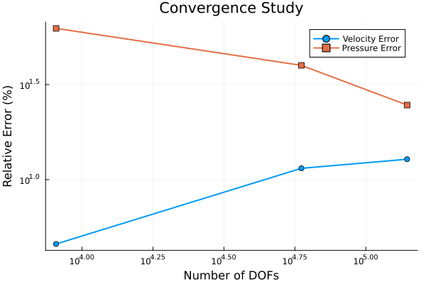

Slide 17
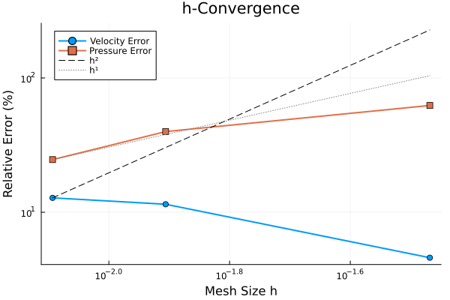

Slide 18
Next Week…
3D tank ferrite Triangles
3D tank ferrite Quadtrilaterals
Understand SubDofHandler
Apply BC to the center line somehow

