Slide 1

23MNG336 - OPERATIONS RESEARCH | FINAL REVIEW
Optimization of Semiconductor Supply Chain Networks
School of Artificial Intelligence
Amrita Vishwa Vidyapeetham, Coimbatore
TEAM AA06
Aksaya Kanthan K S
[CB.AI.U4AID23003]
Kiruthik Nandhan Murthi
[CB.AI.U4AID23018]
Manasa V
[CB.AI.U4AID23022]
Rithvik Rajesh
[CB.AI.U4AID23032]
Optimization of Semiconductor Supply Chain Networks | 1

Slide 2
INTRODUCTION
A global microchip producer must fulfil thousands of customer orders through its outbound logistics network.
Each order can be routed through several warehouses, origin ports and transportation carriers.
Every warehouse has limited daily capacity, a restricted product range and customer-specific restrictions.
Transportation options differ in cost, weight-based pricing, service level and mode.
This project finds cost-effective, feasible logistics decisions that satisfy all customer demand and every operational constraint.
Optimization of Semiconductor Supply Chain Networks | 2

Slide 3
PROBLEM STATEMENT
Every order must be assigned exactly one warehouse, one origin port and one carrier.
The assignment must respect warehouse capacity, product availability, customer restrictions and port connectivity.
The historical dataset records what was done, not what was optimal: almost all volume sits on one warehouse, one port and one carrier.
With 19 warehouses, 11 ports and 9 carriers an order can have hundreds of feasible routes, so manual selection is not practical.
Problem to Address: How can the warehouse, origin port and carrier of every order be chosen so that total logistics cost is minimised while every operational constraint is satisfied?
Optimization of Semiconductor Supply Chain Networks | 3

Slide 4
OBJECTIVES
Network Profiling: Analyse the historical outbound logistics dataset and profile the existing network.
Feasible Routing: Identify the feasible warehouse - port - carrier routes available to every order.
Cost Minimisation: Formulate an integer programme that minimises total warehouse and transportation cost.
Cost vs Delivery Time: Use goal programming to balance logistics cost against delivery time.
Robustness: Test the solution through sensitivity and what-if analysis.
Decision Support: Deliver an interactive web interface for single-order and bulk-order planning.
Optimization of Semiconductor Supply Chain Networks | 4

Slide 5
DATASET DETAILS
Supply Chain Logistics Problem Dataset
Source: Brunel University London (Kaggle)
Scope: one month of outbound orders of a global microchip producer
Structure: 7 related tables
Demand: 9,215 orders, 46 customers, 772 products
Network: 19 warehouses, 11 origin ports, 1 destination port
Freight: 9 carriers, 3 service levels (DTD, DTP, CRF), air and ground modes
DATASET TABLE | ROWS | WHAT IT DESCRIBES
OrderList | 9,215 | Customer demand: weight, service level, dates
FreightRates | 1,540 | Carrier lane rates by weight band and service
WhCosts | 19 | Storage cost per unit at each warehouse
WhCapacities | 19 | Daily order-handling capacity of each warehouse
ProductsPerPlant | 2,036 | Products each warehouse is able to ship
VmiCustomers | 14 | Customers restricted to specific warehouses
PlantPorts | 22 | Warehouse to origin-port connectivity
OrderList alone cannot be optimised: the cost, feasibility and capacity information lives in the other six tables, and every join acts as a feasibility filter.
Optimization of Semiconductor Supply Chain Networks | 5

Slide 6
CONSTRAINTS IN THE NETWORK
Every order needs exactly one warehouse, origin port and carrier.
Warehouse daily capacity is limited and varies from 7 to over 1,000 orders.
Not every warehouse stocks every product (ProductsPerPlant).
Some customers may only be served by specific warehouses (VmiCustomers).
Not every warehouse is connected to every origin port (PlantPorts).
Not every carrier operates on every lane (FreightRates).
Freight cost depends on the weight band, with a minimum charge.
All orders x all routes
17.3 million raw combinations
Product and customer eligibility
Warehouse - port connectivity
Carrier lane and weight band
125,887 feasible routes
input to the optimisation models
Narrowing the solution space before optimisation
Optimization of Semiconductor Supply Chain Networks | 6

Slide 7
PROPOSED METHODOLOGY
Workbook Parsing
seven dataset tables
Feasible Route Generation
joins act as filters
Pricing and Pruning
weight bands, minimum charge
Planning Horizon Check
Maximum Flow
Decision Support System
web interface
Sensitivity and What-If
re-solve perturbed models
Model 2: Cost vs Time
Goal Programming
Model 1: Minimum Cost
Integer Programming
Costs, capacities and transit times are taken directly from the dataset, not assumed.
Both models are solved exactly with the HiGHS solver over a 7-day planning horizon.
Optimization of Semiconductor Supply Chain Networks | 7

Slide 8
OPTIMISATION FORMULATION: MODEL 1
Minimum-cost logistics assignment (Integer Programming): choose the warehouse, origin port and carrier of every order so that total logistics cost is minimised.
Decision variable
Subject to
x(o,w,p,c) = 1 if order o ships from warehouse w
through port p on carrier c, else 0
CONSTRAINT | MATHEMATICAL STATEMENT
Order assignment | Σ x(o,w,p,c) = 1 for every order o
Warehouse capacity | orders at w ≤ H × daily capacity of w, H = 7
Product eligibility | x = 0 unless w stocks the ordered product
Customer eligibility | x = 0 unless w may serve that customer
Port connectivity | x = 0 unless (w, p) appears in PlantPorts
Freight availability | x = 0 unless a rate exists for the lane
Integrality | x(o,w,p,c) ∈ {0, 1}
Objective function 1
min Z = Σ [ WhCost(o,w) + Freight(o,p,c) ] · x(o,w,p,c)
summed over all feasible (o, w, p, c)
Why minimise cost?
Demand is fixed, so the only lever is the route of each order.
Warehouse cost per unit ranges from 0.37 to 2.04.
Freight = max(minimum charge, weight x band rate).
Optimization of Semiconductor Supply Chain Networks | 8

Slide 9
OR MODEL 1: MINIMUM-COST ASSIGNMENT
Planning horizon check (Maximum Flow)
Implementation pipeline
9,215 Orders
one unit of flow each
STEP | WHAT IT DOES
Feasibility filters | Stock, VMI, port links and lanes remove infeasible routes
Weight-band pricing | Freight = max(minimum charge, weight x rate)
Dominance pruning | Keep the cheapest route per order and warehouse
Horizon check | Max-flow test fixes the horizon at H = 7 days
Model build | Binary IP: one row per order, one per warehouse
HiGHS solve | Branch-and-bound to a 0.1% gap in about 0.5 s
19 Warehouses
capacity = H x daily limit
H = 7 Days
smallest horizon with full flow
Total capacity alone suggests 2 days, but 7,387 orders have only one eligible warehouse.
PLANT03 is the only option for 6,868 orders at 1,013 per day, forcing 7 days.
125,887 feasible routes are generated; pruning leaves the optimum unchanged.
Optimization of Semiconductor Supply Chain Networks | 9

Slide 10
MODEL 1: RESULTS
$15,517,994
Optimal total cost, all 9,215 orders
$15,489,878
Warehouse cost (99.8% of total)
$28,116
Transportation cost (0.2% of total)
Status optimal over a 7-day planning horizon; every constraint met.
11 of 19 warehouses, 7 of 11 ports and 5 of 9 carriers are used.
Carriers V444_0 and V444_1 lead; average transit is 2.64 days.
Low-cost warehouses take every order they are eligible for.
PLANT03 is the only binding capacity constraint.
WAREHOUSE | ORDERS | 7-DAY CAPACITY | UTILISATION
PLANT03 | 7,091 | 7,091 | 100% (binding)
PLANT02 | 640 | 966 | 66.3%
PLANT04 | 387 | 3,878 | 10.0%
Other 8 warehouses | 1,097 | - | all have slack
Warehouse loads in the minimum-cost plan. PLANT03 is the sole eligible warehouse for 6,868 orders, which is why the plan needs 7 days.
Optimization of Semiconductor Supply Chain Networks | 10

Slide 11
OPTIMISATION FORMULATION: MODEL 2
Cost versus delivery time (Weighted Goal Programming): Model 1 ignores time, yet transit in the freight data ranges from 0 to 14 days. Model 2 balances both objectives.
Goals
Why minimise the deviations?
Goal 1: total cost ≤ C* = Model 1 optimum + budget (5%)
Goal 2: average transit of DTD/DTP orders ≤ T* (1 day)
A plan may be least-cost yet slow: the Model 1 plan averages 2.64 days in transit.
Only over-achievement is penalised; meeting a goal costs nothing.
Dividing by the targets lets money and days be weighed together.
All Model 1 constraints (assignment, capacity, eligibility) still apply.
The user sets C*, T*, w1 and w2; HiGHS solves it in 2 to 3 s.
Deviation variables
d1+ , d1- = cost above / below the target C*
d2+ , d2- = transit days above / below T* × N
Objective function 2
min Z = w1 · (d1+ / C*) + w2 · (d2+ / (T* × N))
plus a small cost tie-break
Optimization of Semiconductor Supply Chain Networks | 11

Slide 12
MODEL 2: RESULTS
With the default goals (budget +5%, target 1 day, equal weights) both goals are met: average transit falls from 2.64 days to 1.00 day for only +0.22% cost.
TRANSIT TARGET | ACHIEVED TRANSIT | TOTAL COST | COST VS MODEL 1
0.25 days | 0.25 days | $15,694,514 | +1.14%
0.50 days | 0.50 days | $15,633,001 | +0.74%
1.00 day | 1.00 day | $15,551,482 | +0.22%
2.00 days | 2.00 days | $15,521,442 | +0.02%
3.50 days | 2.64 days | $15,517,994 | 0.00% (minimum cost)
The trade-off curve is convex: every extra half-day of speed costs more than the last.
Halving transit to about 1 day costs 0.22%; reaching 0.25 days costs 1.14%.
Optimization of Semiconductor Supply Chain Networks | 12

Slide 13
COMPARISON BETWEEN THE TWO MODELS
METRIC | MODEL 1 (MIN COST) | MODEL 2 (GOAL PROG.) | CHANGE
Total logistics cost | $15,517,994 | $15,551,482 | +0.22%
Average delivery time | 2.64 days | 1.00 day | -62%
Freight cost | $28,116 | $62,126 | +121%
Warehouses used | 11 of 19 | 11 of 19 | same
Origin ports used | 7 of 11 | 7 of 11 | same
Carriers used | 5 of 9 | 5 of 9 | same
Planning horizon | 7 days | 7 days | same
Faster delivery is bought almost entirely with freight, which is a tiny share of total cost.
Both plans spread volume wider than the historical plan (7 warehouses, 3 ports, 3 carriers).
Optimization of Semiconductor Supply Chain Networks | 13

Slide 14
SENSITIVITY ANALYSIS
Each scenario perturbs one parameter and re-solves Model 1 from scratch with HiGHS.
SCENARIO | PARAMETER CHANGE | OPTIMAL COST | CHANGE VS BASE
Base | No change, reference solution | $15,517,994 | reference
S1 | Warehouse capacity -20% | $15,517,238 | -0.005% (9 days)
S2 | Warehouse capacity +20% | $15,517,099 | -0.006% (6 days)
S3 | Freight rates +20% | $15,523,617 | +0.04%
S4 | Warehouse cost +10% | $17,066,981 | +9.98%
S5 | Demand volume +20% | $18,617,042 | +19.97%
Demand and warehouse cost drive total cost; freight (0.2% of cost) barely matters.
Capacity changes move the planning horizon (9 days at -20%, 6 days at +20%), not the cost.
11 preset scenarios per model, plus custom what-if runs on any warehouse or carrier.
Optimization of Semiconductor Supply Chain Networks | 14

Slide 15
SYSTEM ARCHITECTURE AND TOOLS
Logistics Manager
TOOL | PURPOSE
Next.js 16 + React 19 | Tabs, controls and result tables
TypeScript + SheetJS | Parsing and joining the seven tables
TypeScript model builder | Building the IP and GP models
HiGHS (WebAssembly) | Branch-and-bound solver
Recharts + custom SVG | Charts and route network view
Prisma / SQLite | Solve APIs and stored scenarios
Web Interface
Next.js + React
Workbook Parsing and Route Generation
Optimisation Engine (HiGHS)
Integer Programme | Goal Programme | What-If
Results, Route Planner, Bulk Upload and Analytics
Architecture of the decision support system
Optimization of Semiconductor Supply Chain Networks | 15

Slide 16
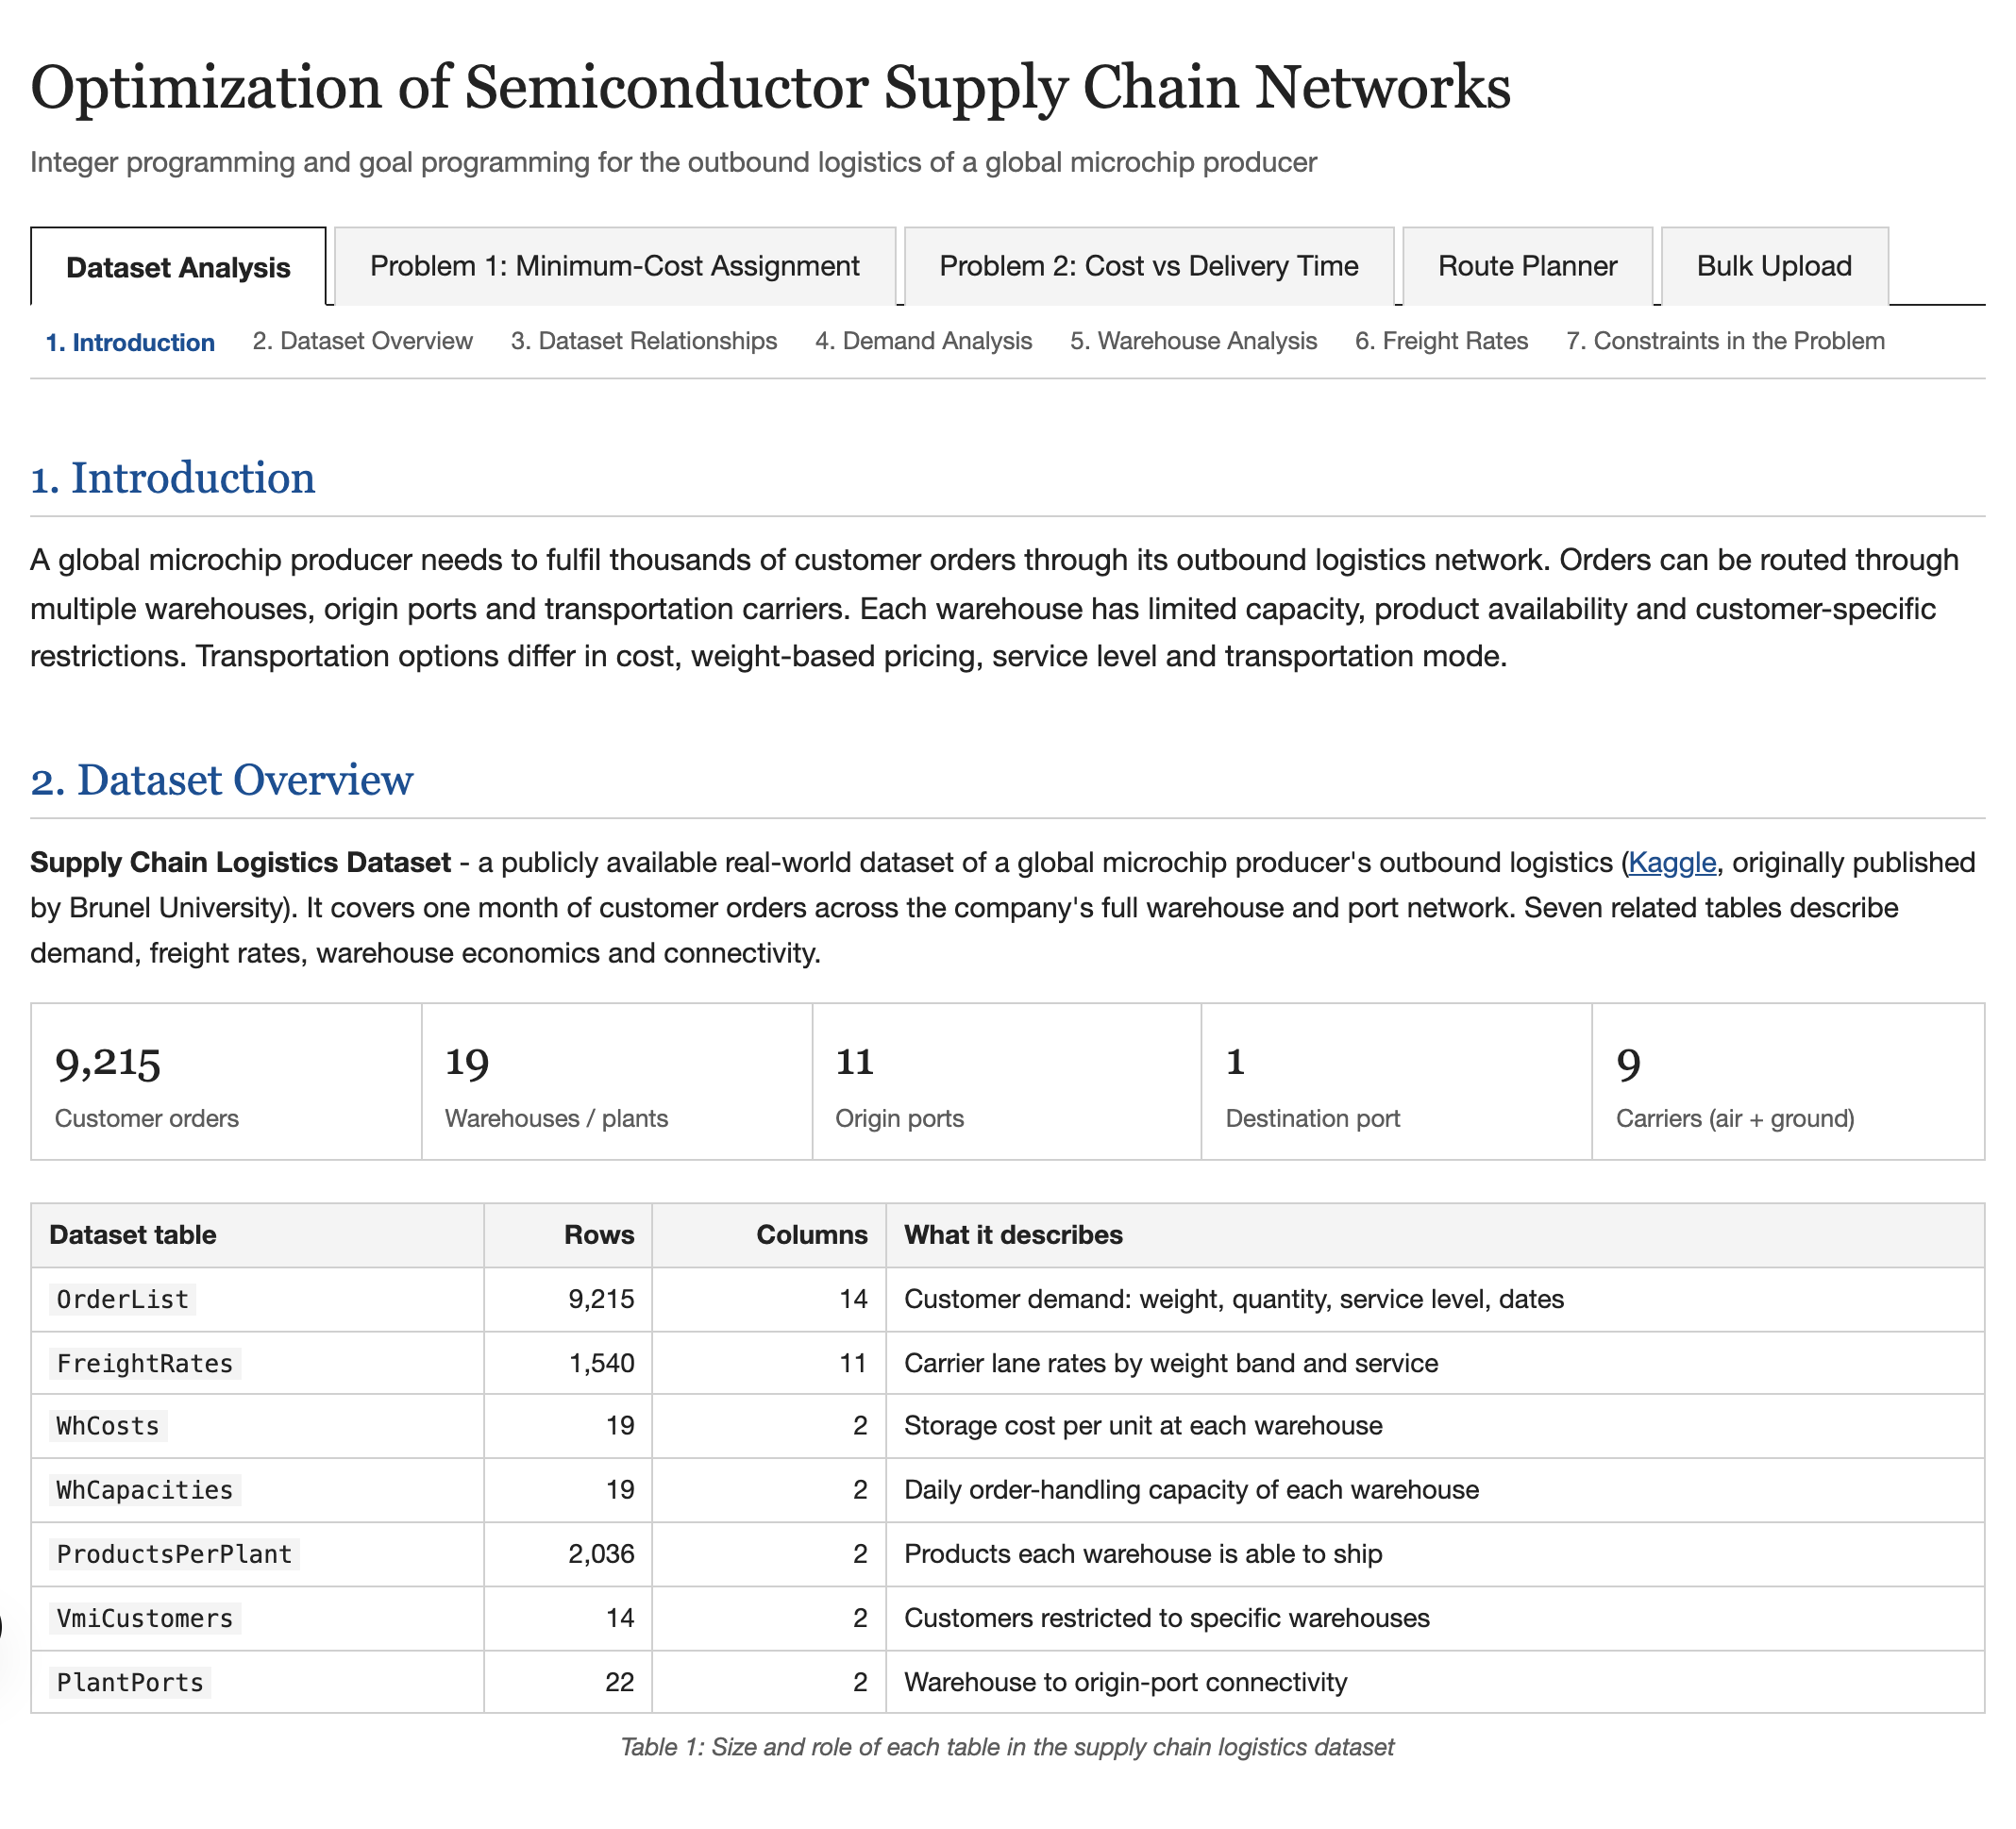
RESULTS: DATASET ANALYSIS
Five tabs: Dataset Analysis, Model 1, Model 2, Route Planner and Bulk Upload.
A section bar under the tabs jumps to any part of the page.
All statistics are computed live from the uploaded workbook.
Dataset Analysis tab with the overview and table summary
Optimization of Semiconductor Supply Chain Networks | 16

Slide 17
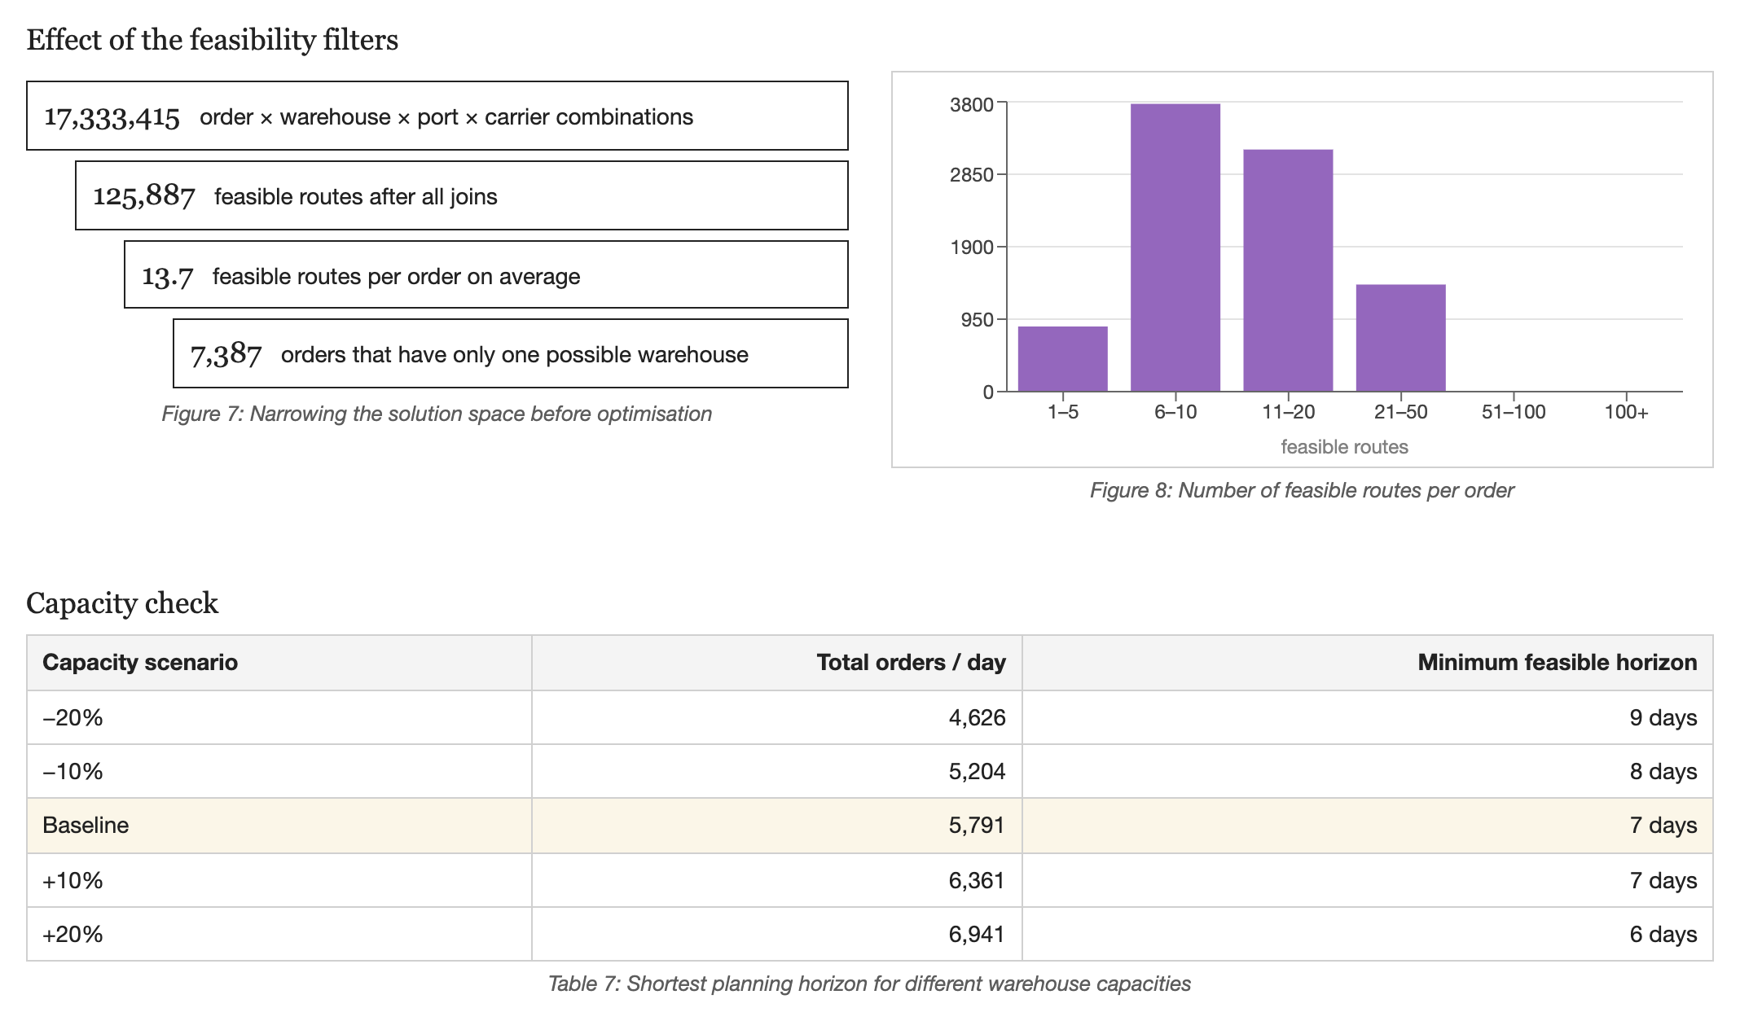
RESULTS: FEASIBILITY AND HORIZON
17.3 million raw combinations shrink to 125,887 feasible routes.
A max-flow test shows every order fits within 7 days at the earliest.
PLANT03 is the bottleneck that sets the horizon.
Narrowing the solution space and the capacity check
Optimization of Semiconductor Supply Chain Networks | 17

Slide 18
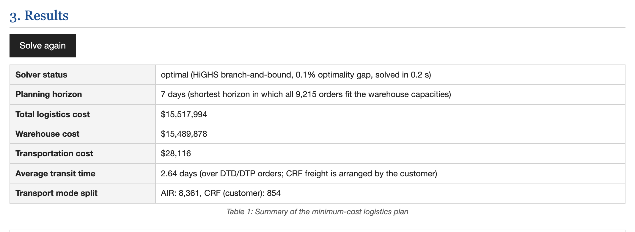
MODEL 1: RESULT SUMMARY
Result summary returned by the HiGHS solver
Optimal plan for all 9,215 orders: total cost $15,517,994.
Warehouse cost is 99.8% of the total, so warehouse choice drives cost.
Optimization of Semiconductor Supply Chain Networks | 18

Slide 19
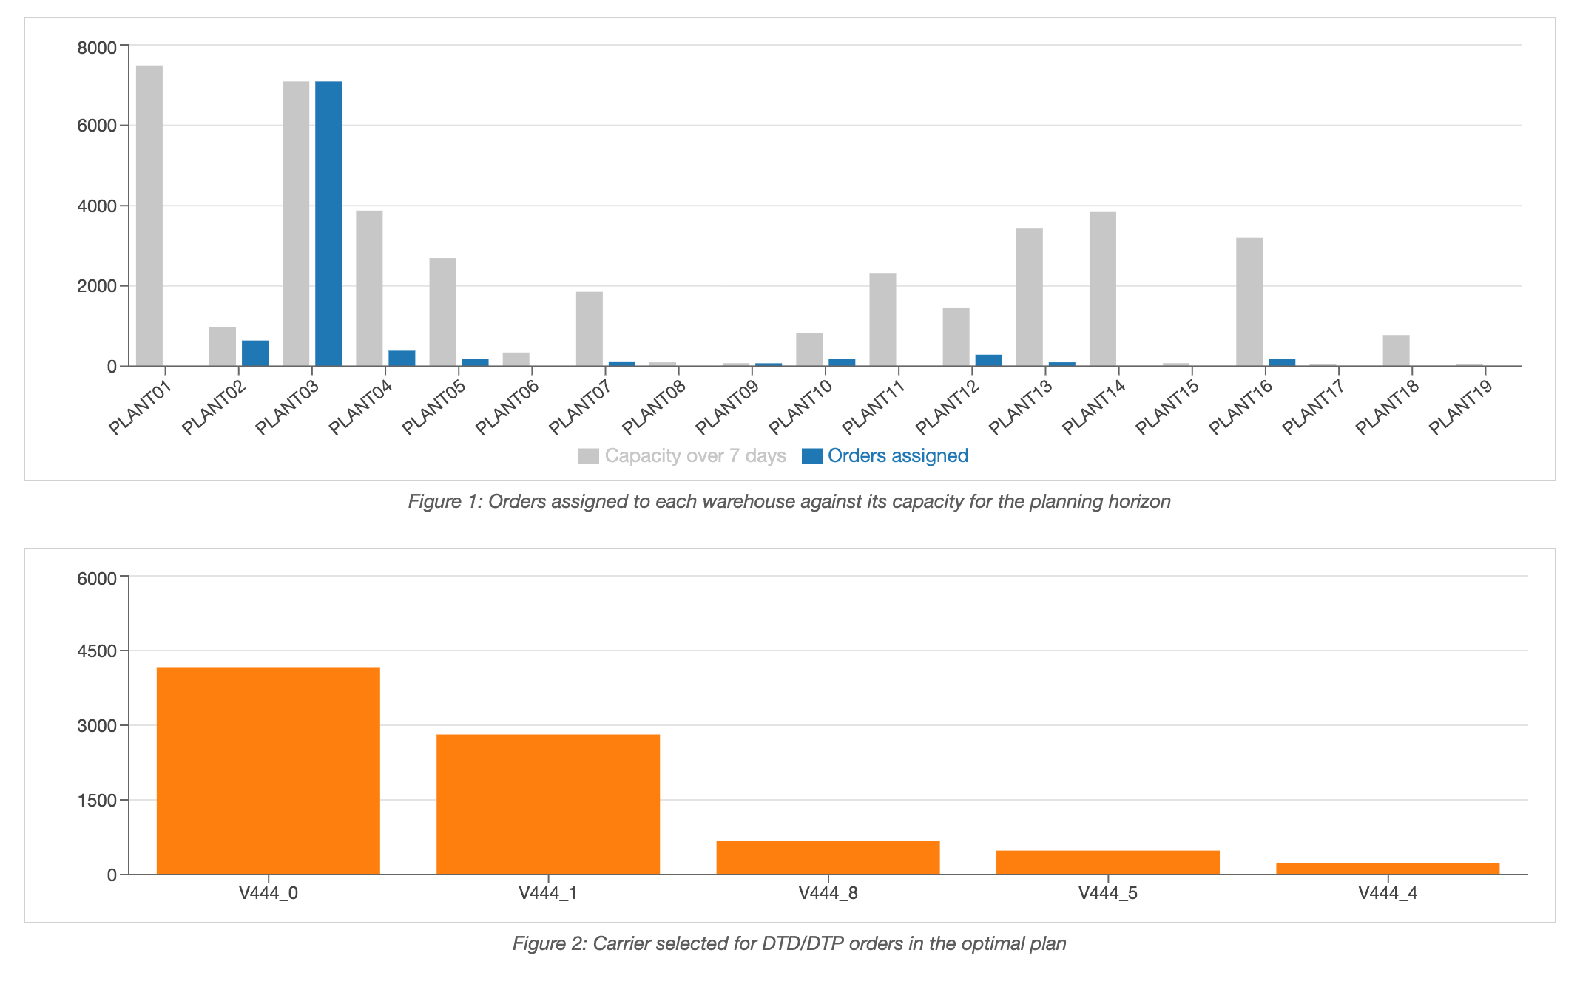
MODEL 1: WAREHOUSE LOAD AND CARRIERS
PLANT03 is filled to its 7-day capacity; every other warehouse has slack.
V444_0 and V444_1 carry most of the DTD/DTP orders.
Only 5 of the 9 carriers are needed.
Orders per warehouse against 7-day capacity, and carriers selected
Optimization of Semiconductor Supply Chain Networks | 19

Slide 20
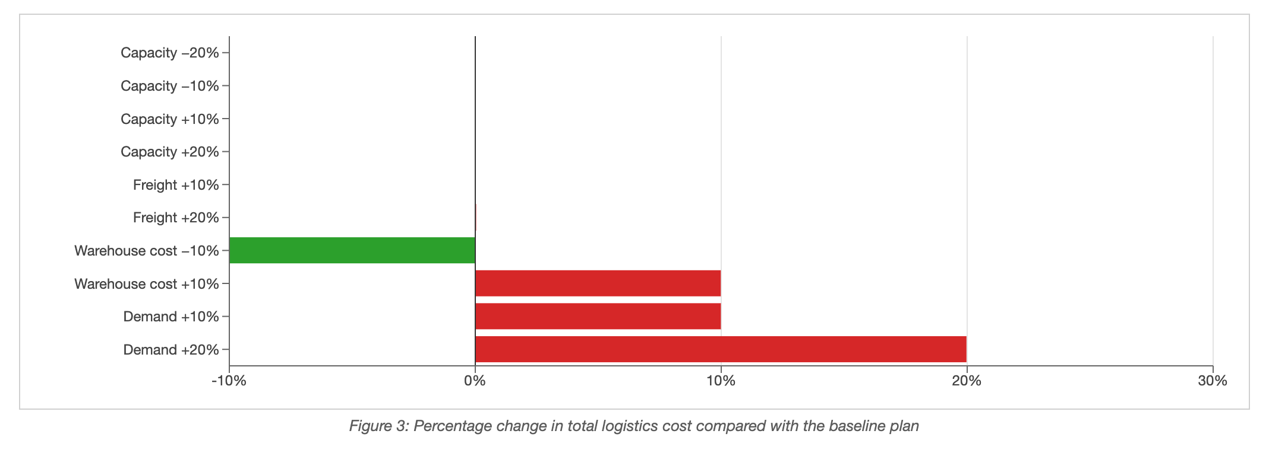
MODEL 1: SENSITIVITY
Change in total cost per scenario against the baseline plan
Demand and warehouse cost move total cost.
Freight and capacity changes barely affect it.
Capacity changes shift the horizon between 6 and 9 days.
Optimization of Semiconductor Supply Chain Networks | 20

Slide 21
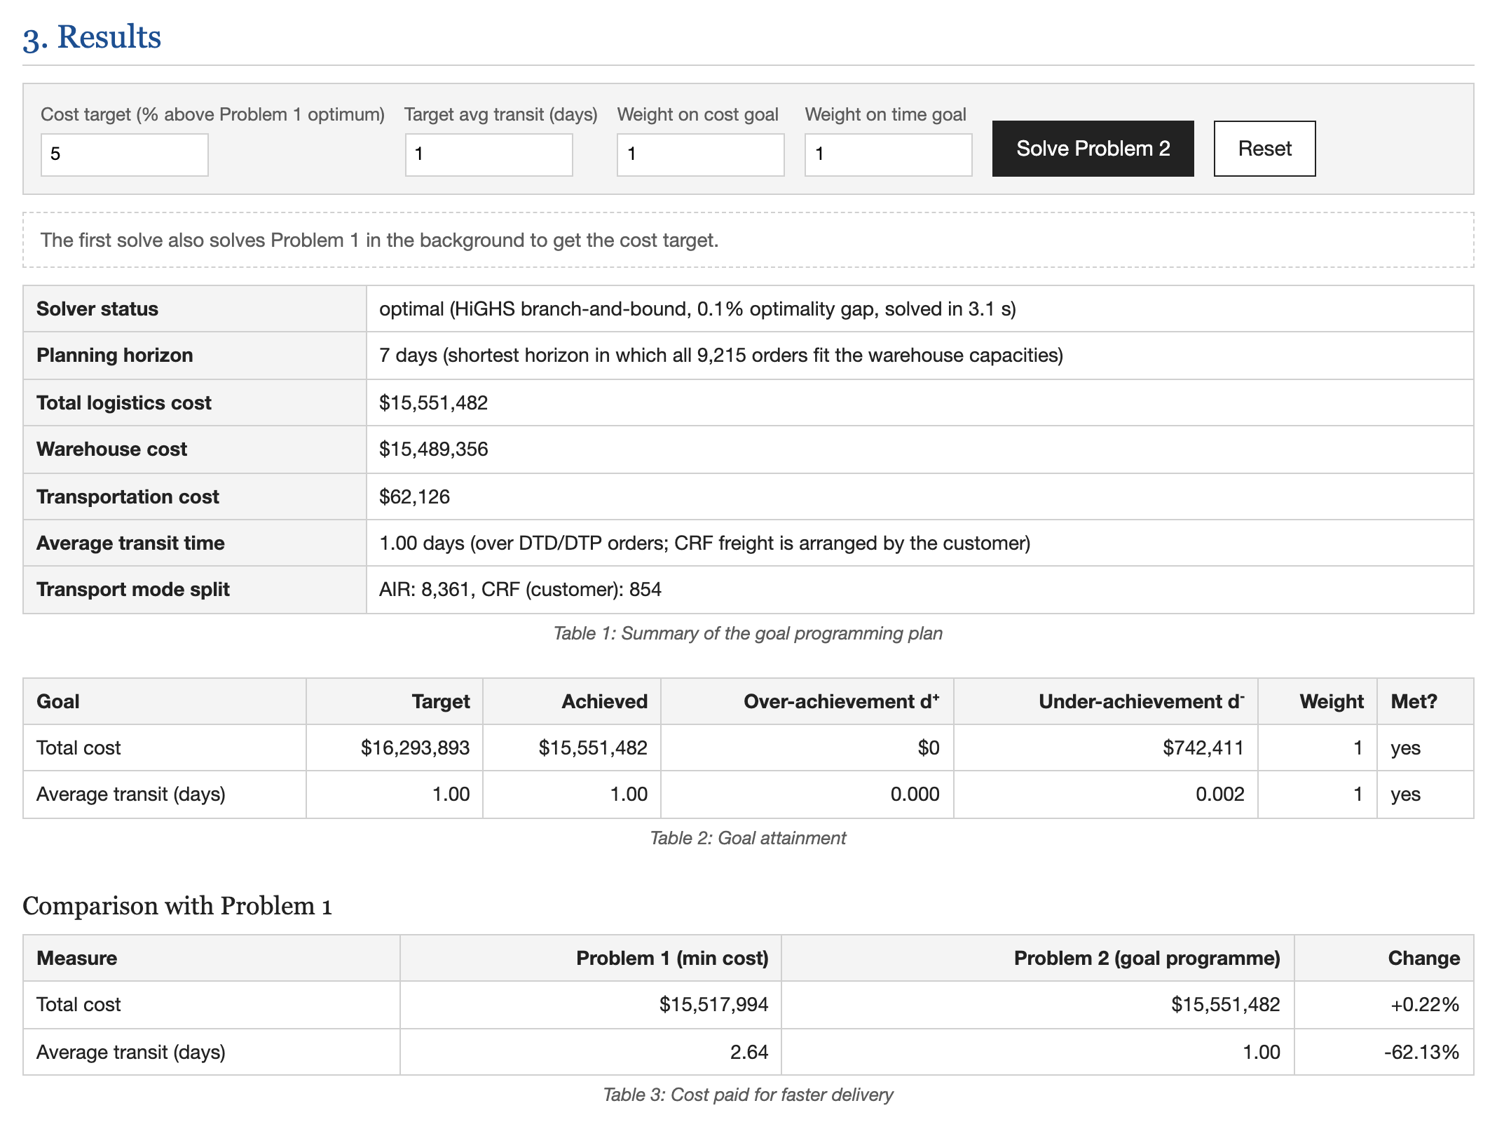
MODEL 2: GOAL ATTAINMENT
Both goals are met: average transit 1.00 day at +0.22% cost.
Targets and weights can be edited before each solve.
The plan is compared with Model 1 side by side.
Goal settings, attainment and comparison with Model 1
Optimization of Semiconductor Supply Chain Networks | 21

Slide 22
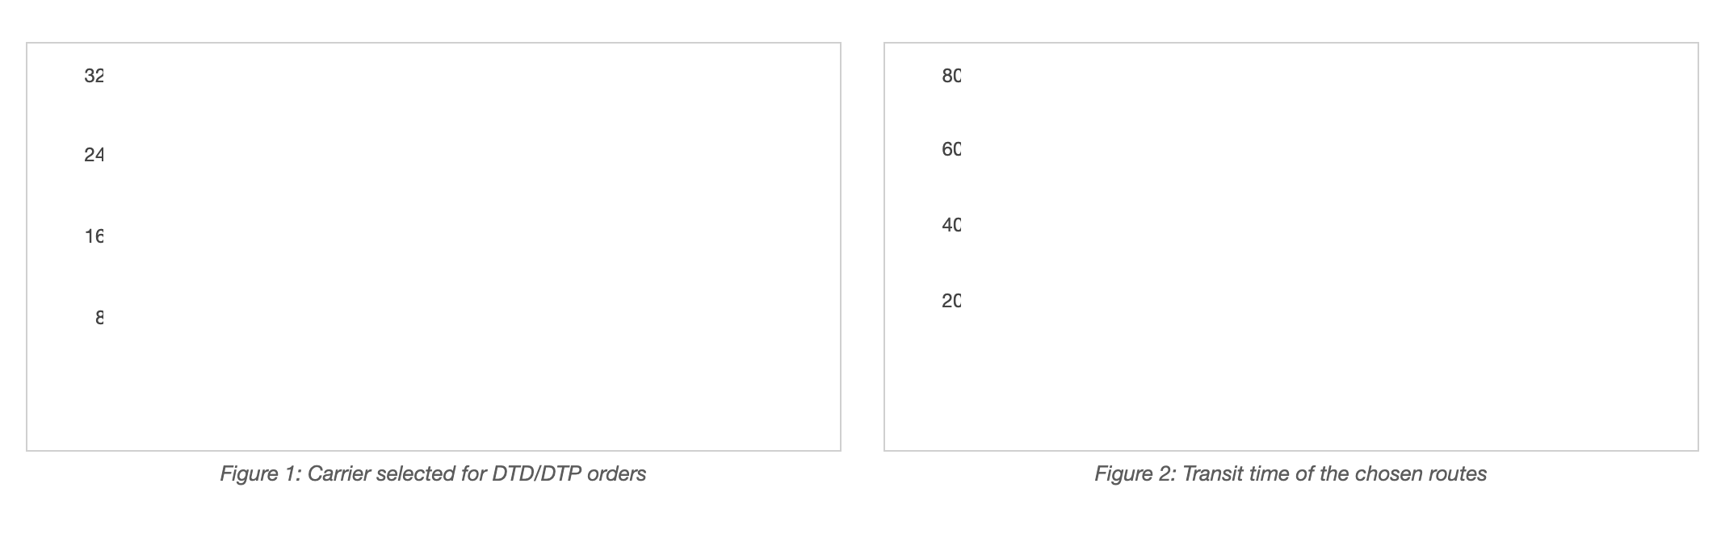
MODEL 2: CARRIER MIX AND TRANSIT TIMES
Carriers selected and transit time of the chosen routes
DTD/DTP orders now ship within 0 to 2 days.
Faster carriers V444_4 and V444_1 take over from V444_0.
Optimization of Semiconductor Supply Chain Networks | 22

Slide 23
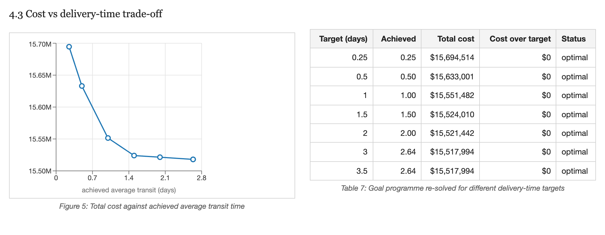
MODEL 2: COST VS DELIVERY-TIME TRADE-OFF
Total cost against achieved average transit time
Cutting average transit from 2.64 to 0.25 days raises cost by 1.14%.
The curve is convex: each further half-day costs more than the last.
Optimization of Semiconductor Supply Chain Networks | 23

Slide 24
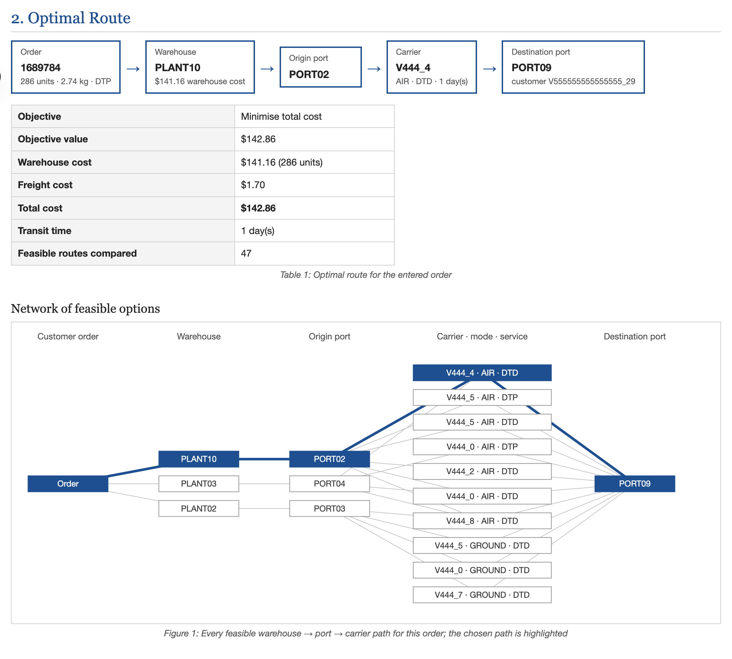
ROUTE PLANNER: OPTIMAL PATH
A single order is planned by product, customer, service level and weight.
47 feasible routes are compared for this order.
The optimal path is highlighted in blue across the network.
Optimal route and every feasible warehouse-port-carrier path
Optimization of Semiconductor Supply Chain Networks | 24

Slide 25
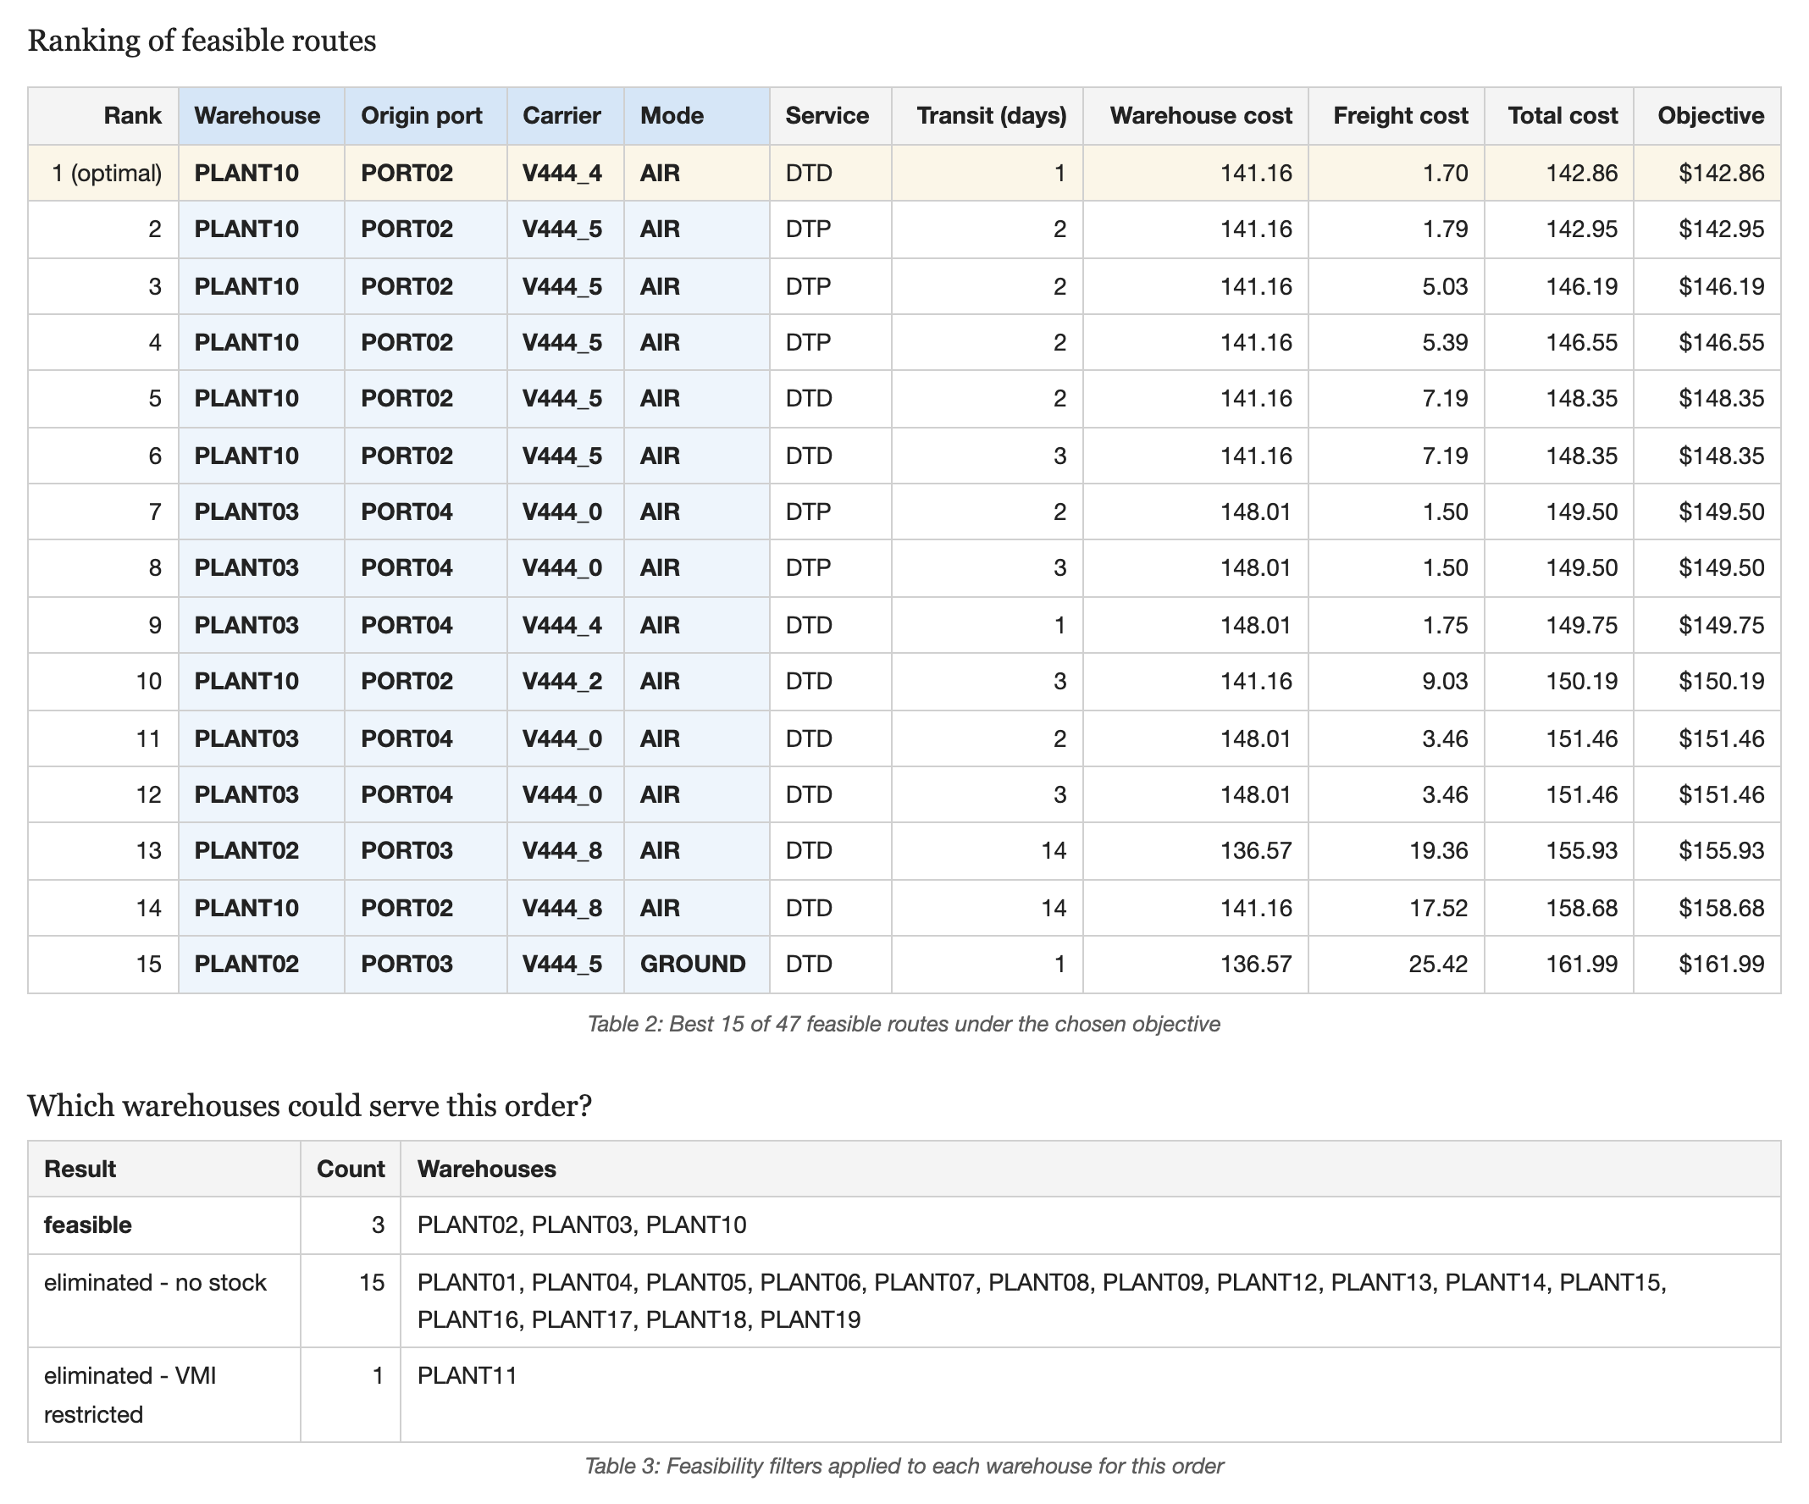
ROUTE PLANNER: RANKED ALTERNATIVES
The best 15 routes are listed with their cost and transit time.
Every eliminated warehouse is shown with the reason it was removed.
Objective: minimise cost, minimise time, or a weighted mix.
Feasible routes ranked by the objective, and filtered warehouses
Optimization of Semiconductor Supply Chain Networks | 25

Slide 26
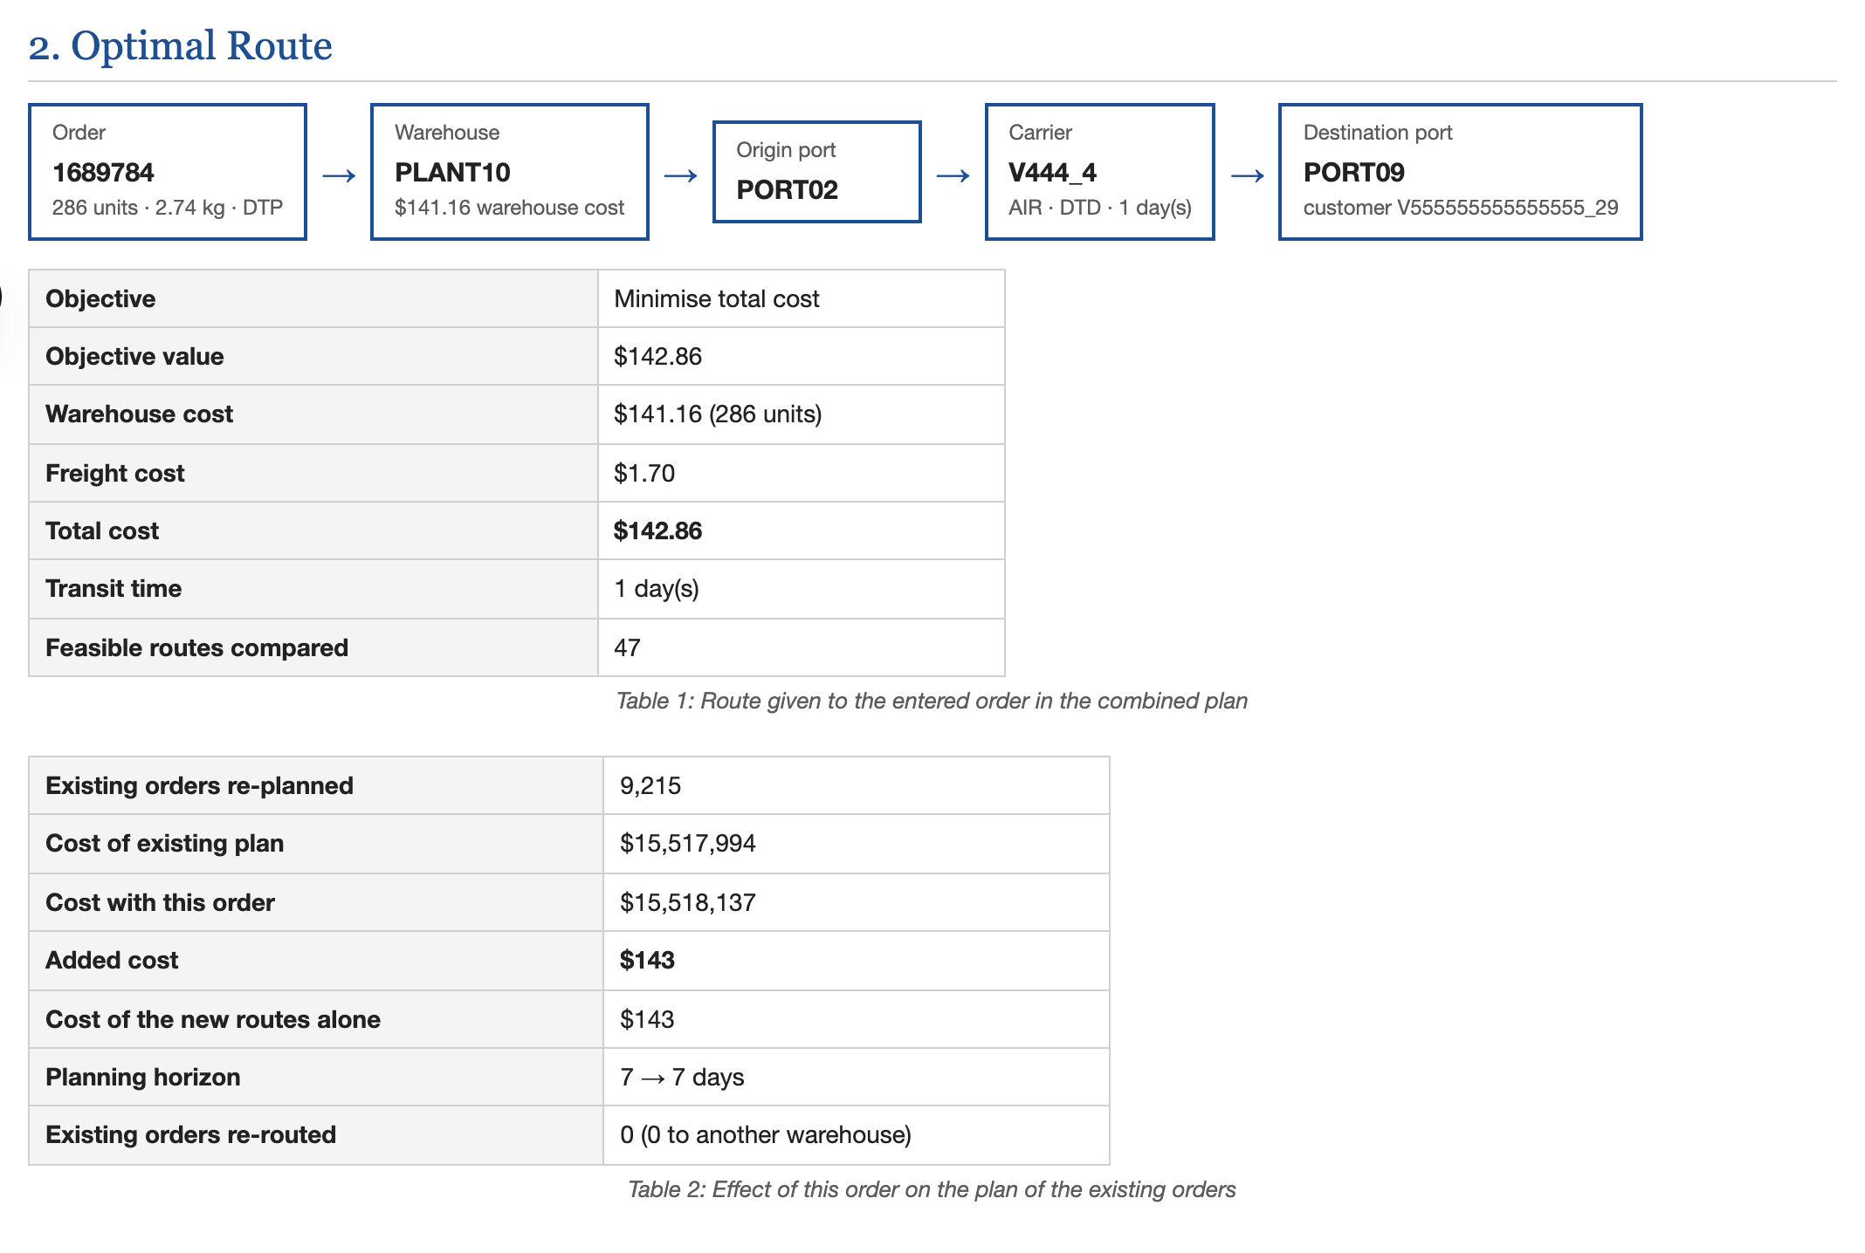
ROUTE PLANNER: WITH EXISTING ORDERS
Planning scope is a choice: the new order alone, or re-solved with all existing orders.
Here the order adds $143 to the total and no existing order has to move.
If the cheapest warehouse were full, the model would pick another route or move orders.
The same order planned together with the 9,215 existing orders
Optimization of Semiconductor Supply Chain Networks | 26

Slide 27
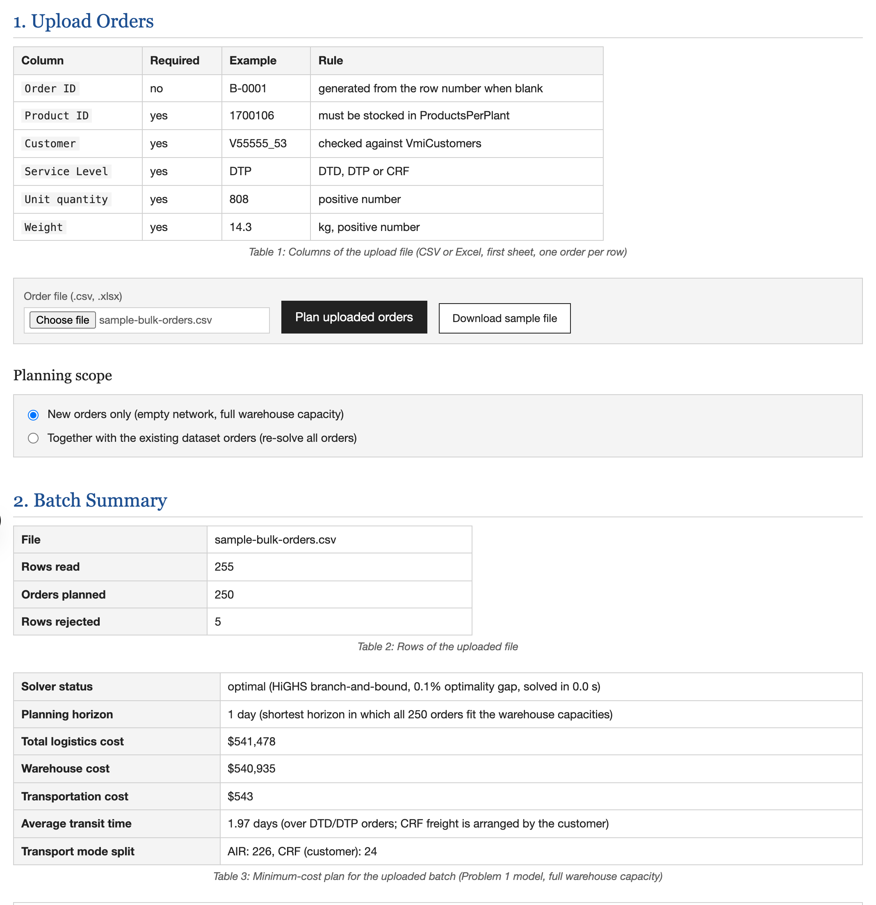
BULK UPLOAD: BATCH PLAN
A CSV or Excel batch of new orders is uploaded in one step.
Planned alone, 250 of the 255 sample rows cost $541,478 over a 1-day horizon.
The same feasibility filters and integer programme as Model 1 are used.
Uploaded order file, batch summary and minimum-cost plan
Optimization of Semiconductor Supply Chain Networks | 27

Slide 28
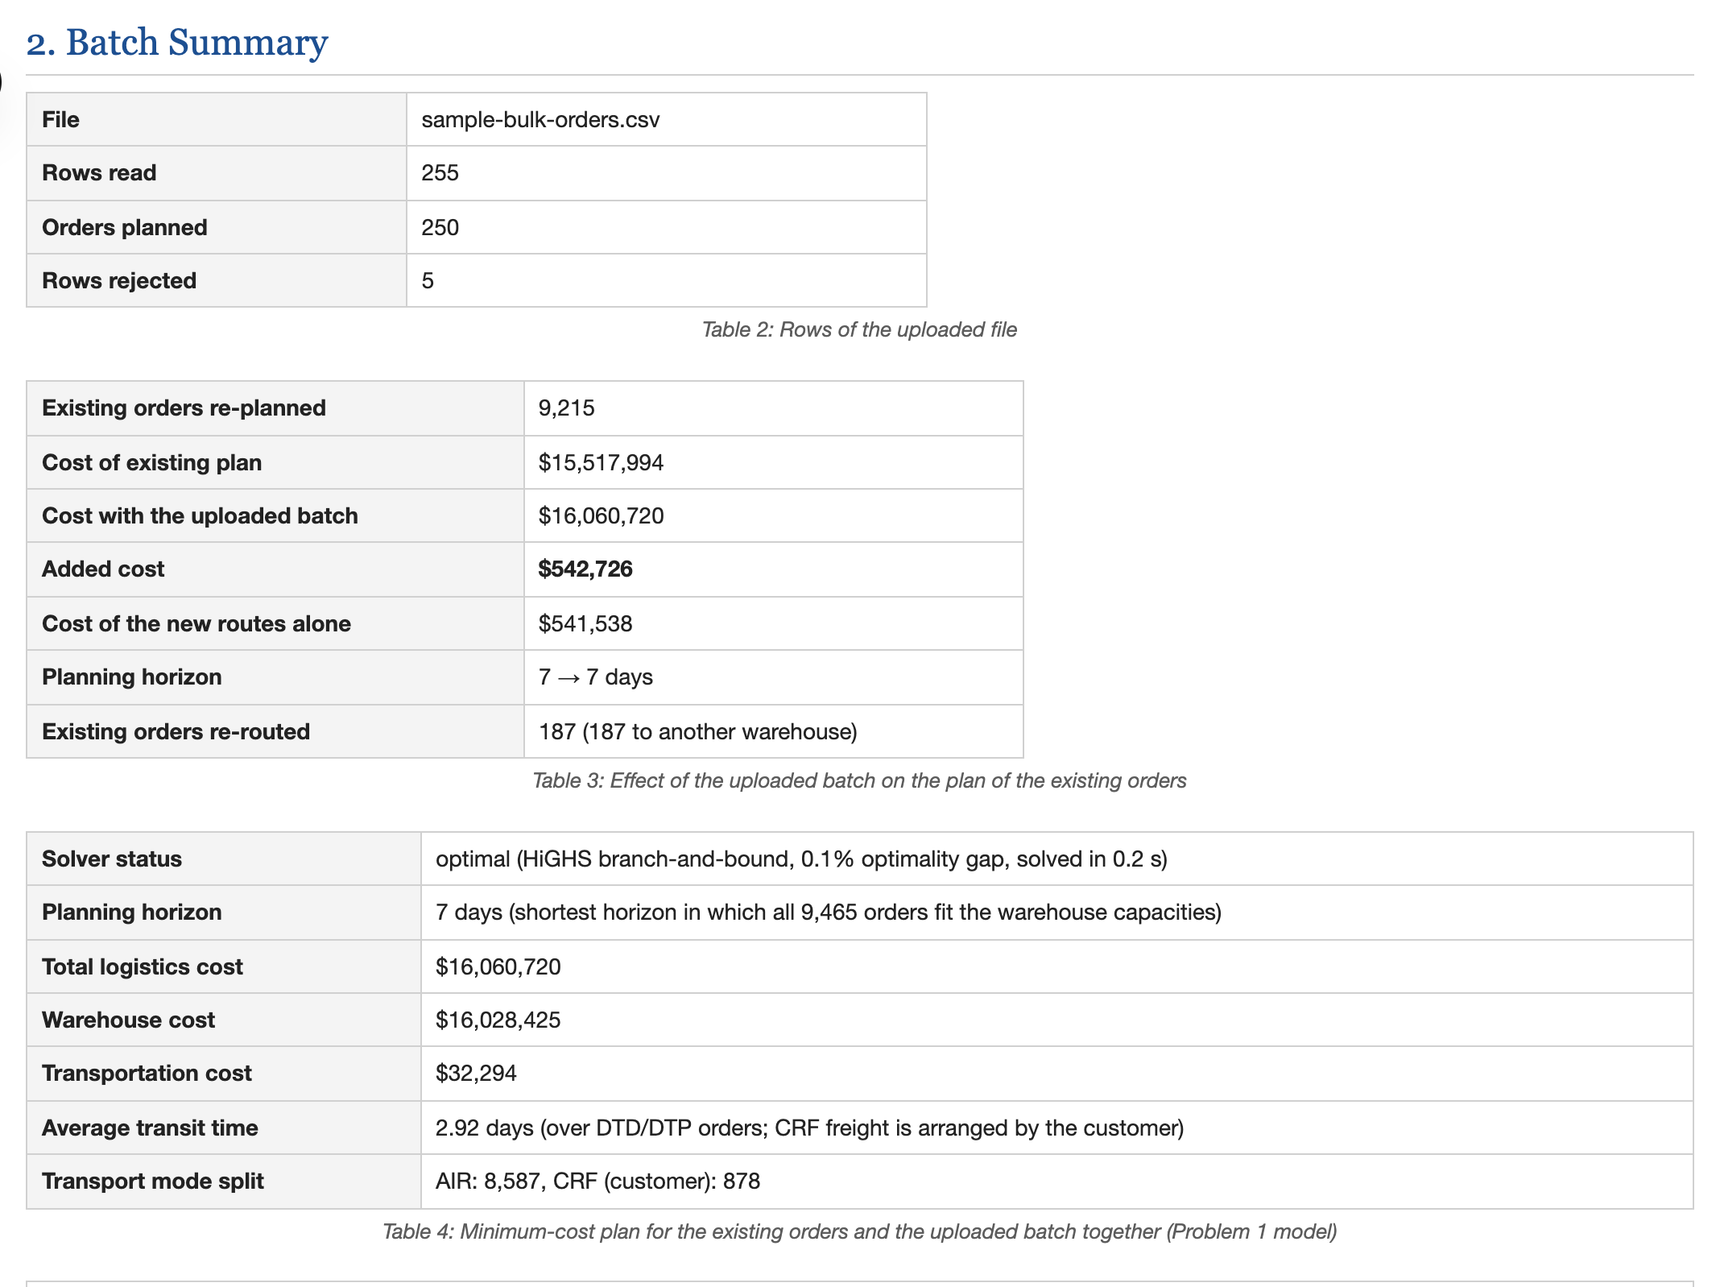
BULK UPLOAD: WITH EXISTING ORDERS
All 9,465 orders are re-solved with the Model 1 integer programme.
The batch adds $542,726, against $541,478 when planned alone.
187 existing orders move to another warehouse; the horizon stays at 7 days.
The uploaded batch re-planned together with the existing orders
Optimization of Semiconductor Supply Chain Networks | 28

Slide 29
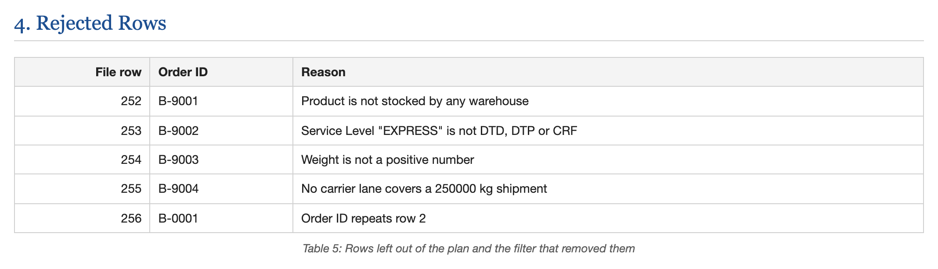
BULK UPLOAD: REJECTED ROWS
Rows left out of the plan and the filter that removed them
Rows that cannot be routed are listed with the reason, not silently dropped.
Checks cover product stock, service level, weight band and repeated order IDs.
The order-level plan can be downloaded as a CSV file.
Optimization of Semiconductor Supply Chain Networks | 29

Slide 30
BUSINESS INSIGHTS
Warehouse choice drives cost: warehouse cost is 99.8% of the total bill.
PLANT03 is the bottleneck: it alone forces the 7-day planning horizon.
Diversification keeps the plan feasible: orders are spread over 11 warehouses and 5 carriers, against 7 and 3 historically.
Faster delivery is cheap at first: a 1-day average transit costs only 0.22% more.
Demand and warehouse cost dominate: +20% demand gives +19.97% cost, while freight barely matters.
Capacity changes the horizon, not the cost: the plan stretches from 6 to 9 days.
Optimization of Semiconductor Supply Chain Networks | 30

Slide 31
CONCLUSION
Applies integer programming, maximum flow and goal programming to a real outbound logistics problem.
Uses real data for 9,215 orders, 19 warehouses, 11 ports and 9 carriers; costs, capacities and transit times are not assumed.
Delivers a minimum-cost, fully feasible plan of $15,517,994 over a 7-day horizon.
Cuts average transit from 2.64 days to 1.00 day for only +0.22% cost with goal programming.
Tests robustness with preset and custom sensitivity scenarios on capacity, cost, freight and demand.
Packages everything in a web decision-support system that solves the models in seconds.
Optimization of Semiconductor Supply Chain Networks | 31

Slide 32
FUTURE SCOPE
Facility Location: decide which of the 19 warehouses should be active at all.
Transportation Network Model: aggregate warehouse - port flows as a smaller LP with dual prices.
Shortest Path: optimise the individual route taken through the transport network.
Analytic Hierarchy Process: rank carriers on qualitative as well as quantitative criteria.
Shipment Consolidation: add discrete decisions that combine orders into shared shipments.
Nonlinear Programming: handle volume discounts and other nonlinear cost relationships.
Optimization of Semiconductor Supply Chain Networks | 32

Slide 33
REFERENCES
[1] Brunel University London, "Supply Chain Logistics Problem Dataset," Kaggle.
[2] H. A. Taha, Operations Research: An Introduction, 10th ed., Pearson, 2017.
[3] F. S. Hillier and G. J. Lieberman, Introduction to Operations Research, 10th ed., McGraw-Hill, 2015.
[4] J. P. Ignizio, Goal Programming and Extensions, Lexington Books, 1976.
[5] Q. Huangfu and J. A. J. Hall, "Parallelizing the dual revised simplex method," Mathematical Programming Computation 10, no. 1 (2018): 119-142.
[6] Next.js, React, Recharts and SheetJS documentation.
Optimization of Semiconductor Supply Chain Networks | 33

