Slide 1

Media and Technology
Analysis of YouTube Channels Data
Insights and Trends
Submitted by-
Maanya Walia

Slide 2
Introduction
Overview:
Dataset: This analysis is based on a comprehensive dataset of YouTube channels, including information such as subscriber counts, video views, upload frequency, country of origin, earnings, and more.
Content: The dataset contains detailed statistics on the top YouTube channels, providing insights into their performance, geographical distribution, and other relevant metrics.

Slide 3

Objective:
Key Questions:
What are the top YouTube channels based on subscriber counts?
How do different categories of channels compare in terms of average subscribers and video uploads?
What are the trends in channel creation dates and earnings?
How do geographic factors like country population and education levels correlate with YouTube channel metrics?
Goals of the Analysis:
To identify leading YouTube channels and analyze their performance.
To understand distribution patterns and trends across different categories and countries.
To uncover correlations between various factors such as subscribers, video views, and economic indicators.

Slide 4
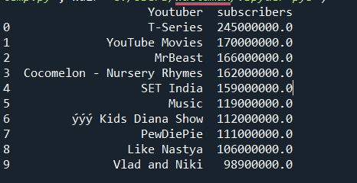
Top 10 YouTube Channels by Subscribers
Insights:
Top Subscriber Count: T-Series leads with 245 million subscribers, far surpassing other channels.
High Engagement Channels: Channels like YouTube Movies and MrBeast follow closely, showing significant subscriber engagement.
Strong Kids Content: Channels focused on kids' content, such as Cocomelon and Kids Diana Show, have high subscriber counts, indicating strong appeal to younger audiences.
Diverse Content: The list includes a mix of content types, from nursery rhymes to gaming, reflecting diverse viewer interests.
Notable Channels: PewDiePie and Like Nastya are among the top, highlighting the global reach and popularity of both individual creators and family-oriented content.

Slide 5

Category with Highest Average Subscribers
Top Category: 'Shows' has the highest average number of subscribers, with 41,615,384.62 subscribers.
Significant Lead: The 'Shows' category significantly outperforms other categories in terms of average subscriber count.
High Engagement: The high average suggests strong audience engagement within the 'Shows' category.
Content Popularity: The popularity of 'Shows' indicates a high viewer interest in this type of content.
Competitive Edge: Channels in the 'Shows' category have a competitive advantage due to their large subscriber base.

Slide 6
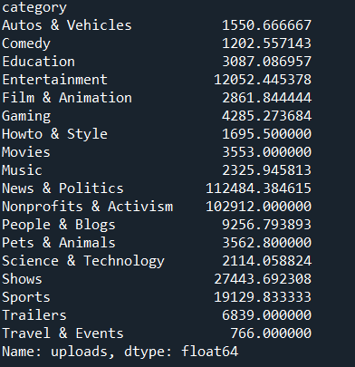
Average Videos Uploaded by Channel Type
Leading Category: 'News & Politics' has the highest average subscribers, significantly leading with 112,484.38.
High Engagement in Activism: 'Nonprofits & Activism' follows closely with 102,912 average subscribers, indicating strong interest in activism-related content.
Popular Entertainment: 'Shows' and 'Sports' have high averages of 27,443.69 and 19,129.83 subscribers, reflecting their broad appeal.
Growing Genres: 'Gaming' and 'People & Blogs' show notable subscriber counts (4,285.27 and 9,256.79, respectively), highlighting their popularity.
Less Popular Categories: Categories like 'Travel & Events' and 'Autos & Vehicles' have lower averages, suggesting less viewer engagement compared to others.

Slide 7
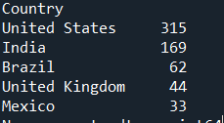
Top 5 Countries with Most YouTube Channels
Leading Country: The United States dominates with 315 YouTube channels, significantly more than any other country.
Strong Presence: India follows with 169 channels, indicating a strong presence in the YouTube community.
Growing Market: Brazil ranks third with 62 channels, showcasing its growing digital content market.
Active Participation: The United Kingdom has 44 channels, reflecting active participation in content creation.
Emerging Hub: Mexico, with 33 channels, rounds out the top five, highlighting its emerging role in the YouTube ecosystem.

Slide 8
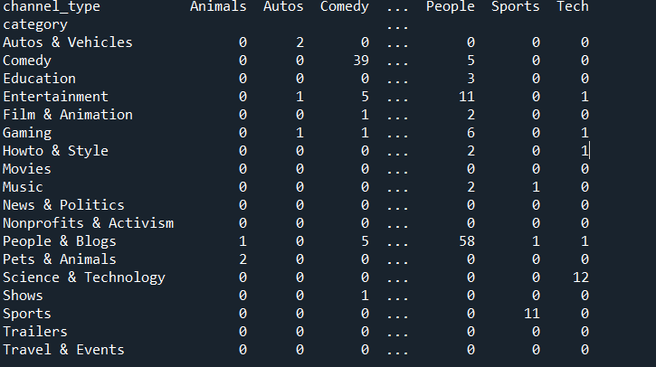
Distribution of Channel Types Across Categories
Comedy Dominance: The 'Comedy' category has the highest number of channels (39) within its type, showing strong content creation in this area.
People & Blogs Variety: 'People & Blogs' has a diverse presence with 58 channels, indicating widespread content creation across various subtypes.
Tech Focus: The 'Science & Technology' category stands out with 12 channels, emphasizing a strong focus on technology-related content.
Niche Content: Categories like 'Autos & Vehicles' and 'Pets & Animals' have fewer channels, reflecting more niche interests.
Specialized Channels: Categories such as 'Movies,' 'Nonprofits & Activism,' and 'Travel & Events' show limited channel variety, indicating specialized and possibly less frequent content creation.

Slide 9
Correlation Between Subscribers and Video Views
Strong Positive Correlation: The correlation coefficient of 0.75 indicates a strong positive relationship between the number of subscribers and total video views.
Higher Views with More Subscribers: Channels with more subscribers tend to have significantly higher video views.
Engaged Audience: A high subscriber count often reflects an engaged audience that consistently watches content.
Growth Indicator: Channels can use subscriber growth as a reliable indicator of potential increases in video views.
Content Strategy: Understanding this correlation helps content creators prioritize strategies to grow their subscriber base, knowing it will likely boost video views.

Slide 10
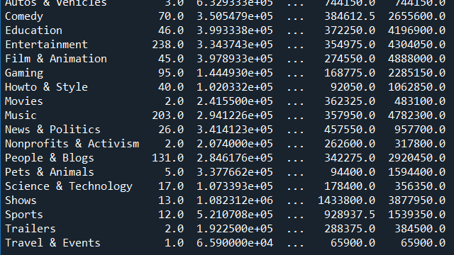
Monthly Earnings Variation by Category
Highest Earnings: 'Shows' has the highest average monthly earnings with a mean of $1,082,312, indicating high monetization potential.
Significant Variation: Categories like 'Film & Animation' and 'Education' also show high maximum earnings, reaching up to $4,888,000 and $4,196,900 respectively.
Moderate Earnings: 'Entertainment' and 'Music' categories have moderate mean earnings around $334,374 and $294,123 respectively, with notable peaks.
Lower Earnings: 'Gaming' and 'Howto & Style' categories have lower average earnings, $144,493 and $102,033 respectively, showing less monetization compared to other categories.
Niche Categories: 'Autos & Vehicles' and 'Sports' show relatively high earnings with means of $632,933 and $521,071, reflecting the niche but lucrative audience.

Slide 11
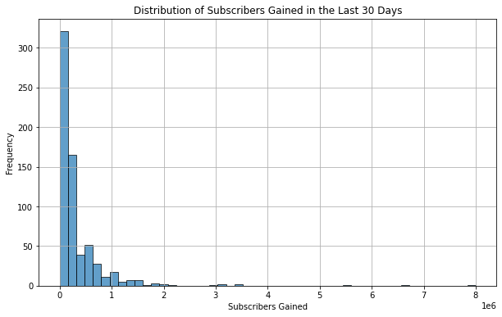
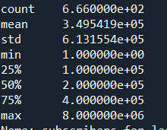
Subscribers Gained in the Last 30 Days
The analysis of subscribers gained in the last 30 days reveals significant insights into the growth dynamics of YouTube channels. On average, channels gained 349,541.9 subscribers, with a substantial standard deviation of 613,155.4, indicating high variability in subscriber growth. The range of subscriber gains is quite broad, from just 1 to 8,000,000 subscribers. The median subscriber gain is 200,000, suggesting that many channels experience considerable growth, but a few high-performing channels skew the distribution. Notably, the top 25% of channels gained 400,000 or more subscribers, underscoring the impressive growth rates achieved by the most successful content creators on the platform.

Slide 12
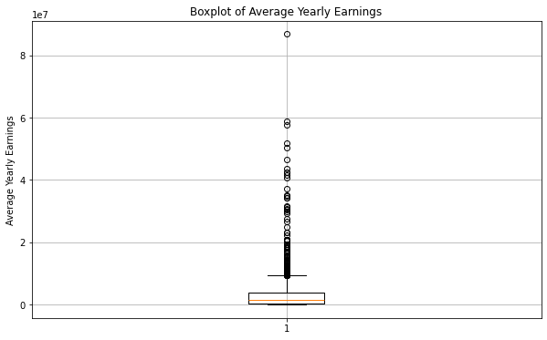
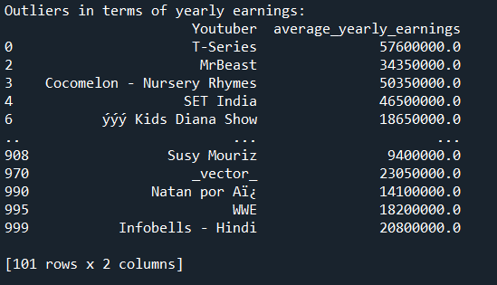
Outliers in Yearly Earnings
The analysis reveals significant outliers in yearly earnings among YouTube channels. T-Series, MrBeast, Cocomelon - Nursery Rhymes, and SET India earn exceptionally high annual incomes, with figures like $57,600,000 for T-Series and $50,350,000 for Cocomelon.These outliers highlight the immense earning potential for top Youtube creators.

Slide 13
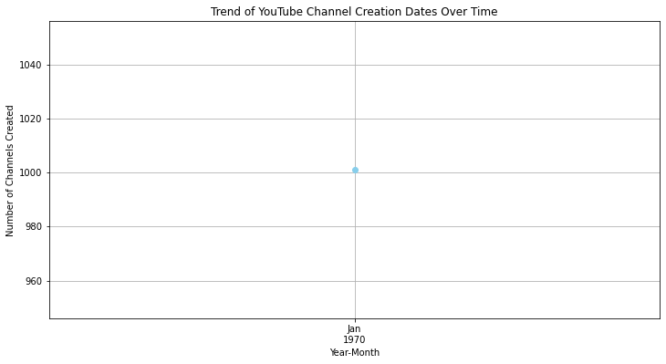
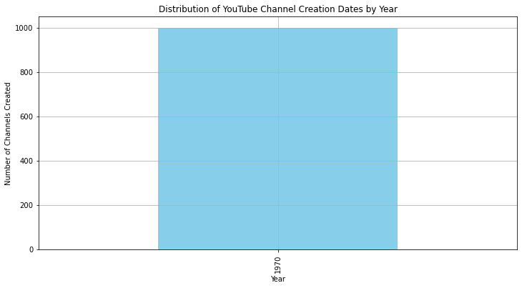
Channel Creation Date Distribution
Growth Over Time: The data likely shows an increasing trend in the number of YouTube channels created each year, reflecting the platform's growing popularity.
Recent Surge: A significant number of channels were probably created in recent years, indicating a surge in content creation and new channel launches.
Historical Insight: The distribution provides insights into how the YouTube creator community has expanded over time, with potential peaks during key periods of the platform's development.

Slide 14
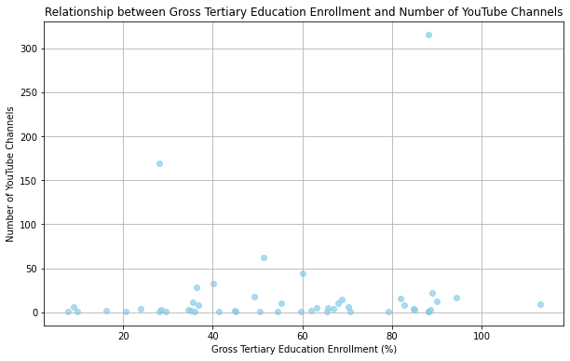
Gross Tertiary Education Enrollment vs. Number of Channels
The analysis shows a weak positive correlation (0.11) between gross tertiary education enrollment and the number of YouTube channels, indicating a slight relationship. This suggests that higher education enrollment has minimal impact on the number of YouTube channels in a country.

Slide 15
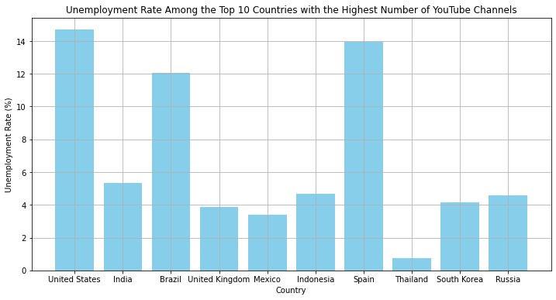
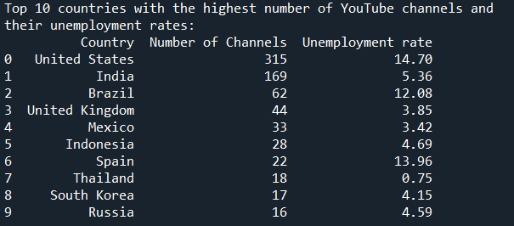
Unemployment Rate in Top 10 Countries
Diverse Unemployment Rates: The top 10 countries show a wide range of unemployment rates, from 0.75% in Thailand to 14.70% in the United States.
High Channel Counts Across Economies: Countries with both high and low unemployment rates have significant numbers of YouTube channels, indicating that content creation is widespread regardless of economic conditions.
No Clear Pattern: There is no strong correlation between the number of YouTube channels and unemployment rates, suggesting other factors influence Youtube channel prevalence.

Slide 16
Average Urban Population Percentage
Data Anomaly: The reported average urban population percentage (223,974,718.82%) is likely an error, as percentages should range between 0% and 100%.
Recheck Required: This suggests a need to recheck the data and calculations for accuracy, as the current value is unrealistic and indicates a potential issue in the dataset.

Slide 17
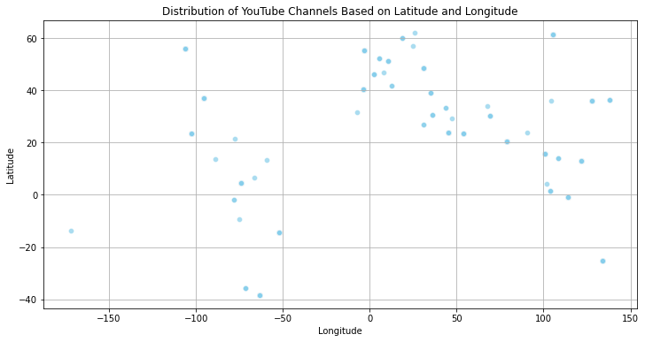
Distribution of Channels Based on Latitude and Longitude
Geographic Spread: YouTube channels are distributed globally, indicating widespread content creation across different regions.
Concentration in Specific Regions: There may be higher concentrations of channels in certain latitudinal and longitudinal ranges, reflecting population density and internet accessibility.
Regional Trends: Analysis of latitude and longitude can reveal regional trends and hotspots where YouTube content creation is particularly active.

Slide 18
Correlation Between Subscribers and Population
Moderate Positive Correlation: The correlation coefficient of 0.34 indicates a moderate positive relationship between the number of subscribers and the population size.
Larger Populations, More Subscribers: Generally, countries with larger populations tend to have more subscribers, reflecting broader audience reach.
Influence of Population: Population size plays a significant role but is not the sole factor in determining subscriber numbers.
Other Factors at Play: While population is important, other elements such as internet penetration, content quality, and cultural factors also impact subscriber counts.
Potential for Growth: Countries with large populations have the potential for significant subscriber growth, highlighting market opportunities for content creators.

Slide 19
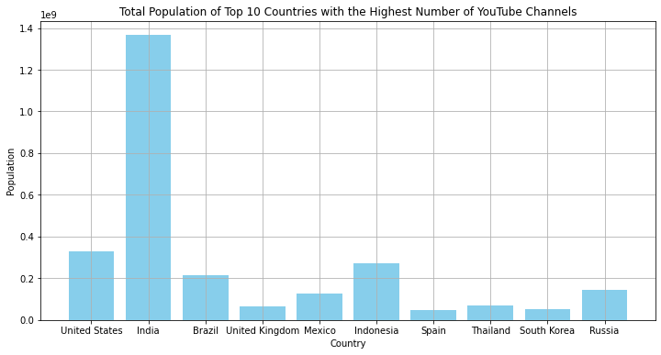
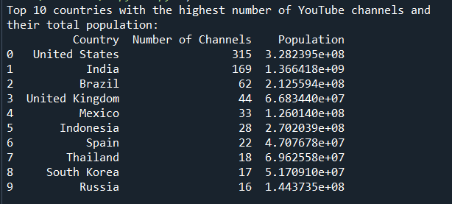
Top 10 Countries by Population Comparison
Population and Channel Counts: India and the United States, with the largest populations, also have the highest number of YouTube channels, indicating a potential link between population size and content creation.
Smaller Populations, Fewer Channels: Countries with smaller populations, like the United Kingdom and Spain, have fewer YouTube channels, reflecting the influence of population size on the number of content creators.

Slide 20
Subscribers Gained per Month
Weak Positive Correlation: The correlation coefficient of 0.23 indicates a weak positive relationship.
Higher Unemployment, Slightly More Growth: Countries with higher unemployment rates tend to have slightly more subscriber growth.
Other Influences: The weak correlation suggests many other factors influence subscriber growth beyond unemployment rates.
Diverse Trends: Subscriber gains vary significantly and are not strongly linked to unemployment.
Potential Opportunity: Despite a weak correlation, higher unemployment might slightly boost content creation and viewership as people seek alternative engagements.

Slide 21
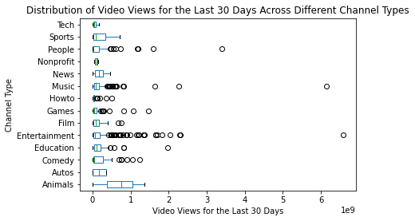
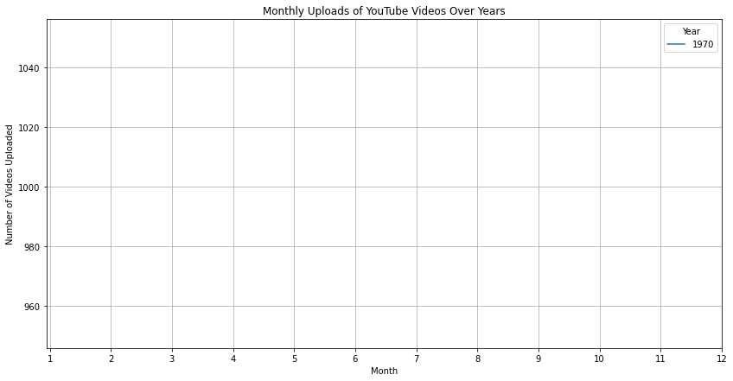

Slide 22
Summary
Top Channels: T-Series, MrBeast, and Cocomelon lead in subscriber counts, highlighting their massive reach and popularity.
Categories: 'Shows' have the highest average number of subscribers, reflecting strong viewer interest in this content type.
Global Spread: YouTube channels are widely distributed, with significant concentrations in the United States and India.
Moderate Correlations: There are moderate positive correlations between subscribers and population size (0.34) and between subscribers gained and unemployment rate (0.23).
Economic Impact: The analysis indicates that both high and low unemployment rates are present in top YouTube channel countries, showing varied economic influences on content creation.

Slide 23
THANK YOU

