Slide 1
OPERATIONS RESEARCH PRESENTATION
Group 3:
20pw01, 20pw19, 20pw24

Slide 2
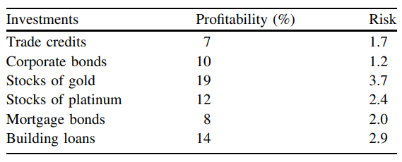
Question 1: Linear programming problem
(1.15) Mixed Investments
The firm Inversiones Internacionales, S.A.U. has up to 5 million $ available to invest in six possible investments.
The table shows the characteristics of each investment.

Slide 3
Decision variables:
x1 = Dollars invested in trade credits
x2 = Dollars invested in corporate bonds
x3 = Dollars invested in stocks of gold
x4 = Dollars invested in stocks of platinum
x5 = Dollars invested in mortgage bonds
x6 = Dollars invested in building loans
Objective function (profitability gained in dollars):
Maximize
z = 0.07x1 + 0.01x2 + 0.19x3 + 0.12x4 + 0.08x5 + 0.14x6

Slide 4
Constraints:
(x1+ x2+ x3+ x4+ x5+ x6) <= $ 5,000,000
From experience in such investments, the firm knows it is not recommended to invest more than 25 % of the total investment in any of these investment options.
x1 <= (25/100)(x1 + x2 + x3 + x4 + x5 + x6)
x2 <= (25/100)(x1 + x2 + x3 + x4 + x5 + x6)
x3 <= (25/100)(x1 + x2 + x3 + x4 + x5 + x6)
x4 <= (25/100)(x1 + x2 + x3 + x4 + x5 + x6)
x5 <= (25/100)(x1 + x2 + x3 + x4 + x5 + x6)
x6 <= (25/100)(x1 + x2 + x3 + x4 + x5 + x6)

Slide 5
Constraints:
Besides, it is necessary to invest at least 30 % in precious metals, and at least 45 % between trade credits and corporate bonds.
For at least 30 % in precious metals:
x3 + x4 >= 0.30 (x1 + x2 + x3 + x4 + x5 + x6)
For at least 45 % between trade credits and corporate bonds:
x1 + x2 >= 0.45 (x1 + x2 + x3 + x4 + x5 + x6)

Slide 6
Constraints:
Finally, an overall risk limit of no more than 2.0 is required.
1.7x1 + 1.2x2 + 3.7x3 + 2.4x4 + 2.0x5 + 2.9x6 <=
2.0 (x1+ x2+ x3+ x4+ x5+ x6)
Non negativity constraint:
x1, x2, x3, x4, x5, x6 >=0

Slide 7
Classifying the problem:
Based on the nature of equations involved:
Linear programming problem
Based on the decision variable:
Real valued programming problem
Based on no. of objective functions:
Single objective problem
Based on constraints involved in the problem:
Multiple constrained optimization problem

Slide 8
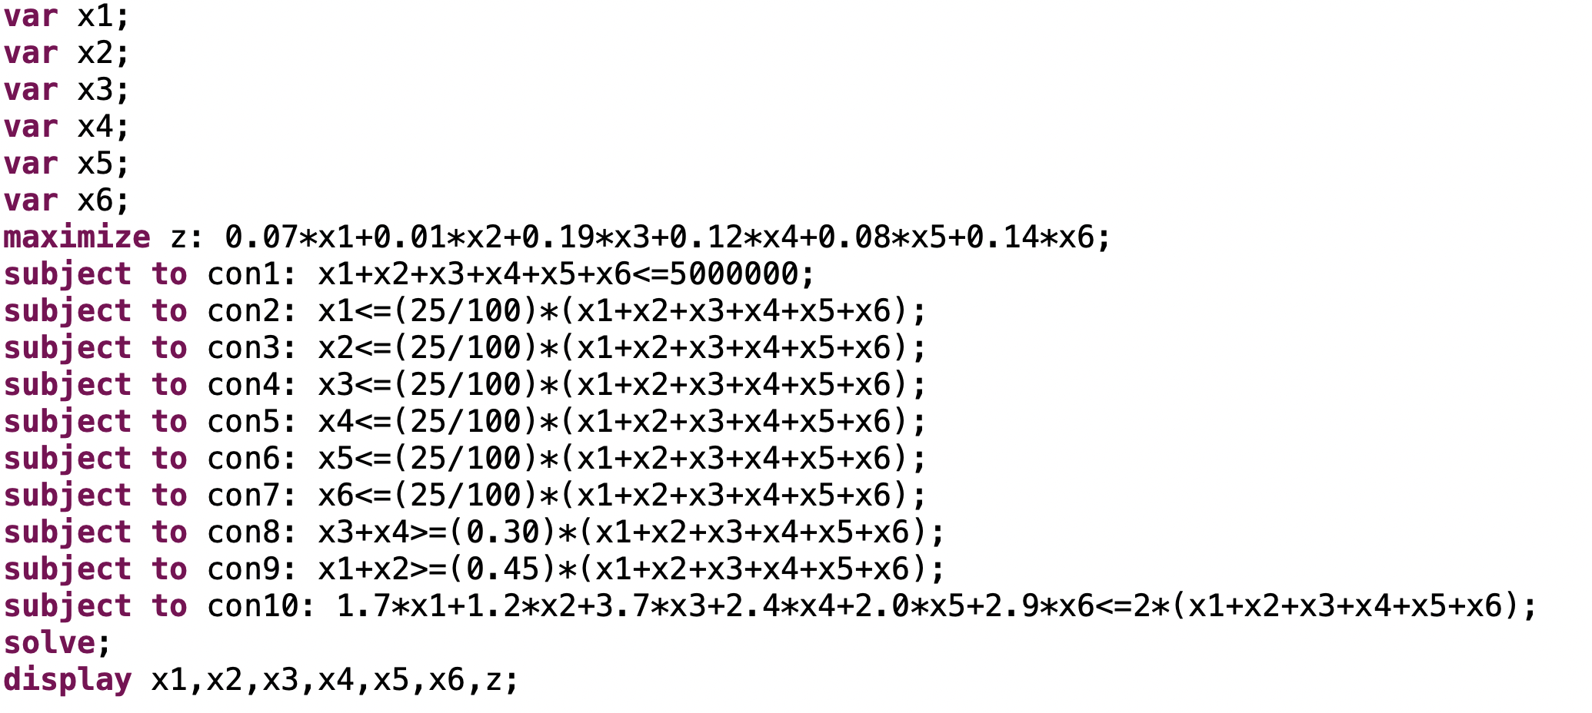
USING AMPL

Slide 9
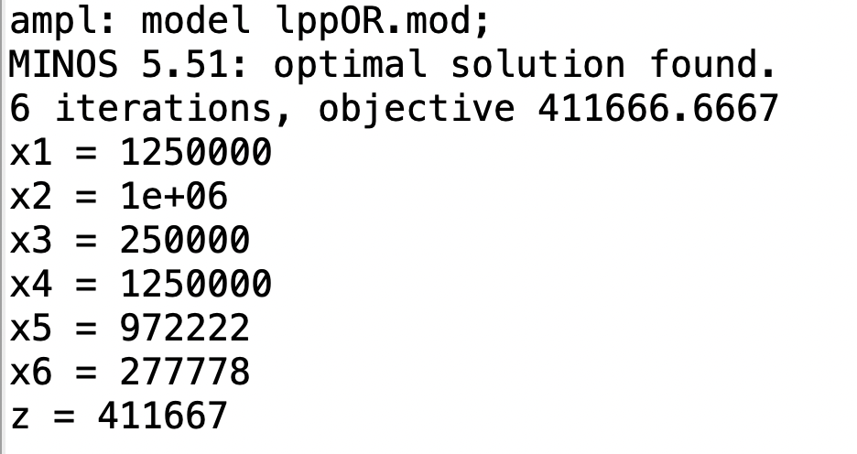
USING AMPL

