Slide 1
Continuous Delivery without Significant Test Automation
Maaret Pyhäjärvi
Email: <maaret@iki.fi> | Twitter: maaretp
Maaret Pyhäjärvi
Nimeä | Attribution (Finland)
http://creativecommons.org/licenses/by/1.0/fi/
http://creativecommons.org/licenses/by/1.0/fi/deed.en

Slide 2
Outline
Why and how delivering continuously improved our quality even without automation
How we use Git branches and Jira Kanban to control the delivery contents and schedules for split value without effort estimates
How continuous delivery changed the way we do exploratory testing with developer-tester collaboration
How we’ve organized for gradual improvement towards higher degrees of automation that we need in the long run

Slide 3
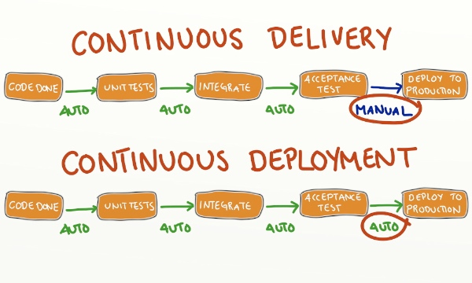
every change to the system is releasable
can release any version at the push of a button
http://blog.crisp.se/2013/02/05/yassalsundman/continuous-delivery-vs-continuous-deployment

Slide 4

CHANGE – WHY AND HOW?
Notes:
Mention tool set in general: c# + microsoft TFS-VS; web UI + DB, several browsers; own hardware & hosting
Team & skills challenges as background. That not all teams are craftsmen and great professionals, but even those who aren’t can strive actively forward from internal motivations or the organization asking for a change.

Slide 5

Change in 2014
From Scrum+TFS
To Kanban+Git(TFS)
Jira Scrum, 30-day sprints
Negative cycle of feedback from failing with estimates & broken build & hotfixing prod.
Everyone working on a common deadline (monthly release) + delay if deadline missed
Visualising flow and limiting Work in Progress with Jira Kanban, measure lead time
Every item worked on in it’s own schedule focusing on lead time
New valuable features to use faster; monitoring production
WHY?
Henri Karhatsu & #NoEstimates
Availability of Git in TFS without plugins
Problems with Testing in Scrum

Slide 6
Testing
Feature 1
Schedule over Quality
Feature 2
Feature 3
Feature 4
Scheduled release
SCRUM + SCHEDULED DELIVERY with continuous integration
KANBAN + CONTINUOUS DELIVERY
Feature 1
Done includes Tested
Feature 2
Feature 3
Feature 4
R1
R2
R3

Slide 7
Mechanisms of Delivery: Git & Kanban

Slide 8
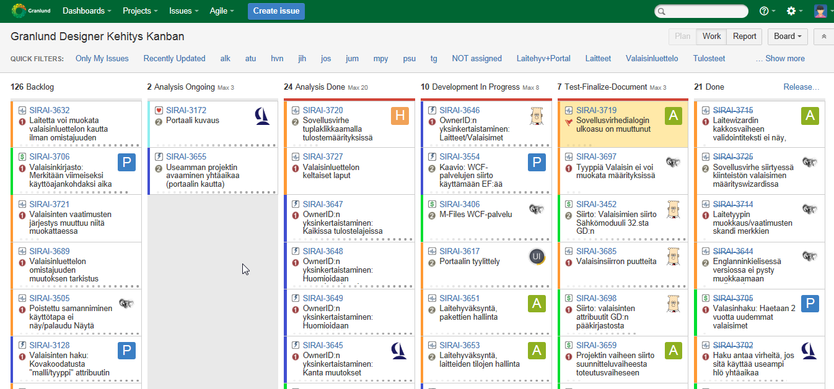
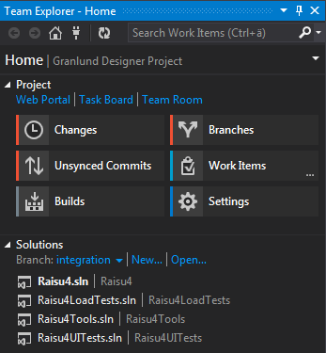
Branches: Master (current in Production), Integration (current in Development), + Feature Branches
Build & Deploy from a Branch

Slide 9
Developer – Tester Collaboration
Notes:
Usual developers; testing is difficult, even automated testing. Missing serendipity and perseverance.

Slide 10
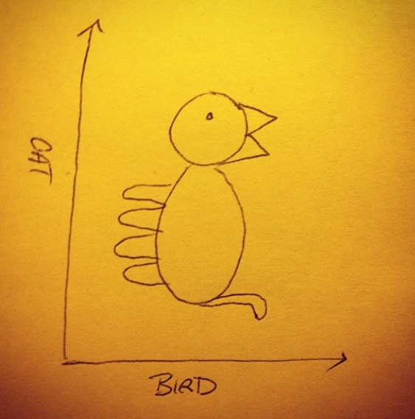
Things Can Look Different from Different Perspectives

Slide 11
Changes
Active discussion about schedules and merging, and needs of testing in the branches
More pairing for testing the features
More group work on defining the features
Introducing Flowdock due to increased need to collaborate; integrating logs, emails

Slide 12
Adding Test Automation

Slide 13
Hardships Faced
Test automation maintenance & buildup for untested legacy
Size of work items – branches not short-lived enough
Developer skills, attitudes and habits – dismantling silo mentality
Requirements & Design Work
Testing Work
Pairing and Mobbing, effective learning
Production control abilities
Monitoring
Releasing for a subset of users
The right tooling & services
Notes:
Services like browserstack, applause etc.

Slide 14
Test Automation
Performance Tests
Exploratory Test Automation
Unit Tests
Due to structures, more tests on “does mocking work” than the logic we’ve implemented
One piece of relevant feedback from tests failing
Tests being dropped with technology change
Selenium Tests
Adding GUI tests make more sense (for now)
Relevant feedback from tests not passing
Database Monitoring Tests
Support for exploratory testing & testing in production

Slide 15
As a tester, I don’t break software, I break illusions.
(paraphrasing James Bach)
Releasing as scheduled over when done is an illusion that deserves to be broken.
Notes:
weekdone

