Slide 1
I Don’t Code, Am I No Longer Useful?
Maaret Pyhäjärvi
Email: <maaret@iki.fi> | Twitter: maaretp
Maaret Pyhäjärvi
Nimeä | Attribution (Finland)
http://creativecommons.org/licenses/by/1.0/fi/
http://creativecommons.org/licenses/by/1.0/fi/deed.en
Notes:
This talk is about non-programming testers looking for their place and identity.
2014 is the perfect time for me to start doing this talk, as I’m doing more code than before (mostly selenium and studying) and it’s clear I will continue to explore on that path. But it does not mean that I would still find coding essential, as I have the “convincing developers to code for me” superpower and often better ideas of what I would like implemented that would be of value.

Slide 2
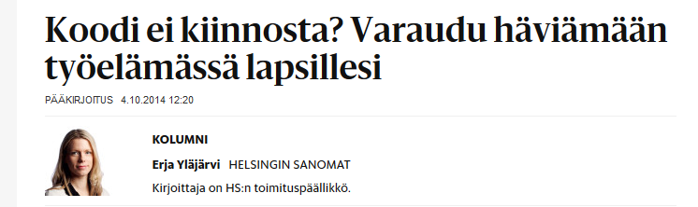

“Code not interesting? Prepare to lose to your kids in work”
“3o working years from mid-life”
Very common in job ads nowadays:
Looking for a Technical Tester / Software Developer in Test to automate…
”…our customer will start with an agile team of three developers and see later if they need a tester at all”
Notes:
I’ve always found the extensive focus on code – over collaborating with people who can write code – silly. There are people like me who can code (to an extent) but would still prefer to spend their days with other things and we don’t really still need to come to “everyone can code” before we also come to “everyone can see relevant size systems, value and requirements plus threats to value” and “everyone can understand all sorts of domains”.
Still for testers in particular, even great exploratory testers, the current message is that the push for automating is so significant that non-coders end up not being recruited. In particular, Agile teams fail to often see the value in non-automated testing done well. And more often still, agile teams who have developers without perfect skills – where testing would be a great way to help bridge many gaps that imperfect teams create on the solution we’re working on.
When there’s no understanding of skilled testing long enough, we will end up not having skilled testers around. That is not a future I would like to see.

Slide 3
Piece of Realism: Different Programmers
‘Hello World’ Programmer / ‘code.org’ – code school programmer
Survives in work environments –programmer
“Specifications” handed ready from the outside
One way to implement; limited maintainability of code
Full-stack Developer
Test Automation is a form of Programming
Notes:
People who can do very simple things with programming are also programmers. It’s just that they tend to not have a programmer identity that would make them state that out loud.
Hello world programmers are not yet much use as programmers as the level of programming skill is more that of mimicking simple structure and changing contents. These people easily learn markup-languages and skilled programmers are quick to say they are not real programmers. Just like skilled testers like to be distinguished from testers, skilled programmers like to be distinguished from programmers.
Every tester is at least a Hello World –programmer. Perhaps we should stop emphasizing that we don’t code? Then again, if most of my days go into not coding, I’d like to somehow emphasize that.
There’s a huge bunch of unskilled developers who can create code but whose code is very broken as it gets created. They don’t necessarily question what problem the code was supposed to solve and they are satisfied with quick hack that appears to solve the part of the problem they came up with. And very often these less skilled developers create spaghetti code that is hard to maintain, for them and others. I would be inclined to claim that most programmers are closer to this than the true multi-skilled craftsmen we seek in agile teams.
Full-stack Developers are the unicorns of the modern software development. They are people who can do both front-end design-detail work and complex back-end server stuff, including all sorts of environmental configurations. They are not just wizards with all types of technology but also have significant people skills to collaborate with those whose problems they are solving with code. We used to call these people programming architects or seniors, but they are the rare people who actually can effectively solve (with good results) many different types of problems. We need more skilled developers like this. And while unicorn-grade is quite much to ask, we would already be happy with one technology and skill to collaborate well with others.

Slide 4
Non-Programming Testers spread out to fill the gaps.

Slide 5

I Test These … Since 04/2012
9 devs
6 devs
PdM team
PdM
… since ~2009
… since 2012
2 ’system testers’
Notes:
Tiimin kehittäjät eivät ole ”full-stack kehittäjiä” – ei teknologioiden eikä varsinkaan yhteistyöasioiden suhteen; UI-detaljit ja testaus eivät vedä puoleensa erityisesti.

Slide 6
Examples of What I Do at Work as ’Testing Specialist’
Learn why the product exists & patiently use the system in varied ways
Provide feedback / log bugs
Work with product manager & developer to clarify a feature
Negotiate smaller workload for the team
Enable trainings and skill building
Pair up with developers for shared experiences on quality
Get developers to pair up with code
Challenge requirements with product management
Negotiate right skillset ratios for the team
Point out things that don’t work
Make efforts needed with skilled testing visible
Fix typos
Create & Review unit & Selenium test ideas; Extend
Provide ideas for how to test a business model
Create User Help Documentation
Provide quality perspective for steering groups
Present for end users on behalf of the team
Not a manager, very much a senior software specialist.
Notes:
Learn why the product exists & patiently use the system in varied ways
Example: program errors
Provide feedback / log bugs
Example: GM 856 / GD 484 issues in 2013; average of 4 issues logged per day every day of the year.
Example: Vau from PdM
Work with product manager & developer to clarify a feature
Example: 3 redos
Negotiate smaller workload for the team
Example: test-fix-finalize week, adding unit testing + refactoring, later selenium
Enable trainings and skill building
Example: code retreat, sending people abroad
Pair up with developers for shared experiences on quality
Example: testing together with devs, inventory management (avoiding overlaps) and GD (creating shared experience of quality)
Challenge requirements with product management
Example: spec rewrite prior to implementation for equipment acceptance feature
Negotiate right skillset ratios for the team
Example: more skilled testing and UI specialists
Example: let 2 people go
Point out things that don’t work
Example: unhappiness
Make efforts needed with skilled testing visible
Example: testing backlog, what gets tested well and what not
Fix typos
Example: reporting vs. fixing time
Create & Review unit & Selenium test ideas
Example: KSP
Provide ideas for how to test a business model
Example: GD productization
Create User Help Documentation
Example: GD Help
Provide quality perspective for steering groups
Example: Regular reviews of how we are doing
Present for end users on behalf of the team
Example: Sales People’s training

Slide 7
Testers don't break your code, they break your *illusions* about your code
* Adapted from James Bach

Slide 8
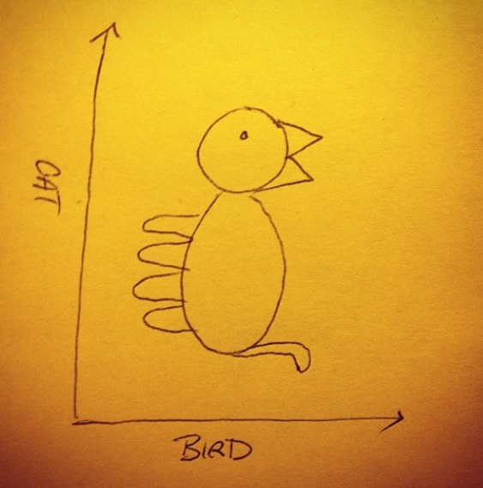
Things Can Look Different from Different Perspectives
Notes:
Got this picture from Llewellyn Falco and I know it’s been going around the internets. Not sure who is the original author though.

Slide 9
Tester vs. Developer Source: Adapted from Bret Pettichord. 2000. Testers and Developers Think Differently
Tester
Developer
Get up to speed quickly Generalist Domain knowledge Ignorance is important
Need of Mastery
Thorough understanding Specialist Knowledge of product internals Expertise is important
Model user behavior Focus on what can go wrong Focus on severity of problem
Focus of Modeling
Model system design Focus on how it can work Focus on interest of problem
Practical Empirical: What is observed Sceptics
Focus of Thinking
Theoretical How it is designed Believers
Tolerate tedium Comfortable with conflict Report problems
Tedium and Conflict
Automate tedium Avoid conflict Understand problems
Notes:
Specialist
Deep understanding of some areas
Get up to speed quickly
Able to make judgements even though subject at hand not mastered
Generalist
Broad understanding of many areas
Domain knowledge
User’s knowledge
Ignorance is important
Gaining and combining superficial knowledge

Slide 10
In Summary
Software Development has a lot of tasks that are not coding
… even if it was great if everyone could do everything
And it would not be great if everyone was exactly the same (diversity!)
Testers need to learn to explain the value they provide – sales skills
Flexibility in titles, a future as a product owner
There may be testing but not tester positions
NON-PROGRAMMING WORK
WORK WITH PRODUCT MANAGEMENT
selecting & clarifying what goes into the development pipeline
learning the system on what creates impacts to focus team work
WORK WITH TESTING
confirming and collecting ideas about what to confirm
delivering and organizing for product feedback
FIX NON-CODE
tweaking configurations
HELP PEOPLE DELIVER VALUE BETTER
designing improvement experiments
Notes:
Can learning code be a bad thing? I would hope not. There’s “opportunity cost” – the idea that time used on something is time away from something else. And early focus on code may cause you to be more blind to the other perspectives. But since usually seasoned architects / truly skilled developers are no longer as vulnerable to bugs (they test themselves), you can choose to learn skills in layers in whatever order you find relevant and useful.

