Slide 1
Making Releases Routine
Maaret Pyhäjärvi

Slide 2
1st year: My Signature Move
30 days
30 minutes

Slide 3
Pool is not a bigger bathtub.

Slide 4
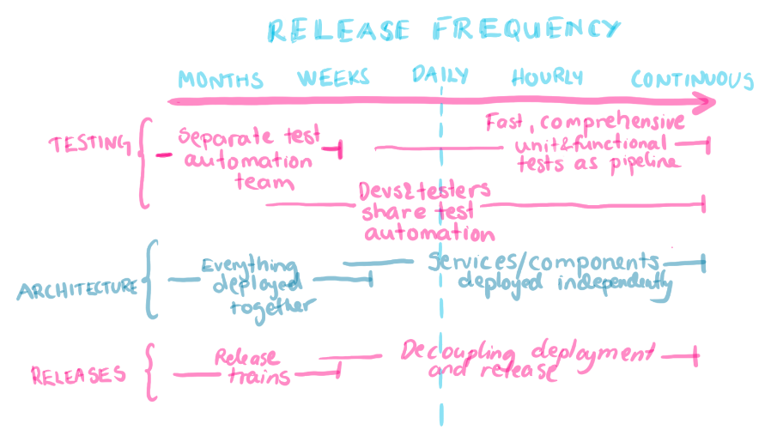

Slide 5
2nd year: Something Lost
30 minutes
90 days

Slide 6
The Failure
Mistakes were made. And by me.
Making results gap visible is a testing skill. Just because someone tests, does not mean they test well.
Recognizing scope
Nudging scope with conversational approach
Orchestrating fixes
Feeling powerless
Premature done starts new work. New work piles up uncertainty.
Continuous testing
Limit WIP

Slide 7
3rd year: Make Releases Routine
90 days
30 minutes

Slide 8
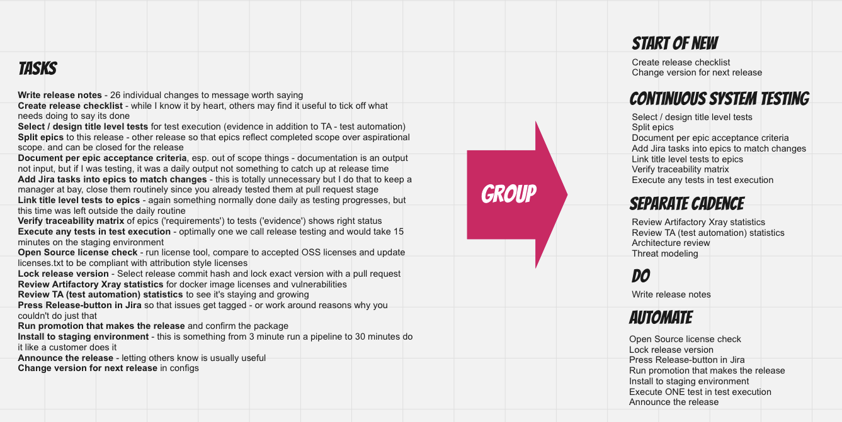
Describing Release and Grouping Tasks

Slide 9
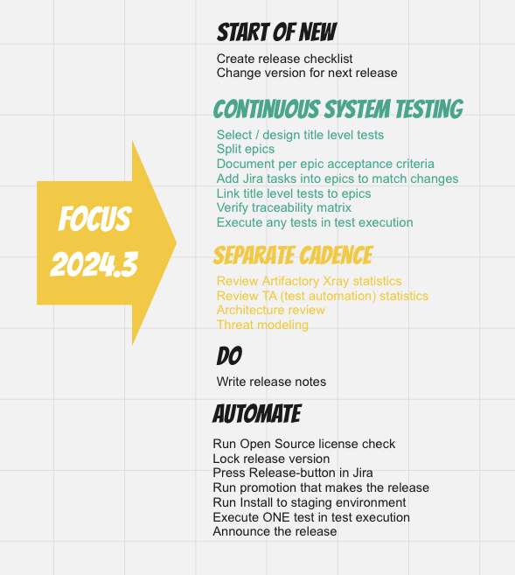
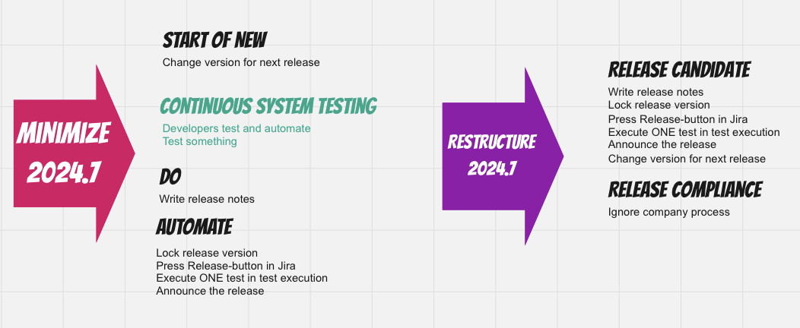
Experimenting with Structure
Practice makes better!

Slide 10
With All Test Green in CI Principle, Release Tagging Preserves Tests for Compliance
When the color is green, no one cares about how many pass and fail.

Slide 11
Context Changes Over Time
30 days
30 minutes
90 days
30 minutes

Slide 12
“Releases are overhead. So much work.”

Slide 13
What is the Work?
What You Have
What You Target
Build and release pipeline
Evidence for compliance
Testing for all things in the results gap
Approvals and permissions

Slide 14
Release Review
3579 compliance checks
22 Required High Level Checks
Action
Architecture and Designs (D1, D6) | Documentation
Technical Quality (Q2, Q3) | Linters Unit test coverage
System Test Contents (Q1, Q4, Q5, Q6, Q7, D1) | Master test plan, test cases, test summary Sufficient testing
Security (Q9) | Threat analysis Vulnerability management
IPR and Licenses (Q8, E1, E2) | OS, Middleware, Application inventory Forbidden licenses check
Product Perspectives (Q10, Q11, Q12, D3, D4) | Usability Documentation Localization
Stakeholder involvement (Q13)
Archiving (D2, D5, D7) | Release repeatability Plans for next up Installation media

Slide 15
Certainty vs. Time
Delivering to environment without use does not add certainty
Certainty
Results Gap
Time

Slide 16
What must be different to shorten release testing from 30 days to 30 minutes?

Slide 17
Fact Checking
There is no automation that gets a month of work done in 30 minutes. Just no.

Slide 18
Fact Checking
We do less in release testing.
We do more before release testing.

Slide 19
Fact Checking
We don’t have bugs. Fixing delays and causes retesting. We don’t wait for testing. Testing can continue after.

Slide 20

Features, Deployments, Releases
Feature flag
Feature
CHANGE
DEPLOY
DEPLOY
RELEASE
System testing =
Feature testing +
Release testing

Slide 21
Guidelines
EaC. Nothing changes without changing something. Follow the changes.
* EaC – Everything as Code, particularly Infra

Slide 22
Guidelines
Continuous testing. Test automation alerts on changes. Change calls to explore.

Slide 23
Guidelines
Pipelines. Doing the work all the time, with every change. Routine comes with repetition.

Slide 24
