Slide 1


Slide 2

2020 - historical film – 1 season
Notes:
One of the enjoyable new arrivals as we were heading into lockdown and had to readjust our lives was a Netflix limited series. I learned about its existence as I saw multiple recommendations on my twitter feed, and found watching it a worthwhile way of passing time. The story of it is not an uplifting one, and today in this talk, we are not looking to put the storylines of this movie together with test automation. Instead, it made me realize I know very little of chess. In fact, so little that I did not know what the name of the movie means when I try translating it in my head to my local languages – after all, I am from Finland, and English is not my native language.

Slide 3
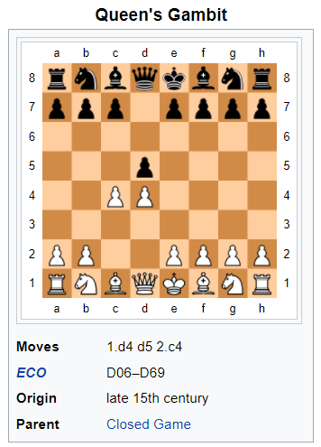
White appears to sacrifice the c-pawn.
Black cannot retain the pawn without incurring a disadvantage.

Slide 4
The Automationist’s Gambit
* Opening by sacrificing material to win in the end
Notes:
The story of “automation is checking” is getting old and it is not serving us well for us being part of the picture of the future.
Multiple possible sacrifices, and I am encouraging one that we currently don’t always encourage!
Software Testing as game is not a game where you win your opponent, but you win on results together! The product not the programmer is the “opponent”.

Slide 5
Time used on warning about test automation is away from succeeding with it.
* opportunity cost

Slide 6
Exploratory Testing
TEST DESIGN
TEST EXECUTION
LEARNING,
AGENCY
IMPACTFUL RESULTS
Notes:
On level on an individual – split in ways that encourage agency and thus learning. We will need multiple people in teams.
“exceptional levels of collaboration” are unusual.

Slide 7
Exploratory Testing?
TEST DESIGN
TEST EXECUTION
MANUAL
AUTOMATED

Slide 8
Exploratory Testing?
TEST DESIGN
TEST EXECUTION
MANUAL
AUTOMATED

Slide 9
Contemporary Exploratory Testing
MANUAL
AUTOMATED
LEARNING,
AGENCY
IMPACTFUL RESULTS

Slide 10
You can't automate well without exploring. You can't explore well without automating.
Notes:
If you create that separation, you rely on extraordinary levels of collaboration, which I find are rare.
Tools: APIs (postman), excel (different data)
Most controversial?

Slide 11
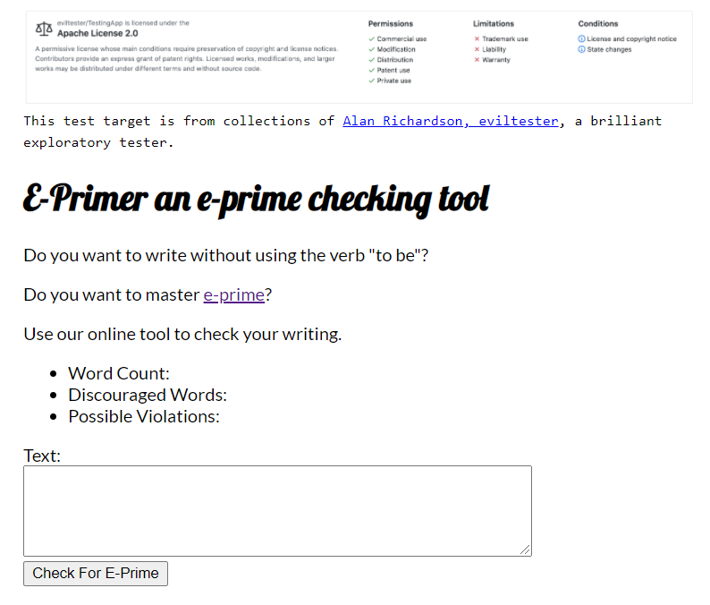
An Example
Notes:
Software Testing as game is not a game where you win your opponent, but you win on results together! The product not the programmer is the “opponent”.

Slide 12
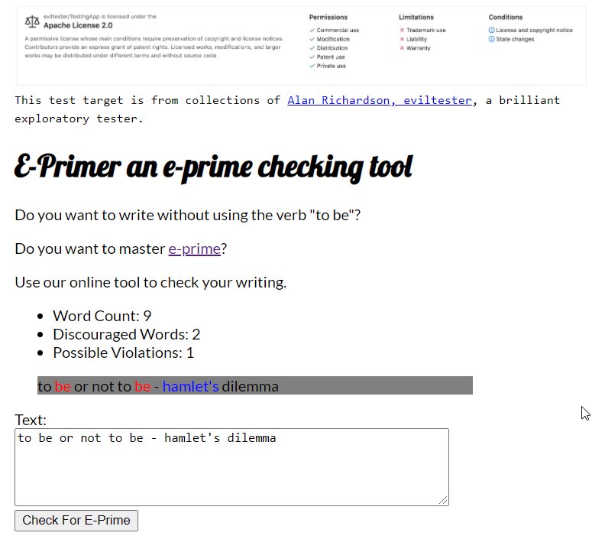
Test Cases
Openings
Bug
Test data
Algorithm
Notes:
Tester’s trap – complicated/interesting data or variables
Test case oriented people want to understand domain first

Slide 13
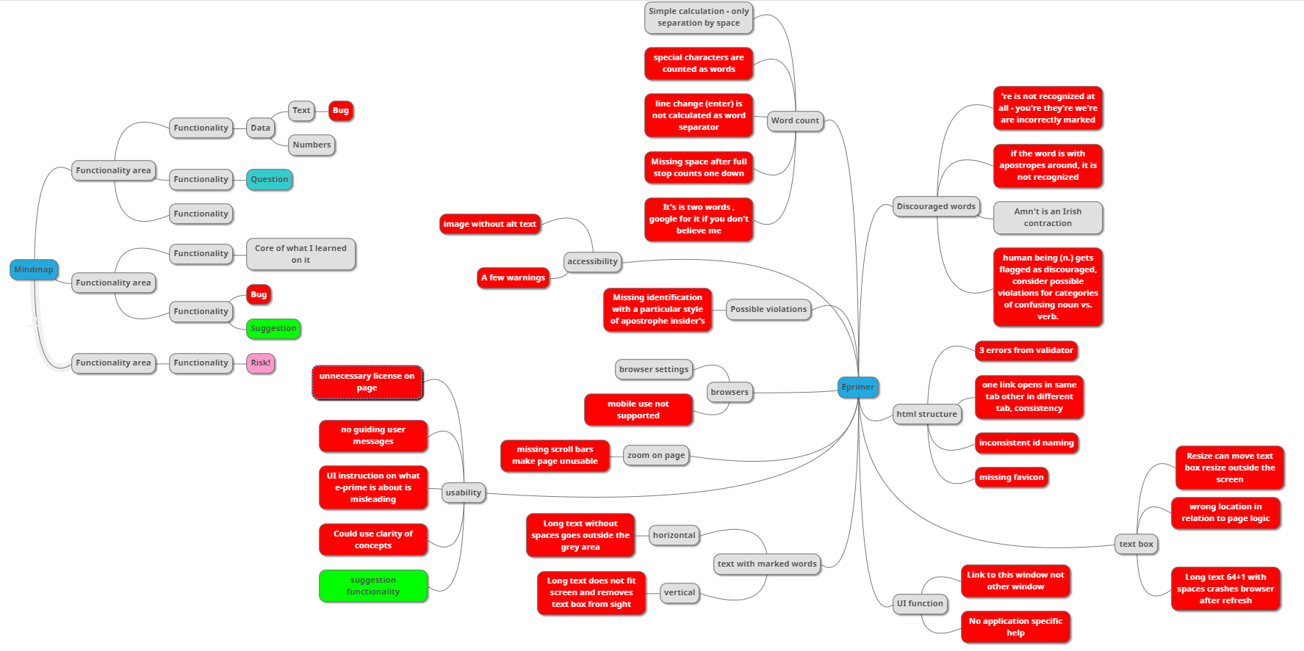
Traditional Exploratory Testing Artifacts

Slide 14
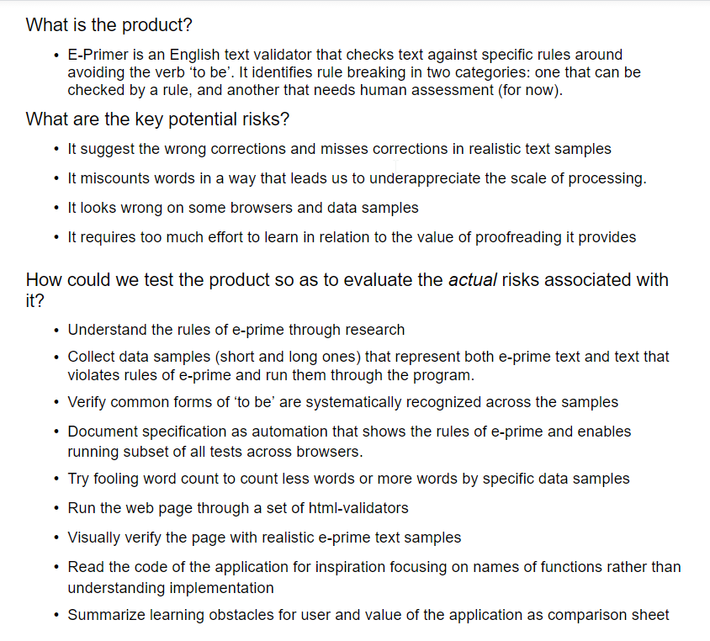
Test Strategy for E-Primer

Slide 15
The Automationist’s Gambit
Test Automation is Documentation!

Slide 16
Robot Framework makes easy things easier and hard things harder.

Slide 17
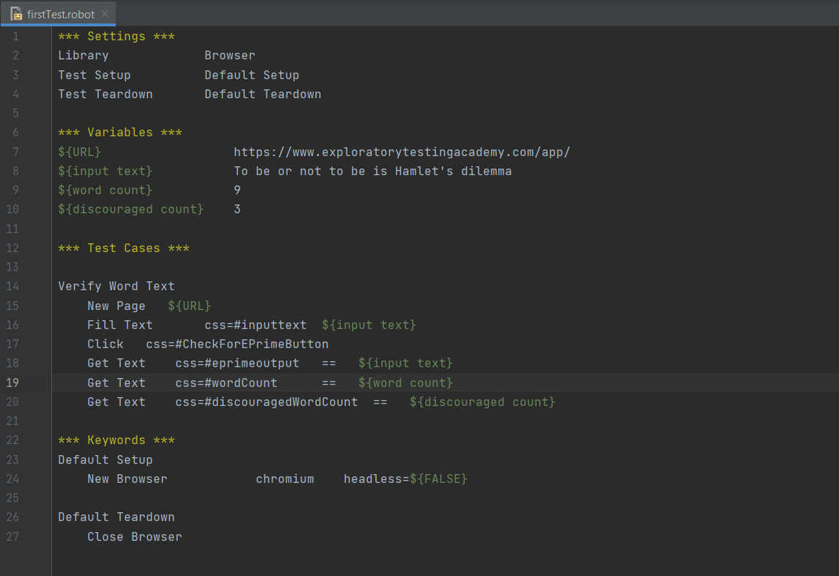
Notes:
Talk about how long it takes to create this. Learning is the investment in the background!

Slide 18
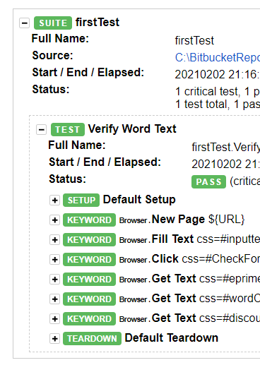

Slide 19
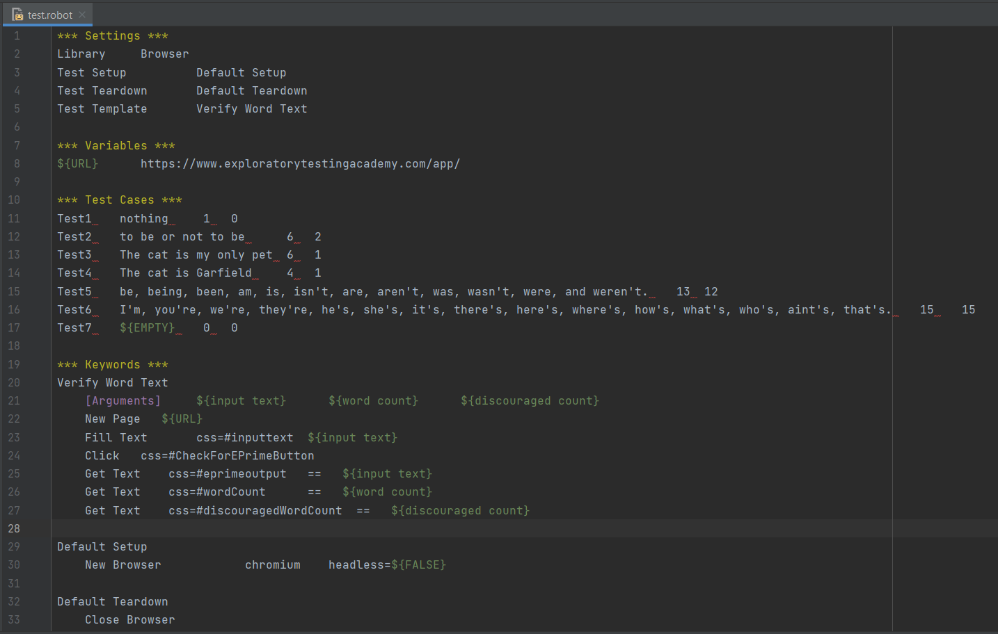

Slide 20
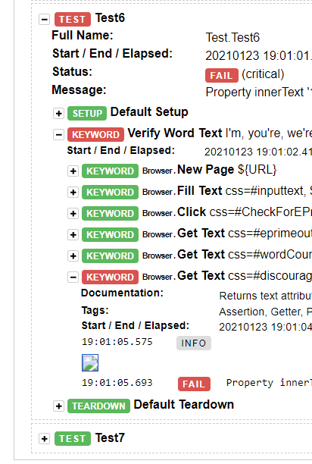

Slide 21
Throwaway automation?
Single line
See it fail
First test
Same test but variables
Same test but templates
Failing test with a bug
Spec to tests
Guess the values that are likely to fail
Multiple browsers
Runs in CI
Notes:
Iterative, incremental. Test Driven Testing. Intentional Programming.
Learning & agency. Tie back to earlier discussion.

Slide 22
Bugs Found
- Some of specified examples not properly recognized
And Missed…
Text box resize is broken (my bad)
Browser crashes with 32k+1 chars with spaces (tool)
\n and – and … messes up word count
More specified examples not properly recognized

Slide 23
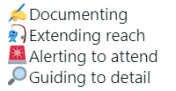
Automation in Frame of Exploratory Testing
Notes:
Extending reach: mention getting to a state and continuing.

Slide 24
Moving Focus
Learning
Attended
Learning
Learning
Learning
Unattended
Notes:
Creating information / data with testing and sometimes your tools do that while you are not attending to them.

Slide 25
Sprinkle On Top Exploratory Testing
Contemporary Exploratory Testing
Exploratory
UI
UI
Exploratory
SERVICE
SERVICE
UNIT
UNIT
Notes:
My favorite unit testing exploration: approvaltests.

Slide 26
Can You?
Test
Code
Collaborate
Ideate
Learn
Notes:
Investing – some now, useful now. More later.

Slide 27
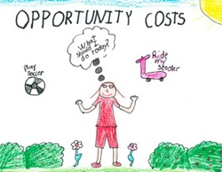

Slide 28
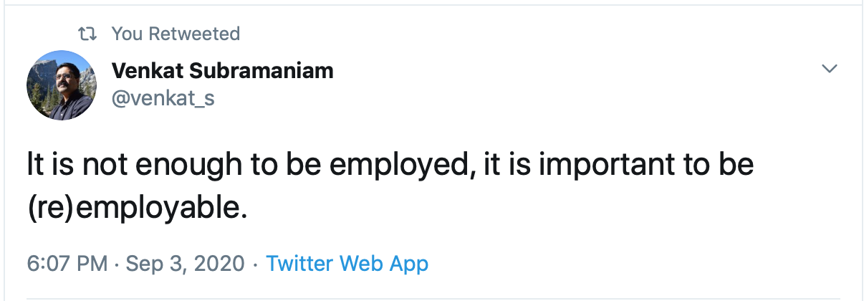
Notes:
Gambit is an opening with a sacrifice. What is your opening and what is your end game?

Slide 29
Gambit is an opening with an appearance of sacrifice. What is your opening and what is your end game?

Slide 30

LinkedIn. https://www.linkedin.com/in/maaret/ Twitter. @maaretp
Email. maaret@iki.fi

