Slide 1
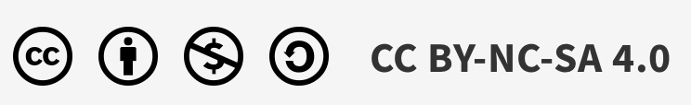
Increase personal AI coverage
AI Native journey
Maaret Pyhäjärvi
November 2026
Notes:
We have to talk about COVERAGE.

Slide 2
LESSON 1 ON COVERAGE
100% is not the goal

Slide 3
FULLY AUTOMATED, DEEPLY HUMAN
People can now do things by asking for it.
Notes:
Many organizations report their business improvement initiative lists are hundreds, and their throughput per year in tens. We aren’t running out of work by making the work more effective.

Slide 4
ASKING FOR IT
Use playwright-cli to operate website https://www.workroom-productions.com/raster-reveal/ and create a script that systematically reveals the image that gets more accurate by mouse movement. Take regular screenshots and figure out for each if you know what is in the picture. Keep the browser open so that I can watch it unfold.

Slide 5
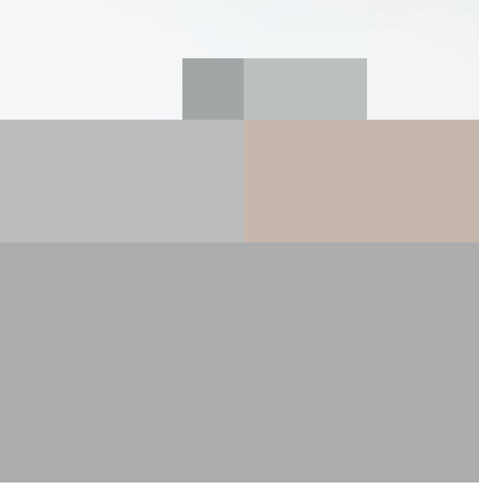
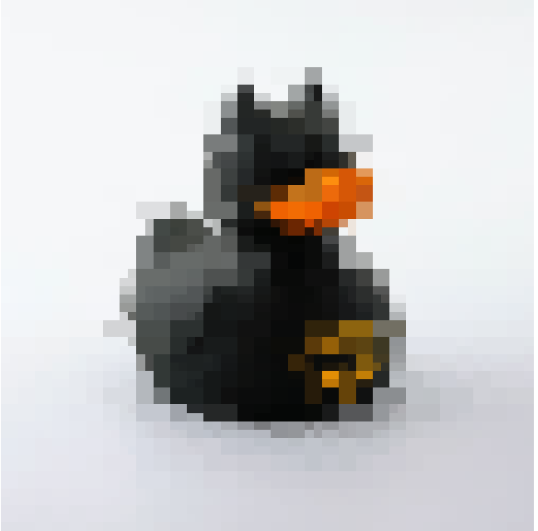


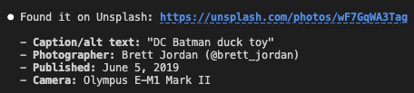
Stopping criteria when automation is more accessible
About testing
Test design
Test execution
Test cases
Exploratory
0:00
0:46
3:12
13:26
Manual
A dark animal-like shape is emerging on a light background, with orange/gold accents.
That's unmistakably a black rubber duck with an orange beak and a gold Batman bat-symbol on its side/wing — a "Batman rubber duck" bath toy.
Final identification stands: a black rubber duck with an orange beak and a gold Batman logo on its side.
Confirmed: it's a quadtree that reveals finer detail in blocks my cursor actually crosses. Let me sweep the remaining bands top-to-bottom.
Automated
Managing
Doing
Avoid confidently incorrect judgement
Notes:
Raster reveal by James Lyndsay, workroomprds
1. First contact (a few mouse hovers) — the canvas just split into a couple of large light/dark quadrant blocks. No content visible yet.
2. First full top-to-bottom raster pass (8 horizontal bands, ~12px grid) — a blocky mosaic silhouette appeared: a dark rounded shape on a light background, with a hint of orange and gold
patches.
3. Finer full-canvas pass (6px grid) — the silhouette sharpened into a duck shape: pointy "ears" (actually the classic bath-duck head bump), an orange beak, and a gold outline resolving into a
clear Batman logo on the flank.
4. Targeted fine pass just over the duck's bounding box (3px grid) — edges, the eye, and the bat-symbol crisped up further, confirming the identification with no real ambiguity left.

Slide 6
LESSON 1 ON COVERAGE
100% is not the goal

Slide 7
LESSON 2 ON COVERAGE
Experiences coverage is foundation for innovation

Slide 8
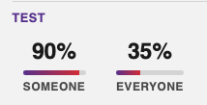
AI-native journey: individual experiences by role
30 experiences people grow into. Knowledge workers track 12; developers track those plus 18 more.
Knowledge worker role
12 experiences
Developer role
18 experiences
01
External imagination
01
Code autocomplete
10
Team/Product context
e.g. .md files
02
Local summarizing
02
Reactive agentic
you start it
11
Team/Product context advanced
e.g. MCPs, memory, skills, orchestration
03
Online summarizing
04
Integrated AI features in domain tools
e.g. Rovo for Confluence & Jira
03
Selecting and configuring 3rd party MCPs
12
Building own MCPs
05
AI-enabled practices
e.g. AI notetaking
04
Integrating 3rd party AI system components
memory, context compression
13
Delivering AI native project
06
Task expansion
05
Skills and AI-friendly git-first templates
14
Product AI feature delivery for proof of concept
07
Personal applications
08
2nd brain
06
Using local models
15
Added business value in domain AI proof of concept
09
Token awareness
07
Proactive agentic
it starts automatically
16
Product AI feature delivery to run in production
10
Generating artifacts
08
Dark factory
unattended
17
Product feature AI feedback
11
Pitch to project for AI usecase
12
Mentioned in CV
09
Spec-driven development
18
Sandboxing
An experience counts when you can tell its story: “…when AI makes it possible for you to do things you used to think as someone else’s work.” Task expansion
Source: AI-Native Journey Tracker, qe-at-cgi-fi.github.io/ai-journey
Notes:
Experience areas from the Individual tab of the AI-Native Journey Tracker, in the tracker's own order and wording. Each area is switched on per person when it becomes true for them; the tracker describes each with a '...when you' story.
We have added extra since:
governance: making rules for where use has limits is the sandboxing for managers
scheduled agentic is the simplest trigger, usually available for knowledge workers to get to proactive agentic that starts on event, whether you are around or not.
Failure you learned from: when you proudly share you learned from a mistake you personally made, because we make plenty

Slide 9


AI for testers journey
DARK FACTORY VALIDATION DESIGN
SMART ARTIFACT TRANSFOR-MATIONS
AGENTIC TESTING
ARTIFACT TRANSFOR-MATIONS
Test data and application
not for AI
No client artifacts to use AI on
EXTERNAL IMAGINATION
No AI tools access
Notes:
Access to client materials limits your journey, makes you slower.
Tarinankerronta vs. todelliset osaamiset.

Slide 10











From doubtful intent to learning at the center
A success mindset: QUALITY ENGINEERING
REQUIREMENTS END
Doubtful intent
TESTING END
Intent Lead sets the bar
Living common ground
Quality feedback slices
Conversations become specifications and acceptance materials.
Layered signals on whether the slice is good, and what we learned.
Converse with the people who hold the intent
IN THE MIDDLE
Properties that must hold across every input
Build a slice of value
Ingest conversations into the OKF-LLM-wiki
Learning
Core examples, built up from the acceptance factory
Facilitate deepening the aspects that matter
Agents build, people validate, we decide what ships.
Model reconciliation: our model vs. the system
Core examples grow from the living common ground into every feedback slice
Notes:
Start from doubtful intent: we rarely know exactly what good looks like, so the Intent Lead sets the bar and we pull on it from both ends. On the requirements end, the acceptance factory turns conversations with people into specifications and acceptance materials. Conversations are ingested into an OKF-LLM-wiki, and human facilitation deepens the aspects that matter. On the testing end, quality feedback slices give layered signals: properties, core examples that grow all the way from the acceptance factory, and model reconciliation. In the middle we build a slice of value, and learning sits at the center of every slice. The five roles from the vision span the flow.

Slide 11
Automation is documentation
New framing for Test Process
1 · FIRST
2 · RIGHT AFTER
3 · THEN
4 · LAST
Collaborate
Automate — the documentation
Explore
Test cases
1 Start with enablers: budget, test environment, people — the things that move slowly
8 Spend time using the application; report bugs by fixing them
9 Publish the list of test cases for review and conversation — generated primarily from the automation
4 When you test, first ask for bugs: quality slices
2 Risk-based sampling of reviews; follow the change
5 Pair to fix bugs, leaving behind architecture-aware test automation: red → green → pull request
3 Build up a risk register and core examples in living common ground
6 Model the APIs and UIs to increase automation coverage
7 Ensure core examples are included and reported green
↻ ALL ALONG
10 Collect product risks and drive risk-based quality slices
11 Improve bug fix decision-making rules
Notes:
Read it left to right as order of investment. First the slow-moving enablers and the conversations that build common ground: risks and core examples. Right after, automation: every bug we find and fix together leaves behind architecture-aware tests (red, green, pull request), and modelling the APIs and UIs grows coverage. That automation is the documentation. Then time spent using the application, reporting bugs by fixing them. Only last do test cases appear, and they are a published list read off the automation, for review and conversation, not a design step up front. All along, risks feed new quality slices and we sharpen the rules for which bugs get fixed.

Slide 12
LESSON 2 ON COVERAGE
Experiences coverage is foundation for innovation

Slide 13
LESSON 3 ON COVERAGE
People coverage matters

Slide 14
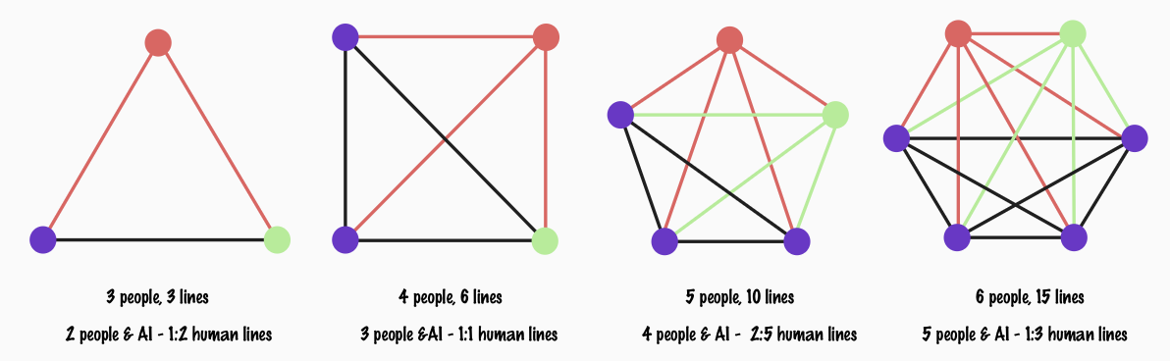
What social at work looks like to you?
Deeply human coverage

Slide 15
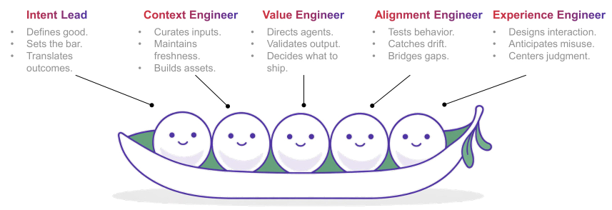
From knowledge workers to builders, specializing in…
Breaking illusions with testing
Notes:
We are reinventing our roles.

Slide 16
Redistribution of work
Mix up the traditional roles is an opportunity to grow
Traditional ↓
New →
Intent Lead
Context Engineer
Value Engineer
Alignment Engineer
Experience Engineer
Lead
Defines good.
Decides what to ship.
Centers judgment.
Analyst
Sets the bar.
Translates outcomes.
Curates inputs.
Maintains freshness.
Bridges gaps.
Designs interaction.
Developer
Builds assets.
Directs agents.
Tester
Validates output.
Tests behavior.
Catches drift.
Anticipates misuse.
Notes:
Rows are the four traditional roles, columns the five new ones. All fifteen responsibilities from the new-role model appear exactly once, in the row of the traditional role that used to carry that work. The analyst’s work spreads the widest, across four new roles. The tester’s work splits between Value, Alignment and Experience. The developer keeps the smallest share: building assets and directing agents. The lead keeps defining good, deciding what ships and centering human judgment.

Slide 17
LESSON 3 ON COVERAGE
People coverage matters

Slide 18
FULLY AUTOMATED, DEEPLY HUMAN
People can now do things by asking for it.
Notes:
Go ask for it. From AI. From people. Stop blocking your agency. Be kind and gentle. But ask again. Build the sociotechnical system we need for the businesses benefit.

