Slide 1
Group 9
Continuous data measurement system
Almmoh017, bhyebr002, snmboi001, smtjos022

Slide 2
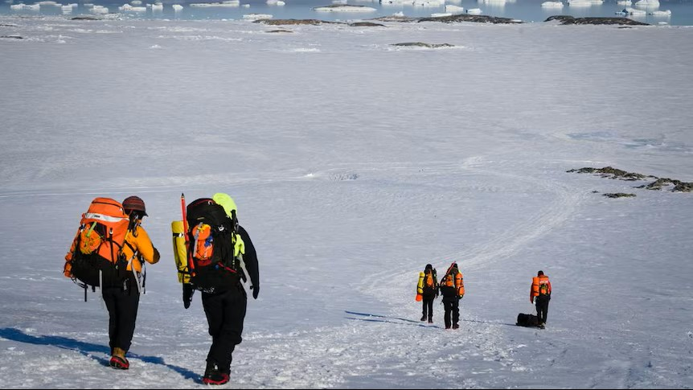
Problem Statement
Robyn has issues with getting continuous ice floe dynamics data in Antarctica
Factors that affect data collection:
Infrequency of expeditions
High-cost of expeditions
Harsh, often dangerous environment
Low bandwidth

Slide 3
Literature
Low-Power Wide-Area Networks: Comparison of LoRaWAN and NB-IoT Performance – IEEE Internet of Things Journal
Engages in discussion about possible network types available to use
Internet of Extreme Things Platform for Remote Antarctic Climate Monitoring – ICMIC
Features power management strategies regarding continual autonomous operation (duty cycle)
Ice Flow of the Antarctic Ice sheet
Discusses the characteristics attributed to the area has well as the evolution of research in the region.
Physics of the Seasonal Ice Zone – Roach, et al
Sea ice floe dynamics in the Antarctic MIZ are governed by wave-induced motion, temperature, and wind forcing — giving us exactly the physical parameters our buoy must measure.

Slide 4
Possible Solution: Measurement Buoy
Measures ice position and movement & what the environment around the ice is doing
Acceleration, tilt, gyro
GPS positioning
Air, water, humidity sensors
Low-power
Power subsystem to manage battery draw over long term deployment
Deployable
Enclosure to house all the components and protect them from external env.
Must be able to autonomously transmit data: low-bandwidth
Network and Comms Subsystem (LoRa) to operate in low-bandwidth env.
Researchers must be able to access the data from the comfort of the base
Data is presented in GUI

Slide 5
Antarctic Environment
Enclosure subsystem
Sensing Subsystem
Power Subsystem
Comms + GUI subsystem
Clean, readable data
Researchers

