Slide 1
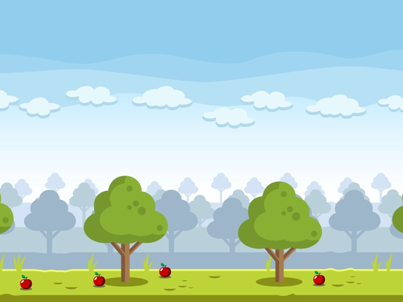

CAT-Gemini!

Slide 2
CAT-Gemini!
What?
Why?

Slide 3
CAT-Gemini!
Play!

