Slide 1

POLYMER

Slide 2

Polymer 2.0
Some ES6 explained
Fix the code with ES6

Slide 3
ES6
Next version of Javascript
Lot’s of handy new features
let cont blockscope
arrow functions
rest and spread operators
template literals
deconstructing

Slide 4
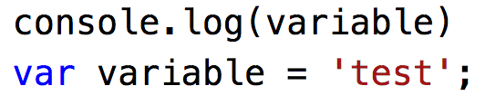
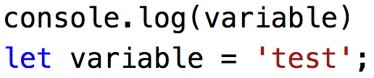
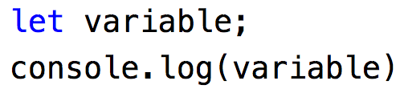

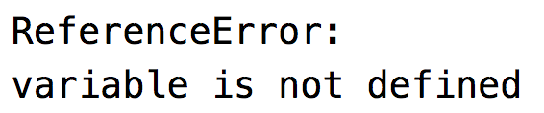
Let
New keyword for variables without hoisting.
Notes:
Let : new keyword for variables without the hoisting
Hoisting is JavaScript's default behavior of moving declarations to the top.

Slide 5
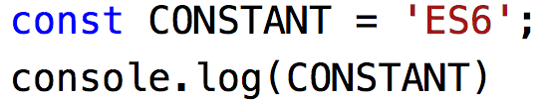
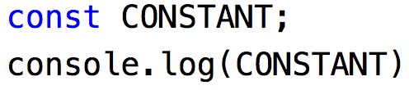
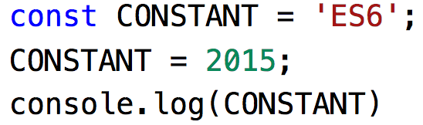
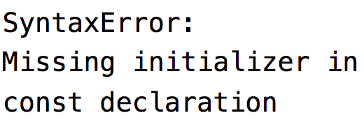

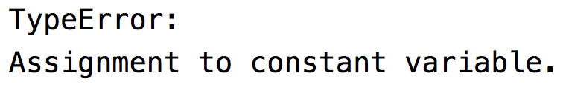
Const
New keyword for declaring variables as constants
Notes:
const: unable to change
Uppercase not required but strongly advised

Slide 6
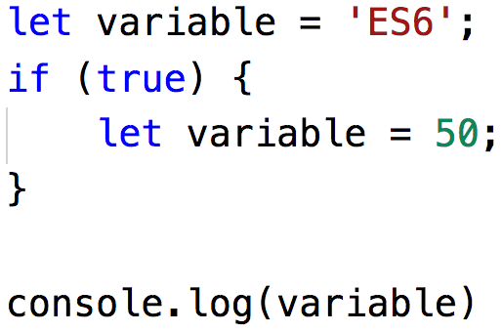
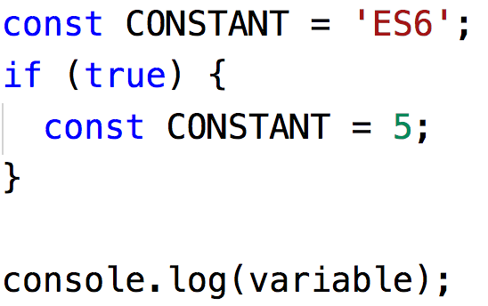
Block scoping
Notes:
block scoping: within curly braces we now have a scope
Using the variable declared in scope outside the scope will result in an ReferenceError: variable is not defined

Slide 7
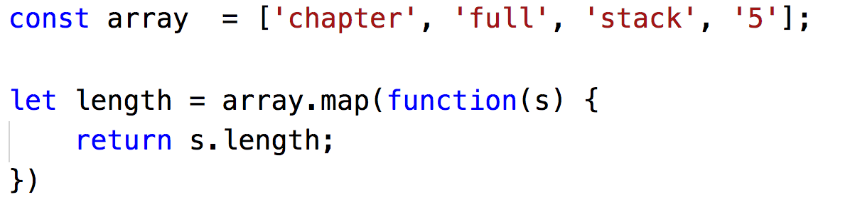
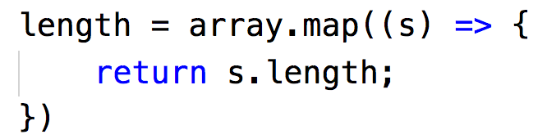

Arrow function
are anonymous and change the way this binds in functions
Notes:
Great way to shorten the function calls

Slide 8
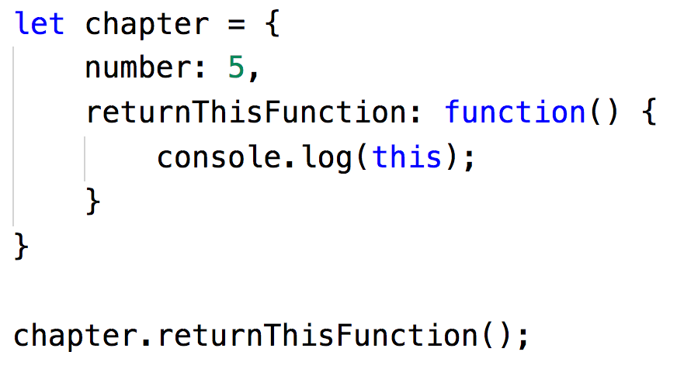
Arrow function
this is something different…
Notes:
But the most important improvement is the binding of this to the function scope

Slide 9
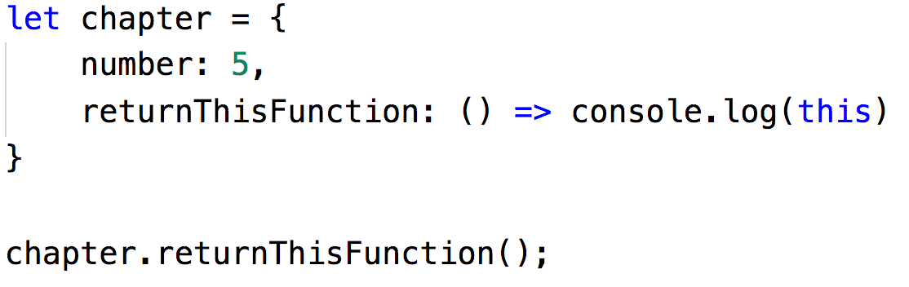

Arrow function
this is something different…
Notes:
Returns the context of the code we are running.
So window or the function this piece of code is in

Slide 10
Arrow function
DEMO
Example that bind works but different…

Slide 11
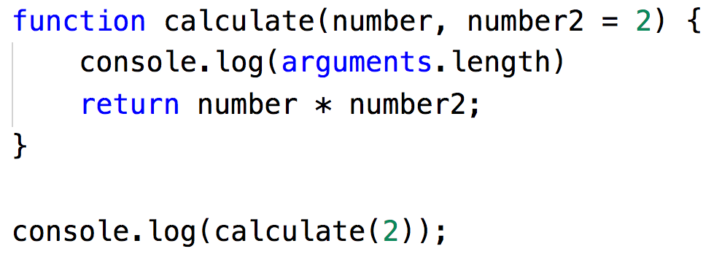
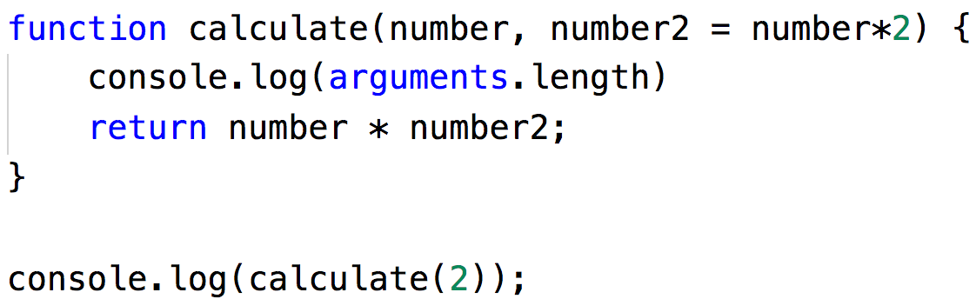


Default parameters
Pass default params to functions
Notes:
Default parameters run in there own code block.
So referencing an argument that is passed in after the reference gives an error

Slide 12
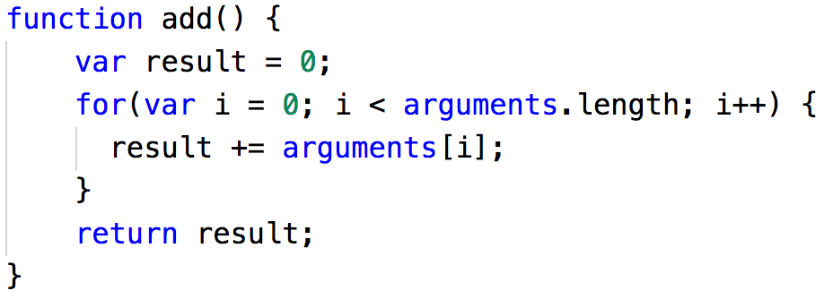
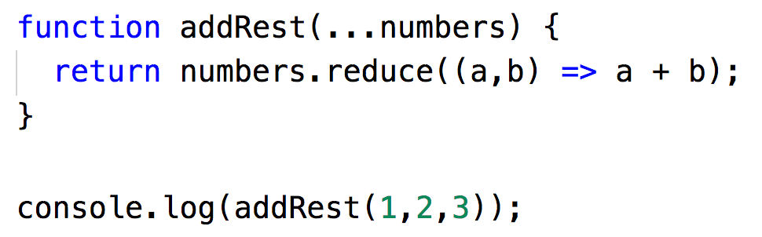

Rest and spread
Rest: gathering parameters and put them in a single array
Notes:
The rest parameter syntax allows us to represent an indefinite number of arguments as an array.
The rest parameter syntax allows us to represent an indefinite number of arguments as an array.

Slide 13
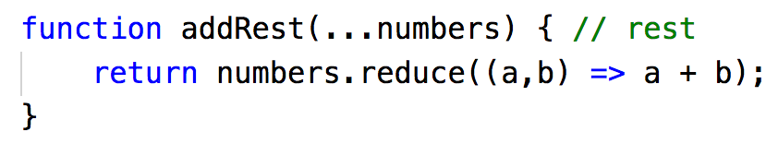
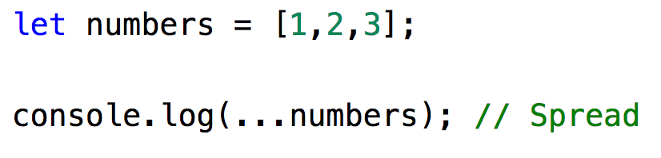
Rest and spread
Spread: Spreading out the element of an array or string
Notes:
Spread syntax allows an iterable such as an array expression to be expanded in places where zero or more arguments (for function calls) or elements (for array literals) are expected, or an object expression to be expanded in places where zero or more key-value pairs (for object literals) are expected.

Slide 14
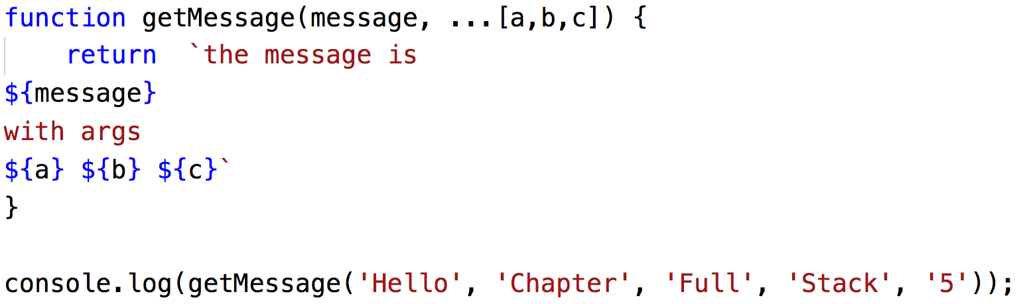
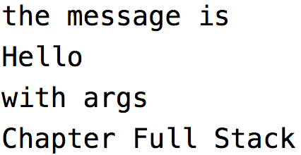
Template literals
string literals allowing embedded expressions
Notes:
Multi-line strings
Allows expressions

Slide 15

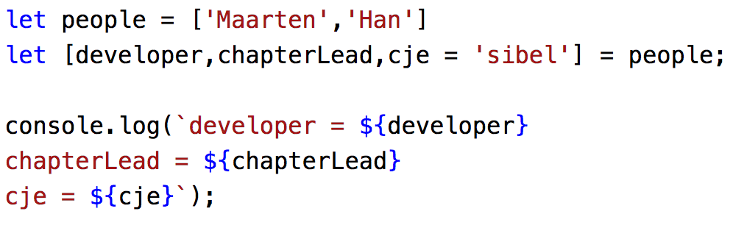

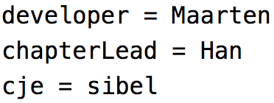
Destructuring
Unpack values from arrays or properties from object into distinct variables
Notes:
The destructuring assignment syntax is a JavaScript expression that makes it possible to unpack values from arrays, or properties from objects, into distinct variables.

Slide 16
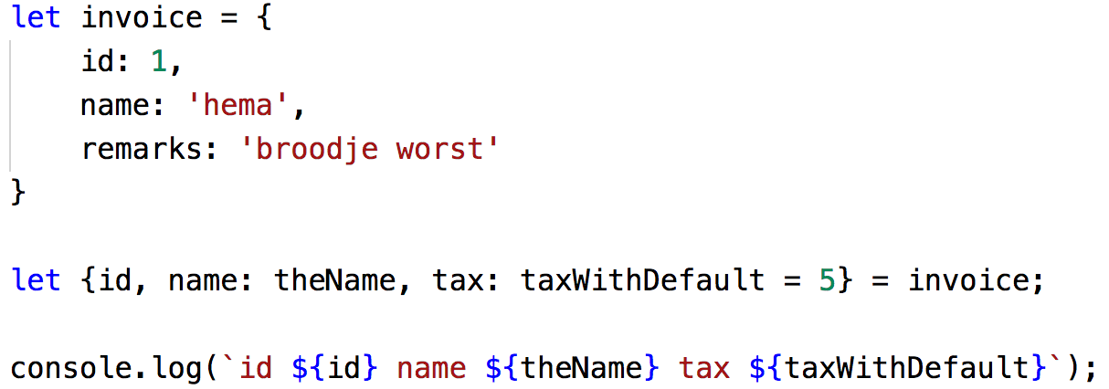

Destructuring
Unpack values from arrays or properties from object into distinct variables
Notes:
The destructuring assignment syntax is a JavaScript expression that makes it possible to unpack values from arrays, or properties from objects, into distinct variables.

Slide 17
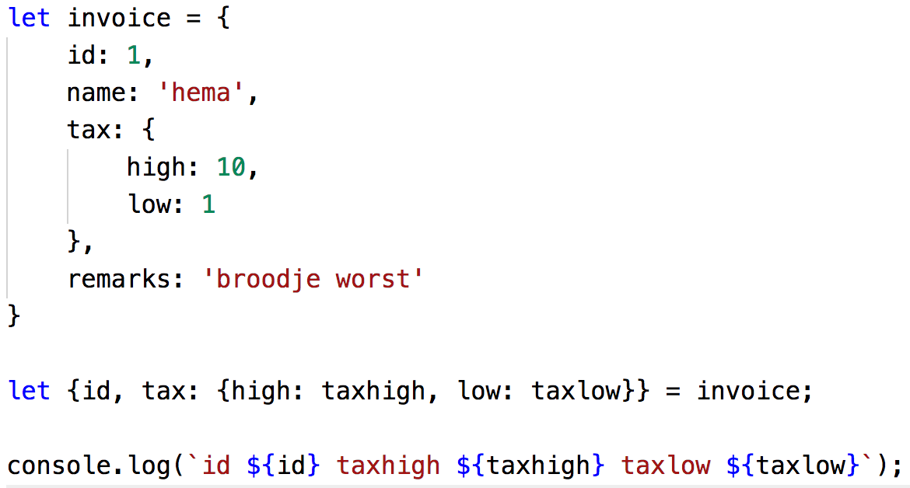

Destructuring
Unpack values from arrays or properties from object into distinct variables
Notes:
The destructuring assignment syntax is a JavaScript expression that makes it possible to unpack values from arrays, or properties from objects, into distinct variables.

