Slide 1

Docker for IT Rockstar Developers
Notes:
Show of hands
Nothing
Ran some containers
Running in production, using orchestration
A little something for everybody
Before we start show of hands, who has done nothing with docker, who used docker before, is running in production? I hope to teach the experienced docker users also some new things

Slide 2
On the menu
What is docker
Building containers: The basics
Break!
Building containers: Advanced
Docker Compose
Integration testing
Notes:
Possibilities of docker
Stopping before or at CI/CD
The talk with focus mainly on the development side of containers, we stop right before we would begin doing CI/CD integration.

Slide 3
NOT On the menu
Windows Containers
CI/CD integration
Container Orchestration
Notes:
Also no windows containers
I will be demo’ing on windows
No container orchestration (kubernetes/docker swarm)
Again, if there is time left I will touch lightly on the subject

Slide 4
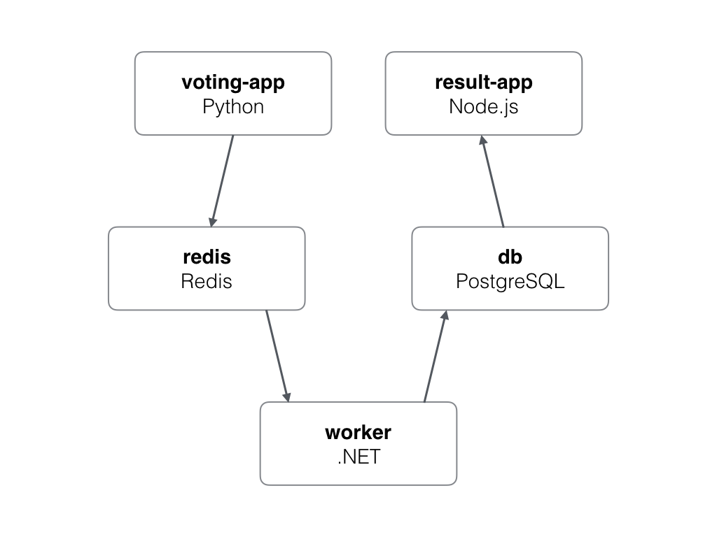
But first!
DEMO:
example-voting-app
Notes:
Power of docker
Easy
Nothing except docker to run this
This demo will show you the power of docker and what it can do, now I hope nobody ever finds him or herself in this situation where literally every service is written in a different language.
I do not have a lot of experience with all the components, I know them all but installing everything would take up a lot of my time and in the back of my head I can see the windows registry getting screwed already.
So all I must do to run all these application is run this simple command “docker-compose up” and everything will start.
Just hit ctrl+c and everything stops, and I can do other things, without for instance having the database still running.
Think of the possibilities:
no longer will you have to sit next to that new employee and take them through the long installation checklist.
or when you decide to update the SDK of one of the apps your whole team won't be mad at you for having to update to the latest version, potentially breaking something else they were working on.
We will come back to this at the end of the presentation, but for now let’s start at the beginning

Slide 5
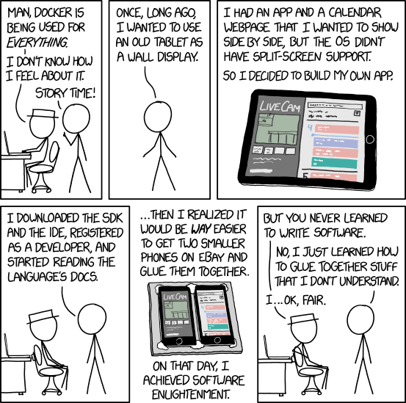
https://xkcd.com/1988/
Notes:
Obligatory xkcd

Slide 6
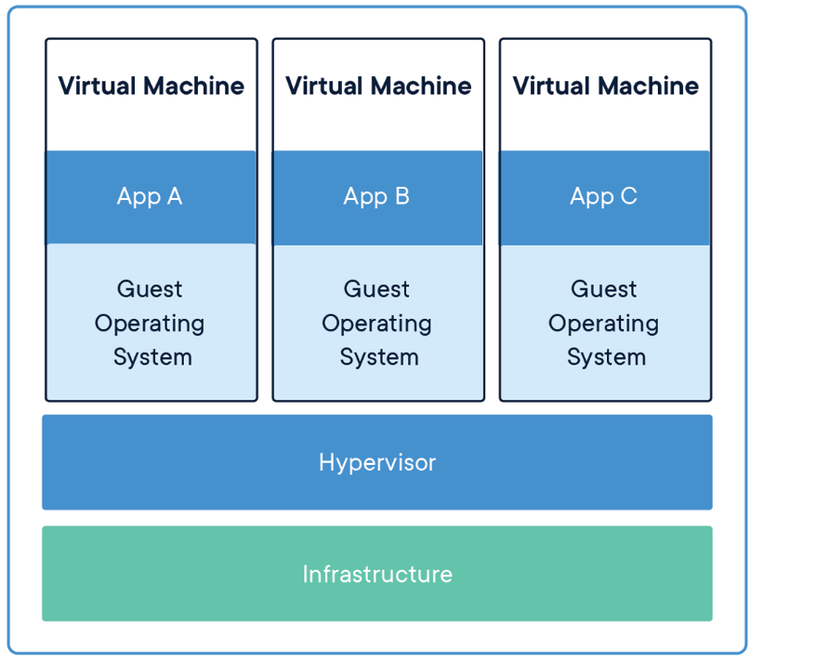
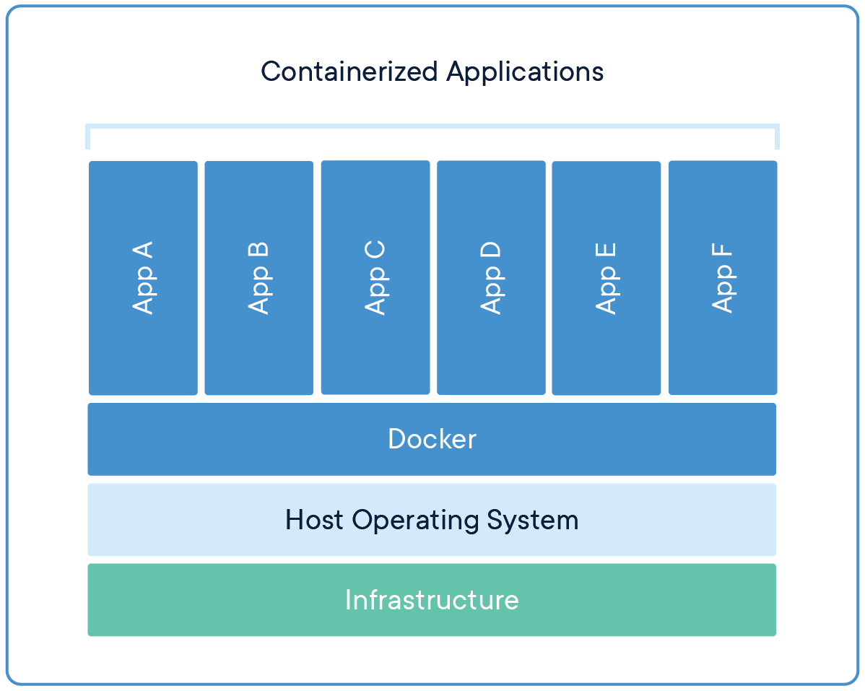
VMs vs Containers
Notes:
So what are containers exactly?
Snapshot of your environment with metadata
Houses (VMs) vs Appartments (Containers)
No separate OS’s running, all share the same kernel/plumbing
Describe your environment with your application
If you would be doing it right, you’d have a single (virtual) machine for a single app in order to isolate your systems but we all know that most of the time multiple application are being run, why? Overhead and complicated management. We have trouble keeping all the machine’s the same, maybe you installed some sdk update on your dev machine and now it’s broken on test or worse production.

Slide 7
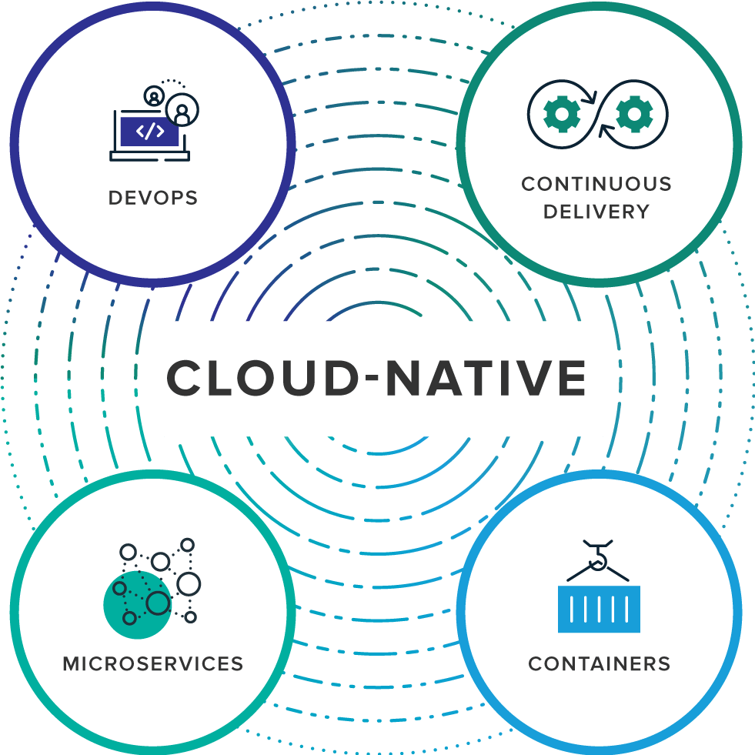
https://pivotal.io/cloud-native
Notes:
Cloud native
Lift and Shift
Easy CLI tools
Repeatability
Small/lightweight = microservices
Personally I think that microservers would not be as popular if Docker didn’t do what it did. It enables us to lift and shift to anywhere wether it is on premise or the cloud, but if you want to go cloud native but remain flexible container is the (dare I say it) only way to go.

Slide 8
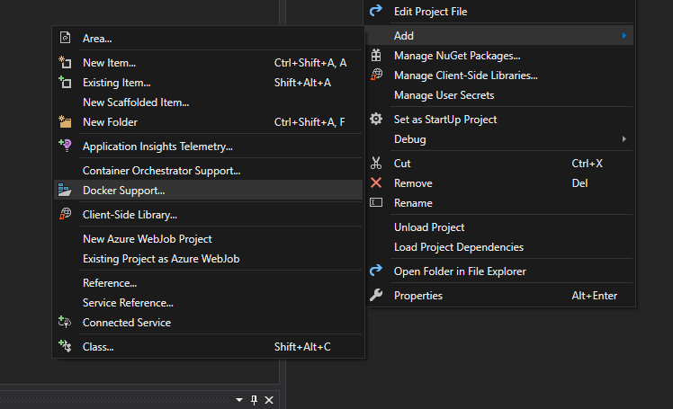
How not to get started with Docker
Notes:
Start small
Understand the bare metal
Just don’t use any tooling that does it all for you (in the beginning!) start small, with the “metal” and understand the concepts. That’s what we will be doing today.

Slide 9
Creating a Dockerfile
FROM ubuntu
COPY hello.sh /scripts/hello.sh
ENTRYPOINT[“hello.sh”]
Notes:
Simple container first
Start from ubuntu
Add files
Start a script

Slide 10
Demo demo demo

Slide 11
Break!
Notes:
Simple container first
Start from ubuntu
Add files
Start a script

Slide 12
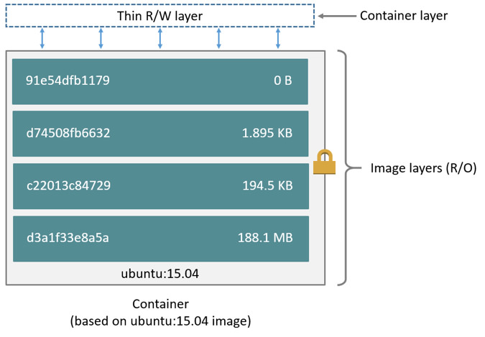
Let’s talk about layers
Notes:
Every COPY/ADD/RUN line will add another layer to your docker image. This means that when downloading a base or your own image you will download the layers not a final compressed state.
This also introduces some best practices to keep your layers small and keep size down (for faster downloads)

Slide 13
Why should I care about layers?
Efficient layers
=
Faster builds and downloads
=
Faster deployments
Notes:
What do I mean by “efficient” layers? There is always a tradeoff between size and changeability. Adding many layers will increase your image size more but ordering the layers smart has even more impact.

Slide 14
Demo demo demo
Notes:
What do I mean by “efficient” layers? There is always a tradeoff between size and changeability. Adding many layers will increase your image size more but ordering the layers smart has even more impact.

Slide 15
A note on deployment
Tag images
docker build –t myregistry.com/myimage:1.0.1 .
Push to a registry
docker push myregistry.com/myimage:1.0.1
Pull from the registry
docker pull myregistry.com/myimage:1.0.1

Slide 16
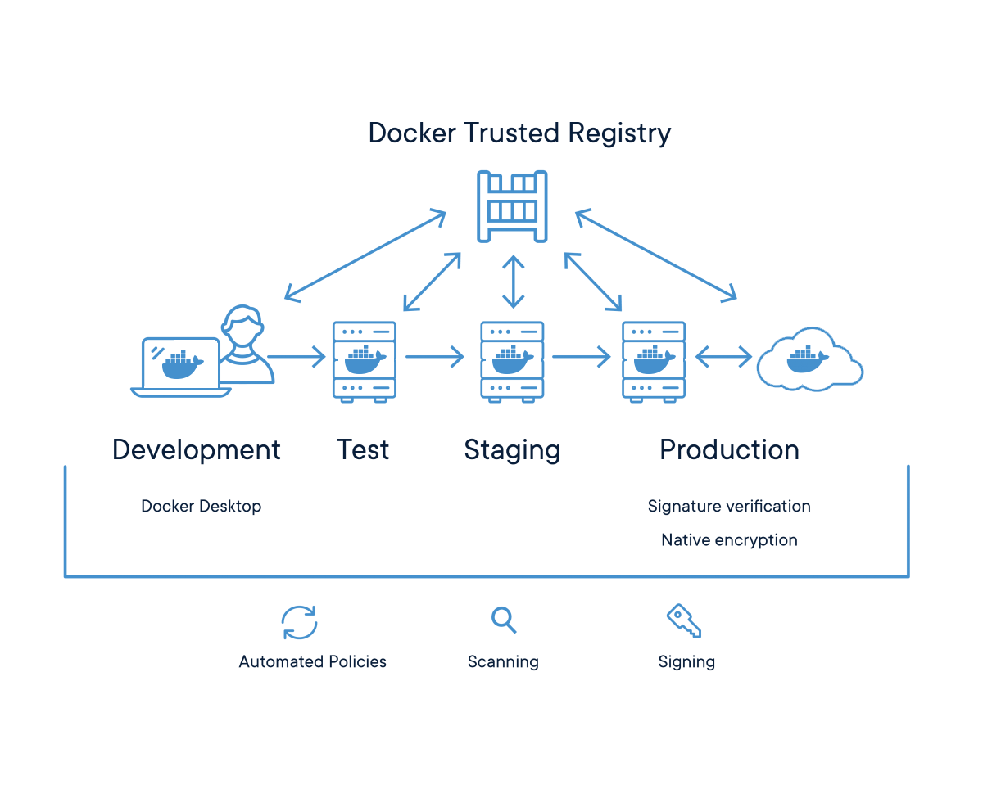
A note on source control
Figure out branch strategies
Container version = prod/acc/test version x
Trunk based development?
No more test/acc/prod branches!

Slide 17
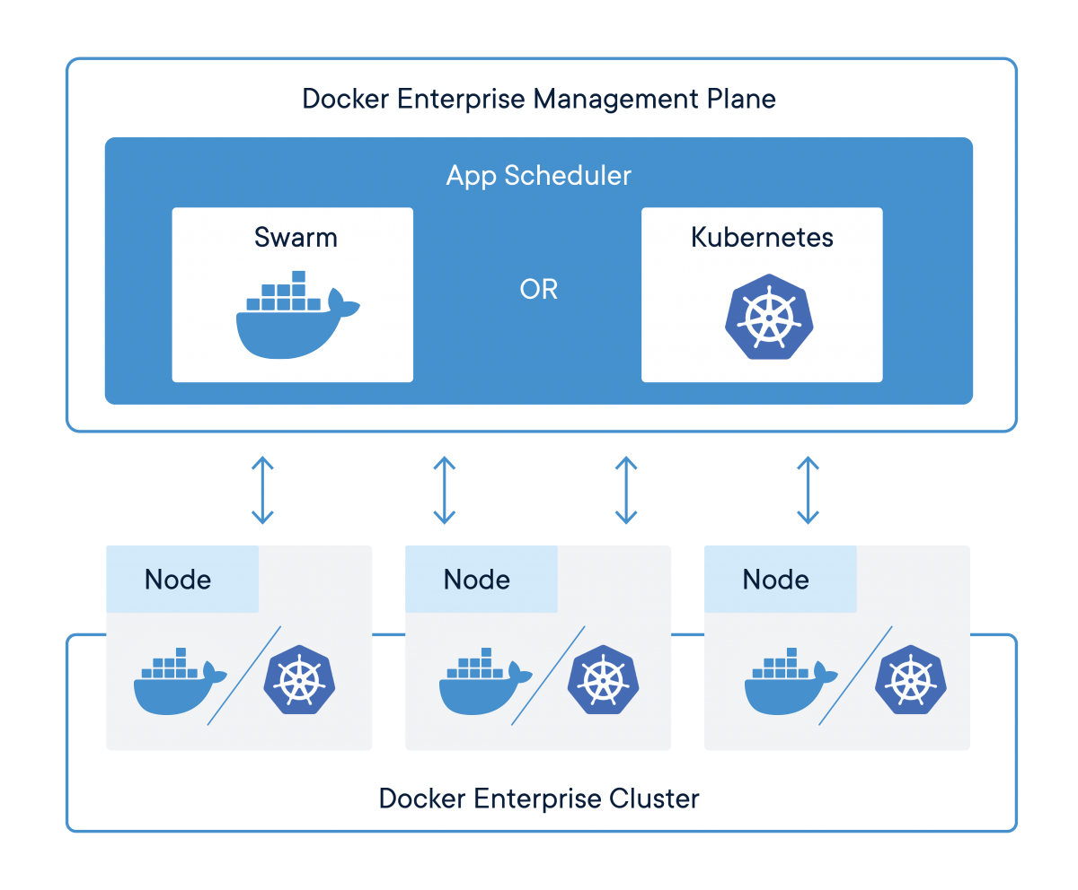
A note on orchestration

Slide 18

Links
https://github.com/maartenvana/ docker-for-it-rockstar-developers
https://docs.docker.com/
https://hub.docker.com/
.NET:
https://github.com/dotnet-architecture/eShopOnContainers

