Slide 1

Software Engineering Department
Attribution of Paintings
Tomer Barak 305284275
Hadi Abu-Maruf 301188504
Supervisor’s Name: Dr. Elena Ravve
4/7/2018

Slide 2
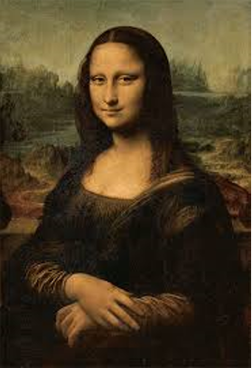
Definition of Attribution
Attribution of a painting is a process that determines an authenticity of a painting based on analysis of colors, style and techniques of the painter.

Slide 3
Related work
The project is mainly based on two previous projects:
“Attribution of Painting”
In this project, in some cases they succeed to attribute the painting to its style, but not to its painter.
2. “Image Segmentation”
This project implements a smart algorithm that divides an image into windows and finds similar windows in an image.

Slide 4
Our progress
In our project, we cluster our database in order to get better results to associate a painting to its style and painter.
We developed an algorithm that associates a painting to its cluster most of the times.
We tried to make pure style detection. However, it is a super complex target to reach in one step.
There are many cases, when our algorithm is close to provide good results.

Slide 5
Why is the project not trivial?
Generally, there is no efficient tool for those matches.
We improve a previous project.
We cluster our database to get better results.
The computer is not able to see like a human eye: it has no ability to recognize the texture, and it uses forced algorithms, which may not succeed

Slide 6
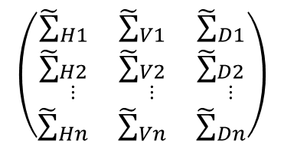
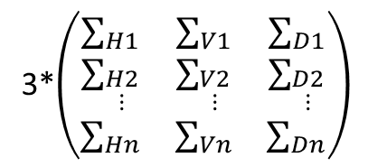
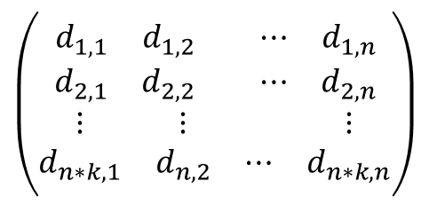
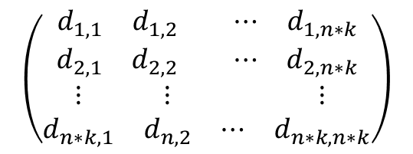
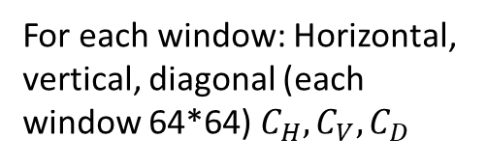
Preprocessing for each painting
3 matrices
(Matrix for each color)
For each color 64 windows
(each window 128*128)
Painting
1024*1024
1. Convert to RGB
2. Division to windows
3. Wavelet transform
For each window: Horizontal, vertical, diagonal (each window 64*64) $C_{H}, C_{V}, C_{D}$
Three variance matrices for each painting (RGB)
3*$\left(\begin{matrix}∑_{H1} & ∑_{V1} & ∑_{D1} \\ ∑_{\begin{aligned}H2 \\ ⋮\end{aligned}} & ∑_{\begin{aligned}V2 \\ ⋮\end{aligned}} & ∑_{\begin{aligned}D2 \\ ⋮\end{aligned}} \\ ∑_{Hn} & ∑_{Vn} & ∑_{Dn}\end{matrix}\right)$
4. Compute three variances for each window
5. Sum the three matrices
into one matrix
Distance matrix between each two windows in different painting
Variance RGB matrix
One distance matrix for all paintings
$$\left(\begin{matrix}{\tilde{∑}}_{H1} & {\tilde{∑}}_{V1} & {\tilde{∑}}_{D1} \\ {\tilde{∑}}_{\begin{aligned}H2 \\ ⋮\end{aligned}} & {\tilde{∑}}_{\begin{aligned}V2 \\ ⋮\end{aligned}} & {\tilde{∑}}_{\begin{aligned}D2 \\ ⋮\end{aligned}} \\ {\tilde{∑}}_{Hn} & {\tilde{∑}}_{Vn} & {\tilde{∑}}_{Dn}\end{matrix}\right)$$
$$\left(\begin{matrix}\begin{matrix}d_{1,1} & d_{1,2} \\ d_{2,1} & d_{2,2}\end{matrix} & \begin{matrix}⋯ & d_{1,n} \\ ⋯ & d_{2,n}\end{matrix} \\ \begin{matrix}⋮ & ⋮ \\ d_{n∗k,1} & d_{n,2}\end{matrix} & \begin{matrix} & ⋮ \\ ⋯ & d_{n∗k,n}\end{matrix}\end{matrix}\right)$$
$$\left(\begin{matrix}\begin{matrix}d_{1,1} & d_{1,2} \\ d_{2,1} & d_{2,2}\end{matrix} & \begin{matrix}⋯ & d_{1,n∗k} \\ ⋯ & d_{2,n∗k}\end{matrix} \\ \begin{matrix}⋮ & ⋮ \\ d_{n∗k,1} & d_{n,2}\end{matrix} & \begin{matrix} & ⋮ \\ ⋯ & d_{n∗k,n∗k}\end{matrix}\end{matrix}\right)$$
6. Geodesic distance
7. distAll matrices
8. Clustering

Slide 7



Clustering of the DB
vector that represent the cluster
8.3 Sum the max appearance to cluster i
8.4 Clustered DB
8.1 Partitioning Around Medoids (PAM) clustering
8.2 Convert vector to matrix
$$\left(\begin{matrix}c_{1} \\ c_{2} \\ \begin{aligned}⋮ \\ c_{n∗k}\end{aligned}\end{matrix}\right)$$
Distance matrix
$$\left(\begin{matrix}\begin{matrix}d_{1,1} & d_{1,2} \\ d_{2,1} & d_{2,2}\end{matrix} & \begin{matrix}⋯ & d_{1,n∗k} \\ ⋯ & d_{2,n}\end{matrix} \\ \begin{matrix}⋮ & ⋮ \\ d_{n∗k,1} & d_{n,2}\end{matrix} & \begin{matrix} & ⋮ \\ ⋯ & d_{n∗k,n∗k}\end{matrix}\end{matrix}\right)$$
Matrix of indexes, each index represent window, each row represent painting
$$\left(\begin{matrix}\begin{matrix}c_{1,1} & c_{1,2} \\ c_{2,1} & c_{2,2}\end{matrix} & \begin{matrix}⋯ & c_{1,n} \\ ⋯ & c_{2,n}\end{matrix} \\ \begin{matrix}⋮ & ⋮ \\ c_{n,1} & c_{n,2}\end{matrix} & \begin{matrix} & ⋮ \\ ⋯ & c_{n,n}\end{matrix}\end{matrix}\right)$$
Paintings clustered by their style

Slide 8
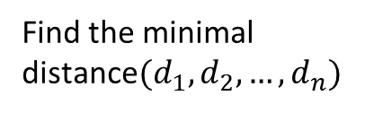

Input painting process
$$\left(\begin{matrix}\begin{matrix}0 & d_{1,2} \\ d_{2,1} & 0\end{matrix} & \begin{matrix}⋯ & d_{1,n} \\ ⋯ & d_{2,n}\end{matrix} \\ \begin{matrix}⋮ & ⋮ \\ d_{n,1} & d_{n,2}\end{matrix} & \begin{matrix} & ⋮ \\ ⋯ & 0\end{matrix}\end{matrix}\right)$$
Associate an input to a cluster
Associate an input to a painter
(using Pareto Optimization)
Steps 1-6 of preprocessing
Calculate the minimal Euclidian Distance from each cluster using k-medoids
Show results
Input painting
Find the minimal distance$(d_{1},d_{2},…,d_{n})$
Painting associated to a cluster

Slide 9
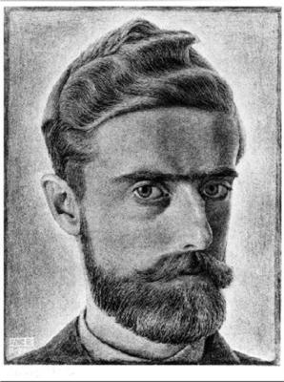
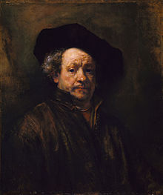
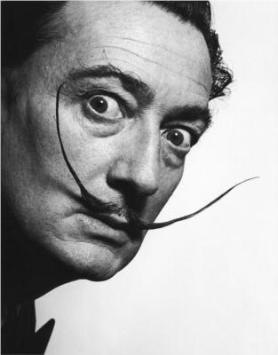
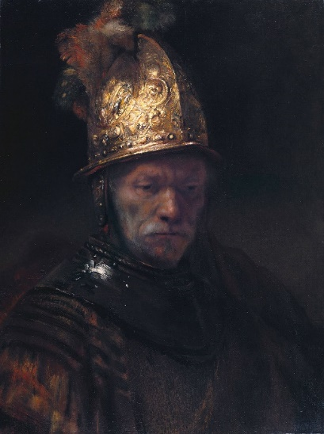

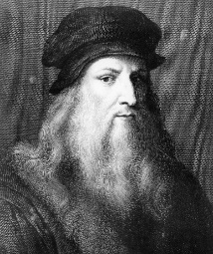
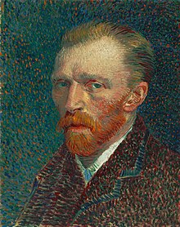
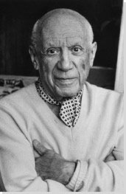
Algorithm – Input
Choosing a painting we want to classify (greyscale/RGB).
A painting of potential artists.
The test painting may belong to one of them.
Who painted “The Man with the Golden Helmet”?
Database

Slide 10
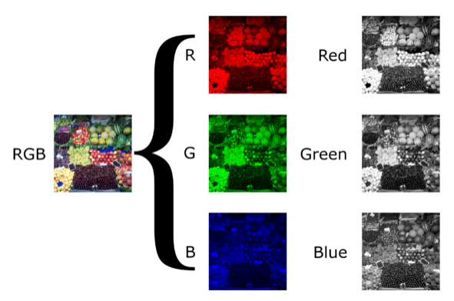
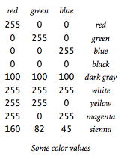
1. Algorithm – Converting to RGB
Input: painting matrix.
Converting all inputted paintings to RGB gray level format to get better results, represented as matrices of pixels, where each value is luminance of a color.
Output: three R,G,B matrices.

Slide 11
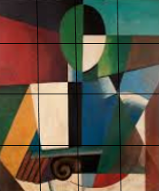
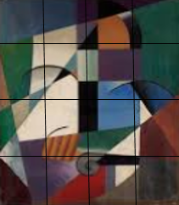
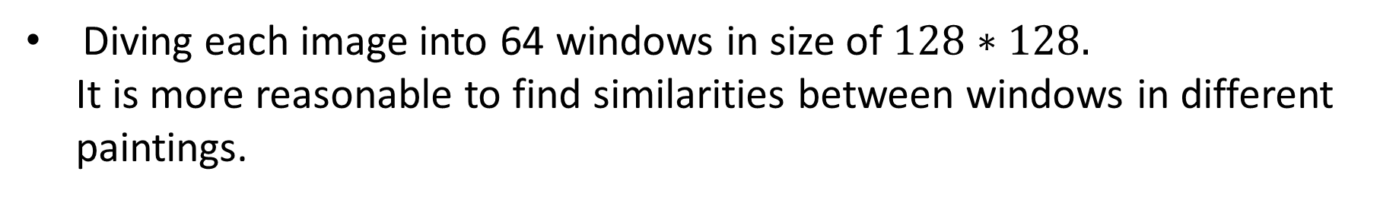
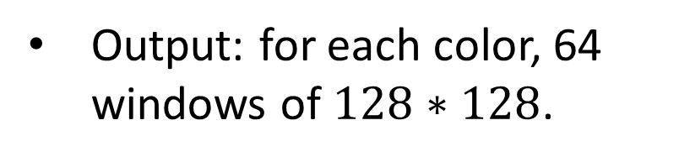
2. Algorithm – Division to windows
Input: three R,G,B matrices.
Diving each image into 64 windows in size of $128∗128.$
It is more reasonable to find similarities between windows in different
paintings.
Output: for each color, 64 windows of $128∗128$.

Slide 12
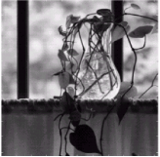
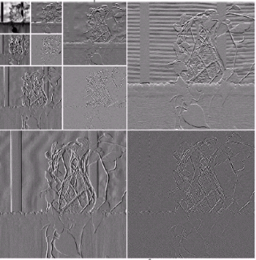
3. Algorithm – Wavelet Transform for each window
Input: for each color, 16 windows 128*128.
Using of wavelet transform on window in order to get wavelet coefficients (texture characteristics).
Output: Horizontal, vertical and diagonal matrices.

Slide 13
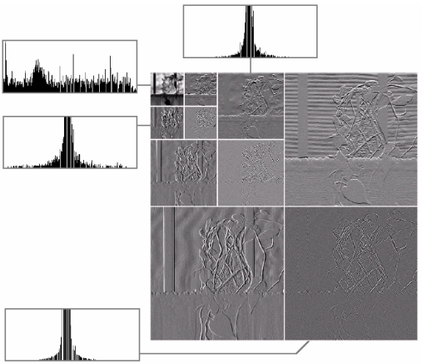
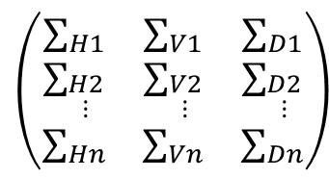
4. Gaussian Distribution for each color and window
Input: Horizontal, vertical and diagonal matrices.
Here, Gaussian Distribution provides us the distribution of a window as histogram, which is always gathered around the center.
After dividing a window to four parts,
calculate the variance of each part
according to its histogram.
Output: Matrix of variances
$$\left(\begin{matrix}∑_{H1} & ∑_{V1} & ∑_{D1} \\ ∑_{\begin{aligned}H2 \\ ⋮\end{aligned}} & ∑_{\begin{aligned}V2 \\ ⋮\end{aligned}} & ∑_{\begin{aligned}D2 \\ ⋮\end{aligned}} \\ ∑_{Hn} & ∑_{Vn} & ∑_{Dn}\end{matrix}\right)$$

Slide 14
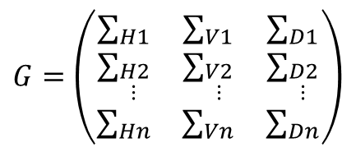
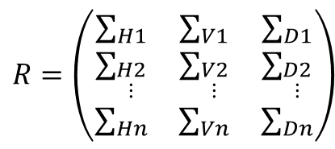


5. Sum the R,G,B matrices into one matrix
$$R=\left(\begin{matrix}∑_{H1} & ∑_{V1} & ∑_{D1} \\ ∑_{\begin{aligned}H2 \\ ⋮\end{aligned}} & ∑_{\begin{aligned}V2 \\ ⋮\end{aligned}} & ∑_{\begin{aligned}D2 \\ ⋮\end{aligned}} \\ ∑_{Hn} & ∑_{Vn} & ∑_{Dn}\end{matrix}\right)$$
$$G=\left(\begin{matrix}∑_{H1} & ∑_{V1} & ∑_{D1} \\ ∑_{\begin{aligned}H2 \\ ⋮\end{aligned}} & ∑_{\begin{aligned}V2 \\ ⋮\end{aligned}} & ∑_{\begin{aligned}D2 \\ ⋮\end{aligned}} \\ ∑_{Hn} & ∑_{Vn} & ∑_{Dn}\end{matrix}\right)$$
$B=$ $\left(\begin{matrix}∑_{H1} & ∑_{V1} & ∑_{D1} \\ ∑_{\begin{aligned}H2 \\ ⋮\end{aligned}} & ∑_{\begin{aligned}V2 \\ ⋮\end{aligned}} & ∑_{\begin{aligned}D2 \\ ⋮\end{aligned}} \\ ∑_{Hn} & ∑_{Vn} & ∑_{Dn}\end{matrix}\right)$
Input:
Sum the three matrices into one matrix.
Output:
$$RGB=\left(\begin{matrix}{\tilde{∑}}_{H1} & {\tilde{∑}}_{V1} & {\tilde{∑}}_{D1} \\ {\tilde{∑}}_{\begin{aligned}H2 \\ ⋮\end{aligned}} & {\tilde{∑}}_{\begin{aligned}V2 \\ ⋮\end{aligned}} & {\tilde{∑}}_{\begin{aligned}D2 \\ ⋮\end{aligned}} \\ {\tilde{∑}}_{Hn} & {\tilde{∑}}_{Vn} & {\tilde{∑}}_{Dn}\end{matrix}\right)$$

Slide 15


6. Algorithm - Similarity Measurement by Gaussian Distance
Input: matrix of variances
Using Geodesic Distance (GD) provides us the similarity level.
We compare between the variances of each two windows in different painting.
Output: matrix of distances between each two windows
$$RGB=\left(\begin{matrix}{\tilde{∑}}_{H1} & {\tilde{∑}}_{V1} & {\tilde{∑}}_{D1} \\ {\tilde{∑}}_{\begin{aligned}H2 \\ ⋮\end{aligned}} & {\tilde{∑}}_{\begin{aligned}V2 \\ ⋮\end{aligned}} & {\tilde{∑}}_{\begin{aligned}D2 \\ ⋮\end{aligned}} \\ {\tilde{∑}}_{Hn} & {\tilde{∑}}_{Vn} & {\tilde{∑}}_{Dn}\end{matrix}\right)$$
$$\left(\begin{matrix}\begin{matrix}d_{1,1} & d_{1,2} \\ d_{2,1} & d_{2,2}\end{matrix} & \begin{matrix}⋯ & d_{1,n} \\ ⋯ & d_{2,n}\end{matrix} \\ \begin{matrix}⋮ & ⋮ \\ d_{n∗k,1} & d_{n,2}\end{matrix} & \begin{matrix} & ⋮ \\ ⋯ & d_{n∗k,n}\end{matrix}\end{matrix}\right)$$

Slide 16


7. Algorithm - Similarity Measurement by Gaussian Distance
Input: matrices of distances
Combine all matrices into one matrix.
Output: One large matrix of distances between each two windows
$$\left(\begin{matrix}\begin{matrix}d_{1,1} & d_{1,2} \\ d_{2,1} & d_{2,2}\end{matrix} & \begin{matrix}⋯ & d_{1,n} \\ ⋯ & d_{2,n}\end{matrix} \\ \begin{matrix}⋮ & ⋮ \\ d_{n∗k,1} & d_{n,2}\end{matrix} & \begin{matrix} & ⋮ \\ ⋯ & d_{n∗k,n}\end{matrix}\end{matrix}\right)$$
$$\left(\begin{matrix}\begin{matrix}d_{1,1} & d_{1,2} \\ d_{2,1} & d_{2,2}\end{matrix} & \begin{matrix}⋯ & d_{1,n∗k} \\ ⋯ & d_{2,n∗k}\end{matrix} \\ \begin{matrix}⋮ & ⋮ \\ d_{n∗k,1} & d_{n,2}\end{matrix} & \begin{matrix} & ⋮ \\ ⋯ & d_{n∗k,n∗k}\end{matrix}\end{matrix}\right)$$

Slide 17
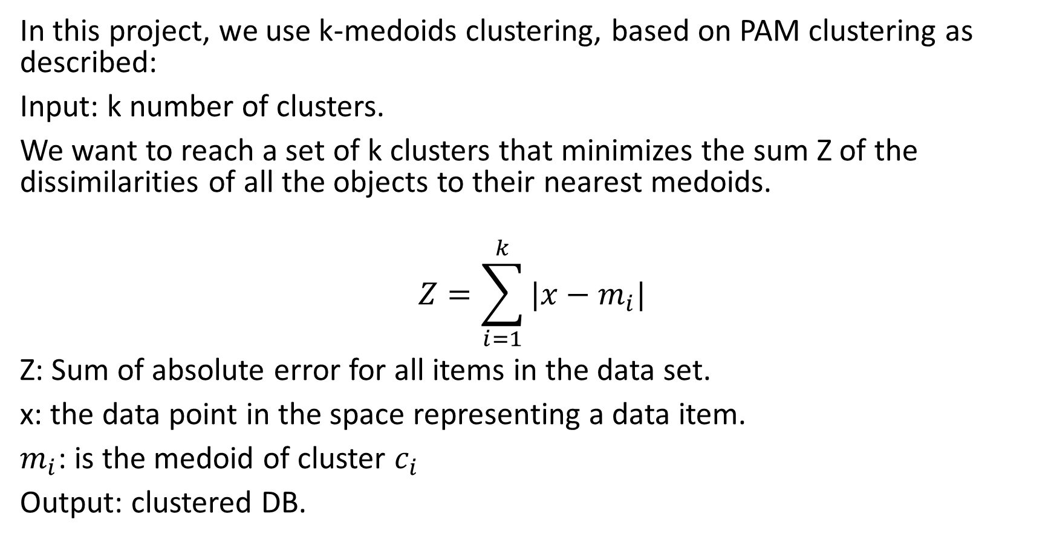
8. Clustering the DB
In this project, we use k-medoids clustering, based on PAM clustering as described:
Input: k number of clusters.
We want to reach a set of k clusters that minimizes the sum Z of the dissimilarities of all the objects to their nearest medoids.
$$Z=\sum_{i=1}^{k}{|x−m_{i}|}$$
Z: Sum of absolute error for all items in the data set.
x: the data point in the space representing a data item.
$m_{i}$: is the medoid of cluster $c_{i}$
Output: clustered DB.

Slide 18
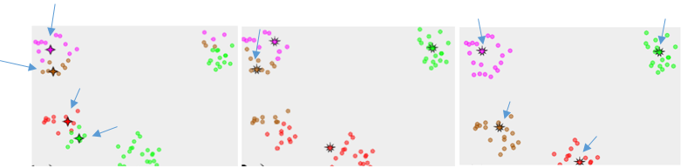
K - medoids demonstration
Finding the best partition provides the best clustering of k styles.
In this example, k=4.
Stage 1, Z = 40
…
Stage i, Z=50
…
Stage n, Z=10
We found that case 3 is the optimal clustering solution.
Now our DB is clustered.

Slide 19
Associating of a painting to its painter using medoids
What has left to do is to find which painter given has the shortest distance between his paintings collection and the input. In multi-criteria optimization, there does not typically exist a feasible solution that minimizes all objective functions simultaneously.
Therefore, attention is paid to Pareto optimal solutions.
Our criteria will be minimization the distances between inputs and in the cluster.

Slide 20


Algorithm – Classification of test painting
After implementing of all stages of the algorithm, we can classify a tested input painting to its potential artists.
Database
Belongs to Ivan Rembrandt

Slide 21
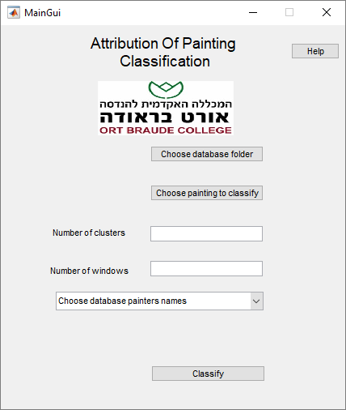
GUI results
The user selects the following:
Databases folder
Input painting
Number of cluster
Number of windows
Database painters
User chose all necessary data and clicked “Classify”.

Slide 22
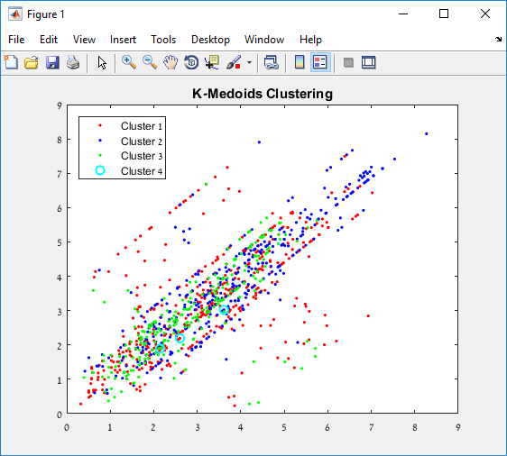
Classification results
1. K-medoids clustering visual demonstration

Slide 23
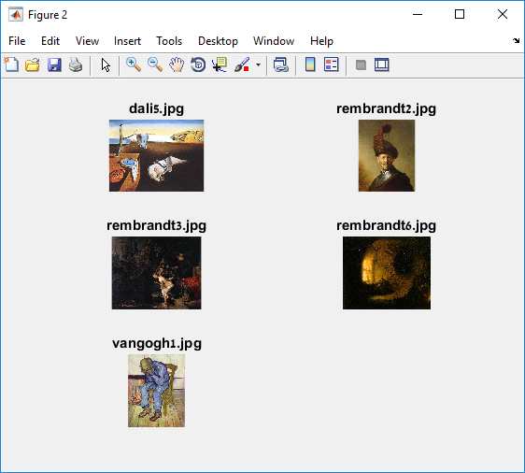
Classification results
2. Five (at most) best matching paintings in the same cluster

Slide 24
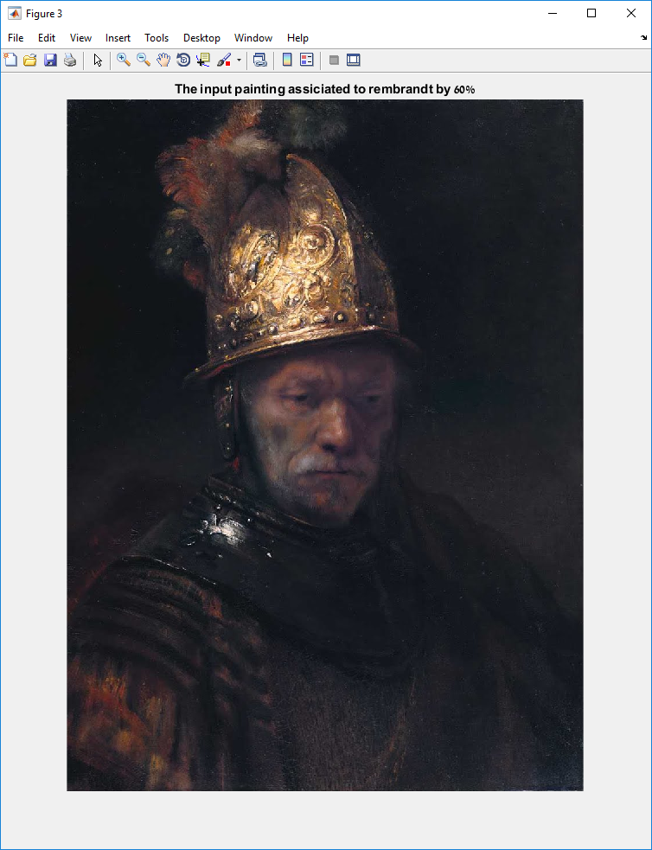
Classification results
3. Painter association

Slide 25
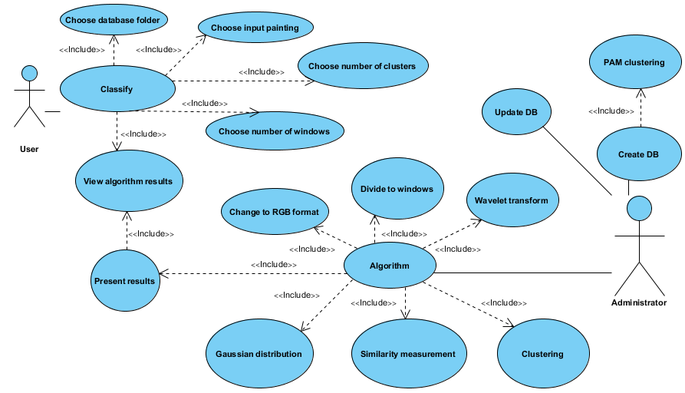
Use Case

Slide 26
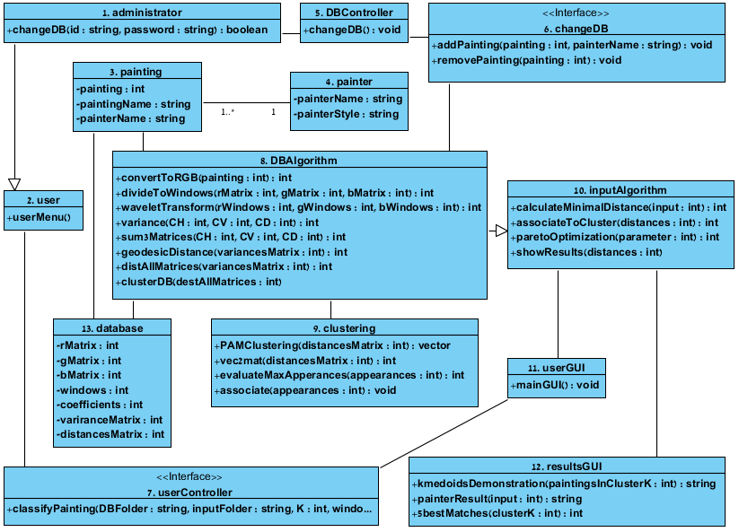
Class Diagram

Slide 27
Results
First database with 17 paintings
No. | Description | Comments | Results
1 | Input: Van Goghs painting Number of clusters: 3 Number of windows: 64 | Database is quite balanced for van Gogh. He has 5/17 paintings in first database. Parameters are strict. | 100% success.
2 | Input: Van Goghs painting Number of clusters: 3 Number of windows: 36 | Database is quite balanced for van Gogh. He has 5/17 paintings in first database. Number of windows is lower. | 70% success.
3 | Input: Van Goghs painting Number of clusters: 2 Number of windows: 64 | Database is quite balanced for van Gogh. He has 5/17 paintings in first database. Number of clusters is lower. | 90% success.

Slide 28
Second database with 45 paintings
No. | Description | Comments | Results
1 | Input: Van Gogh painting Number of clusters: 5 Number of windows: 64 | Database tends for van Gogh a little. He has 12/45 paintings in second database. Parameters are strict. | 100% success.
2 | Input: Van Gogh painting Number of clusters: 5 Number of windows: 36 | Database tends for van Gogh a little. He has 12/45 paintings in second database. Number of windows is lower. | 20% success.
3 | Input: Aivazovsky painting Number of clusters: 5 Number of windows: 64 | Database quite balanced for Aivazovsky. He has 10/45 paintings in second database. | 80% success.
4 | Input: Aivazovsky painting Number of clusters: 5 Number of windows: 36 | Database quite balanced for Aivazovsky. He has 10/45 paintings in second database. | 60% success.

Slide 29
Conclusions – good points
The previous project did not cluster database, it caused bad results.
We succeeded to create an algorithm that clusters a database and uses this classification to get right results. The algorithm has good success rate and there is always a chance to succeed.
Even when the algorithm fails, it can still find several similar paintings to the input ,which are correct.
Building a database wisely increases the success rate.
There are many parts in the algorithm which are open for new functions or improvements. The algorithm is dynamic.

Slide 30
Conclusions – bad points
The algorithms success rate depends crucially on database and parameters.
It demands knowledge in paintings, which not everyone has.
If the clustering is not accurate enough, then the algorithm always fails and the results are pointless. Working with a big database must cluster perfectly.
The algorithm has some weaknesses. It is vulnerable to some types of database that do not keep strict conditions.

Slide 31
Conclusions – ideas for improvement
It is better as much as there are more differences between paintings of different painters, and less differences of paintings of the same painter.
There should be a balance with the quantity of paintings for each painter.
Recruiting an expert in paintings to build a database will be clever.

Slide 32
Summary
We found the project very interesting but also challenging.
We have made all efforts to implement. We want all requirements done.
However, we learned from our friends experience that this is not a simple project, but we think that we made a significant progress.
Probably, there will be a continuous project to our. Now, our descendants can start from a good basic and will improve our results.

