Slide 1



ImageJ Legacy
Matthias Arzt
maarzt
arzt@mpi-cbg.de

Slide 2
Session Overview
Why legacy? (5 Slides)
How to distinguish IJ1 / IJ2? (2 Slides)
IJ1 and IJ2 Versions of: (4 Slides)
  Images
  Rois
  (Services)
  Tables
4 Exercises

Slide 3
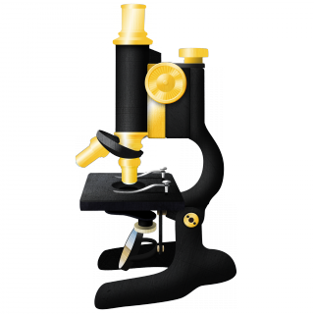
Why ImageJ2 ?
Modern Software Architecture
UI Independent / Headless
Extensible
Imglib 2

Slide 4
Advantage of ImgLib2
IJ1
ImgLib2
// normalize all pixels
for (int t = 1; t <= output.getNFrames(); t++) {
input.setT(t);
output.setT(t);
for (int c = 1; c <= output.getNChannels(); c++) {
input.setC(c);
output.setC(c);
for (int z = 1; z <= output.getNSlices(); z++) {
input.setZ(z);
output.setZ(z);
ImageProcessor inputProcessor = input.getProcessor();
ImageProcessor outputProcessor = output.getProcessor();
for (int x = 0; x < output.getWidth(); x++) {
for (int y = 0; y < output.getWidth(); y++) {
float value = inputProcessor.getf(x, y);
float normalisedValue = (value - minPixelValue)
/ (maxPixelValue - minPixelValue);
outputProcessor.setf(x, y, normalisedValue);
}
}
}
}
}
// normalize all pixels
Cursor<T> inputCursor = Views.flatIterable(input).cursor();
Cursor<FloatType> outputCursor = output.cursor();
while (inputCursor.hasNext() && outputCursor.hasNext()) {
float value = inputCursor.next().getRealFloat();
float normalisedValue = (value - minPixelValue) /
(maxPixelValue - minPixelValue);
outputCursor.next().set(normalisedValue);
}

Slide 5
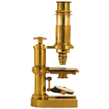
Why ImageJ1
UI
Mature Software
Useful / Widely Used Tool
Limited Extensibility

Slide 6
FIJI is IJ1 + IJ2
Thats crazy! How does it work?

Slide 7
FIJI is IJ1 + IJ2
imagej-legacy
<dependency>
<groupId>net.imagej</groupId>
<artifactId>imagej-legacy</artifactId>
</dependency>
Extends IJ2
LegacyService
LegacyDisplayService
Converters:
  Images
  Table
  Rois
  ...
Injects code into IJ2:
Main Menu
PlugIn Execution IJ.run(...)
Image Opening
...

Slide 8
Why is legacy still important?
Because of:
Macro Recorder
Save + Open Images
(Sometimes faster + weird)
Missing Functionality:
  Rois (done)
  Tables (done)
  Progress Bar (done)

Slide 9
How to distinguish?
IJ1
IJ2
import ij.…
IJ.…
new ij.ImageJ()
PlugInFilter
ImagePlus
ImageStack
ImageProcessor
ImageWindow
Roi
Overlay
import net.imagej.…
import net.imglib2.…
import com.scijava.…
new net.imagej.ImageJ()
Context, …Service
Command
@Plugin, @Paramter
Img, Dataset
RandomAccessibleInterval
FloatType, UnsigneByteType…

Slide 10
How to distinguish?
IJ1 vs. IJ2 Plugin
public class ImageNormalizerPlugin
implements PlugInFilter
{
@Override
public int setup(String s, ImagePlus imagePlus)
{
return DOES_8G + DOES_16 + DOES_32;
}
@Override
public void run(ImageProcessor imageProcessor)
{
ImagePlus input = IJ.getImage();
// process …
ImagePlus output = …;
output.show();
}
}
Config File:
* plugins.config
@Plugin(type = Command.class,
menuPath = "Plugins>Filtering>Normalisation")
public class ImageNormalizerPlugin
implements Command
{
@Parameter
Dataset input;
@Parameter( type = ItemIO.OUTPUT )
ImageJ output;
@Override
public void run()
{
// process ...
output = ...;
}
}

Slide 11
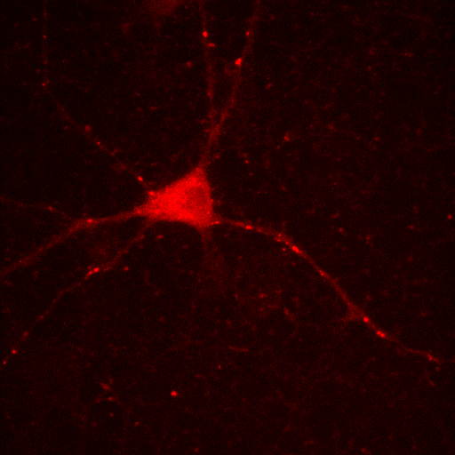
Images

Slide 12
Images
IJ1
IJ2
ImagePlus
ImageStack
ImageProcessor
Dataset
Img & RandomAccessibleInterval
Conversion:
- ConvertService (not recommended)
→ Img<?> img = ImageJFunctions.wrap(imagePlus);
→ Img<? Extends RealType<?>> img = ImageJFunctions.wrap(imagePlus);
← ImagePlus imagePlus = ImageJFunctions.wrap(img, “title”)

Slide 13
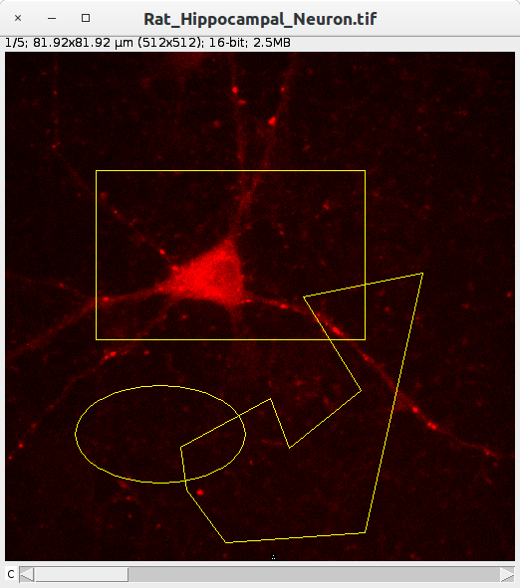
Rois
Regions Of Interest

Slide 14
Rois
IJ1
IJ2
Roi
Overlay
(collection of Roi)
RealRoi
ROITree
(tree of ???)
Conversion:
ConvertService (recommended)
→ RealRoi roi2 = convertService.convert(roi1, RealRoi.class);
← Roi roi1 = convertService.conver(roi2, Roi.class);
Note: imagePlus.getRoi(), imagePlus.getOverlay()

Slide 15
Services
IJ1
IJ2
IJ.openImage(…)
IJ.save(…)
IJ.log(…)
IJ.show(…)
IJ.run(...)
IJ.showProgress()
DatasetIOService
IOService
LogService / Logger
UIService
CommansService, OpService
StatusService
Gateway | In a Command | From the Context
ImageJ imageJ = new ImageJ(); imageJ.ui() | @Parameter UIService uiService; | Context context = …; context.service(UIService.class)

Slide 16
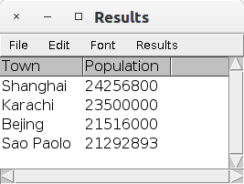
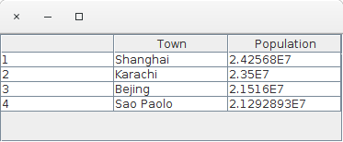
Tables
IJ1
IJ2
ResultsTable
GenericTable
Conversion:
Cheetsheet
ConvertService (recommended)
→ RealRoi roi2 = convertService.convert(roi1, RealRoi.class);

Slide 17
Links
Exercises:
  https://github.com/maarzt/imagej-legacy-course
Cheatsheet:
  https://github.com/mpicbg-scicomp/ij2course-images/blob/master/slides/ij_legacy_cheetsheet.pdf
ImageJ Legacy Course focused on:
Updating Image Processing Pipeline IJ1 → IJ2
  https://github.com/mpicbg-scicomp/ij2course-images
  https://github.com/mpicbg-scicomp/ij2course-regions
  https://github.com/mpicbg-scicomp/ij2course-tables

