Slide 1
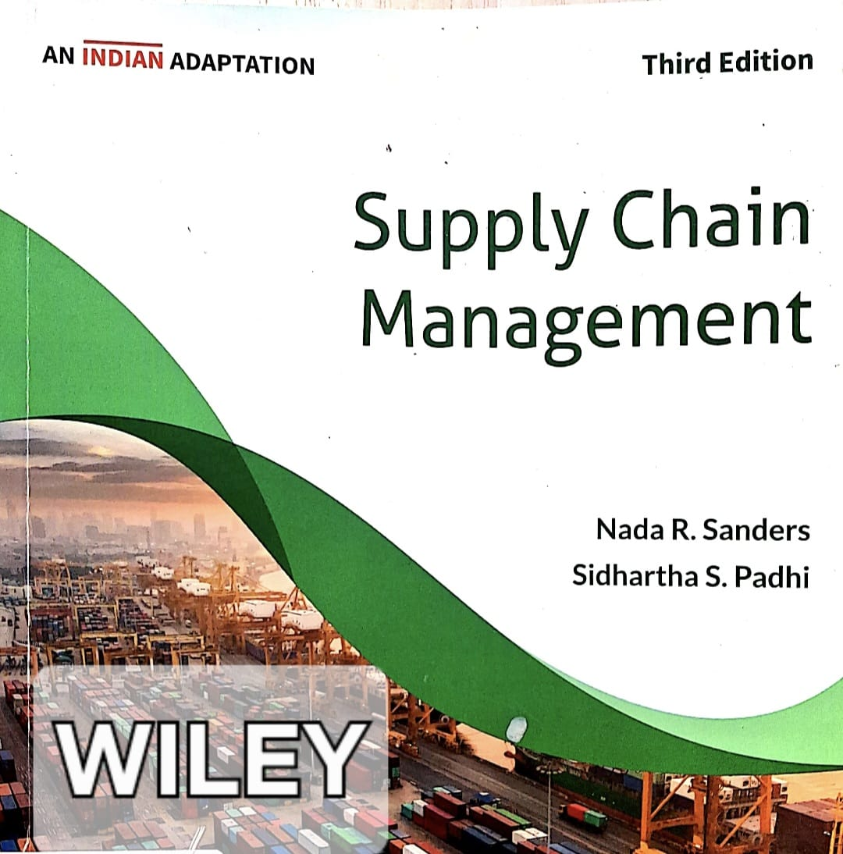
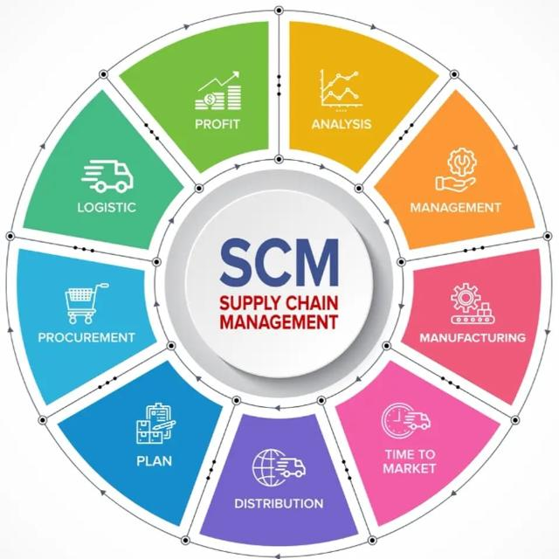

Slide 2
SUBJECT: SUPPLY CHAIN MANAGEMENT STRATEGY
CHAPTER: 09
CHAPTER TITLE: Inventory Management
REFERENCE BOOK:
SUPPLY CHAIN MANAGEMENT (AN INDIAN ADAPTATION), N R SANDERS & S S PADHI, WILEY, 3RD ED. (2023)

Slide 3
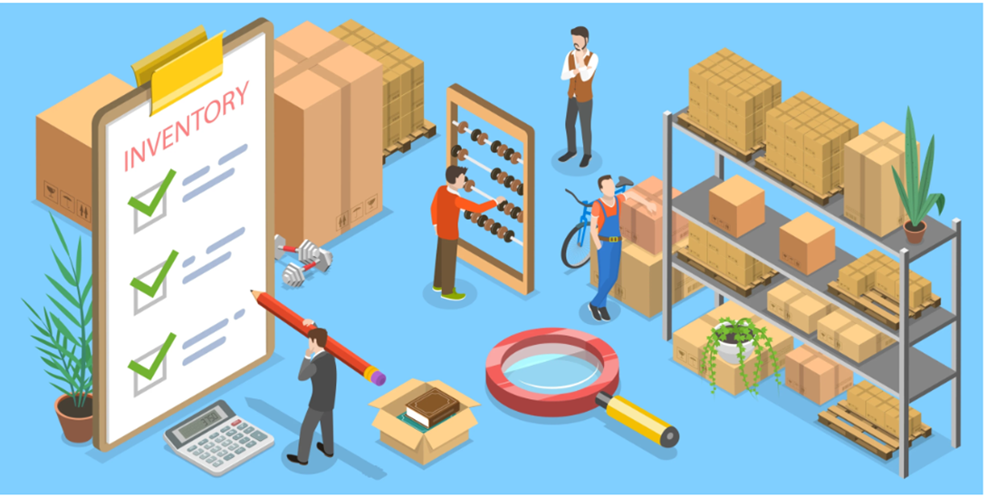
WHAT IS INVENTORY?
Quantities of goods in stock, i.e, stock of raw materials and finished goods.

Slide 4
MANUFACTURING & SERVICE INVENTORY
Manufacturing Inventory: Manufacturing organisations carry inventory.
Inventory of Raw materials and component parts that are delivered from suppliers.
Work-in-process (WIP) inventory: Raw materials and component parts enter the production process
Inventory of Finished Goods: Stock of finished goods after the completion of the production process.
Service Inventory:
The tangible goods that support delivery of the service, such as medical tools in an operating room or soaps in a hotel chain. It also includes items sold as part of the service, such as hair products at a beauty salon.

Slide 5
REASONS FOR CARRYING INVENTORY
Protect Against Lead Time Demand | Holding extra inventory (safety stock) to ensure you have enough products to meet customer orders while waiting for new stock to arrive from suppliers.
Maintain Independence of Operations | Holding enough buffer stock (raw materials, work-in-process, or finished goods) to ensure production and sales continue uninterrupted by supply chain disruptions, vendor delays, or demand fluctuations.

Slide 6
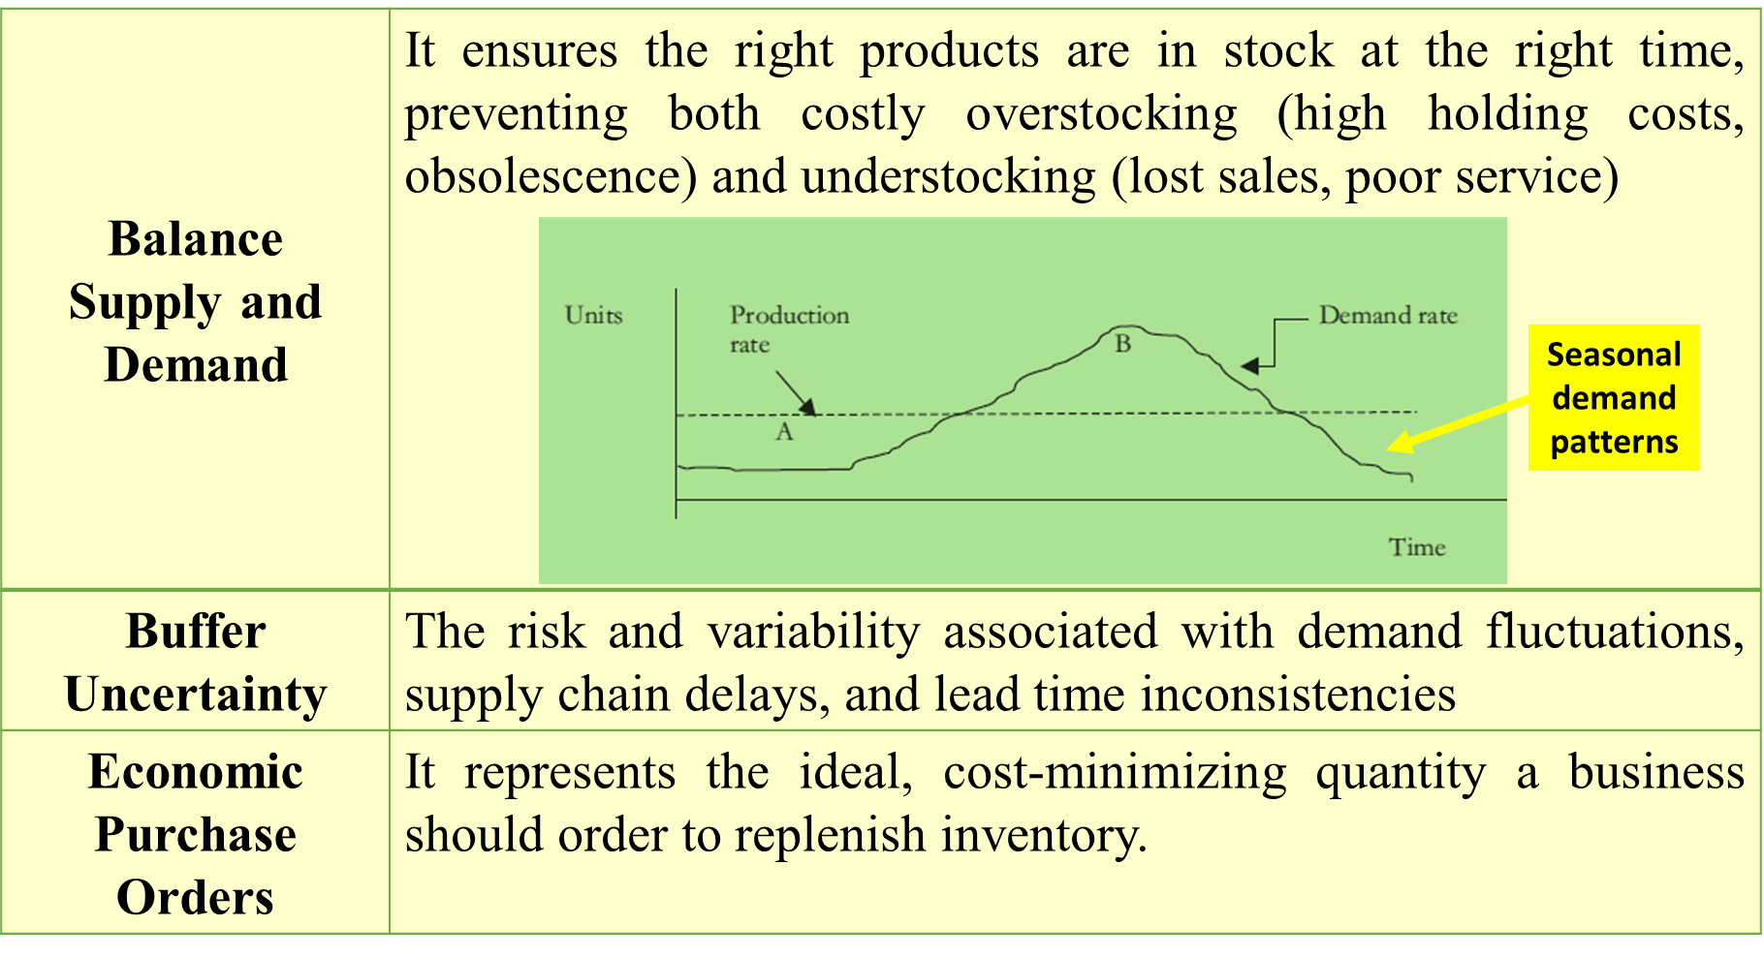
REASONS FOR CARRYING INVENTORY

Slide 7
TYPES OF INVENTORY
Cycle Stock (Lot Size Inventory) | Inventory for immediate use and is computed based on expected demand over a certain time period.
Safety Stock (Buffer Stock) | The extra inventory the firm carry to serve as a cushion for uncertainties in supply and demand.
Anticipation inventory | Extra stock acquired in advance of anticipated demand surges, seasonal spikes, or expected supply chain disruptions.
Pipeline inventory (Transportation Inventory) | Goods that have been ordered and paid for but are still in transit from a supplier to a warehouse or, finally, to the customer.
Maintenance, Repair & Operating Items (MRO) | Supplies, consumables, and spare parts used to support daily production and facility upkeep without becoming part of the finished product

Slide 8
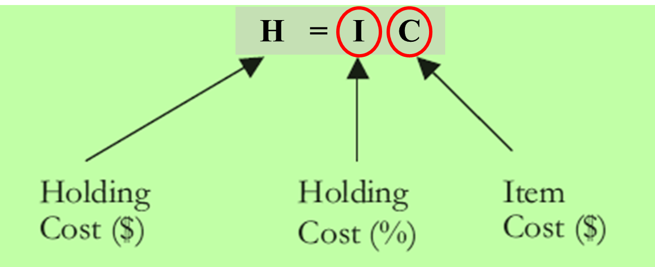
INVENTORY COSTS
Holding Cost (Carrying Cost)
Ordering Cost (Setup Cost) | Costs involved in placing an order and procuring the item and involves deciding on order quantities, clerical costs involved in placing the order, tracking the order, and receiving it. Lowering ordering cost will result in a higher inventory cost as we then have to carry more in stock.
Shortage costs | Shortage costs occur when we run out of stock and reflects the consequences of not having enough in inventory.
Costs that vary with the amount of inventory held in stock, including storage facilities, handling, insurance, breakage, depreciation, taxes, and the opportunity cost of capital. This cost varies with the time period inventory is held in stock.

Slide 9
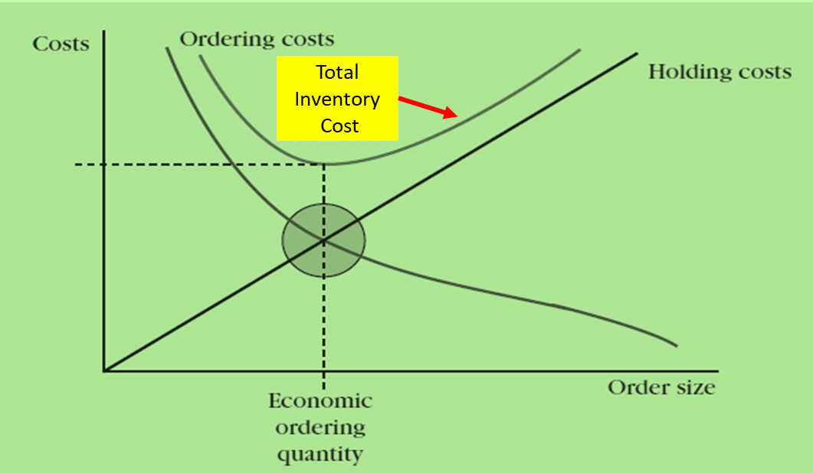
INVENTORY COSTS
Inventory holding cost increases with the order quantity, ‘Q’.
Higher order quantities mean holding more inventory.
Holding more inventory means ordering less frequently, so ordering cost decreases.
A smaller order quantity results in a lower holding cost.
Holding less inventory means ordering more frequently, so ordering cost increases.

Slide 10
INVENTORY SYSTEMS
ANSWER TWO BASIC QUESTIONS
WHEN TO ORDER?
HOW MUCH TO ORDER?

Slide 11
INVENTORY SYSTEMS
FIXED-ORDER QUANTITY SYSTEM | An inventory management method where a specific, pre-determined amount of stock is ordered automatically whenever inventory levels drop to a designated reorder point. Hotel chain has a policy is that it always orders 2,000 soaps, for which it gets a nice quantity discount, and the order is made when the number of soaps drops to 300.
FIXED-TIME PERIOD SYSTEM | An inventory management method where inventory levels are checked in fixed time periods, ‘T’, and the quantity that is ordered varies. The system sets a target inventory level, ‘R’, to be maintained. Inventory is checked every T intervals, say every week or every two weeks, and an order is placed to restore the inventory level back to R. Based on the inventory level at time period T, the amount of inventory that needs to be ordered will be some quantity ‘Q’ that varies from period to period.

Slide 12
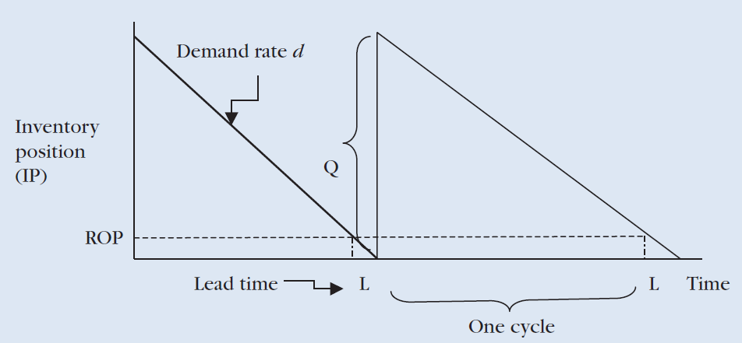
INVENTORY SYSTEMS:
(FIXED ORDER QUANTITY SYSTEM)
Quantity that is ordered with this system is constant or fixed, and is denoted by Q.
An order is placed when the inventory position drops to a predetermined level, noted as the Reorder Point (ROP).
Two variables that define this system and answer the two basic questions
When to place an order: when inventory reaches the reorder point ROP.
How much to order: the quantity Q
The system assumes a constant demand rate of ‘d’ by which the inventory position (IP) is reduced.
An order is placed for quantity ‘Q’ when ‘IP’ reaches the reorder point (ROP).
Inventory position is increased by Q when goods are received the inventory is replenished.
Inventory cannot arrive the moment an order is placed, as there is a certain amount of Lead Time (L) during which we have to wait for the order.

Slide 13
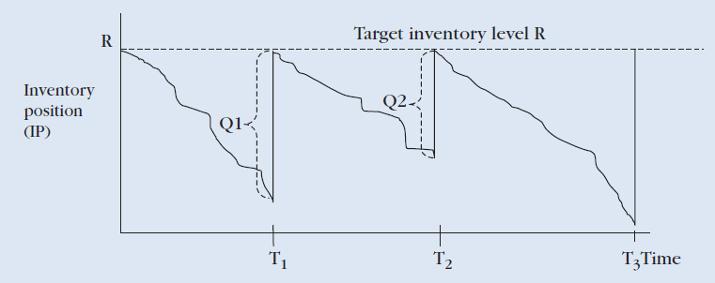
INVENTORY SYSTEMS:
(FIXED TIME-PERIOD SYSTEM / PERIODIC REVIEW SYSTEM)
Inventory levels are checked at fixed time intervals (T), say every week or every two weeks, and the quantity ordered varies.
The system sets a target inventory level (R), to be maintained.
Inventory is checked every ‘T’ intervals, and an order is placed to restore the inventory level back to ‘R’.
This system answers the two basic questions of when to order (T) and how much to order (R).
Thus. ‘Q – order quantity’ is the difference between the target inventory (R) and the inventory position (IP).
Q = R – IP
A hotel chain uses a fixed-time period model to check inventory levels every 02 weeks for its inventory of lavender bath soaps.
The hotel has a target inventory level R = 5,000 soaps.
If after two weeks the company checks its inventory level and finds its inventory position IP =2,800 soaps, it would place an order for quantity:
Q = R – IP = 5,000 – 2,800 =2,200 soaps.

Slide 14
FIXED ORDER QUANTITY SYSTEM
Determining Economic Order Quantity (EOQ)
Economic Order Quantity (EOQ) is an inventory management technique that determines the optimal order size a company should purchase to minimise total inventory costs, including holding and ordering costs.
Total Inventory Cost (TIC) = Total Ordering Cost + Total Holding Cost
=> TIC = [Number of Orders per Year * Ordering Cost per Order]
+ [Average Annual Inventory * Annual Holding Cost per Unit]
=> TIC = (D/Q)*S + (Q/2)*H
Where,
D = Annual Demand; Q = Economic Order Quantity
S = Ordering cost per unit; H = Holding cost per unit
D/Q = Number of orders per year
Q/2 = Average annual inventory

Slide 15
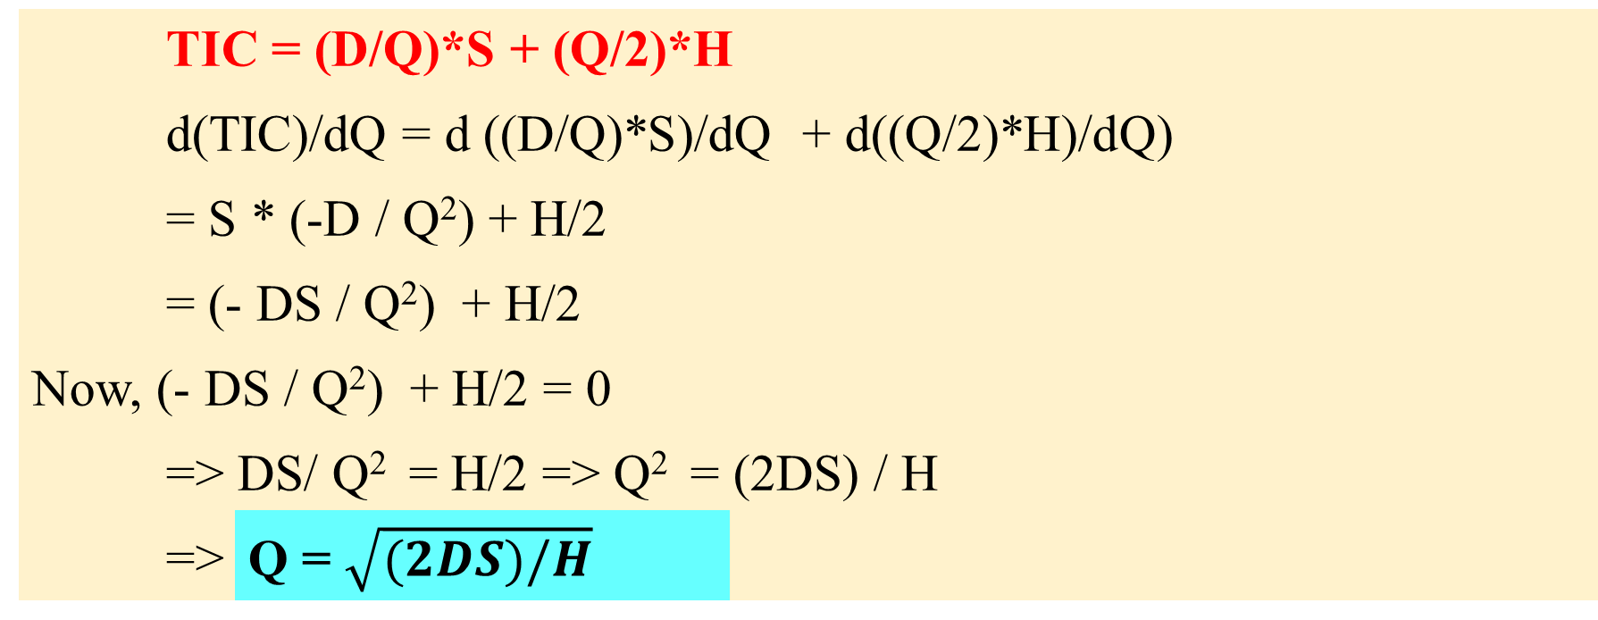
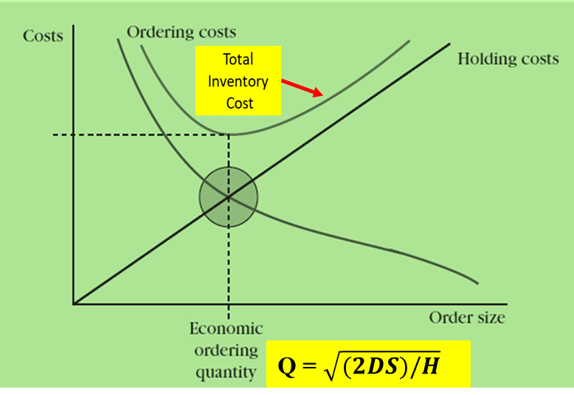
FIXED ORDER QUANTITY SYSTEM
Determining Economic Order Quantity (EOQ)
Here, the basic objective is to determine the Economic Order Quantity (EOQ).
To find EOQ (Q),
minimize TIC
Taking first order derivative of TIC with respect to Q,
Set it to zero and Solving for ‘Q’.

Slide 16
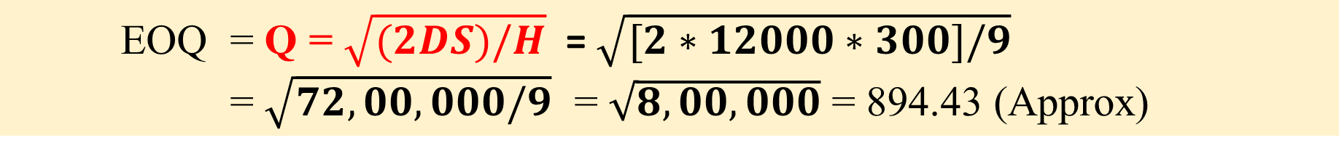
FIXED ORDER QUANTITY SYSTEM
Determining Economic Order Quantity (EOQ)
Georgia’s Florist ordered orchids once a month in quantities of 1,000 to simply match the monthly demand. Orchids are expensive to order with an ordering cost of $300 per order. Holding cost is estimated at 15% of product cost annually, with a product cost of $60 per unit. What would be your order? What is the number of orders per year?
The following information is given:
Annual demand (D) =1,000 orchids per month * 12 months = 12,000 orchids
Holding cost per unit (H) = 15 % of $60 = $9
Ordering cost per order (S) = $300
EOQ = $\text{Q}\text{ = }\sqrt{(2DS)/H}$ = $\sqrt{[2∗12000∗300]/9}$
= $\sqrt{72,00,000/9}$ = $\sqrt{8,00,000}$ = 894.43 (Approx)
Orders Per Year = D / Q = 12,000 / 894.43 = 13.416 (Approx)

Slide 17
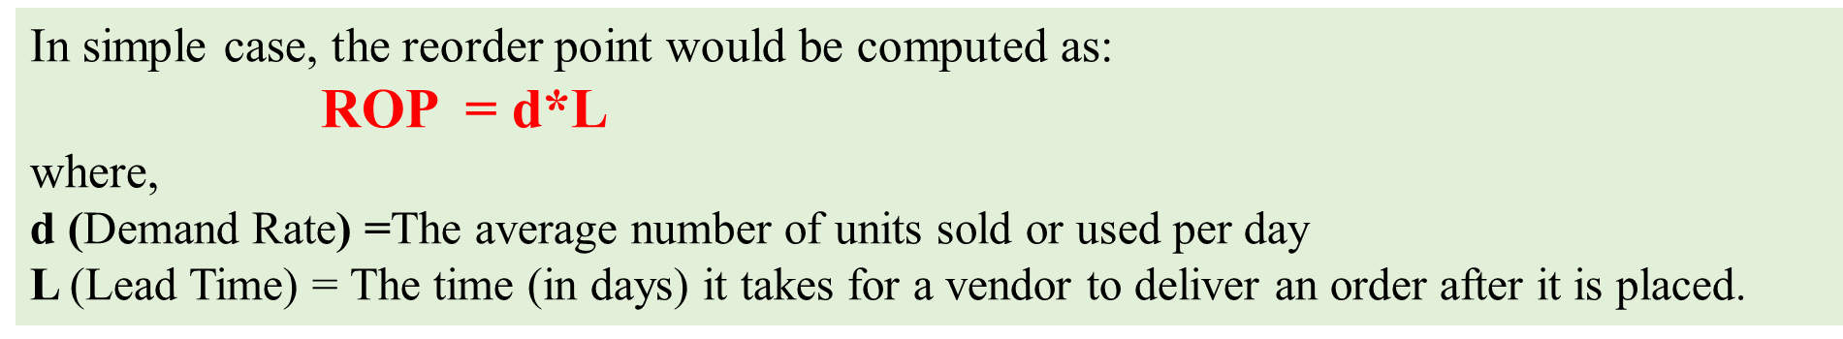
FIXED ORDER QUANTITY SYSTEM
Determining Reorder Point (ROP)
The Reorder Point (ROP) answers the question when more inventory will be reordered.
A Reorder Point (ROP) is the specific, minimum inventory level that triggers a replenishment order for an item, ensuring stock is refilled before it runs out.
The reorder point would simply be enough inventory to ensure that demand is covered during the length of the lead time.

Slide 18
FIXED ORDER QUANTITY SYSTEM
Determining Reorder Point (ROP)
The average number of units sold or used by Georgia Florists is 250 units per week, and the time it takes for a vendor to deliver an order is one week. Calculate the Reorder Point (ROP)
It is given
d = 250 and L = 1 week
Reorder Point (ROP) = d * L = 250 * 1 week = 250 units
The order policy for Georgia’s Florists is defined by the EOQ and ROP.
This would mean that Georgia’s Florists will order 894.43, say 895 orchids when inventory drops to 250 orchids.

