Slide 1
SCTP – Capstone Project (Associate Data Analyst)
Presented By: Mathanky Kaneshalingam
20/01/2025

Slide 2
Credit card Fraud Detection
The credit card fraud detection problem includes modelling past credit card transactions with the knowledge of the ones that turned out to be fraud.
This model is then used to identify whether a new transaction is fraudulent or not.
Our aim here is to detect maximum of the fraudulent transactions while minimizing the incorrect fraud classifications.

Slide 3
Dataset
This dataset contains credit card transactions made by European cardholders in the year 2023.
It comprises over 550,000 records
It is taken from Kaggle website.
The data has been anonymized to protect the cardholders' identities.

Slide 4
Data Columns
id: Unique identifier for each transaction
V1-V28: Anonymized features representing various transaction attributes (e.g., time, location, etc.)
Amount: The transaction amount
Class: Binary label indicating whether the transaction is fraudulent (1) or not (0). It is a target column and a factor variable.

Slide 5
Potential Use Cases
Credit Card Fraud Detection: Build machine learning models to detect and prevent credit card fraud by identifying suspicious transactions based on the provided features.
Merchant Category Analysis: Examine how different merchant categories are associated with fraud.
Transaction Type Analysis: Analyze whether certain types of transactions are more prone to fraud than others.

Slide 6
Steps Involved
Importing the required packages into our python environment
Importing the dataset
Processing the data to our needs and exploratory data analysis
Feature selection and data split
Building classification models

Slide 7
Exploratory Data Analysis
It is a key step in data analysis, focusing on understanding patterns, trends, and relationships through statistical tools and visualizations
Reading dataset - pd.read_csv('creditcard_2023.csv')
Analyzing the data - df.shape, df.info(), df.describe()
Checking for the duplicates - df.duplicated()
Missing Values Calculation - df.isnull().values.any()
Analyzing the Visuals – Column chart, Pi chart, Subplot, Density map, Histogram, Box pot

Slide 8
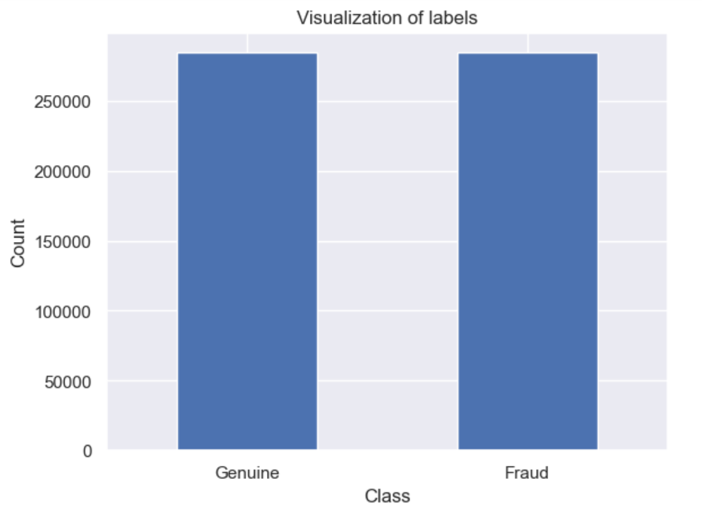
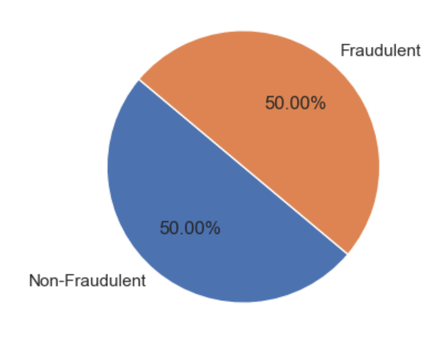
Column chart & Pie Chart

Slide 9
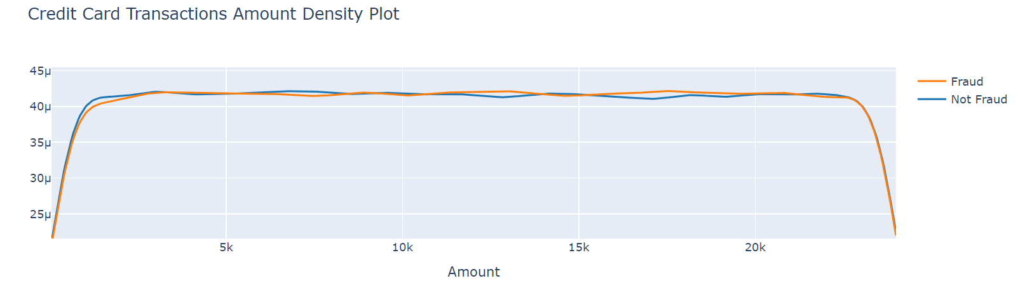
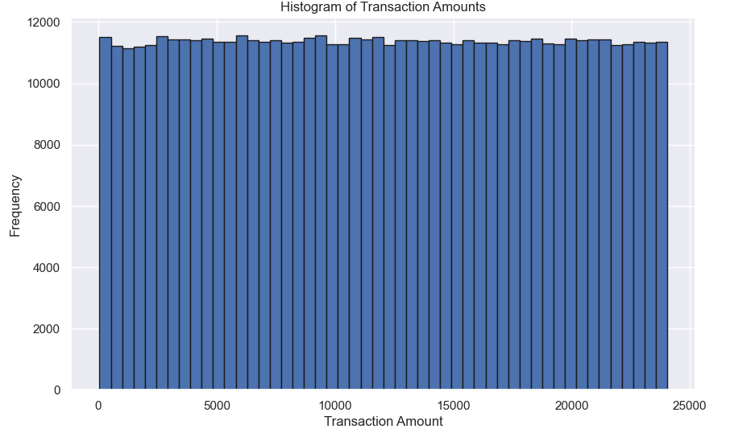
Density plot & Histogram

Slide 10
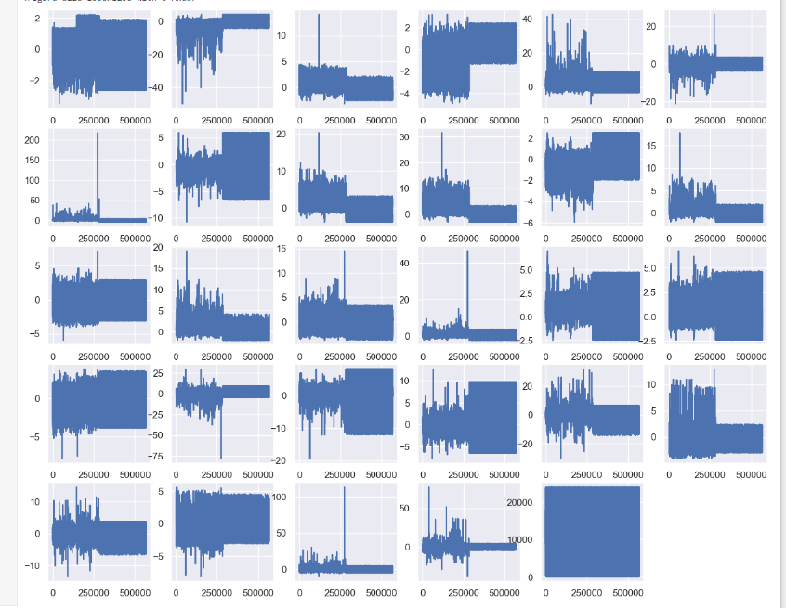
Subplots

Slide 11
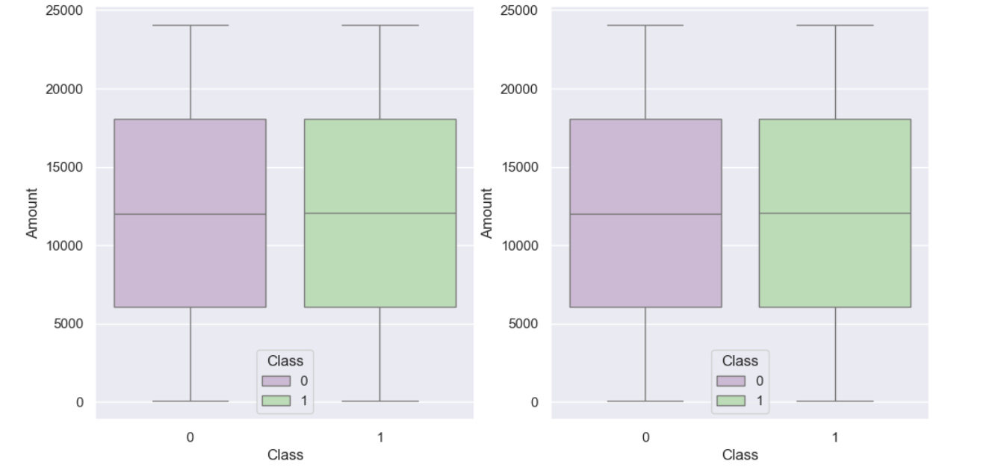
Box plot

Slide 12
Correlation Analysis
By analyzing the correlation matrix and visualizing the relationships between selected features and the transaction Amount, I identified key features that have significant correlations with Amount.
These features (V1, V5, V7, and V20) can provide valuable insights for further analysis and model building in the context of credit card fraud detection.

Slide 13
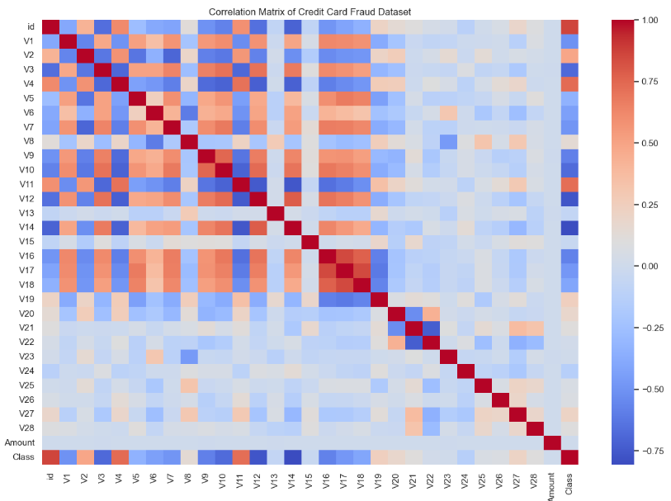
Correlation matrix

Slide 14
Confusion matrix
It is a table that is often used to describe the performance of a classification model (or classifier) on a set of test data for which the true values are known.
A confusion matrix allows the visualization of the performance of an algorithm.

Slide 15
Metrics
True positive – The fraud cases that the model predicted as fraud
False positive – The non-fraud cases that the model predicted as fraud
True Negative – The non-fraud cases that the model predicted as non-fraud
False Negative – The fraud cases that the model predicted as non-fraud

Slide 16
Metrics
Accuracy – The measure of the correct prediction made by the model. That is the ratio of fraud transactions classified as fraud and non-fraud classified as non-fraud to the total transactions in the test data.
Sensitivity/Recall or True Positive Rate – It is the ratio of correctly identified fraud cases to total fraud cases.
Specificity or True Negative Rate – It is the ratio of correctly identifies non-fraud cases to total non-fraud cases.
Precision – Precision is the ratio of correctly predicted fraud cases to total predicted fraud cases.
F1-Score - It combines precision and recall into a single value.

Slide 17
Logistic Regression
It is a supervised machine learning algorithm used for classification tasks
Logistic regression is a statistical algorithm which analyze the relationship between two data factors.

Slide 18
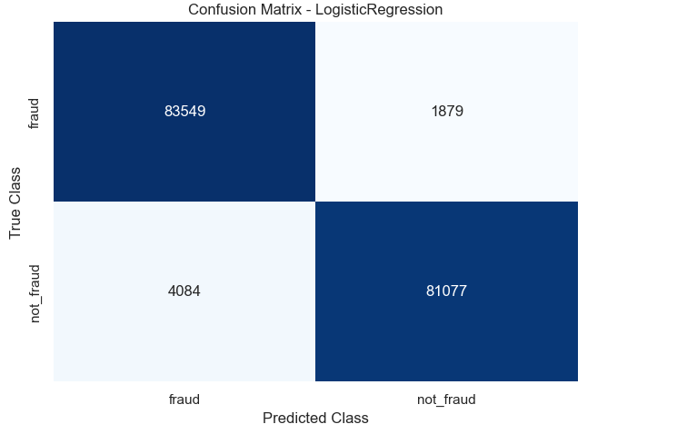
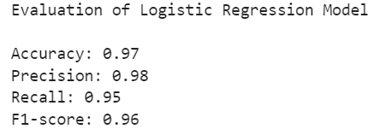
Logistic Regression (Confusion matrix)

Slide 19
Decision Tree Algorithm
It is a type of machine-learning algorithm that can be used for both classification and regression tasks.
Decision trees are represented as tree structures, where each internal node represents a feature, each branch represents a decision rule, and each leaf node represents a prediction.

Slide 20
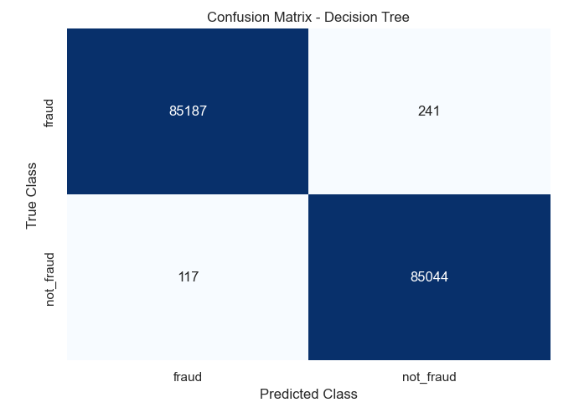
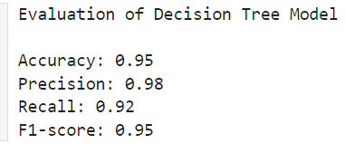
Decision Tree Algorithm (Confusion matrix)

Slide 21
Random Forest Algorithm
Random Forest is a collaborative team of decision trees that work together to provide a single output.
Each tree is constructed using a random subset of the data set to measure a random subset of features in each partition.

Slide 22
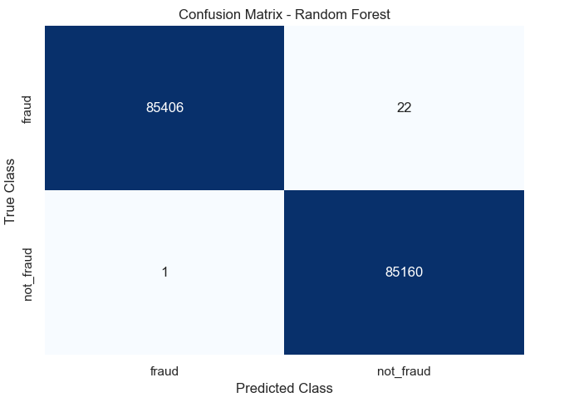
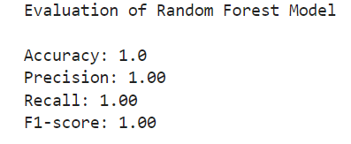
Random Forest Algorithm (Confusion matrix)

Slide 23
Insights
Easier to predict as the data is well balanced, clean and clear cut
Model could also be biased so will need more data as input to better train the model
Having a split of more training data does not always result in better accuracies due to overfitting. Similarly, too little of training data may result in underfitting.
Number of iterations also play apart in the accuracy of model.

Slide 24

Thank you

