Slide 2
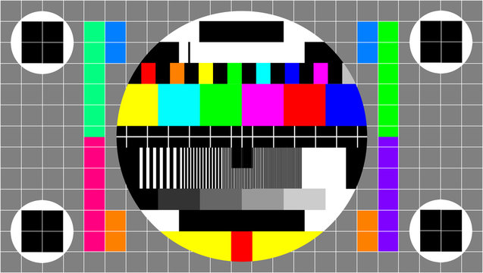

Slide 3
Content Warning
This presentation is intended for mature audiences and contains Adult Content, as well as political, graphic, inappropriate, non-PC and potential offensive language.
Some contents may not be suitable for some, really most, let's be honest, all viewers.
Viewer discretion is expected. If you stay for this presentation, your discretion is implied.

Slide 4
Assumed Knowledge
Currency Pair / Futures / Forwards / Options
Orderbook / Price Ladder
ECN / Data Center / Brokers
Bilateral / Multilateral / Credit Agreements / Limits

Slide 5
Table of Contents
Where can I trade FX?
Where do the machines live?
What do the prices look like?
Who does What and When?
Curiouser and Curiouser
Need for Speed
Outro

Slide 6
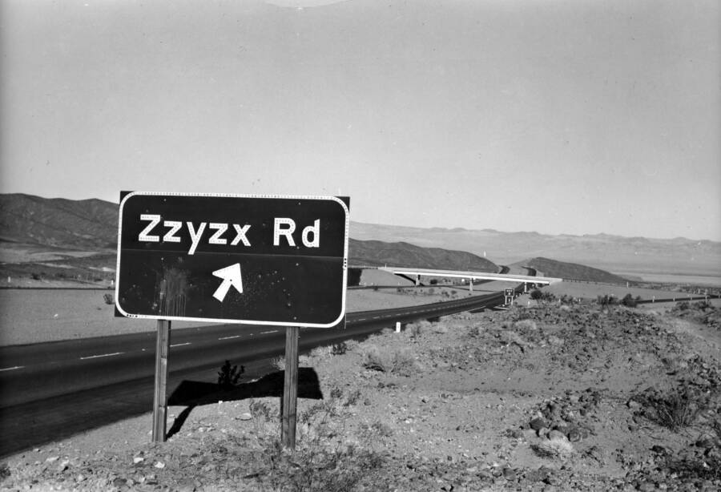

Slide 7













Where Can You Buy?

Slide 8



Who are they really?

Slide 9

What Can You Buy?
EURSEK
USDRUB
USDCAD
EURNOK
EURDKK
USDCHF
GBPUSD
EURCHF
EURPLN
EURHUF
EURUSD
EURRON
USDCNY
USDJPY
XAGUSD
USDKRW
USDTRY
XAUUSD
USDCNH
USDTWD
XPDUSD
USDHKD
AUDJPY
USDMXN
USDINR
XPTUSD
NZDJPY
USDTHB
USDMYR
USDSGD
USDIDR
USDBRL
AUDUSD
USDZAR
NZDUSD

Slide 10
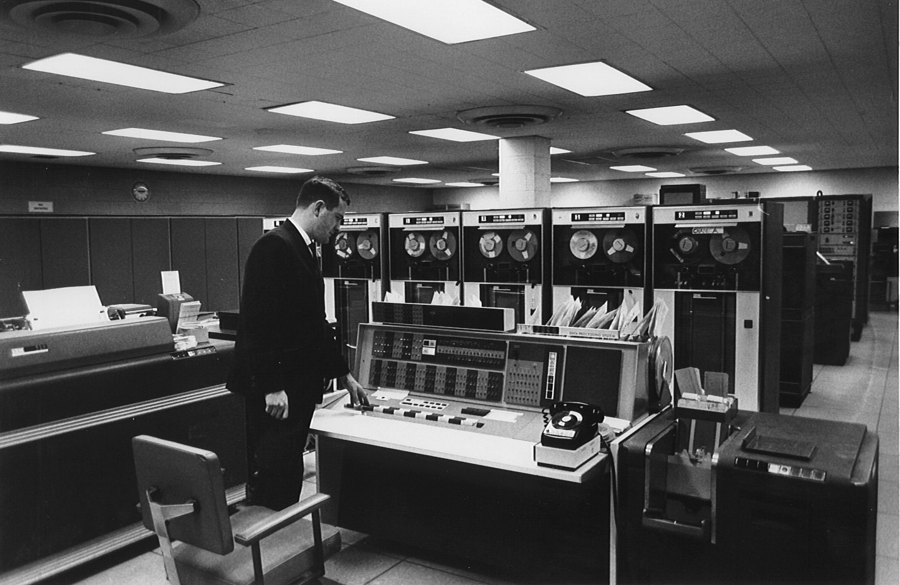

Slide 11

Where do my orders go?

Slide 12

We are the world

Slide 13

Sun Worshipers

Slide 14
Matching in America Gets Adopted
EURSEK
USDRUB
USDCAD
EURNOK
EURDKK
GBPUSD
EURCHF
EURPLN
EURHUF
EURUSD
EURRON
USDCNY
USDJPY
XAGUSD
USDKRW
USDTRY
XAUUSD
USDCNH
USDTWD
XPDUSD
USDHKD
USDMXN
USDINR
XPTUSD
USDTHB
USDMYR
USDSGD
USDIDR
USDBRL
AUDUSD
USDZAR
NZDUSD

Slide 15

Empire 2.0 Strikes Back
USDCAD
GBPUSD
USDHKD
AUDUSD
NZDUSD

Slide 16

Dark Pool vs MidMatch
Question
Dark Pool
MidMatch
Where are they (mostly)
Banks, Market Makers
Lit Venues
Is there an orderbook
Yes
No
Are orderbooks published
No
No
What info is contained in an order
Price, Size, Type
Size(, Type?)
How are orders matched
Price
-
Time
-
Size Priority
Time
-
Size Priority
How do you match on price if you
There is an orderb
ook
, so not
All participants need to stream in
can’t see the price
an issue
mid
-
price.
PnL
is calculated from
difference between
mids.
Monthly process redistributes
PnLs
amongst parties to make it
“fair”. May have speed bumps.
* BGC /
FastMatch
/ 360T

Slide 17
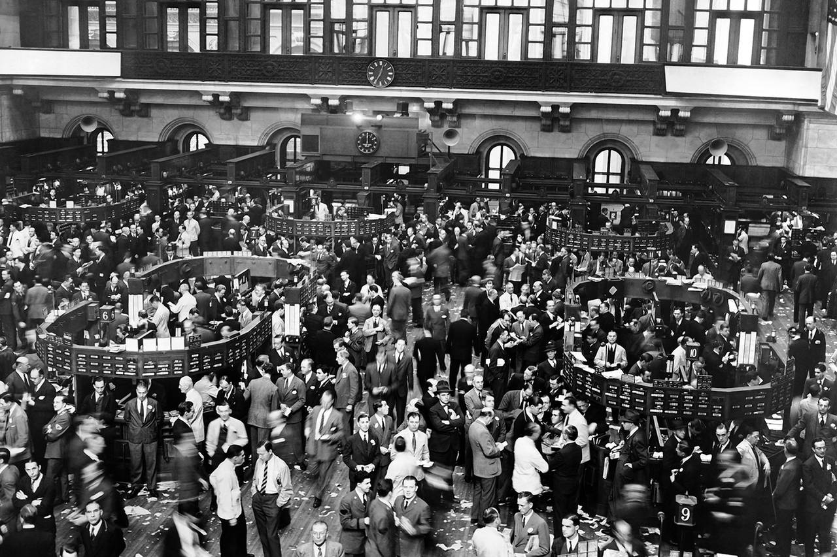

Slide 18



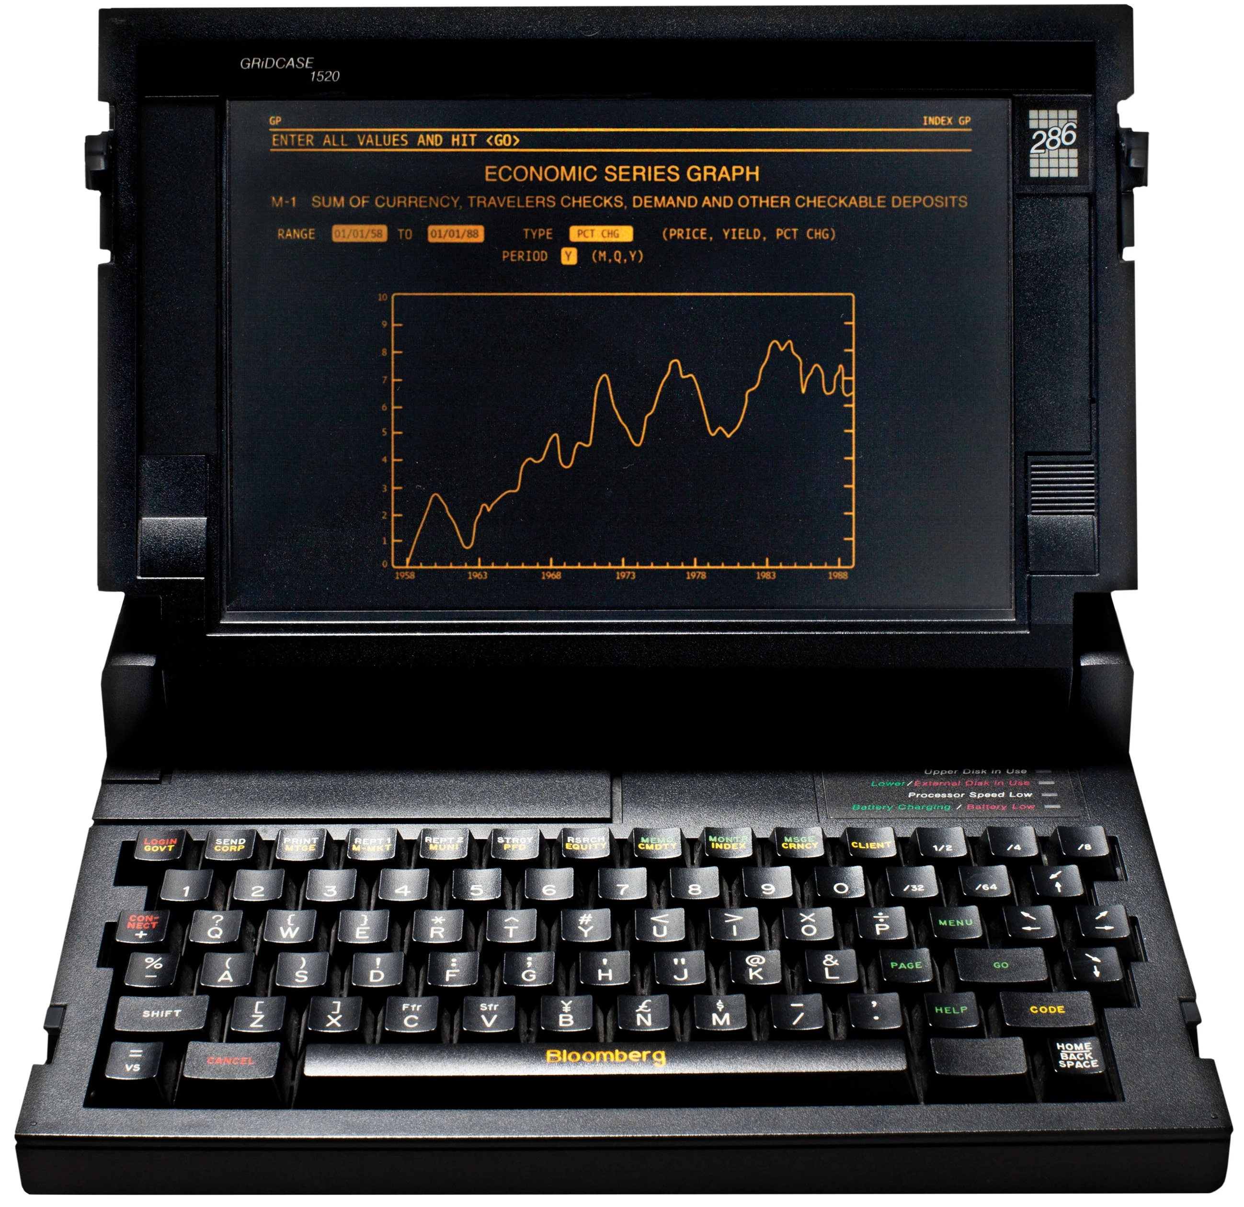








What Makes a Market Maker Tick?

Slide 19
Sounds great! But How much?

Slide 20
That’s a bargain! Give me more!

Slide 21
More! More!! MORE!!!
Content

Slide 22
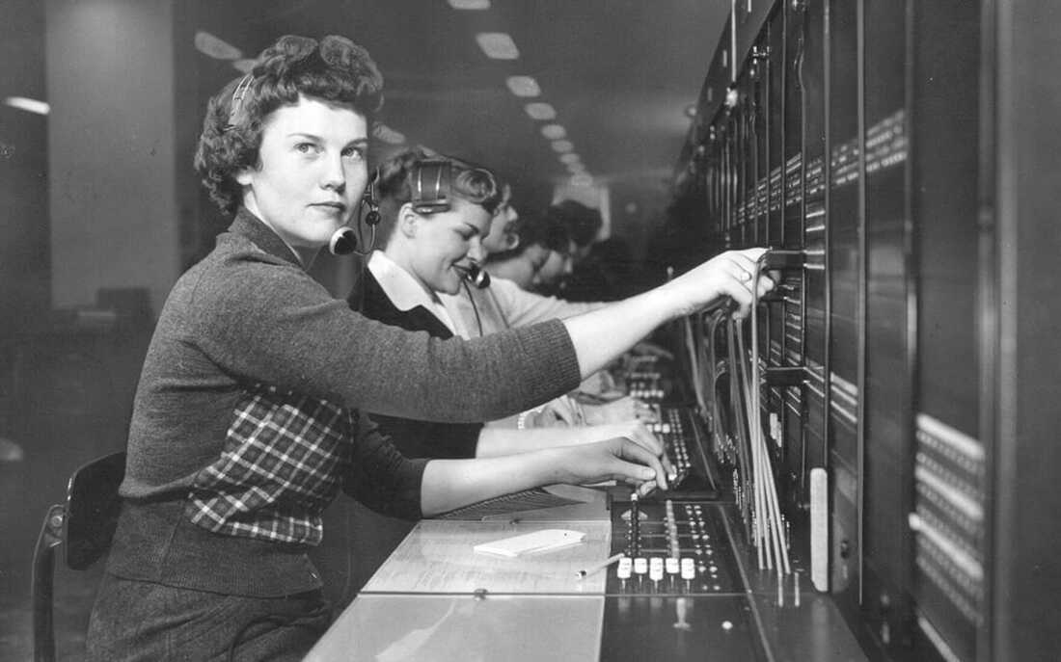

Slide 23
You are open 24/5.5?

Slide 24
Seriously? All day long?

Slide 25
How does <ANother> compare?

Slide 26
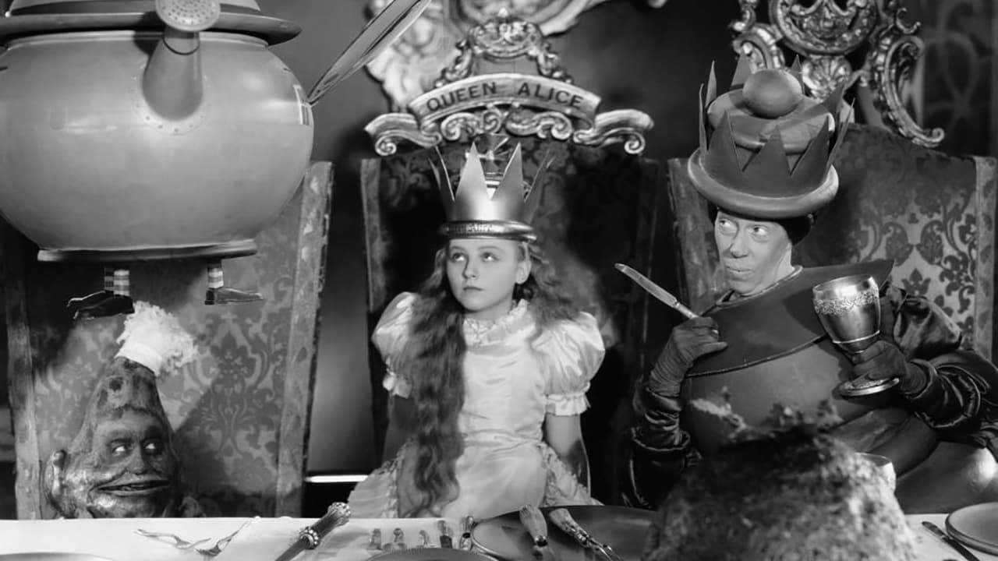

Slide 27
Currency Pair Triangle
Content

Slide 28
NFP

Slide 29
CNHCNY

Slide 30
USDHKD

Slide 31
Currenex Stuck Orders

Slide 32
Other bits and bobs…
WYSINWYG
Last Look
Too fast (eg too many orders per second)
Too slow (eg absolute time, too many ticks behind)
Too much Profit / Loss (eg market too volatile, price has moved too much)
Claw back
I lost too much on this trade – can I have some money back please?
Price adjustment
I was only joking about the price I gave you
EFP (Gold you buy on an exchange is not pure enough)

Slide 33
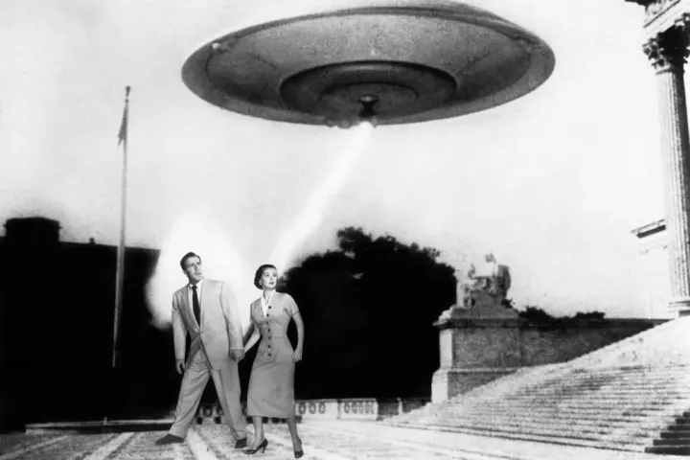

Slide 34
c = f($)
End Points | Latency Round Trip ms
Chicago <-> New York (Cable) | 14.1
Chicago <-> New York (Microwave) | 8.2
London <-> New York (Hiberia Global Financial Network) | 65.5
London <-> New York (Hiberia Express) | 58.8
London <-> Tokyo | 230
London <-> Tokyo (via Atlantic) | 170
Google | ???
Meta | ???
Microsoft | ???

Slide 35







29ms
115ms
4ms
7ms
115ms
32.5ms

Slide 36

AUDUSD
USDJPY
UJ
UJ
UJ
UJ
UJ
AJ
AJ
AJ
AJ
AJ
AJ
AJ
AJ
AUDJPY

Slide 38
Other Client Offerings
Direct Market Access (DMA)
Trading Analytics
Algorithmic Strategies
Passive / Iceberg
Time- / Volume-based
Opportunistic - Guerrilla, Sniper
Hybrid - Float-Guerrilla, Float Sniper, Price Inline
https://www.credit-suisse.com/media/ib/docs/investment-banking/client-offering/aes-strategy-guide-and-attestation-equities.pdf

