Slide 1
Title
Content

Slide 2
Content Warning
This presentation is intented for mature audiences and contains Adult Content, as well as graphic, inappropriate, non-PC and potential offensive language. Some contents may not be suitable for some, really most, let's be honest, all readers. Viewer discretion is expected.

Slide 3
Intro – List of Keywords
Bilteral / Multilateral / Credit Agreements / Limits
ECN / Brokers

Slide 4













Where Can You Buy?

Slide 5



Who are they really?

Slide 6
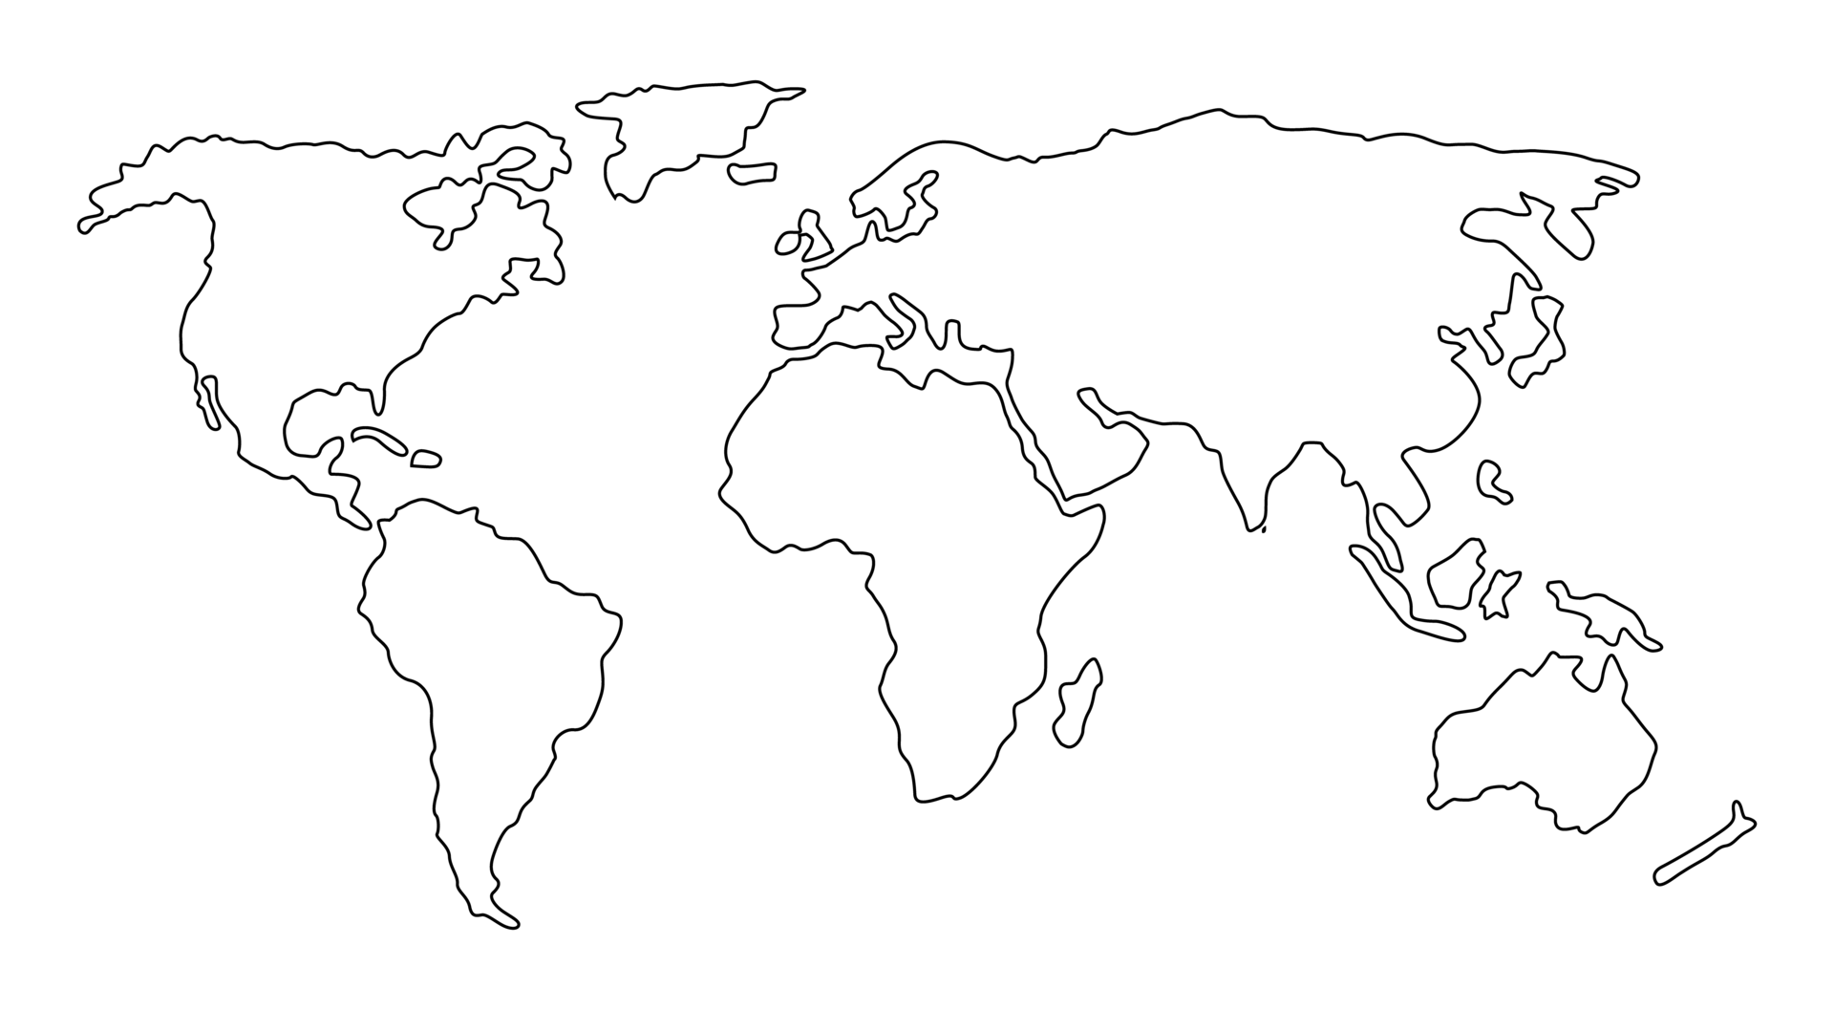
What Can You Buy?
EURSEK
USDRUB
USDCAD
EURNOK
EURDKK
USDCHF
GBPUSD
EURCHF
EURPLN
EURHUF
EURUSD
EURRON
USDCNY
USDJPY
XAGUSD
USDKRW
USDTRY
XAUUSD
USDCNH
USDTWD
XPDUSD
USDHKD
AUDJPY
USDMXN
USDINR
XPTUSD
NZDJPY
USDTHB
USDMYR
USDSGD
USDIDR
USDBRL
AUDUSD
USDZAR
NZDUSD

Slide 7

Where do my orders go?

Slide 8

We are the world

Slide 9

Sun Worshipers

Slide 10
Matching in America Gets Adopted
EURSEK
USDRUB
USDCAD
EURNOK
EURDKK
GBPUSD
EURCHF
EURPLN
EURHUF
EURUSD
EURRON
USDCNY
USDJPY
XAGUSD
USDKRW
USDTRY
XAUUSD
USDCNH
USDTWD
XPDUSD
USDHKD
USDMXN
USDINR
XPTUSD
USDTHB
USDMYR
USDSGD
USDIDR
USDBRL
AUDUSD
USDZAR
NZDUSD

Slide 11

Empire 2.0 Strikes Back
USDCAD
GBPUSD
USDHKD
AUDUSD
NZDUSD

Slide 12
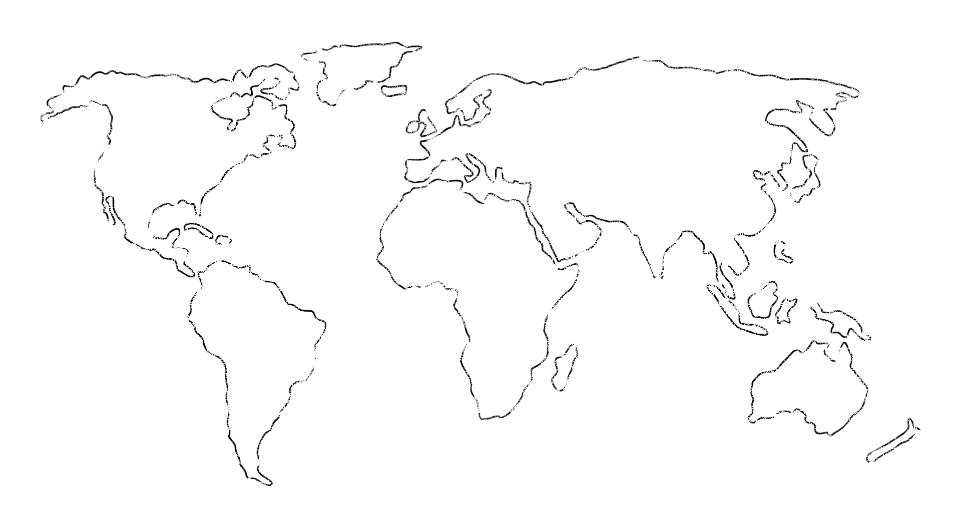
Dark Pool vs MidMatch
Question
Dark Pool
MidMatch
Where are they (mostly)
Banks, Market Makers
Lit Venues
Is there an orderbook
Yes
No
Are orderbooks published
No
No
What info is contained in an order
Price, Size, Type
Size(, Type?)
How are orders matched
Price
-
Time
-
Size Priority
Time
-
Size Priority
How do you match on price if you
There is an orderb
ook
, so not
All participants need to stream in
can’t see the price
an issue
mid
-
price.
PnL
is calculated from
difference between
mids.
Monthly process redistributes
PnLs
amongst parties to make it
“fair”. May have speed bumps.
* BGC /
FastMatch
/ 360T

Slide 13



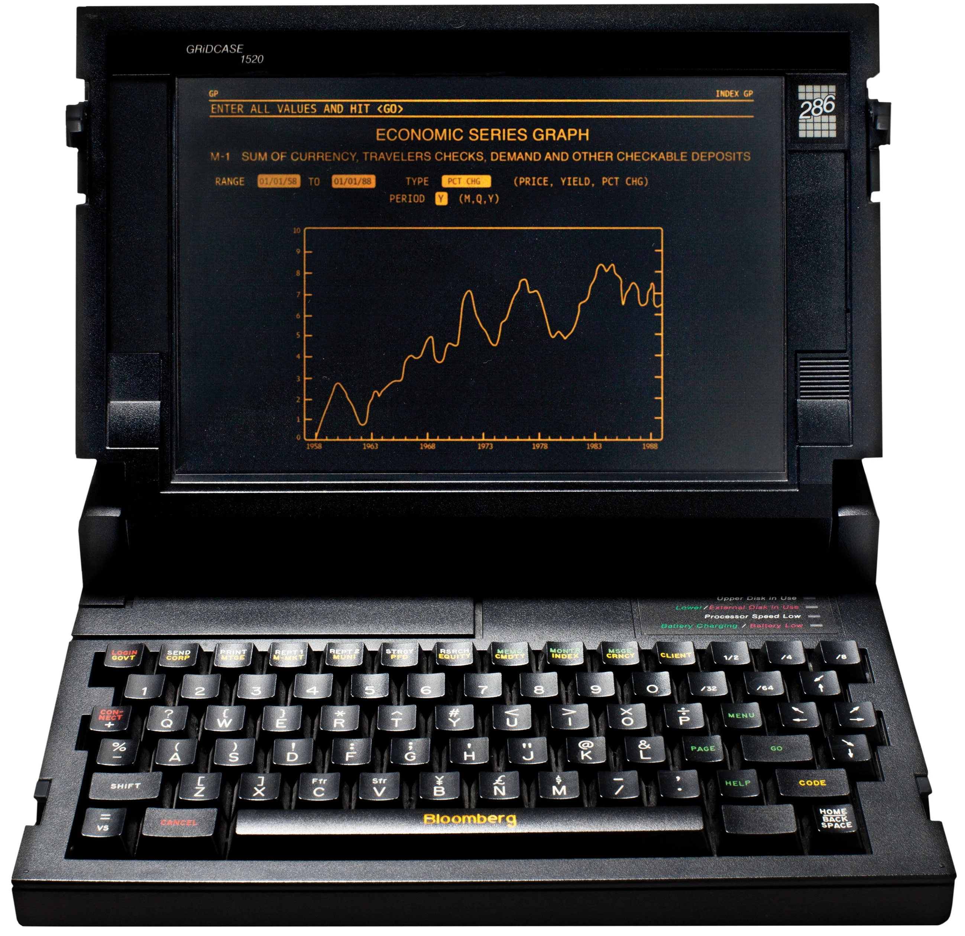








What Makes a Market Maker Tick?

Slide 14
Sounds great! But How much?

Slide 15
That’s a bargain! Give me more!

Slide 16
More! More!! MORE!!!
Content

Slide 17
You are open 24/5.5?

Slide 18
Seriously? All day long?

Slide 19
How does <ANother> compare?

Slide 20
Currency Pair Triangle
Content

Slide 21
NFP

Slide 22
CNHCNY

Slide 23
USDHKD

Slide 24
Currenex Stuck Orders

Slide 25
Other bits and bobs…
WYSINWYG
Last Look
Too slow (eg absolute time, too many ticks behind)
Too much symmetric PnL (eg market too volatile, price has moved too much)
Claw back
I loss too much on this trade – can I have some money back please?
Price adjustment
I was only joking about the price I gave you
EFP

Slide 26
c = f($)
End Points | Latency Round Trip ms
Chicago <-> New York (Cable) | 14.1
Chicago <-> New York (Microwave) | 8.2
London <-> New York (Hiberia Global Financial Network) | 65.5
London <-> New York (Hiberia Express) | 58.8
London <-> Tokyo | 230
London <-> Tokyo (via Atlantic) | 170
Google | ???
Meta | ???
Microsoft | ???

Slide 27







29ms
115ms
4ms
7ms
115ms
32.5ms

Slide 28

AUDUSD
USDJPY
UJ
UJ
UJ
UJ
AJ
AJ
AJ
AJ
AJ
AJ
AJ
AJ
AUDJPY

Slide 29
What is BBG used for?
IB / News
Graphs
Trade Amendments (claw-back / price adjustment)
EFP
BQuant

Slide 30
Other Client Offerings
Direct Market Access (DMA)
Trading Analytics
Algorithmic Strategies
Passive / Iceberg
Time- / Volume-based
Opportunistic - Guerrilla, Sniper
Hybrid - Float-Guerrilla, Float Sniper, Price Inline
https://www.credit-suisse.com/media/ib/docs/investment-banking/client-offering/aes-strategy-guide-and-attestation-equities.pdf

