Slide 1
Title
Content

Slide 2






Where Can You Buy?

Slide 3
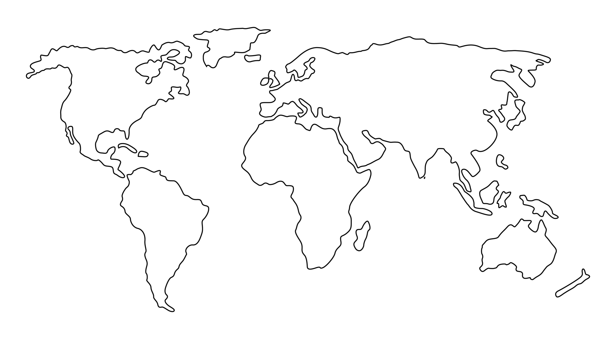
What Can You Buy?
EURSEK
USDRUB
USDCAD
EURNOK
EURDKK
GBPUSD
EURCHF
EURPLN
EURHUF
EURUSD
EURRON
USDCNY
USDJPY
XAGUSD
USDKRW
USDTRY
XAUUSD
USDCNH
USDTWD
XPDUSD
USDHKD
USDMXN
USDINR
XPTUSD
USDTHB
USDMYR
USDSGD
USDIDR
USDBRL
AUDUSD
USDZAR
NZDUSD

Slide 4
How Much Can You Buy?

Slide 5
Price Ladder
Content

Slide 6
Skew
Content

Slide 7
Currency Pait Triangle
Content

Slide 8
NFP
Content

Slide 9
Currenex Stuck Orders
Content

Slide 10
How Much Can You Buy?

Slide 11
c = f($)
End Points | Latency Round Trip ms
Chicago to New York (Cable) | 14.1
Chicago to New York (Microwave) | 8.2
Hiberia Global Financial Network | 65.5
Hiberia Express | 58.8
London <-> Tokyo | 230
London <-> Tokyo (via Atlantic) | 170
Google | ???
Meta | ???
Microsoft | ???

Slide 12





29ms
115ms
4ms
7ms
115ms
32.5ms

