Slide 2


Slide 3
Content Warning
This presentation is intended for mature audiences and contains Adult Content, as well as political, graphic, inappropriate, non-PC and potential offensive language.
Some contents may not be suitable for some, really most, let's be honest, all viewers.
Viewer discretion is expected. If you stay for this presentation, your discretion is implied.

Slide 4
Assumed Knowledge
Currency Pair / Futures / Forwards / Options
Orderbook / Price Ladder
ECN / Data Center / Brokers
Bilateral / Multilateral / Credit Agreements / Limits

Slide 5
What is FX
The cost of any currency is expressed in its exchange rate, which is like a currency’s price tag.
The rise or fall of the exchange rate itself depends on several factors, including inflation, interest rates, trade balance, and overall economic and political stability.
Currency pairs have different exchange rates because the global demand for each currency - meaning the demand for the country’s goods or financial assets – varies.

Slide 6
Table of Contents
Where can I trade FX?
Where do the machines live?
What do the prices look like?
Who does What and When?
Curiouser and Curiouser
Need for Speed
Outro

Slide 7
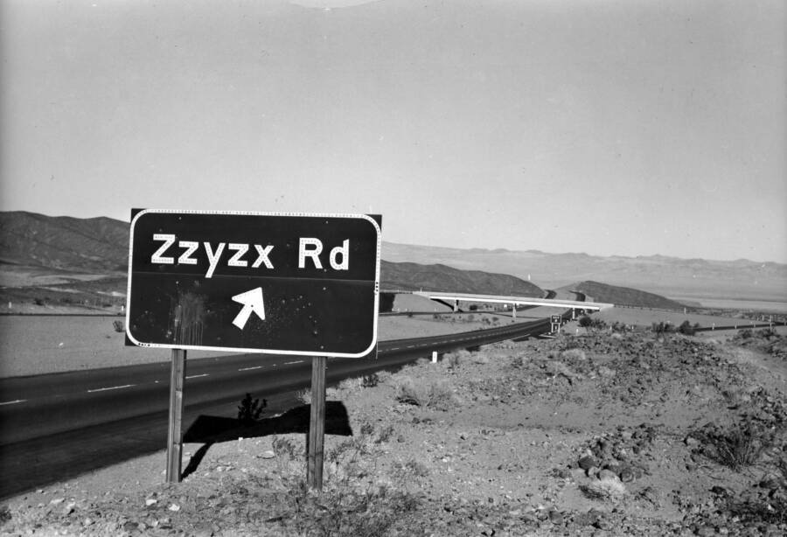

Slide 8













Where Can You Buy?

Slide 9



Who are they really?

Slide 10
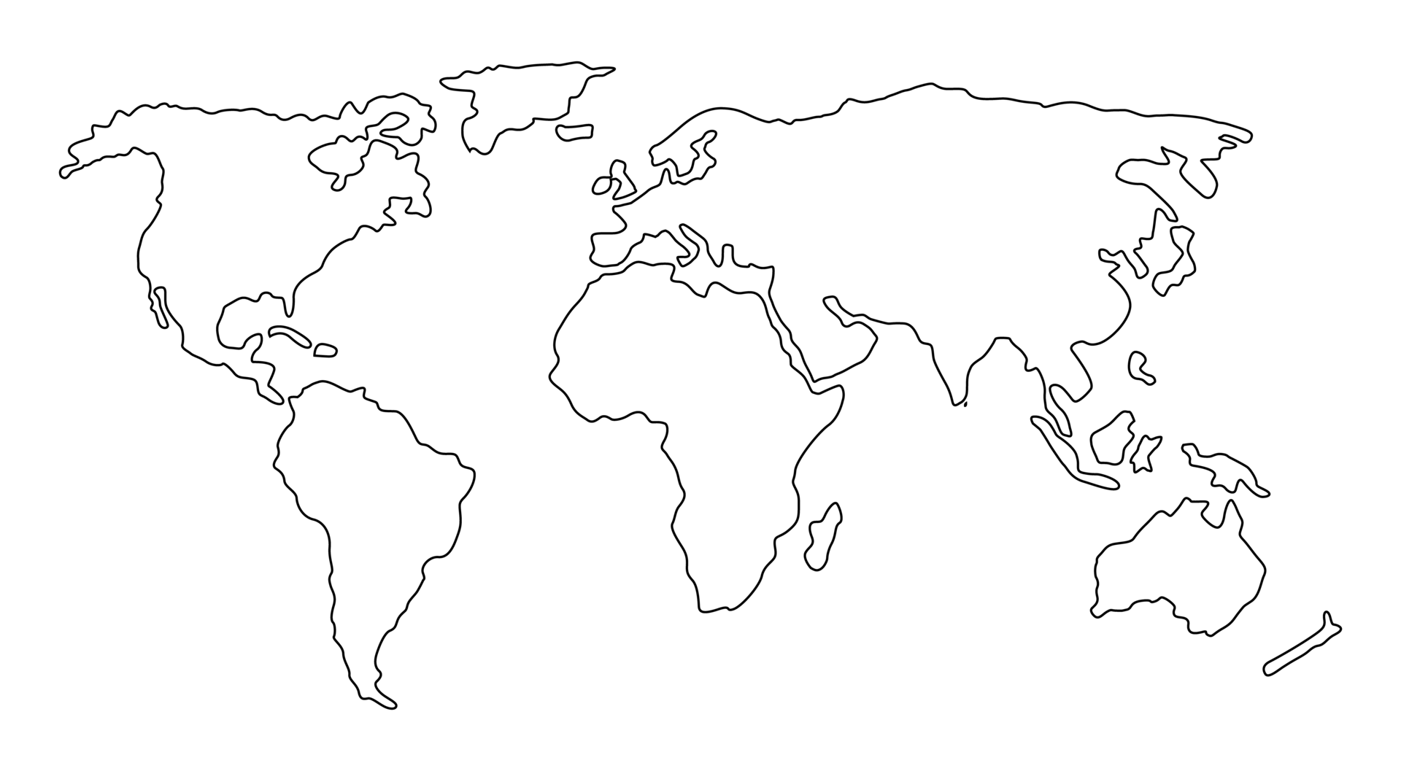
What Can You Buy?
EURSEK
USDRUB
USDCAD
EURNOK
EURDKK
USDCHF
GBPUSD
EURCHF
EURPLN
EURHUF
EURUSD
EURRON
USDCNY
USDJPY
XAGUSD
USDKRW
USDTRY
XAUUSD
USDCNH
USDTWD
XPDUSD
USDHKD
AUDJPY
USDMXN
USDINR
XPTUSD
NZDJPY
USDTHB
USDMYR
USDSGD
USDIDR
USDBRL
AUDUSD
USDZAR
NZDUSD

Slide 11
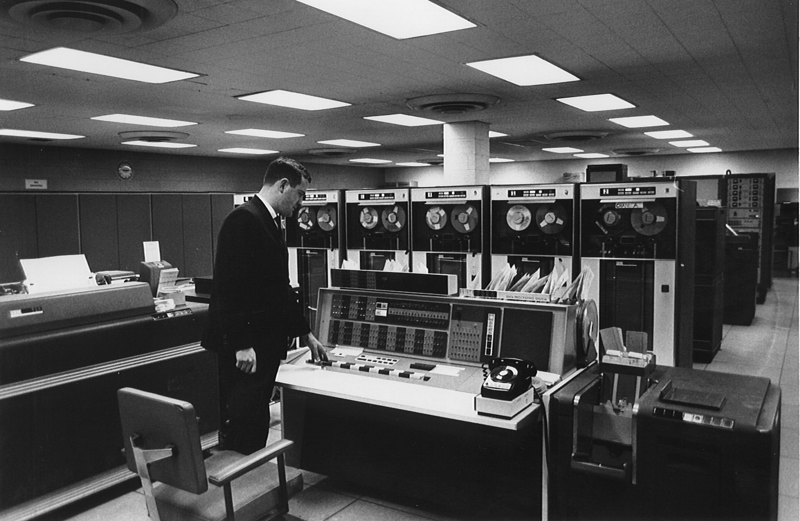

Slide 12

Where do my orders go?

Slide 13

We are the world

Slide 14

Sun Worshipers

Slide 15
Matching in America Gets Adopted
EURSEK
USDRUB
USDCAD
EURNOK
EURDKK
GBPUSD
EURCHF
EURPLN
EURHUF
EURUSD
EURRON
USDCNY
USDJPY
XAGUSD
USDKRW
USDTRY
XAUUSD
USDCNH
USDTWD
XPDUSD
USDHKD
USDMXN
USDINR
XPTUSD
USDTHB
USDMYR
USDSGD
USDIDR
USDBRL
AUDUSD
USDZAR
NZDUSD

Slide 16

Empire 2.0 Strikes Back
USDCAD
GBPUSD
USDHKD
AUDUSD
NZDUSD

Slide 17
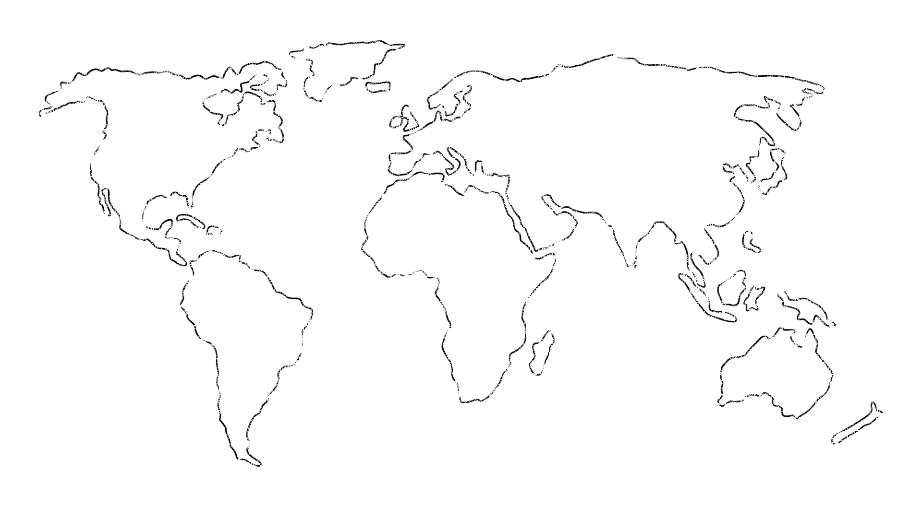
Dark Pool vs MidMatch
Question
Dark Pool
MidMatch
Where are they (mostly)
Banks, Market Makers
Lit Venues
Is there an orderbook
Yes
No
Are orderbooks published
No
No
What info is contained in an order
Price, Size, Type
Size(, Type?)
How are orders matched
Price
-
Time
-
Size Priority
Time
-
Size Priority
How do you match on price if you
There is an orderb
ook
, so not
All participants need to stream in
can’t see the price
an issue
mid
-
price.
PnL
is calculated from
difference between
mids.
Monthly process redistributes
PnLs
amongst parties to make it
“fair”. May have speed bumps.
* BGC /
FastMatch
/ 360T

Slide 18
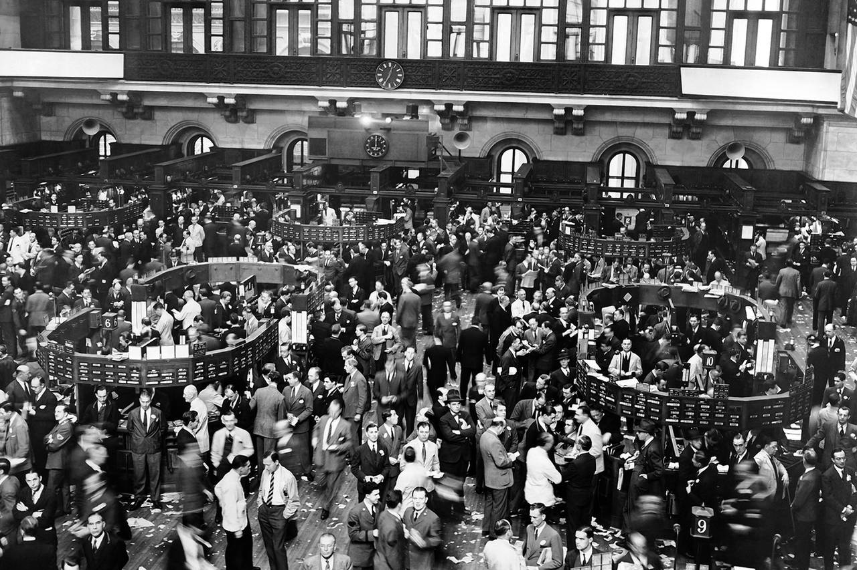

Slide 19



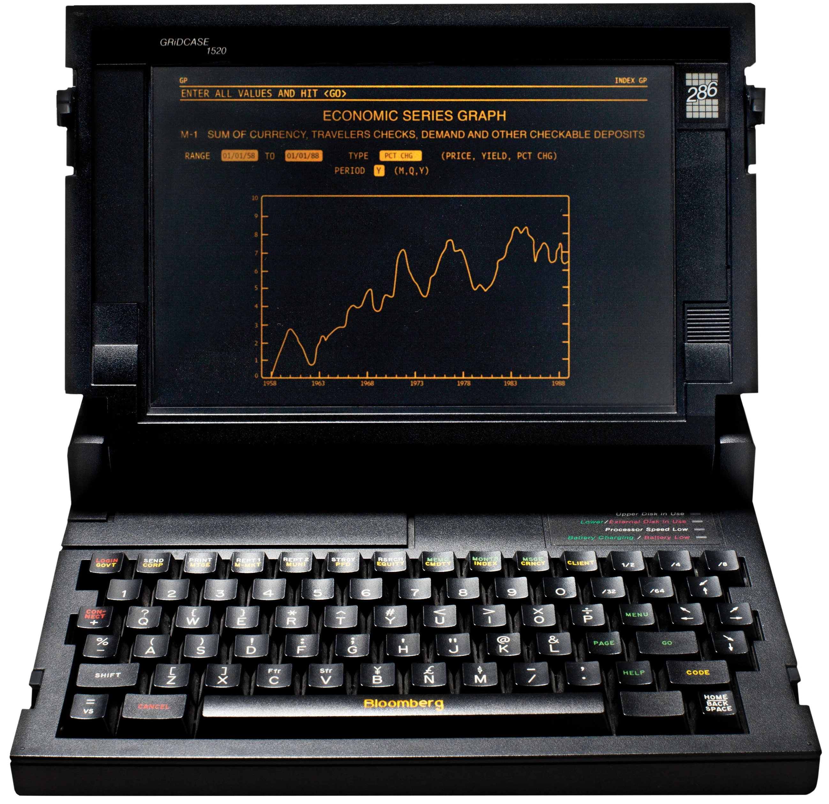








What Makes a Market Maker Tick?

Slide 20
Sounds great! But How much?

Slide 21
That’s a bargain! Give me more!

Slide 22
More! More!! MORE!!!
Content

Slide 23
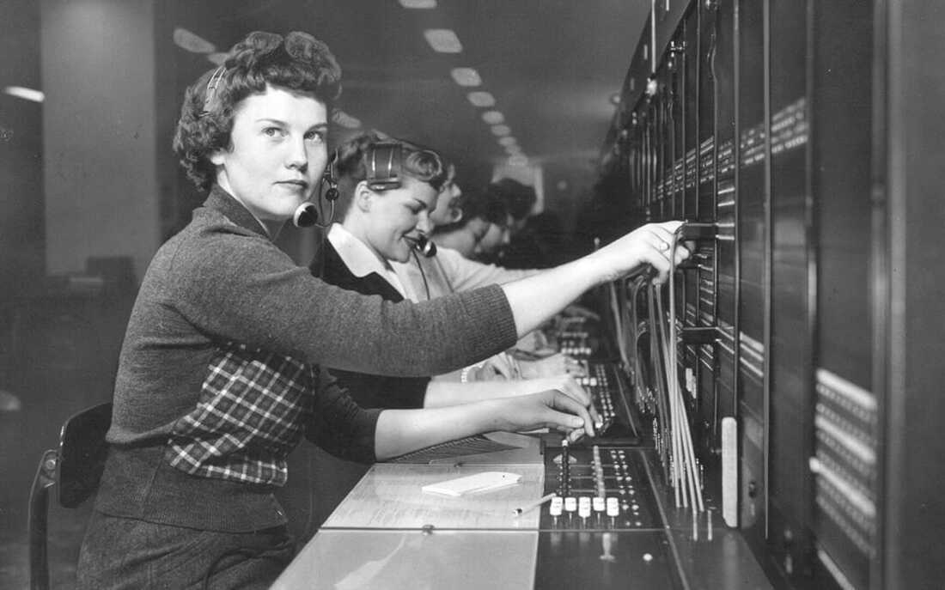

Slide 24
You are open 24/5.5?

Slide 25
Seriously? All day long?

Slide 26
How does <ANother> compare?

Slide 27
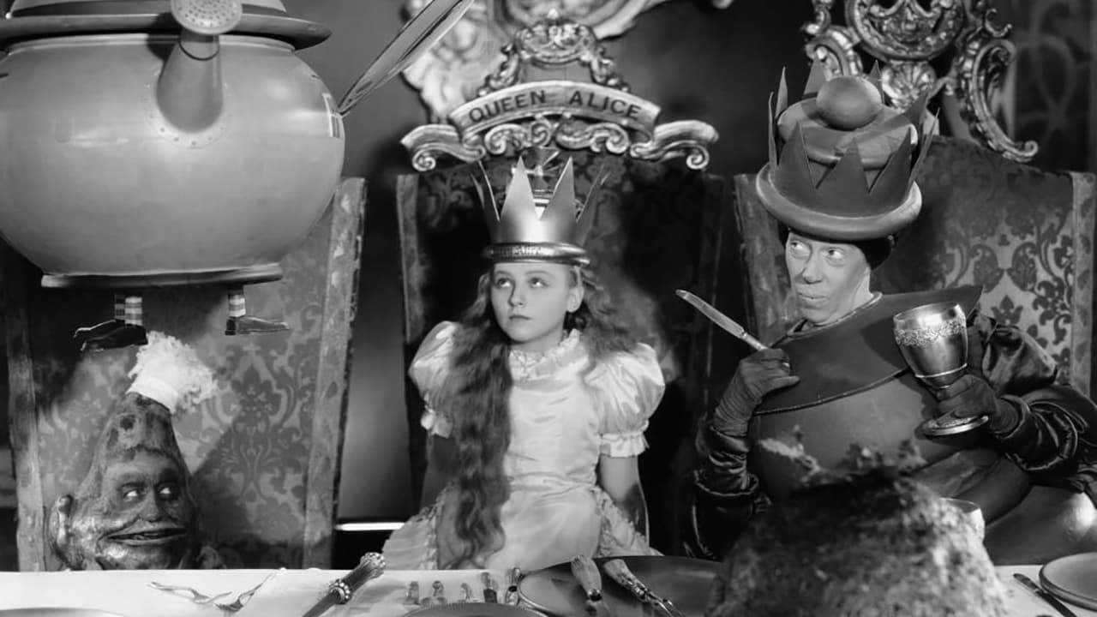

Slide 28
Currency Pair Triangle
Content

Slide 29
NFP

Slide 30
CNH vs CNY
As Mainland China is still not completely open to international foreign exchange and capital markets, the two types of Renminbi still remain a reality to this day:
CNY is onshore RMB currency traded within Mainland China only.
CNH is offshore RMB currency traded outside of Mainland China.
NOTE:
- You CAN actually settle in CNY for international trades
- As of 2009, there is no limit on RMB trade settlements between China and Hong Kong.

Slide 31
USDCNH vs USDCNY

Slide 32
USDHKD

Slide 33
Currenex Stuck Orders

Slide 34
Other bits and bobs…
WYSINWYG
Prices are different from / for everyone
Last Look
Too fast (eg too many orders per second)
Too slow (eg absolute time, too many ticks behind)
Too much Profit / Loss (eg market too volatile, price has moved too much)
Claw back
I lost too much on this trade – can I have some money back please?
Price adjustment
I was only joking about the price I gave you
EFP (Gold you buy on an exchange is not pure enough)

Slide 35
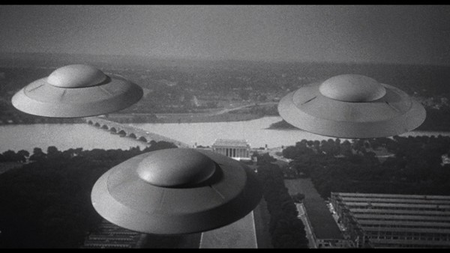

Slide 36
c = f($)
End Points | Latency Round Trip ms
Chicago <-> New York (Cable) | 14.1
Chicago <-> New York (Microwave) | 8.2
London <-> New York (Hiberia Global Financial Network) | 65.5
London <-> New York (Hiberia Express) | 58.8
London <-> Tokyo | 230
London <-> Tokyo (via Atlantic) | 170
Google | ???
Meta | ???
Microsoft | ???

Slide 37







29ms
115ms
4ms
7ms
115ms
32.5ms

Slide 38

AUDUSD
USDJPY
UJ
UJ
UJ
UJ
UJ
AJ
AJ
AJ
AJ
AJ
AJ
AJ
AJ
AUDJPY

Slide 39
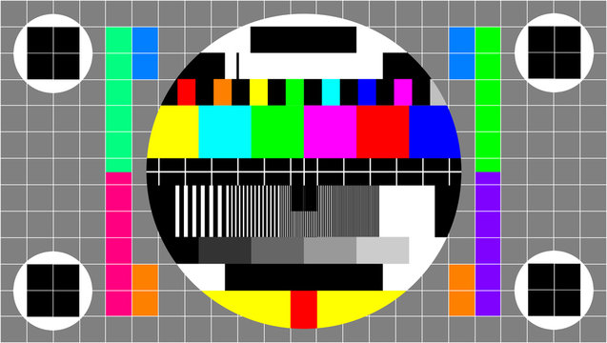

Slide 40
Other Client Offerings
Direct Market Access (DMA)
Trading Analytics
Algorithmic Strategies
Passive / Iceberg
Time- / Volume-based
Opportunistic - Guerrilla, Sniper
Hybrid - Float-Guerrilla, Float Sniper, Price Inline
https://www.credit-suisse.com/media/ib/docs/investment-banking/client-offering/aes-strategy-guide-and-attestation-equities.pdf

