Slide 1
Title
Content

Slide 2













Where Can You Buy?

Slide 3



Who are they really?

Slide 4
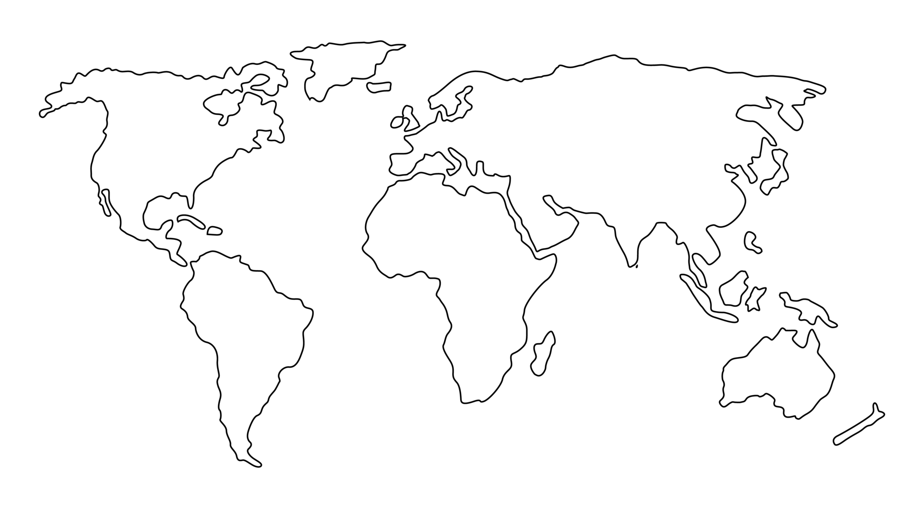
What Can You Buy?
EURSEK
USDRUB
USDCAD
EURNOK
EURDKK
GBPUSD
EURCHF
EURPLN
EURHUF
EURUSD
EURRON
USDCNY
USDJPY
XAGUSD
USDKRW
USDTRY
XAUUSD
USDCNH
USDTWD
XPDUSD
USDHKD
USDMXN
USDINR
XPTUSD
USDTHB
USDMYR
USDSGD
USDIDR
USDBRL
AUDUSD
USDZAR
NZDUSD

Slide 5

Where do my orders go?

Slide 6

… no … seriously …

Slide 7
… seriously …?!
EURSEK
USDRUB
USDCAD
EURNOK
EURDKK
GBPUSD
EURCHF
EURPLN
EURHUF
EURUSD
EURRON
USDCNY
USDJPY
XAGUSD
USDKRW
USDTRY
XAUUSD
USDCNH
USDTWD
XPDUSD
USDHKD
USDMXN
USDINR
XPTUSD
USDTHB
USDMYR
USDSGD
USDIDR
USDBRL
AUDUSD
USDZAR
NZDUSD

Slide 8
Sounds great! But How much?

Slide 9
That’s a bargain! Give me more!

Slide 10
More! More!! MORE!!!
Content

Slide 11
You are open 24/5.5?

Slide 12
Seriously? All day long?

Slide 13
How does BBG compare?

Slide 14
Currency Pair Triangle
Content

Slide 15
NFP

Slide 16
CNHCNY

Slide 17
USDHKD

Slide 18
Currenex Stuck Orders

Slide 19
Other bits and bobs…
WYSINWYG
Last Look
Claw back
Trade Amendments (price adjustment)
EFP

Slide 20
c = f($)
End Points | Latency Round Trip ms
Chicago to New York (Cable) | 14.1
Chicago to New York (Microwave) | 8.2
Hiberia Global Financial Network | 65.5
Hiberia Express | 58.8
London <-> Tokyo | 230
London <-> Tokyo (via Atlantic) | 170
Google | ???
Meta | ???
Microsoft | ???

Slide 21


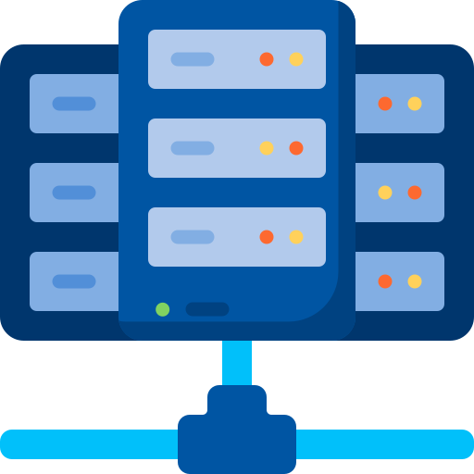


29ms
115ms
4ms
7ms
115ms
32.5ms

Slide 23
What is BBG used for?
IB / News
Graphs
Trade Amendments (claw-back / price adjustment)
EFP
BQuant

Slide 24
Other Client Offerings
Direct Market Access (DMA)
Trading Analytics
Algorithmic Strategies
Passive / Iceberg
Time- / Volume-based
Opportunistic - Guerrilla, Sniper
Hybrid - Float-Guerrilla, Float Sniper, Price Inline
https://www.credit-suisse.com/media/ib/docs/investment-banking/client-offering/aes-strategy-guide-and-attestation-equities.pdf

