Slide 1
Title
Content

Slide 2
Intro – List of Keywords
Bilteral / Multilateral / Credit Agreements / Limits
ECN / Brokers

Slide 3













Where Can You Buy?

Slide 4



Who are they really?

Slide 5
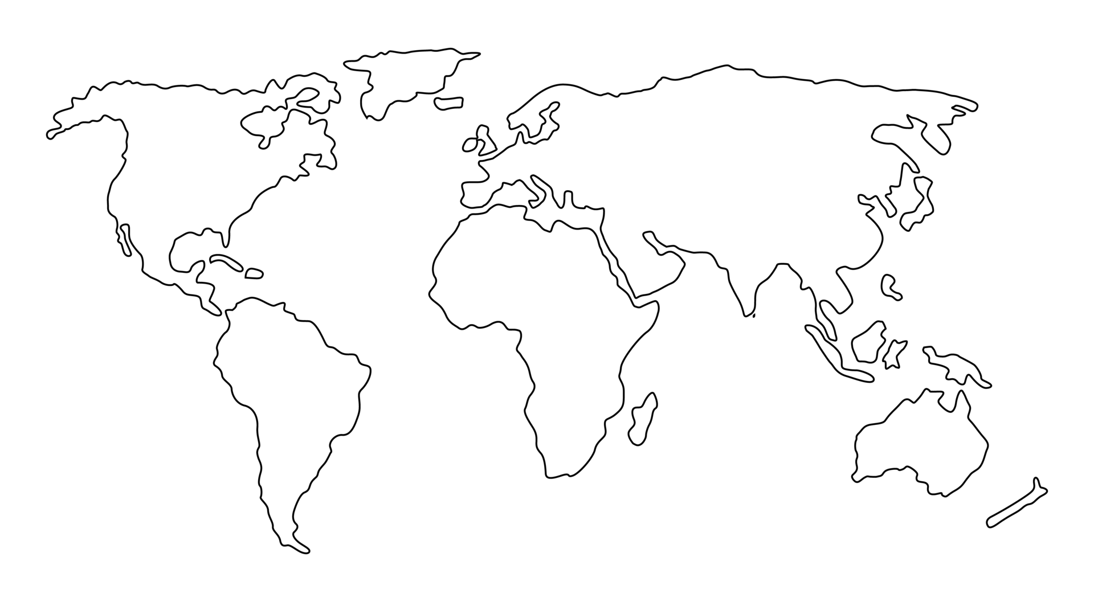
What Can You Buy?
EURSEK
USDRUB
USDCAD
EURNOK
EURDKK
USDCHF
GBPUSD
EURCHF
EURPLN
EURHUF
EURUSD
EURRON
USDCNY
USDJPY
XAGUSD
USDKRW
USDTRY
XAUUSD
USDCNH
USDTWD
XPDUSD
USDHKD
AUDJPY
USDMXN
USDINR
XPTUSD
NZDJPY
USDTHB
USDMYR
USDSGD
USDIDR
USDBRL
AUDUSD
USDZAR
NZDUSD

Slide 6

Where do my orders go?

Slide 7

… no … seriously …

Slide 8
… seriously …?!
EURSEK
USDRUB
USDCAD
EURNOK
EURDKK
GBPUSD
EURCHF
EURPLN
EURHUF
EURUSD
EURRON
USDCNY
USDJPY
XAGUSD
USDKRW
USDTRY
XAUUSD
USDCNH
USDTWD
XPDUSD
USDHKD
USDMXN
USDINR
XPTUSD
USDTHB
USDMYR
USDSGD
USDIDR
USDBRL
AUDUSD
USDZAR
NZDUSD

Slide 9

There is another way!
USDCAD
GBPUSD
USDHKD
AUDUSD
NZDUSD

Slide 10
Sounds great! But How much?

Slide 11
That’s a bargain! Give me more!

Slide 12
More! More!! MORE!!!
Content

Slide 13
You are open 24/5.5?

Slide 14
Seriously? All day long?

Slide 15
How does BBG compare?

Slide 16
Currency Pair Triangle
Content

Slide 17
NFP

Slide 18
CNHCNY

Slide 19
USDHKD

Slide 20
Currenex Stuck Orders

Slide 21
Other bits and bobs…
WYSINWYG
Last Look
Too slow
Too volatile
Too much PnL
Claw back
I loss too much on this trade – can I have some money back please?
Price adjustment
I was only joking about the price I gave you
EFP
MidMatch / Darkpool

Slide 22
c = f($)
End Points | Latency Round Trip ms
Chicago to New York (Cable) | 14.1
Chicago to New York (Microwave) | 8.2
Hiberia Global Financial Network | 65.5
Hiberia Express | 58.8
London <-> Tokyo | 230
London <-> Tokyo (via Atlantic) | 170
Google | ???
Meta | ???
Microsoft | ???

Slide 23







29ms
115ms
4ms
7ms
115ms
32.5ms

Slide 24

AUDUSD
USDJPY
AUDJPY

Slide 25
What is BBG used for?
IB / News
Graphs
Trade Amendments (claw-back / price adjustment)
EFP
BQuant

Slide 26
Other Client Offerings
Direct Market Access (DMA)
Trading Analytics
Algorithmic Strategies
Passive / Iceberg
Time- / Volume-based
Opportunistic - Guerrilla, Sniper
Hybrid - Float-Guerrilla, Float Sniper, Price Inline
https://www.credit-suisse.com/media/ib/docs/investment-banking/client-offering/aes-strategy-guide-and-attestation-equities.pdf

