Slide 1



Engineering a High-Performance GPU B-Tree
PPoPP19
Muhammad A. Awad*
Muhammad A. Awad, Saman Ashkiani, Rob Johnson, Martín Farach-Colton, and John D. Owens

Slide 2
Data Structures in Our Group
Quotient Filters: Approximate Membership Queries on the GPU, Geil et al., IPDPS 2018. [ bib | DOI | http ]
GPU LSM: A Dynamic Dictionary Data Structure for the GPU, Ashkiani et al., IPDPS 2018. [ bib | DOI | http ]
A Dynamic Hash Table for the GPU, Ashkiani et al., IPDPS 2018. [ bib | DOI | http ]

Slide 4
Notes:
6x faster
3.5x

Slide 5
Our GPU B-Tree
Goal:
A high-performance dynamic GPU B-Tree that supports concurrent queries and updates.
Design Decisions:
Node size (choice of B)
Warp Cooperative Work Sharing Strategy
B-Link-Tree
Decoupled Read and Write Modes
Proactive Splitting
Restarts Instead of Spinlocks
Notes:
B-link-tree [Lehman and Yao, 1981]

Slide 6
Our GPU B-Tree
Goal:
A high-performance dynamic GPU B-Tree that supports concurrent queries and updates.
Design Decisions:
Node size (choice of B)
Warp Cooperative Work Sharing Strategy
B-Link-Tree
Decoupled Read and Write Modes
Proactive Splitting
Restarts Instead of Spinlocks
high query throughput
high update throughput
Notes:
B-link-tree [Lehman and Yao, 1981]

Slide 7
Node Size
How do we pick a node size?
On NVIDIA GPUs, a cache line is 128 bytes.
Maximize memory throughput.
Coalesced memory access.
Then, we choose a size of 128 bytes for our tree node (we’ll talk about the branching factor later).

Slide 8
Divergence During Traversal
Different tree traversals will have different paths.
…….
…….

Slide 9
Divergence During Traversal
Different tree traversals will have different paths.
…….
…….

Slide 10
Divergence During Traversal
Different tree traversals will have different paths.
Eliminate branch divergence.
Warp cooperative work sharing strategy.
Per-thread assignment.
Per-warp processing.
What WCWS offers:
No branch divergence.
Coalesced memory access.
No load balancing needed.
Perform concurrent queries and updates.
…….
…….

Slide 11
Divergence During Traversal
Different tree traversals will have different paths.
Eliminate branch divergence.
Warp cooperative work sharing strategy.
Per-thread assignment.
Per-warp processing.
What WCWS offers:
No branch divergence.
Coalesced memory access.
No load balancing needed.
Perform concurrent queries and updates.
…….
…….

Slide 12
Our GPU B-Tree
Goal:
A high-performance dynamic GPU B-Tree that supports concurrent queries and updates.
Design Decisions:
Node size (choice of B)
Warp Cooperative Work Sharing Strategy
B-Link-Tree
Decoupled Read and Write Modes
Proactive Splitting
Restarts Instead of Spinlocks
high query throughput
Notes:
B-link-tree [Lehman and Yao, 1981]

Slide 13
Splitting Tree nodes
How to split a full tree node?
…….
…….
Adding new Key-value pair to this full leaf
Notes:
B-link-tree [Lehman and Yao, 1981]

Slide 14
Splitting Tree nodes
How to split a full tree node?
Latch coupling
Latch a safe path
(i.e. splitting will not propagate
beyond this safe path)
Safe path
…….
…….
Adding new Key-value pair to this full leaf
Notes:
B-link-tree [Lehman and Yao, 1981] emphasis on the shallow tree and locking the first two levels is too bad

Slide 15

Splitting Tree nodes
How to split a full tree node?
Latch coupling
Latch a safe path
(i.e. splitting will not propagate
beyond this safe path)
Safe path
…….
No parallelism
…….
Adding new Key-value pair to this full leaf
Notes:
B-link-tree [Lehman and Yao, 1981] emphasis on the shallow tree and locking the first two levels is too bad

Slide 16
Splitting Tree nodes
How to split a full tree node?
Latch coupling
Proactive splitting
Split any full node during
insertion traversal.
Still using X-Latches
…….
…….
Adding new Key-value pair to this full leaf
Notes:
B-link-tree [Lehman and Yao, 1981]

Slide 17
Splitting Tree nodes
How to split a full tree node?
Latch coupling
Proactive splitting
Split any full node during
insertion traversal.
Still using X-Latches
…….
Still no parallelism
…….
Adding new Key-value pair to this full leaf
Notes:
B-link-tree [Lehman and Yao, 1981]

Slide 18
Splitting Tree nodes
How to split a full tree node?
Why X-Latches?
Scenario:
One warp inserting 13
Another warp looking up 20
5
5
10
14
20
Notes:
B-link-tree [Lehman and Yao, 1981]

Slide 19

Splitting Tree nodes
How to split a full tree node?
Why X-Latches?
5
W1: lookup 20
State: traversing to leaf
5
10
13
14
20
Warp 1
Where is my key?
W0: insert 13
State: split leaf, next updating the parent with additional pivot (14).
Notes:
B-link-tree [Lehman and Yao, 1981]

Slide 20
Splitting Tree nodes
How to split a full tree node?
Latch coupling
Proactive splitting
B^{link}-tree
Each tree node has two
additional entries:
High-key
Pointer to its right sibling
…….
…….
Adding new Key-value pair to this full leaf
Notes:
B-link-tree [Lehman and Yao, 1981]

Slide 21

Splitting Tree nodes
How to split a full tree node?
Latch coupling
Proactive splitting
B^{link}-tree
Each tree node has two
additional entries:
High-key
Pointer to its right sibling
…….
…….
Adding new Key-value pair to this full leaf
Much better
Notes:
B-link-tree [Lehman and Yao, 1981]

Slide 22
Splitting Tree nodes
How to split a full tree node?
Latch coupling
Proactive splitting
B^{link}-tree
And, now we can have:
Decoupled reads and writes modes.
…….
…….
Notes:
B-link-tree [Lehman and Yao, 1981]

Slide 23
Latching
Do we use spinlocks? backoff locking?
We find that spinlocks reduces the amount of resident warps and reduces memory throughput.
Backoff: 1.47x faster than spinlocks.
Adaptive backoff window is better.
We use restarts.
Restart an insertion from parent node (or root, if needed).
Similar to backoff with adaptive window.
Restarts: 6.39x faster than spinlocks.
Notes:
B-link-tree [Lehman and Yao, 1981]

Slide 24
Latching
Do we use spinlocks? backoff locking?
We find that spinlocks reduces the amount of resident warps and reduces memory throughput.
Backoff: 1.47x faster than spinlocks.
Adaptive backoff window is better.
We use restarts.
Restart an insertion from parent node (or root, if needed).
Similar to backoff with adaptive window.
Restarts: 6.39x faster than spinlocks.
Notes:
B-link-tree [Lehman and Yao, 1981]

Slide 25
Our GPU B-Tree
Goal:
A high-performance dynamic GPU B-Tree that supports concurrent queries and updates.
Design Decisions:
Node size (choice of B → B = 15)
Warp Cooperative Work Sharing Strategy
B-Link-Tree
Decoupled Read and Write Modes
Proactive Splitting
Restarts Instead of Spinlocks
high query throughput
high update throughput
Overall three orders of magnitude faster than the baseline (182.9 vs. 0.166 MKey/s)
Notes:
B-link-tree [Lehman and Yao, 1981]

Slide 26
Results
B-Tree operations:
Queries: Point, range, successor.
Updates: insertion, deletion.
Bulk-build.
We compare our results to:
GPU LSM [Ashkiani et al., IPDPS18].
GPU SA.
We use NVIDIA TITAN V (Volta) GPU.

Slide 27
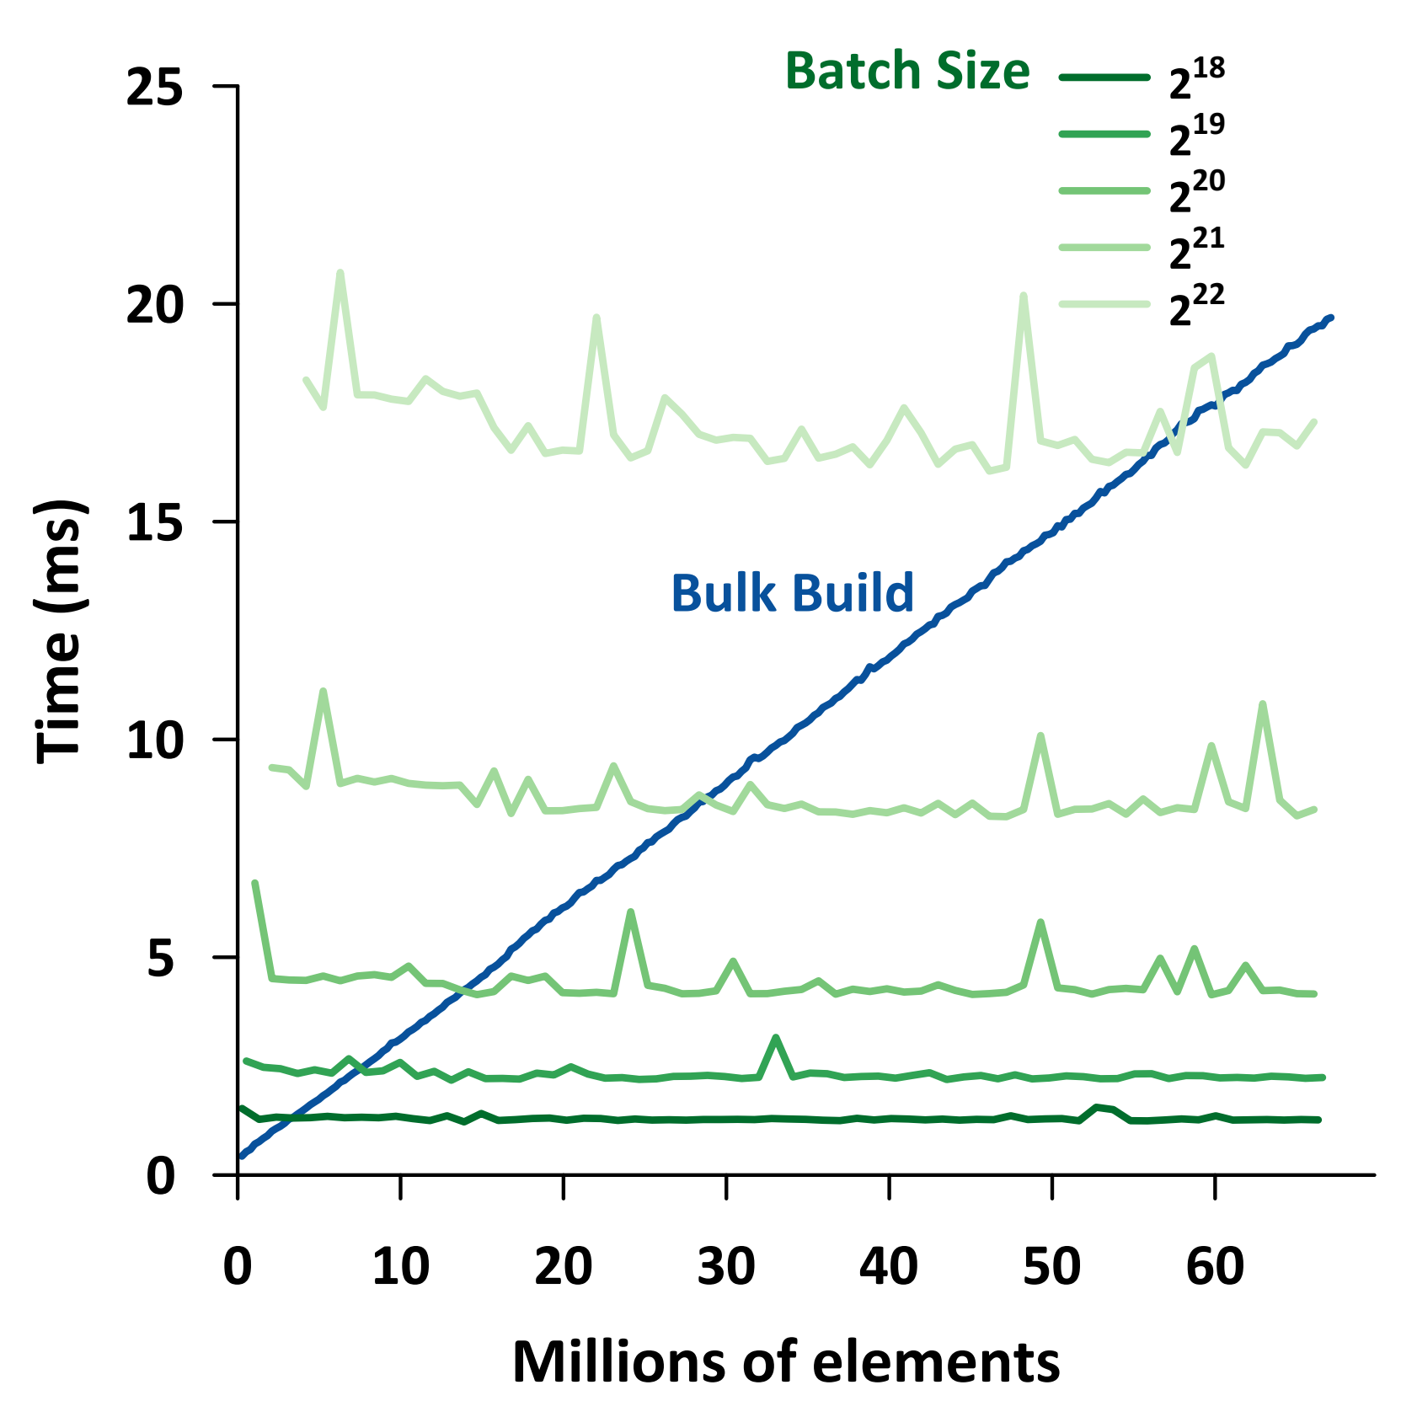
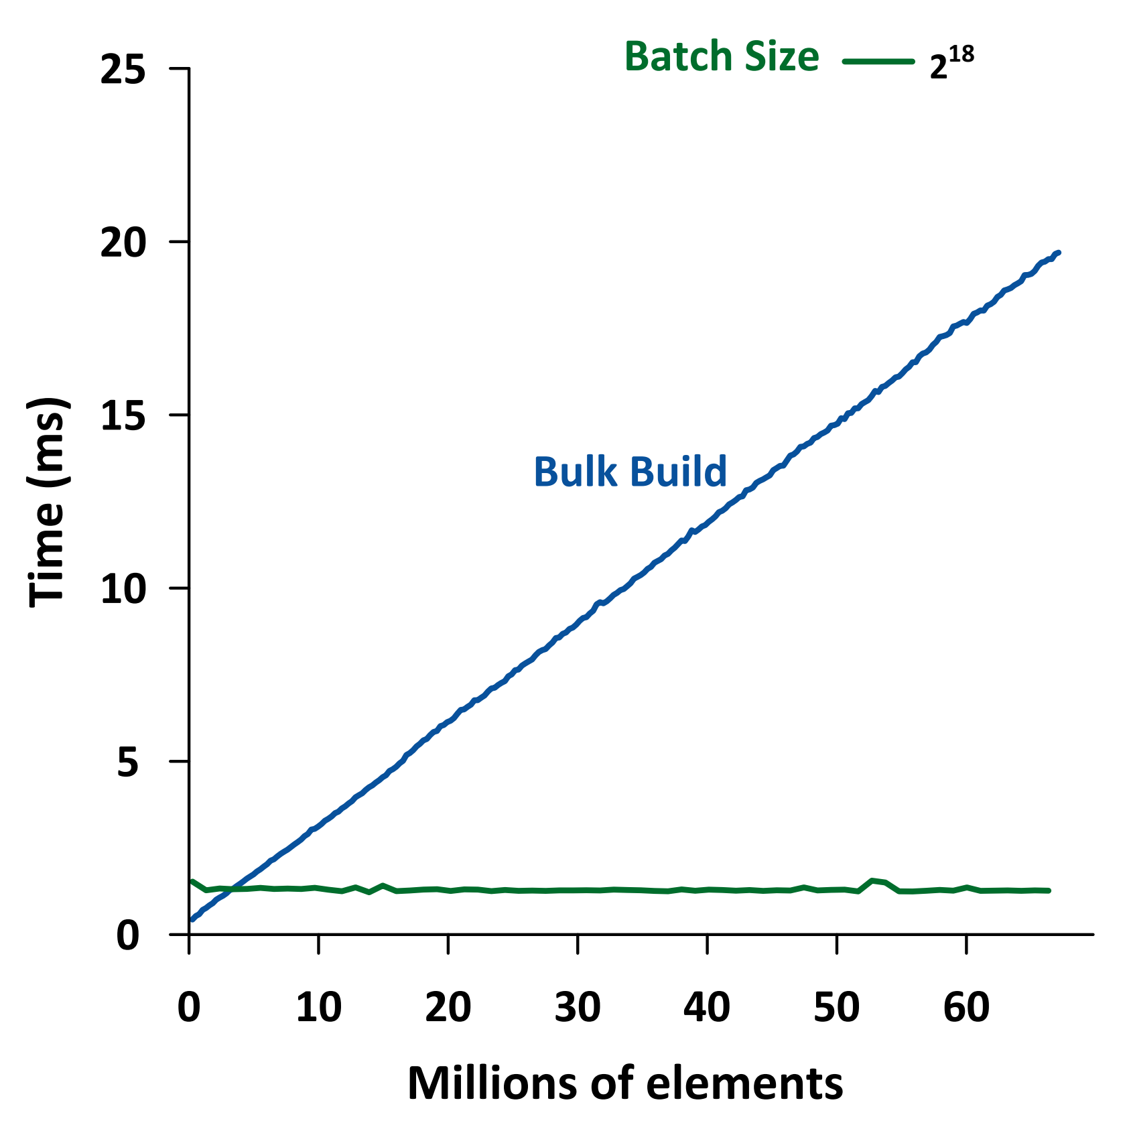
Bulk rebuild or incremental insertion?
Bulk rebuild
is better
Incremental insertion
is better
3.15MKey
Notes:
Bulk build throughput: 3124.32 MKey/s.

Slide 28
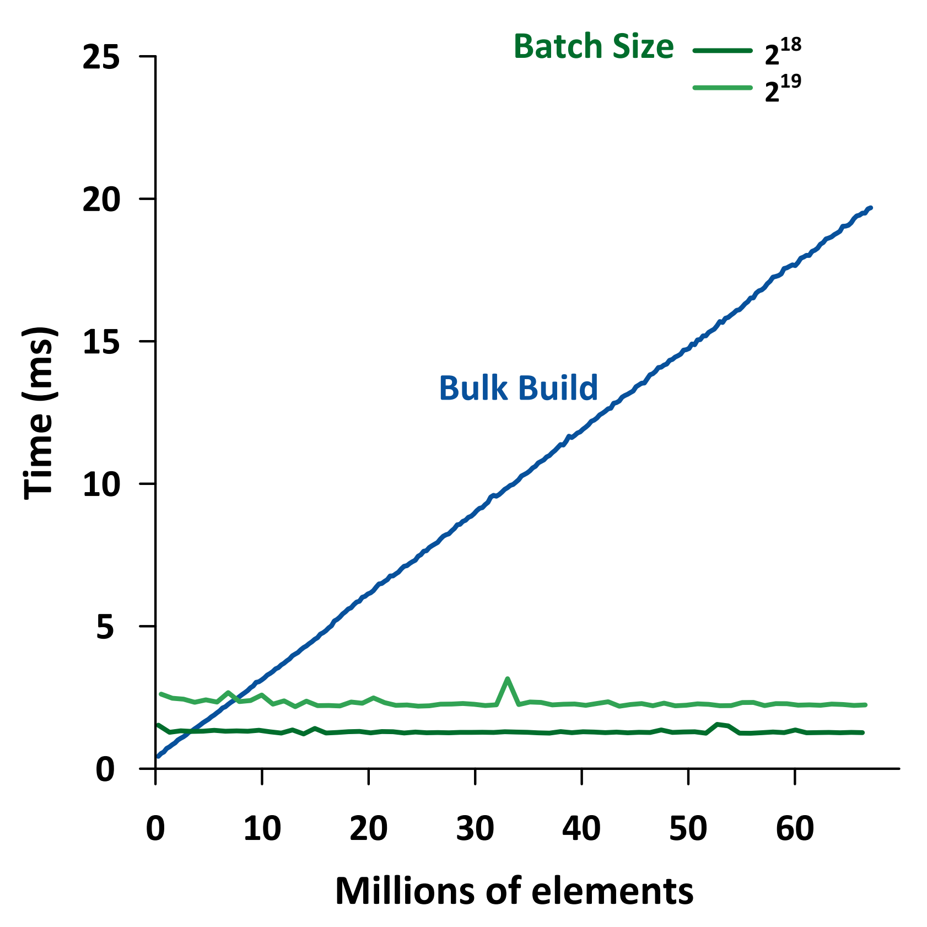
Bulk rebuild or incremental insertion?
Bulk rebuild
is better
Incremental insertion
is better
Notes:
Bulk build throughput: 3124.32 MKey/s.

Slide 29
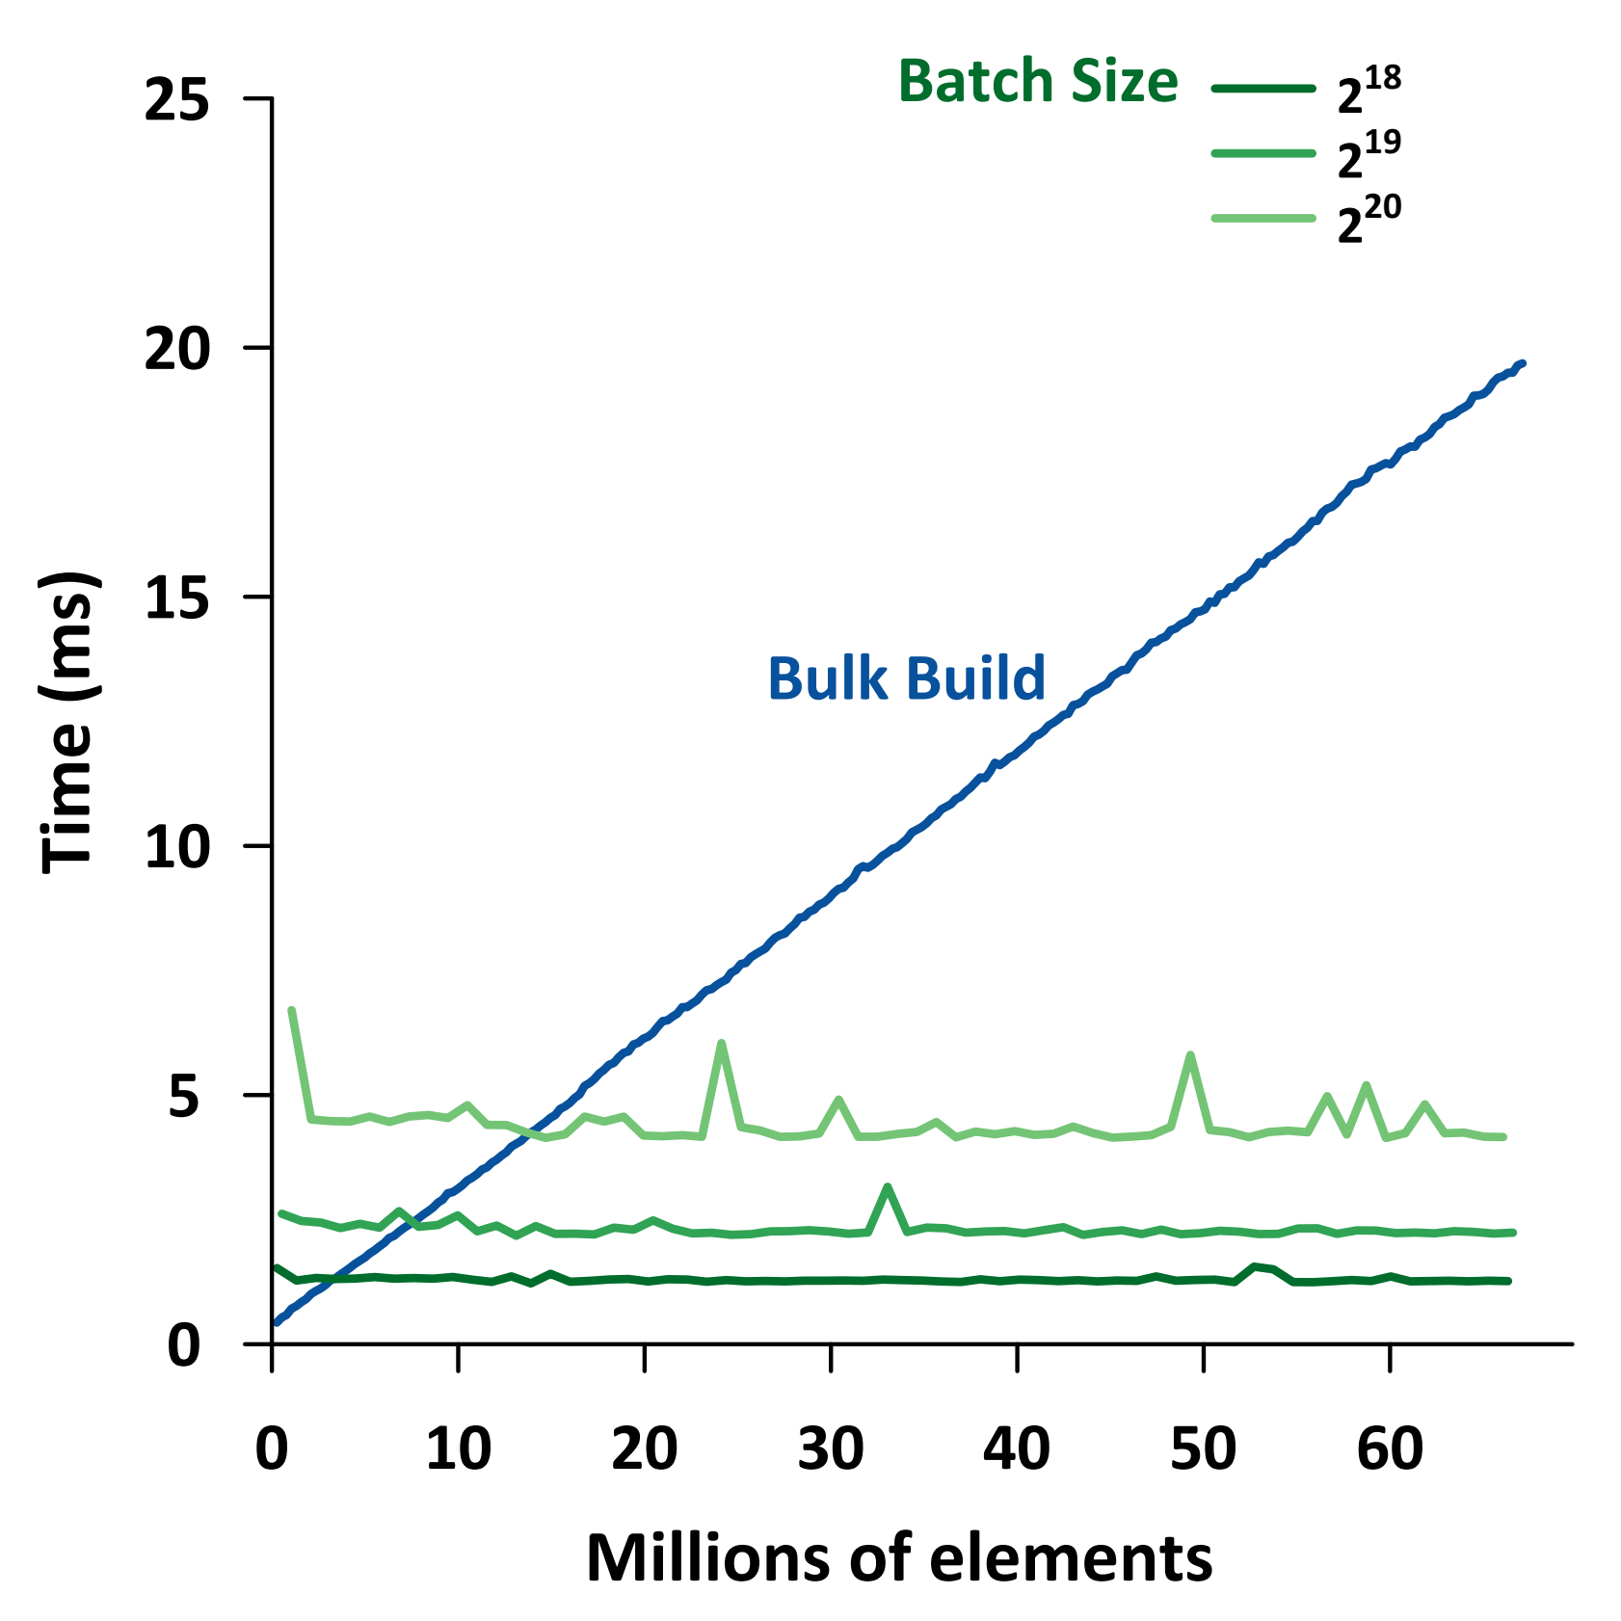
Bulk rebuild or incremental insertion?
Bulk rebuild
is better
Incremental insertion
is better
Notes:
Bulk build throughput: 3124.32 MKey/s.

Slide 30
Bulk rebuild or incremental insertion?
Bulk rebuild
is better
Incremental insertion
is better
*Bulk build throughput: 3124.32 MKey/s.
Notes:
Bulk build throughput: 3124.32 MKey/s.

Slide 31
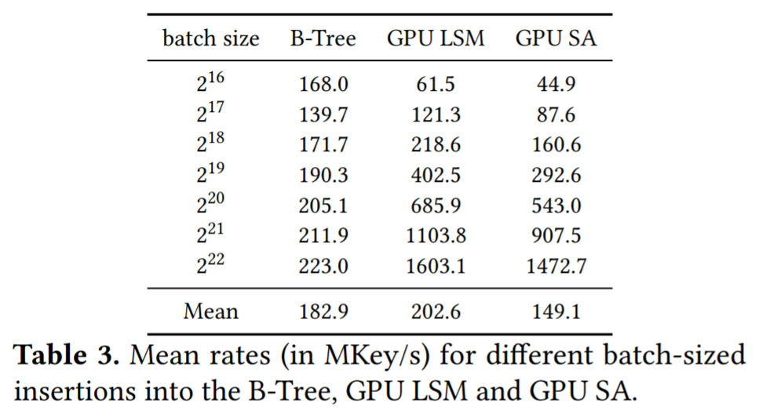
Batch size effect on insertion throughput
B-Tree is faster than LSM for smaller batches (<= 2¹⁷). Why?

Slide 32
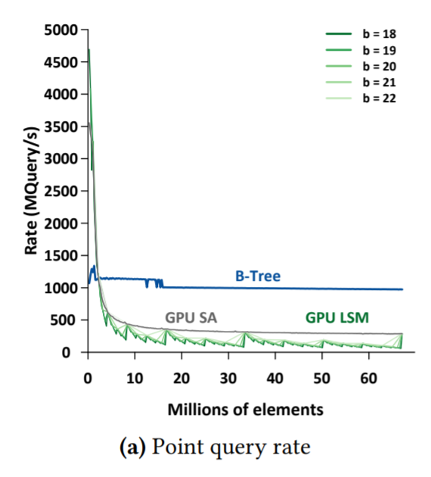
Queries performance
Point Query:
6.44x faster than LSM.
3x faster than SA.
Tree height changes from 7 to 8. Same throughput up to 15⁸x15 ≈ 38B Keys.

Slide 33
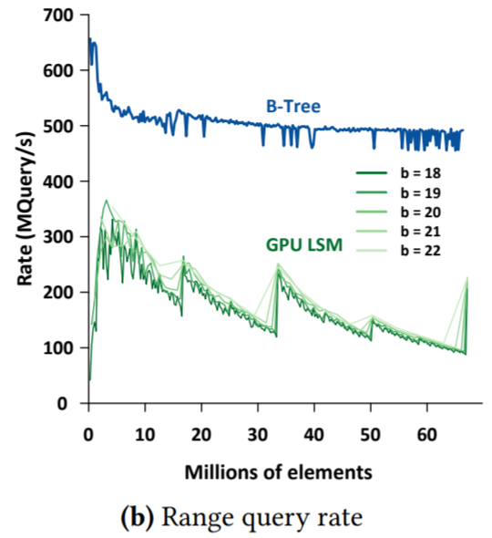
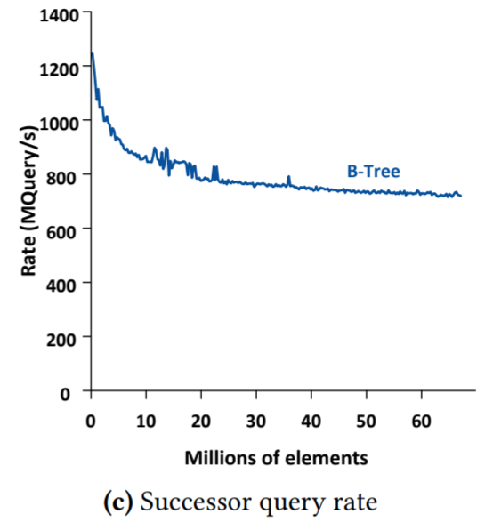
Queries performance
Point Query:
6.44x faster than LSM.
3x faster than SA.
Range Query:
3x faster than LSM.
Tree height changes from 7 to 8. Same throughput up to 15⁸x15 ≈ 38B Keys.

Slide 34
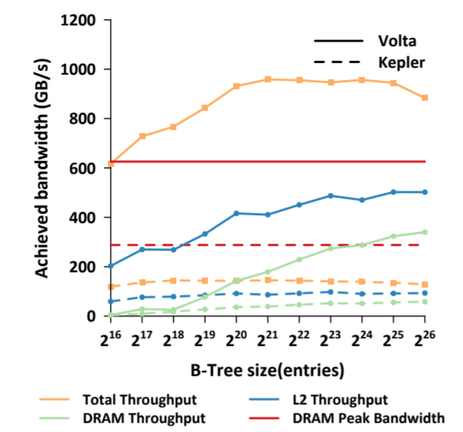
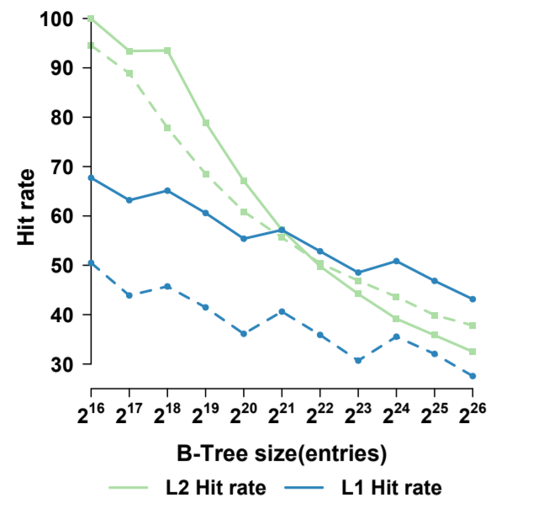
Cache Utilization
Volta’s DRAM throughput
is 2.27x faster than Kepler.
Bigger caches.
Cache-aware design.
B-Tree throughput
is 6.2x faster.
Up to 1 TB/s achieved
bandwidth.
Higher throughput than the DRAM peak bandwidth on Volta
Throughput
Hit rates
Notes:
Put it in text why we are improves

Slide 35
Acknowledgments
This material is based upon work supported by the National Science Foundation under Grant No. CCF-1637442 and Grant No. CCF-1637458, with this project initiated at the December 2017 AlgoPARC Workshop on Parallel Algorithms and Data Structures at the University of Hawaii at Manoa (Grant No. CCF-1745331). Any opinions, findings, and conclusions or recommendations expressed in this material are those of the authors and do not necessarily reflect the views of the National Science Foundation.
NVIDIA for GPUs
Lars Nyland, NVIDIA
Tyler Sorensen, Princeton University

Slide 36
Conclusions and Future Work
Careful choice of the design decisions = high performance B-Tree.
For smaller batch sizes our B-Tree provides higher updates throughput than GPU LSM, thanks to our warp-centric approach.
Larger keys (and values) than 31 bit.
Predecessor.
Source code will be available at: https://github.com/owensgroup/GpuBTree
Notes:
* Add the github link

Slide 37

GPU Dynamic Graph
Adj. list
Slablist
Dynamic Graph
SlabHash
Gunrock
Updates
Dynamic
B-Tree
Queries
Static
CSR
Graph data structure

Slide 38
GPU Dynamic Graph
Goals:
Defining an opaque interface between Gunrock operators and graph data structures (Static or Dynamic graph).
Gunrock operators respecting the new interface.
Dynamic graph representations.
Dynamic graph operations.
Applications.

Slide 39
GPU Dynamic Graph
Goals:
Defining an opaque interface between Gunrock operators and graph data structures (CSR and dynamic graph).
Gunrock (advance and intersect) respecting the new interface.
Dynamic graph representations: vertex dictionary pointing to slab lists.
Dynamic graph operations: loading adjacency lists, edges insertion and deletion, and compaction.
Applications.
Static: SSSP, TC .
Dynamic: K-Truss .

Slide 40
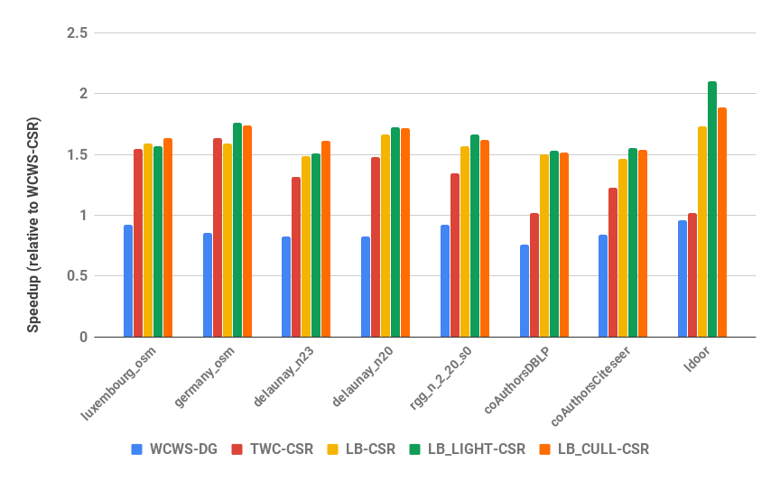
GPU Dynamic Graph
Initial results for SSSP:
Using Tesla V100
TWC and LB are Gunrock current load-balanced operator.
WCWS new operator.
Notes:
Using Tesla V100

Slide 41
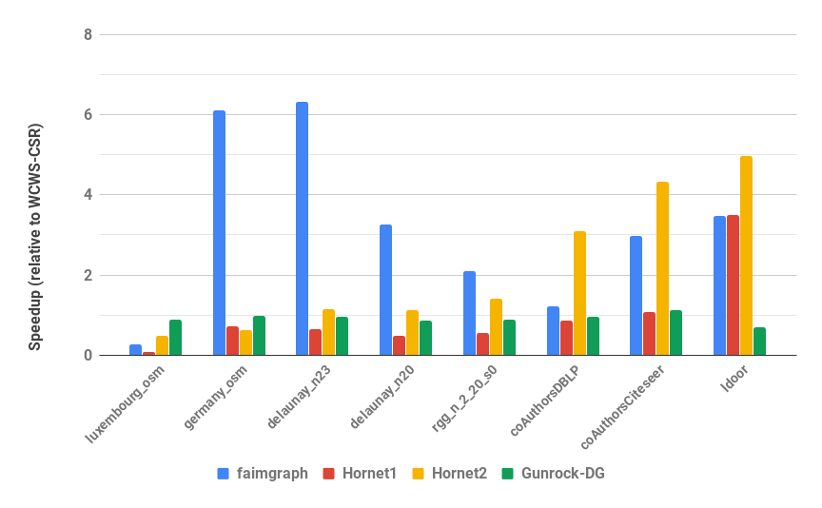
GPU Dynamic Graph
Initial results for TC:
Using Tesla V100
Hornet1/2 are based on different intersection algorithms.
Gunrock new intersect implementation doesn’t make any assumptions on the input.

