Slide 1


Dynamic Graphs on the GPU
IPDPS 2020
Muhammad A. Awad, Saman Ashkiani, Serban D. Porumbescu, and John D. Owens
Notes:
Hello! I’m Muhammad Awad and I’ll be presenting our paper Dynamic Graphs on the GPU published in IPDPS20.

Slide 2
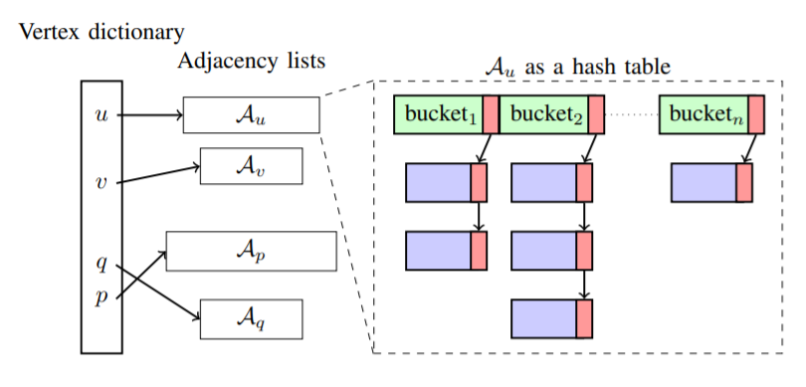
Dynamic Graphs on the GPU
Goal: High-performance dynamic graph data structure optimized for updates and queries.
Approach: Hash-table-based graph data structure.
Argument: List-based data structures add the complexity of maintaining sorted adjacency lists to optimize queries and updates.
High level schematic of our graph data structure
Notes:
Graphs change overtime. We would like to be able to update a graph through the different update operations such as edge insertion and deletion; vertex insertion and deletion. And we would like to perform these operations at high throughputs. To achieve this goal we design a hash-table-based dynamic graph data structure. We replace the list-based adjacency lists with more sophisticated data structure such as a hash table. And we argue that this is the right way to represent a dynamic graph given the complexities of maintaining sorted adjacency lists.

Slide 3
Graph Data Structures
Vertex Dictionary
v₁
v₂
v₃
v₄
v₅
v₆
Edge List (CSR)
Fixed-size array
E₁
E₂
E₃
E₄
E₅
E₆
Notes:
Now I will briefly go over how graph data structures store a graph. Typically we have a vertex dictionary that contains pointers to a vertex’s neighbor’s list. In a compressed sparse row (CSR) forma, the adjacency lists are stored inside a fixed size array, which is the most compact form. Now if we need to perform any update, we need to copy the whole array which is not practical in a dynamic settings.

Slide 4
Graph Data Structures
Vertex Dictionary
v₁
v₂
v₃
v₄
v₅
v₆
Edge List (CSR)
Fixed-size array
E₁
E₂
E₃
E₄
E₅
E₆
Edge List (Hornet)
Variable-size array
E₁
E₂
E₃
E₄
E₅
E₆
Notes:
A first solution is by Hornet (a GPU graph processing library). They break down the adjacency lists into variable size arrays per vertex. And if you exceed the capacity of an array you double the array size and copy the adjacency list. This is better than copying the whole adjacency list but we still have to do some copying.

Slide 5
Graph Data Structures
Vertex Dictionary
v₁
v₂
v₃
v₄
v₅
v₆
Edge List (CSR)
Fixed-size array
E₁
E₂
E₃
E₄
E₅
E₆
Edge List (Hornet)
Variable-size array
E₁
E₂
E₃
E₄
E₅
E₆
Edge List (faimGraph)
Linked-list of fixed-size arrays
E₁₁
E₁₂
E₁₃
E₁₄
E₁₅
E₁₆
E₂₁
E₂₂
E₂₃
E₂₄
E₂₅
E₂₆
E₃₆
Notes:
A different approach by faimGraph, is to break down each vertex’s adjacency list even further and present it using a GPU linked list (each node is a page of fixed size). Now this is better since we don’t need to do any copying.

Slide 6
Graph Data Structures
Vertex Dictionary
v₁
Edge exist query is an essential query.
Example: insertion while maintaining unique edges per-vertex.
Query cost if the adjacency list is not sorted:
O(|E|)
And if sorted:
O(log(|E|))
… But we must maintain the sorting order during updates.
Edge List (CSR)
Fixed-size array
E₁
Edge List (Hornet)
Variable-size array
E₁
Edge List (faimGraph)
Linked-list of fixed-size arrays
E₁₁
E₂₁
Notes:
Now the problem with these approaches is that if we want to perform a basic operation such as an edge exist query (which is important when maintaining unique edges per vertex) this operation will require linear time if the adjacency list is not sorted. Sorting will improve this but then we must maintain the sorting order during updates.

Slide 7
Our Dynamic Graph Data Structure
Hash-table-based graph data structure.
Notes:
Now our approach is to replace these lists and use hash tables instead.

Slide 8
Our Dynamic Graph Data Structure
Hash-table-based graph data structure.
Each vertex has:
Pointer to its own hash table (we use Slab Hash*).
Additional counters for number
of edges and other metrics.
Query Performance:
O(1)
* Saman Ashkiani, Martin Farach-Colton, and John D. Owens. A Dynamic Hash Table for the GPU. In Proceedings of the 32nd IEEE International Parallel and Distributed Processing Symposium, IPDPS 2018, pages 419–429, May 2018. [ bib | DOI | code | http ]
Notes:
So each vertex has its own hash table and additional counters like edges per vertex. And we use Slab Hash a dynamic GPU hash table that was designed in our group. If we construct the hash table with the right load factor, queries will be in constant time.

Slide 9
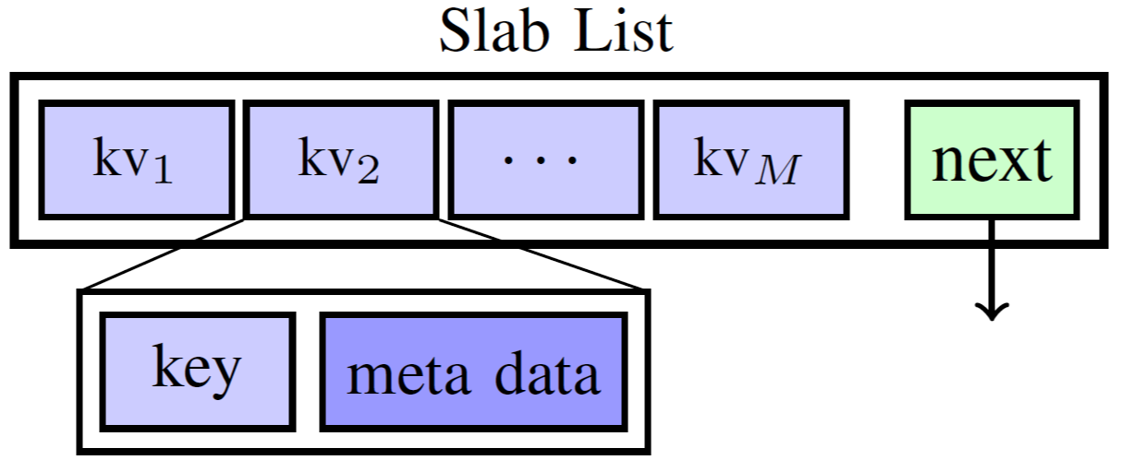
Slab Hash*
Load factor defines the initial number of buckets.
Each bucket is a 128 bytes slab.
Collision is resolved using a linked-list of dynamically allocated slabs.
Offers concurrent multimap (duplicate keys) and our additions:
Concurrent map (unique keys) -> used in weighted graphs
Concurrent set (unique keys and no values) -> used in unweighted graphs
* Saman Ashkiani, Martin Farach-Colton, and John D. Owens. A Dynamic Hash Table for the GPU. In Proceedings of the 32nd IEEE International Parallel and Distributed Processing Symposium, IPDPS 2018, pages 419–429, May 2018. [ bib | DOI | code | http ]
Notes:
Now a brief description of SlabHash. Given a load factor we define the number of buckets in the hash table and each of these buckets is a Slab List (shown in the figure). And if collision happens, we resolve it by dynamically allocating a new slab and link it to the previous slab.
Initially Slab Hash supported concurrent multimap but we added support for Concurrent map which we use in representing weighted graphs. And we added Concurrent Set and we use that in unweighted graphs.

Slide 10
Our Dynamic Graph Data Structure
We support the following operations:
Low-level Operations
Edge insertion and deletion
Vertex insertion and deletion
Bulk build
Queries
Edge exist query
Iterator over a vertex’s adjacency list
Notes:
Back to our graph data structure. We support different operations such as edge insertion/deletion, bulk build, and queries such as edge exist or iterators over a vertex’s adjacency list.

Slide 11
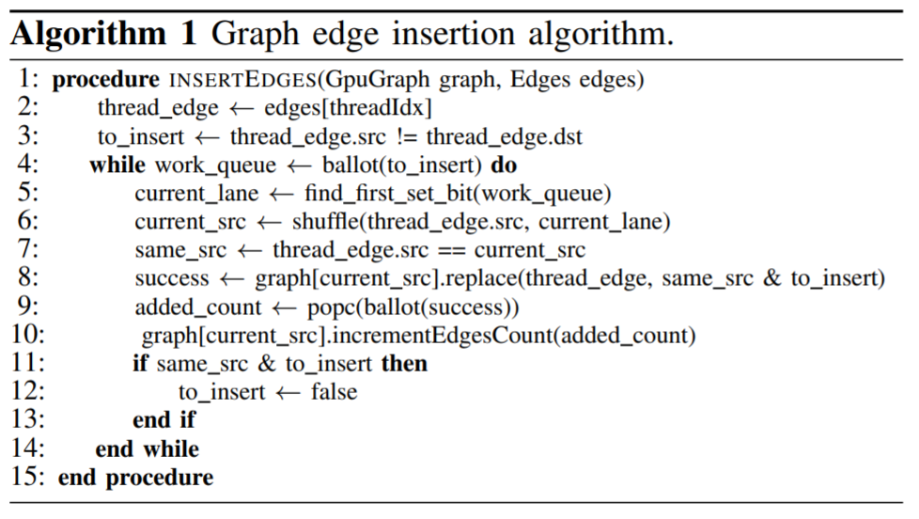
Example Operation: Edge Insertion
Using warp cooperative work sharing strategy (WCWS).
Per-thread assignment.
Per-warp processing.
Notes:
Now I’d like to highlight one of Slab hash design decisions, warp cooperative work sharing strategy which we follow in our work. In WCWS each thread has its own work assignment but a warp process each of these assignments one at a time.

Slide 12
Example Operation: Edge Insertion
Using warp cooperative work sharing strategy (WCWS).
Per-thread assignment.
Per-warp processing.
Build a queue of new edges
Notes:
Typically this is done by forming a queue work.

Slide 13
Example Operation: Edge Insertion
Using warp cooperative work sharing strategy (WCWS).
Per-thread assignment.
Per-warp processing.
Build a queue of new edges
Warp-wide single edge insertion
Notes:
Followed by performing one of the queue operation using the while warp.

Slide 14
Example Operation: Edge Insertion
Using warp cooperative work sharing strategy (WCWS).
Per-thread assignment.
Per-warp processing.
Build a queue of new edges
Warp-wide single edge insertion
Maintain per-vertex edge count
Notes:
And finally based on the operation result we update our per-vertex counters.

Slide 15
Example Operation: Edge Insertion
Using warp cooperative work sharing strategy (WCWS).
Per-thread assignment.
Per-warp processing.
WCWS benefits:
Eliminates branch divergence.
Coalesced memory access.
Notes:
And finally based on the operation result we update our per-vertex counters.

Slide 16
Evaluating a Dynamic Graph Data Structure
We define a set of benchmarks to evaluate a dynamic graph data structure:
Low-level Operations:
Edge insertion and deletion
Vertex insertion and deletion
Workloads:
Bulk build
Incremental build
Applications:
Static and dynamic graph application (we use triangle counting)
We evaluate our graph data structure and compare it to Hornet and faimGraph.
Notes:
One of our contributions is defining a set of benchmarks that we believe represent real life workloads. We divide these benchmarks into low-level operations, workloads and solving a graph problem (or an application). We expect a real workload would be starting from a graph followed by add-and-age operations and this translates into a bulk build followed by low level operations. Or maybe we are starting from scratch and we incrementally build the graph.

Slide 17
Results*
Sorting CSR† compared to building our data structure (log scale).
* Using an NVIDIA TITAN V (Volta) GPU.
† Using CUB’s Segmented Sort
Notes:
Moving on to results. Our main argument is that sorting is a costly operation. We can think of the other data structures as sorting a CSR followed by maintain it. So let’s look at how this compares the runtime of sorting and our data structure building. And here we see that just building our data structure is orders of magnitudes faster than sorting a CSR. Which proves our point.

Slide 18
Results*
High throughput low-level operations.
High throughput in graph building workloads.
Incremental build: 993.82 MEdge/s (5x faster than Hornet).
Bulk build: 2–30x faster than Hornet.
In hollywood-2009 dataset 45% of Hornet’s time is spent in deduplication (same time required to build or data structure).
Operation | Rate (MOp/s) | Speedup vs. Hornet | Speedup vs. faimGraph
Edge insertion | 646 | 5.8-14.8x | 3.4-5.4x
Edge deletion | 1024.87 | 1.0-7.0x | 3.6-5.7x
Vertex deletion | 26.49 | -- | 8.9-12.2x
* Using an NVIDIA TITAN V (Volta) GPU.
* Averaged over different datasets
Notes:
Moving on to results. Our main argument is that sorting is a costly operation. We can think of the other data structures as sorting a CSR followed by maintain it. So let’s look at how this compares the runtime of sorting and our data structure building. And here we see that just building our data structure is orders of magnitudes faster than sorting a CSR. Which proves our point.

Slide 19
Results*
Dynamic triangle counting.
Intersection: given two adjacency lists, count the number of common vertices.
Two phases: 1) compute the intersections, 2) update the graph.
Although performing intersection using hash tables is slower than using sorted lists, the update phase makes up for the slowdown.
5 rounds of updates (1M Edge insertion).
Hollywood-2009: 56,774 ms (0.91x Hornet).
Road_usa: 325.8 ms (1.83x Hornet).
* Using an NVIDIA TITAN V (Volta) GPU.

Slide 20
Conclusions and Future Work
Hash-table-based dynamic graph data structure offers superior performance compared to alternative list-based graph data structures.
Vertices have different workloads (updates and queries).
Load factor controls this tradeoff and we can have different load factors per-vertex.
Notes:
In conclusion we showed that a hash table-based solution provides superior performance compared to list-based techniques.
And I’d like to mention a few points that we can investigate here: Each vertex has a different workload in terms of updates and queries. The load factor control this tradeoff and even though we use a single load factor for all vertices, each vertex can have its own load factor.
Hash tables might not suit all problems: for example we found that a sorted adjacency list is useful for intersection operations and we can replace a hash table with a B-Tree (which we designed in our group) and this offers a different set of tradeoffs.
We support concurrent updates and queries, but an application needs to carefully consider the semantics of these concurrent operations. Finally we are still lacking real life dynamic graph workloads and we would like to investigate more into these workloads.

Slide 21
Conclusions and Future Work
Hash tables are not suited for all graph problems.
A sorted adjacency list is useful for some application, we can replace a hash table with a B-Tree*.
Concurrent updates and queries.
Dynamic graph problems and workloads.
* Muhammad A. Awad, Saman Ashkiani, Rob Johnson, Martín Farach-Colton, and John D. Owens.
Engineering a High-Performance GPU B-Tree. In Proceedings of the 24th ACM SIGPLAN Symposium on Principles and Practice of Parallel Programming, PPoPP 2019, pages 145–157, February 2019. [ bib | DOI | http ]
Notes:
In conclusion we showed that a hash table-based solution provides superior performance compared to list-based techniques.
And I’d like to mention a few points that we can investigate here: Each vertex has a different workload in terms of updates and queries. The load factor control this tradeoff and even though we use a single load factor for all vertices, each vertex can have its own load factor.
Hash tables might not suit all problems: for example we found that a sorted adjacency list is useful for intersection operations and we can replace a hash table with a B-Tree (which we designed in our group) and this offers a different set of tradeoffs.
We support concurrent updates and queries, but an application needs to carefully consider the semantics of these concurrent operations. Finally we are still lacking real life dynamic graph workloads and we would like to investigate more into these workloads.

Slide 22





Acknowledgments
Martín Farach-Colton. Rutgers University
Yuechao Pan, Muhammad Osama, and Kerry A. Seitz. UC Davis
Notes:
Finally, I’d like to thank everyone who made this work possible and our collaborator Martín and people from our group for their help.

Slide 23
Thanks!
Send us your questions:
Muhammad A. Awad: mawad@ucdavis.edu
Saman Ashkiani: sashkiani@ucdavis.edu
Serban D. Porumbescu: sdporumbescu@ucdavis.edu
John D. Owens: jowens@ece.ucdavis.edu
Our code:
In Gunrock: https://github.com/gunrock/gunrock/tree/dynamic-graph
Open issues if you have questions about the code or how to use it.
Notes:
If you have any questions, please send us an email. Our code is in Gunrock and we are happy to help you with any questions there as well. Thank you!

