Slide 1
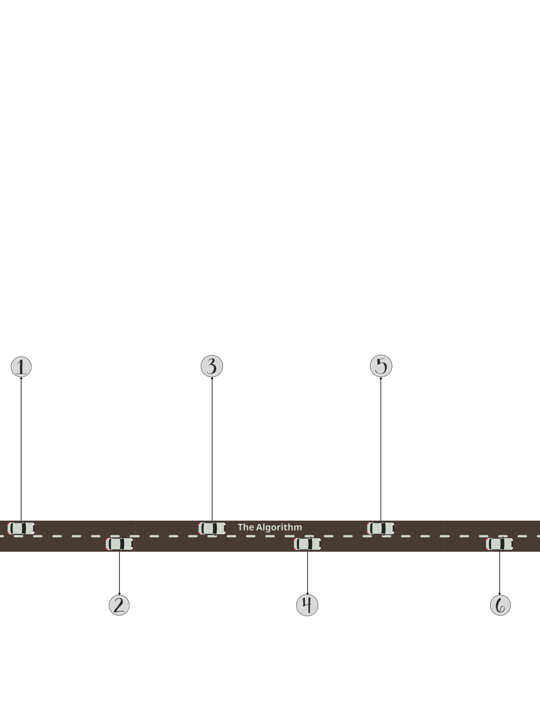


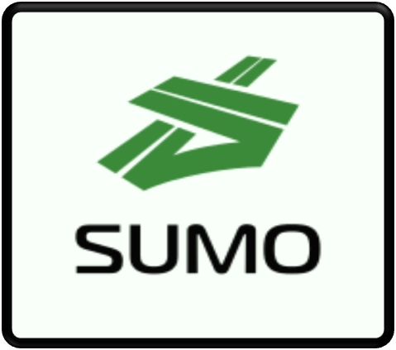
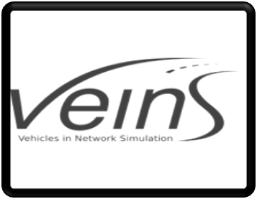
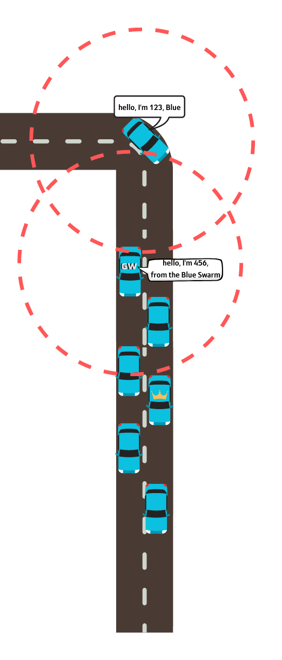
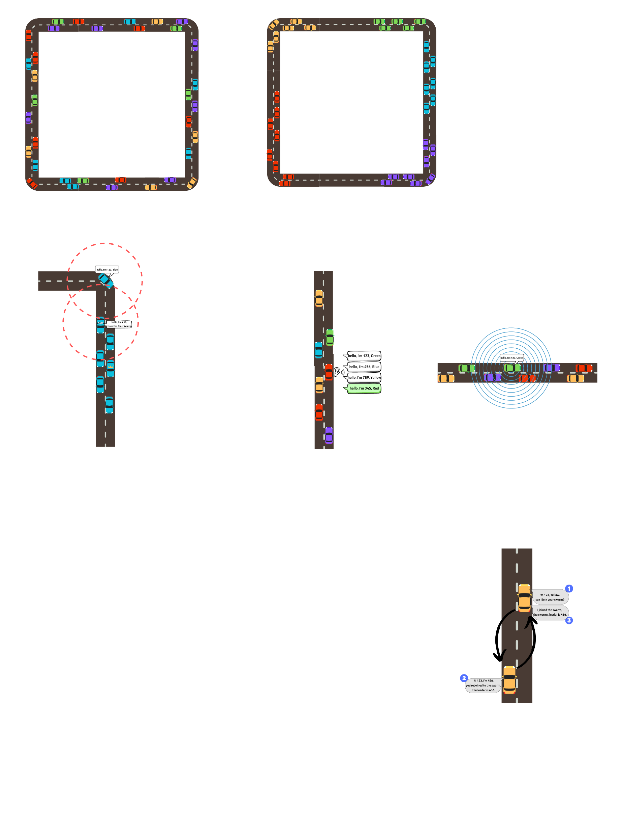
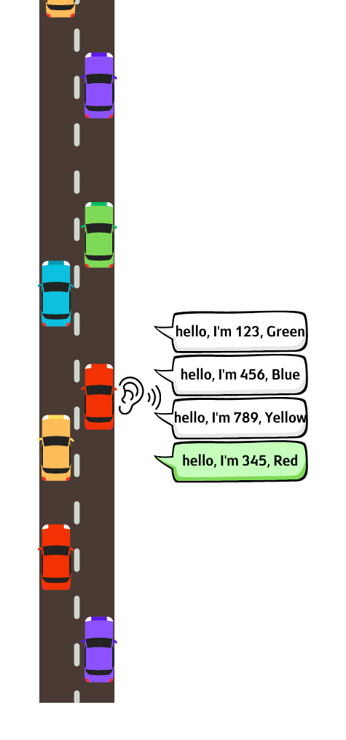
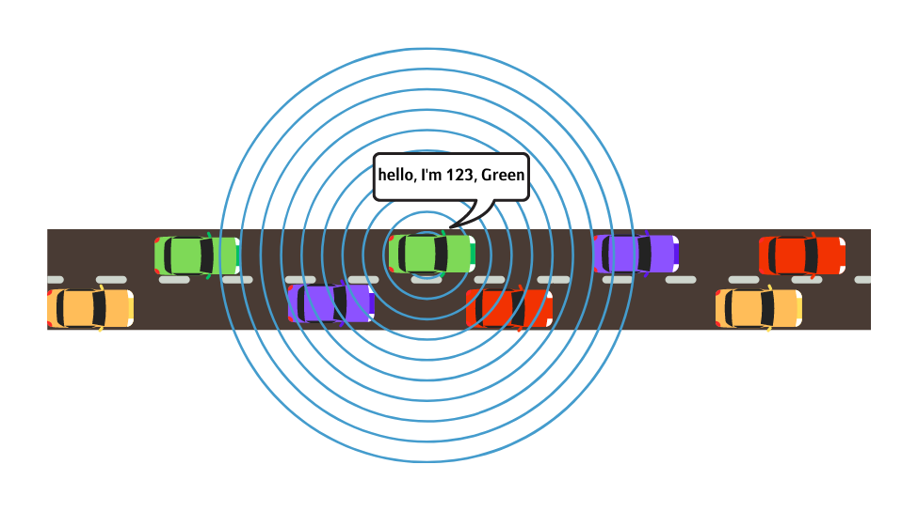
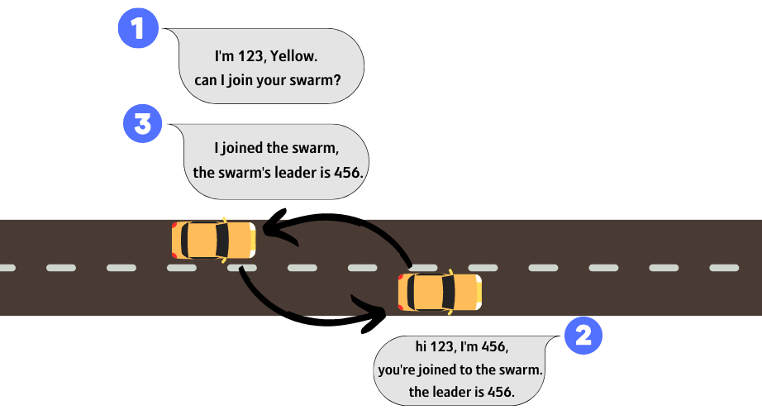
P-2023-003
Faculty of Engineering Sciences
School of Electrical & Computer Engineering
Autonomous Driving Using Swarms
Maayan Ben-Gal, Noy Ella
Advisor: Prof. Michael Segal
The Motivation
The autonomous vehicle is defined as a vehicle able to make decisions on its own using information from a remote server.
Such client-server communication can be problematic due to the amount of traffic and maintaining QOS and the distance and failure of communication that might occur.
In nature, swarms of animals are very common. The idea of a group which in every individual has their own responsibility in order to move the group towards its goals.
The idea of the project is to create vehicle swarms and use more V2V communication this way reduces reliance on a remote server to create more effective real-time communication.
The Goal
Our project goal is to develop an algorithm that maps autonomous vehicles into swarms using vehicular ad hoc networks (VANET) in real-time, based on the vehicle's destination in a minimum time.
Software Development Environment
SUMO (Simulation of Urban Mobility) - Traffic simulation
software for modeling vehicles, road networks, and traffic behavior.
OMNeT++ (Objective Modular Network Testbed in C++) -
Discrete event simulation framework for network
protocol and system modeling.
TraCI (Traffic Control Interface) - for bidirectional
communication between SUMO and OMNeT++,
allowing real-time information exchange.
Veins (Vehicles in Network Simulation) - Framework
connecting SUMO and OMNeT++ for simulating vehicular
communication and data exchange.
DSRC Technology
Dedicated short-range communications (DSRC) is a technology for direct wireless communication and data exchange between vehicles, other road users (such as pedestrians, cyclists), and roadside infrastructure (such as traffic lights). DSRC uses channels in the licensed 5.9GHz band based on IEEE standard 802.11p.
Initial State:
Infinite road with two lane
n vehicles with k different colors (n>k)
r meters message transmission and receiving radius
Each vehicle has parameters:
ID (vehicle number)
Destination marked by color
Initial speed
Initial position on the road
Deciding to Join a Swarm:
When a vehicle receives information on another vehicle with the same destination, it sends it a unicast message with its own details and requests to join the other vehicle swarm.
While Not All the Vehicles in a Swarm: Vehicles that are not part of a swarm repeat stage #2 periodically. If a vehicle in a swarm, but not the leader, receives a message from another vehicle with the same destination it sends the message to the leader vehicle to proceed to stages #3 and #4 in front of the vehicle that needs to join the swarm.
Sending Broadcast Message: Each vehicle sends a broadcast message within a radius of r, containing its information such as ID, destination, current location, and speed. Meanwhile, each vehicle listens to received messages from other vehicles.
Joining a Vehicle to My Swarm: When a vehicle receives a joining message, it joins the other vehicle into its own swarm. In this process, the vehicle decides which vehicle is defined as the new leader of the swarm and sends a response message with details such as the leader's ID, location and speed, and the number of vehicles in the swarm. All the vehicles in the swarm follow the leader defined and drive together as a unified swarm.
All the Vehicles in Swarms!
The Algorithm is Done!

