Slide 1



Autonomous Driving Using Swarms
Project number: p-2023-003
Students: Maayan Ben-Gal and Noy Ella
Advisor: Prof. Michael Segal

Slide 2
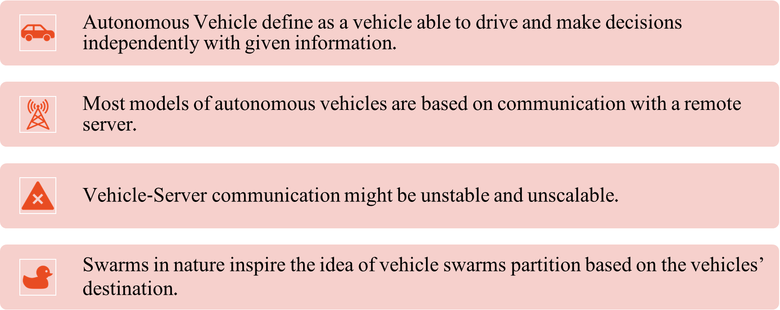
Introduction

Slide 3
Project Goal
Develop an algorithm that maps autonomous vehicles into swarms using
vehicular ad hoc networks (VANET) in real-time, based on the vehicle's destination
in a minimum time.

Slide 4


Software Tools - SUMO
SUMO or Simulation of Urban Mobility is a traffic simulation software for modeling vehicles, road networks, and traffic behavior.
SUMO focus on simulating the traffic the vehicles’ characteristics and routing.
SUMO can simulate a realistic environment such as random traffic, road conditions, etc.
the simulator can’t control the communication between the vehicles.

Slide 5


Software Tools – OMNeT++
OMNeT++ or Objective Modular Network Testbed in C++ is a discrete event simulation framework for network protocol and system modeling.
OMNeT++ focus on simulating the communication only.
It may simulate the type of messages, the traffic frequency, the bandwidth, radios, and the communication protocol.
The simulator can’t control the vehicles in any way.

Slide 6
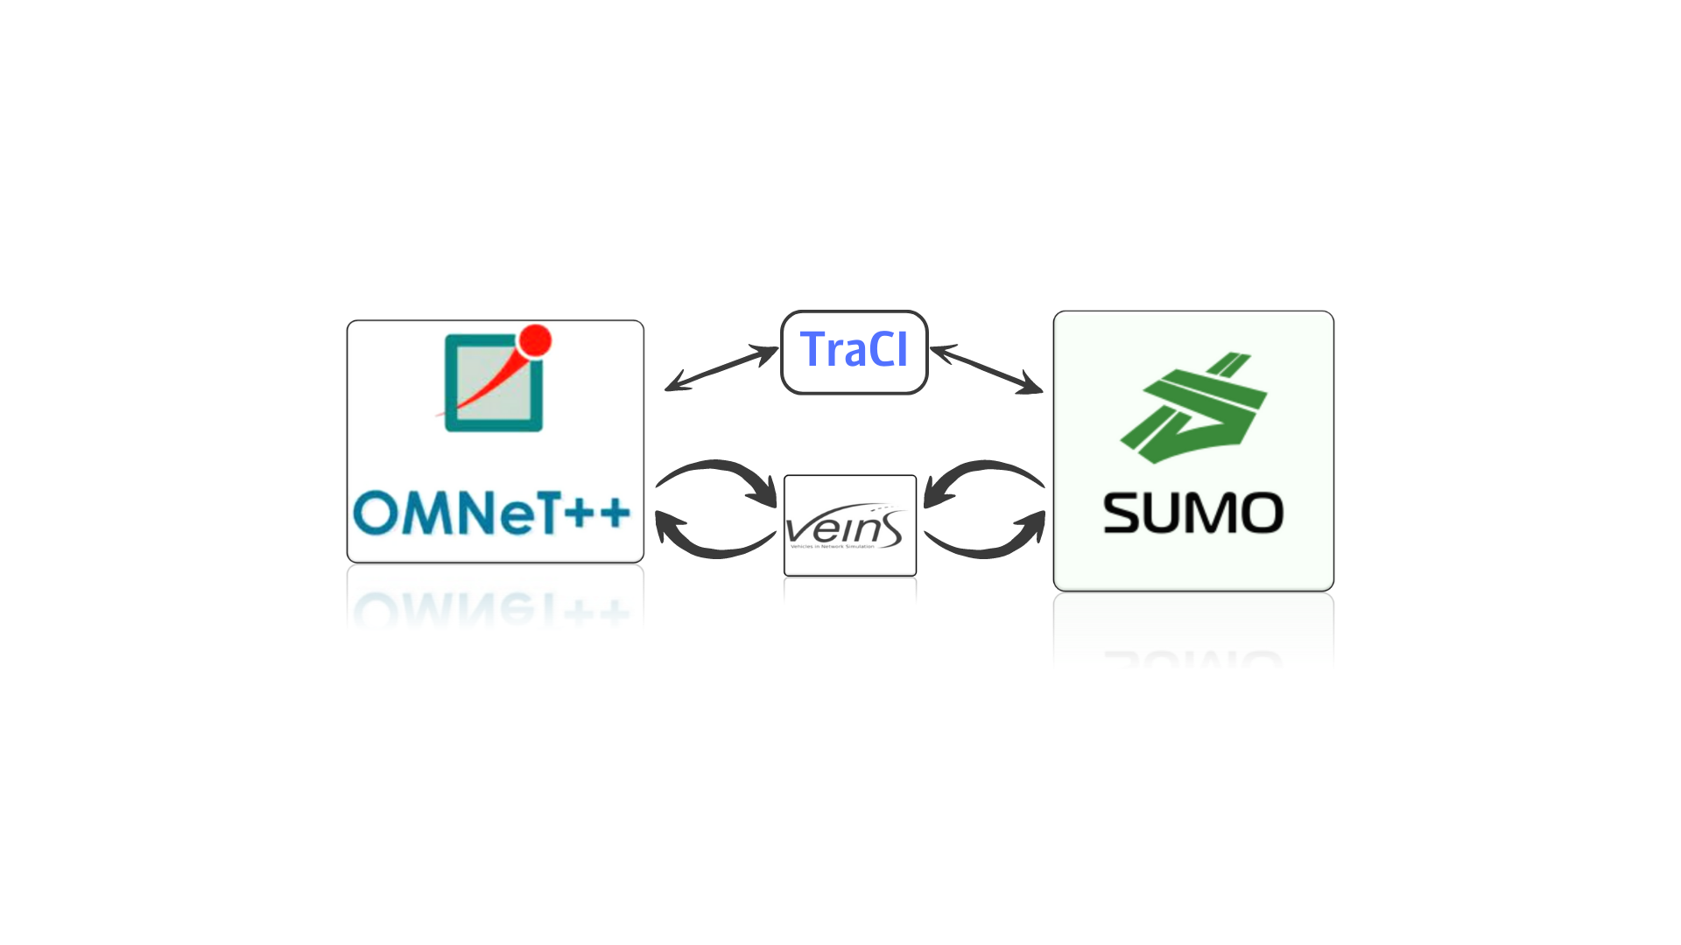

Software Tools – Veins and TraCI
Veins (Vehicles in Network Simulation) - Framework connecting SUMO and OMNeT++ for simulating vehicular communication and data exchange.
This Framework is responsible for passing messages, for the data itself, and for the transmission of the messages between the two simulators.
TraCI (Traffic Control Interface) - for bidirectional communication between SUMO and OMNeT++, allowing real-time information exchange.
TraCI produces a kind of ‘control’ that passes information between the two main simulators. It can use Python or C code to run TraCI.

Slide 7


DSRC Protocol
Dedicated short-range communications (DSRC) is a technology for direct wireless communication and data exchange between vehicles (vehicle to vehicle communication), other road users (such as pedestrians, cyclists), and roadside infrastructure (such as traffic lights).
DSRC uses channels in the licensed 5.9GHz band based on IEEE standard 802.11p.

Slide 8
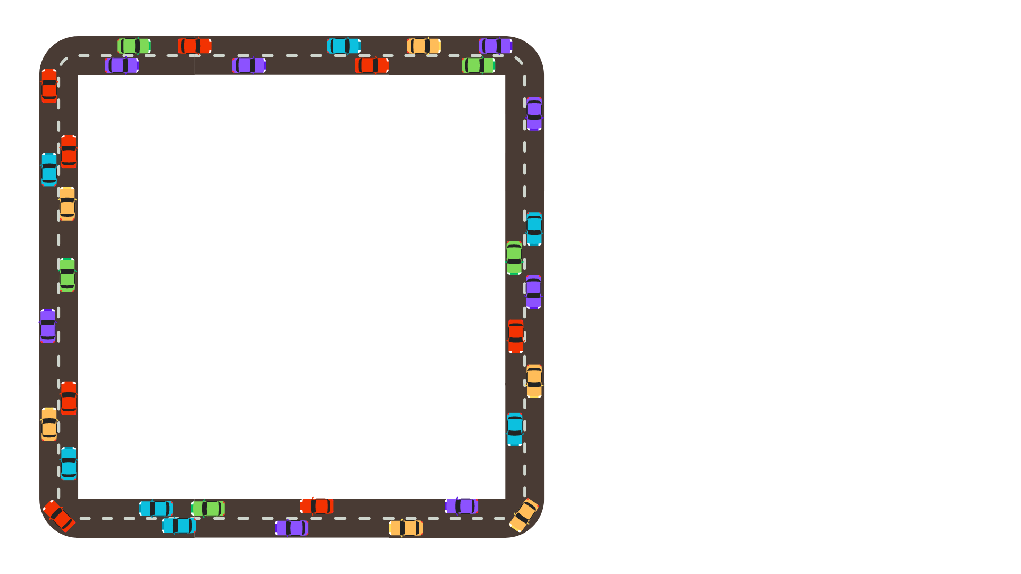
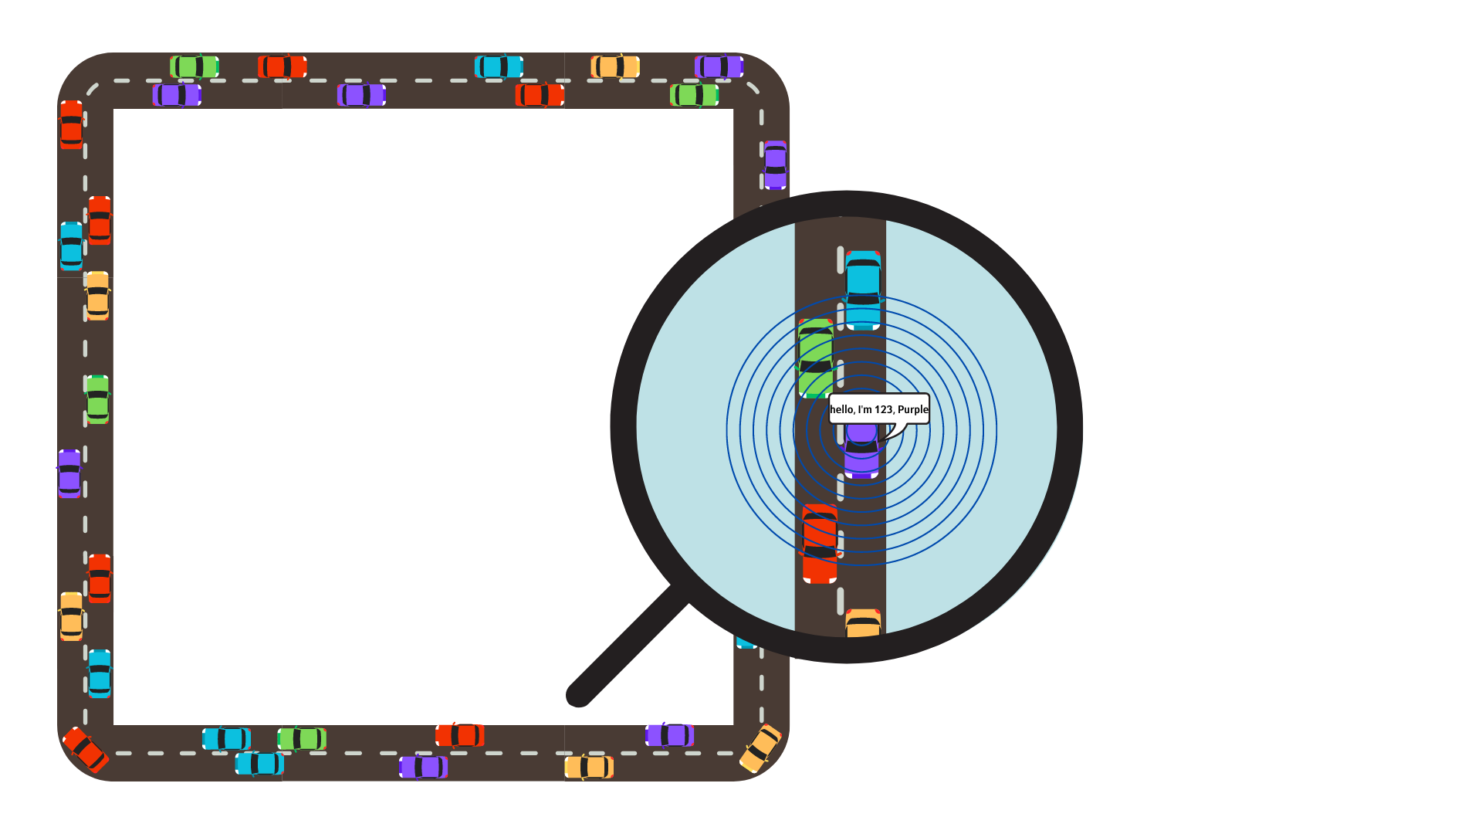
The Algorithm
Initial State:
A two-lane loop-shape road with n vehicles driving. Each vehicle has its own ID, a destination\route marked by color, and random location and speed.
Sending Broadcast Message:
Each vehicle sends a broadcast message within a radius of r, containing its information such as ID, destination, current location, and speed. Meanwhile, each vehicle listens to received messages from other vehicles.

Slide 9
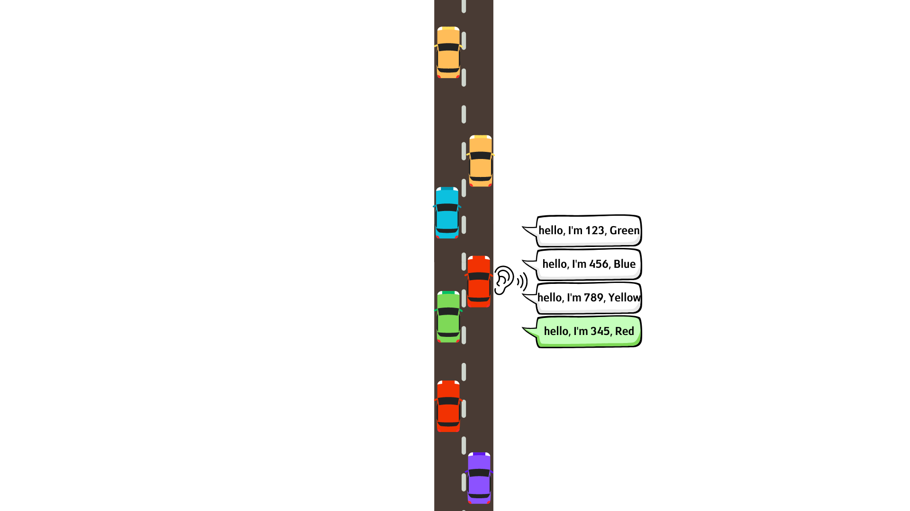
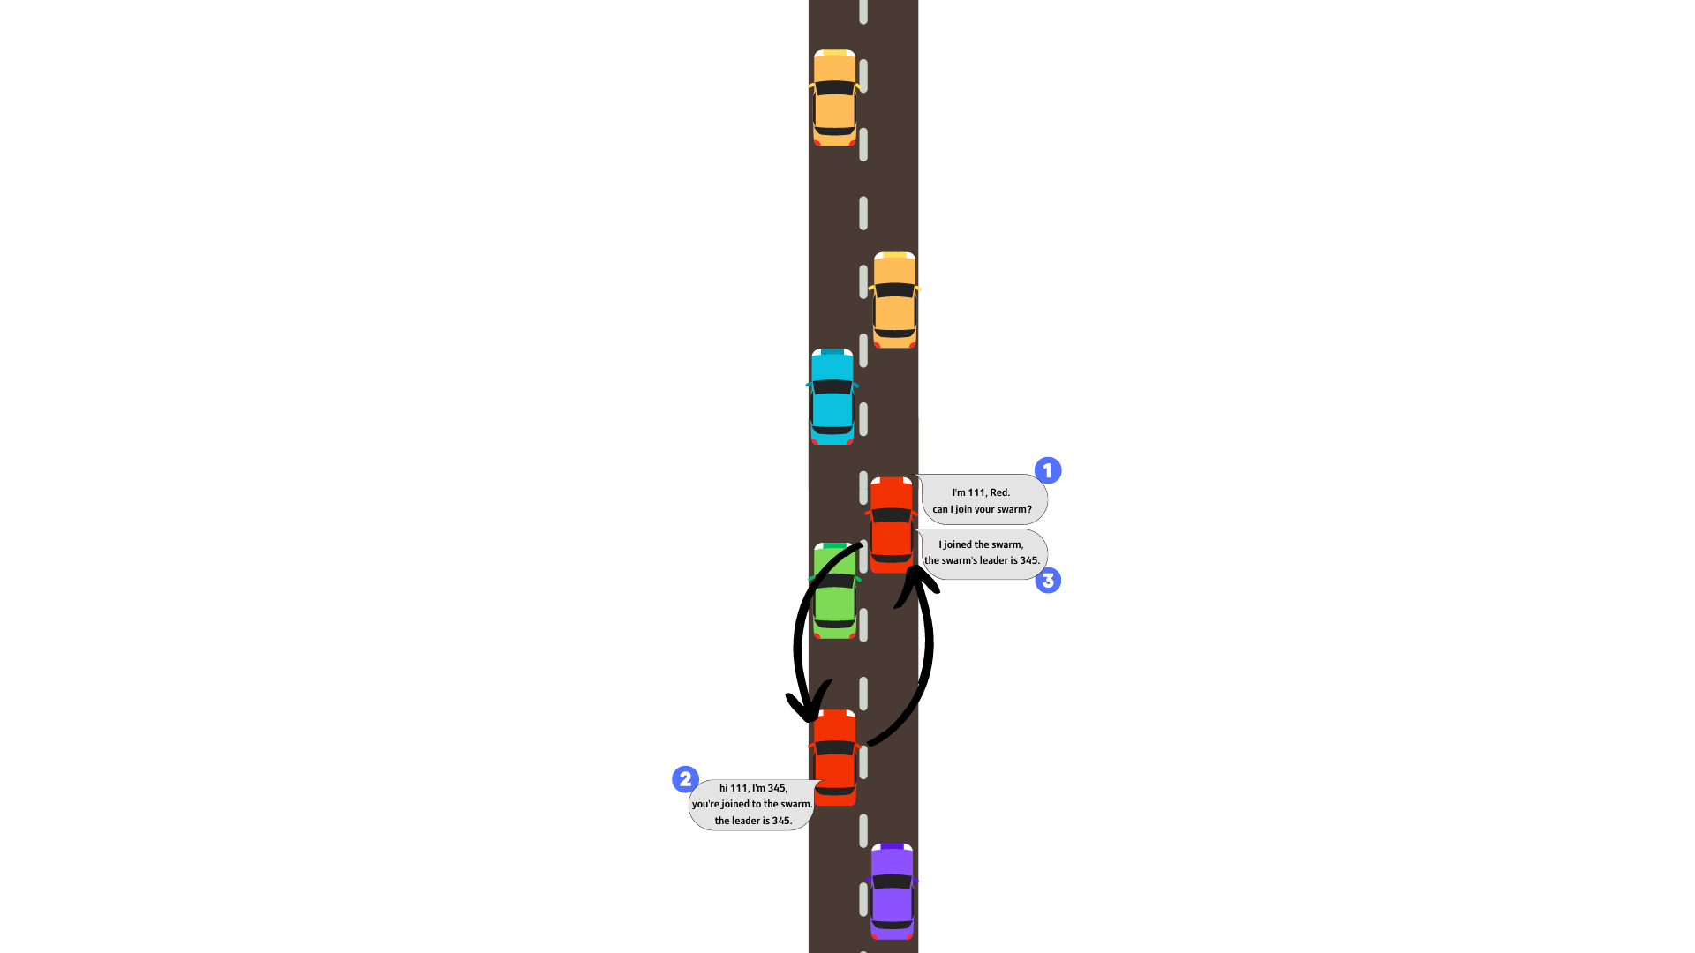
The Algorithm
Joining a Vehicle to My Swarm: When a vehicle receives a joining message, it joins the other vehicle into its own swarm. In this process, the vehicle decides which vehicle is defined as the new leader of the swarm and sends a response message with details such as the leader's ID, location and speed, and the number of vehicles in the swarm. All the vehicles in the swarm follow the leader defined and drive together as a unified swarm.
Deciding to Join a Swarm: When a vehicle receives information on another vehicle with the same destination, it sends it a unicast message with its own details and requests to join the other vehicle swarm.

Slide 10
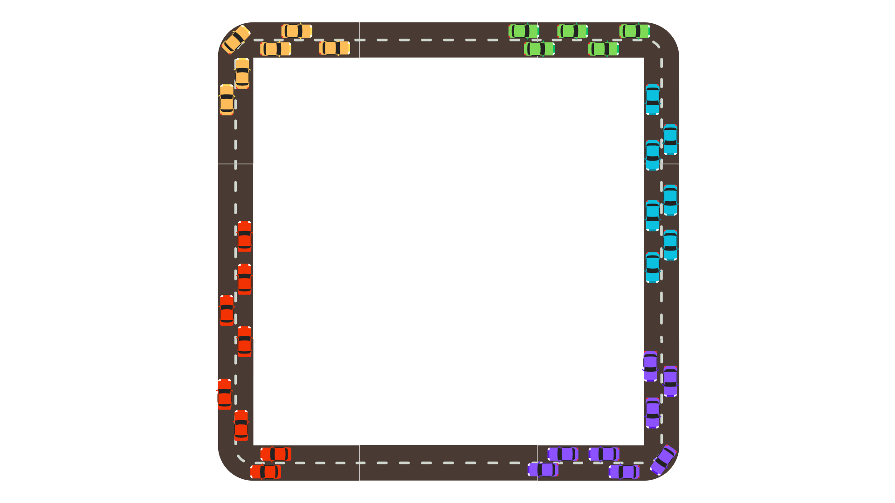
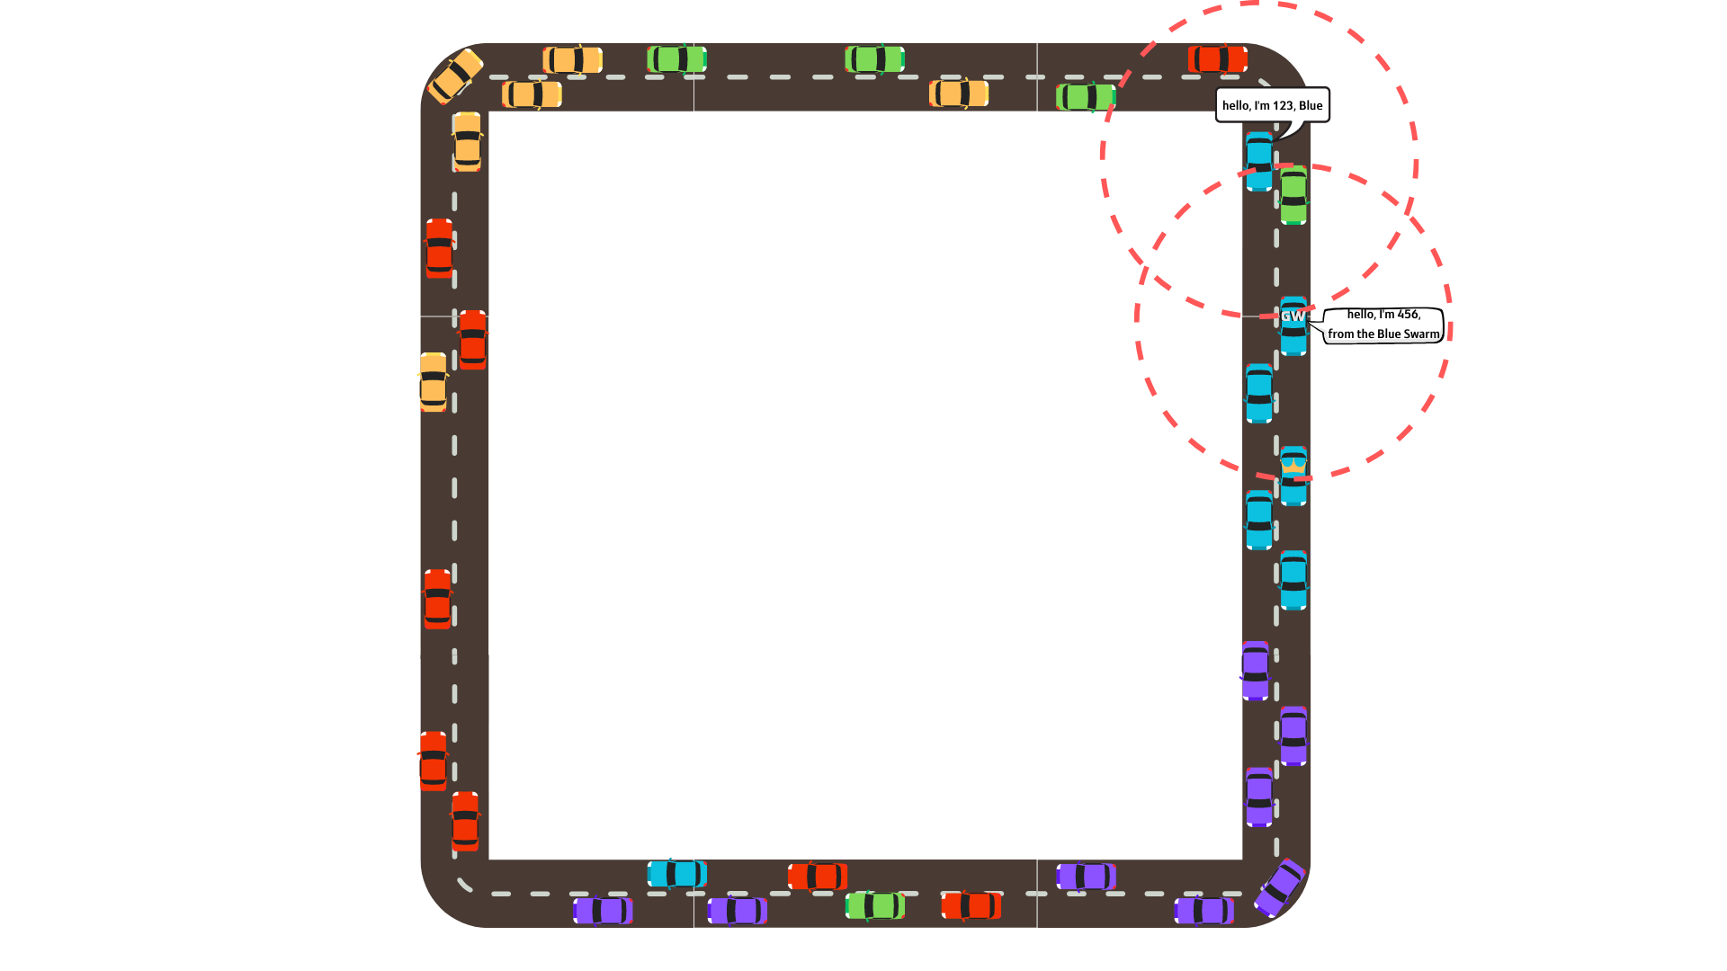
The Algorithm
While Not All the Vehicles in a Swarm: Vehicles that are not part of a swarm repeat stage #2 periodically. If a vehicle in a swarm, but not the leader, receives a message from another vehicle with the same destination it sends the message to the leader vehicle to proceed to stages #3 and #4 in front of the vehicle that needs to join the swarm.
All the Vehicles in Swarms! The Algorithm is Done!

Slide 11
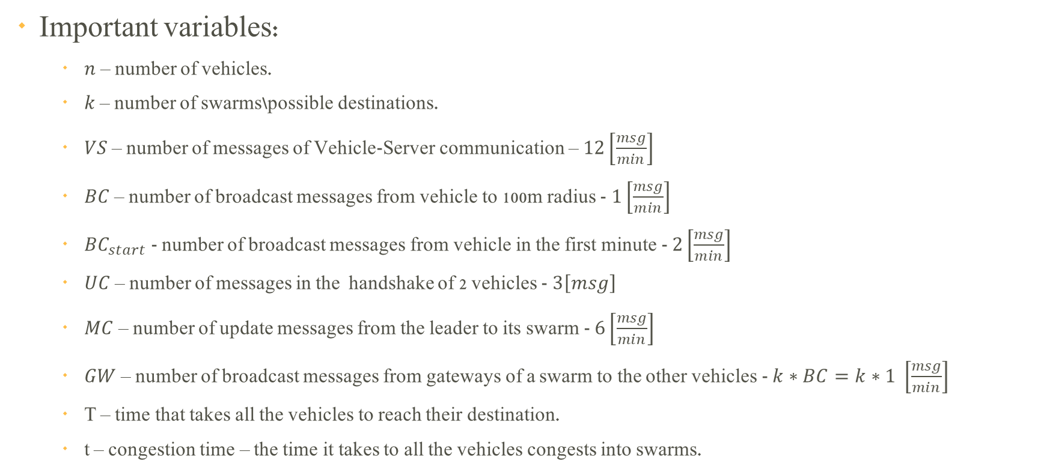
Solution Calculations

Slide 12

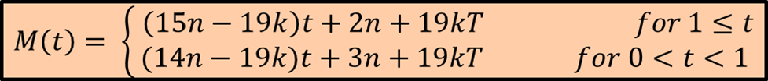
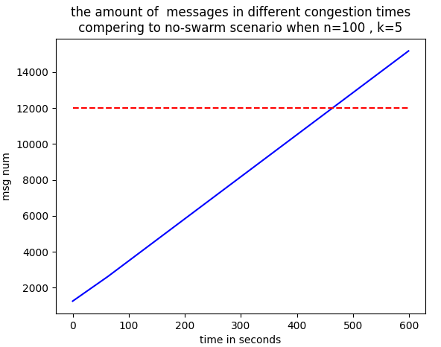
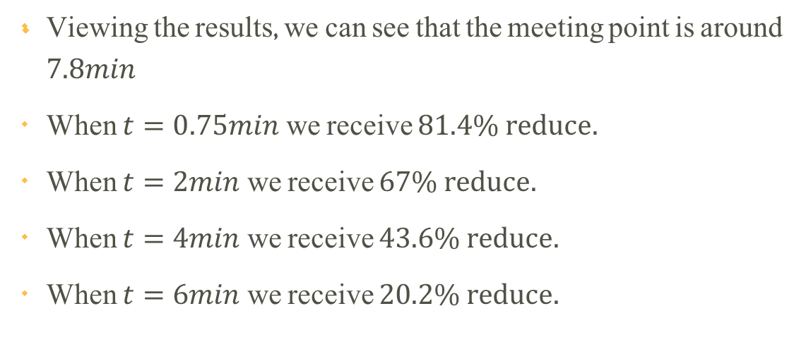
Solution Calculations

Slide 13
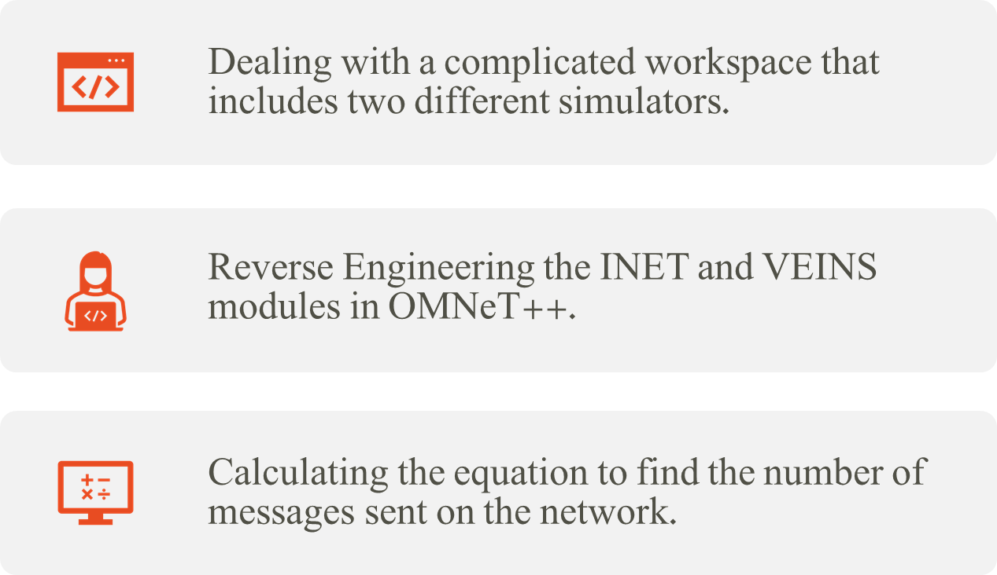

Challenges

Slide 14

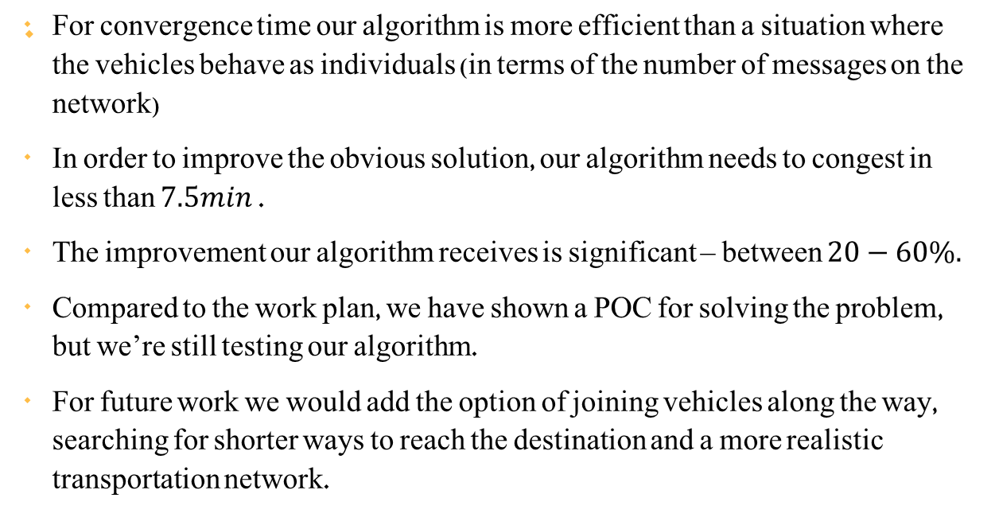
Conclusions & Summary

Slide 15
Thank You For Listening

