Slide 1


Autonomous Driving Using Swarms
Project number: p-2023-003
Students: Maayan Ben-Gal and Noy Ella
Advisor: Prof. Michael Segal

Slide 2
Introduction
Autonomous Vehicle define as a vehicle able to drive and make decisions independently with given information.
Most models of autonomous vehicles are based on communication with a remote server.
Vehicle-Server communication might be unstable and unscalable.
Swarms in nature inspire the idea of vehicle swarms partition based on the vehicles’ destination.
Notes:
Have a lot to say about – not only introduction but also a presentation of the problem we wish to solve

Slide 3
Project Goal
Develop an algorithm that maps autonomous vehicles into swarms using vehicular ad hoc networks (VANET) in real-time, based on the vehicle's destination in a minimum time.
Notes:
Maybe highlight some parts of the goal

Slide 4

Software Tools - SUMO
SUMO or Simulation of Urban Mobility is a traffic simulation software for modeling vehicles, road networks, and traffic behavior.
SUMO focus on simulating the traffic the vehicles’ characteristics and routing.
SUMO can simulate a realistic environment such as random traffic, road conditions, etc.
the simulator can’t control the communication between the vehicles.
Notes:
Do we want to add the type of file or anything?

Slide 5

Software Tools – OMNeT++
OMNeT++ or Objective Modular Network Testbed in C++ is a discrete event simulation framework for network protocol and system modeling.
OMNeT++ focus on simulating the communication only.
It may simulate the type of messages, the traffic frequency, the bandwidth, radios, and the communication protocol.
The simulator can’t control the vehicles in any way.
Notes:
Do we want to add the type of file or anything?
Or maybe the type of communication? Like RT or WIFI or mobile?...

Slide 6
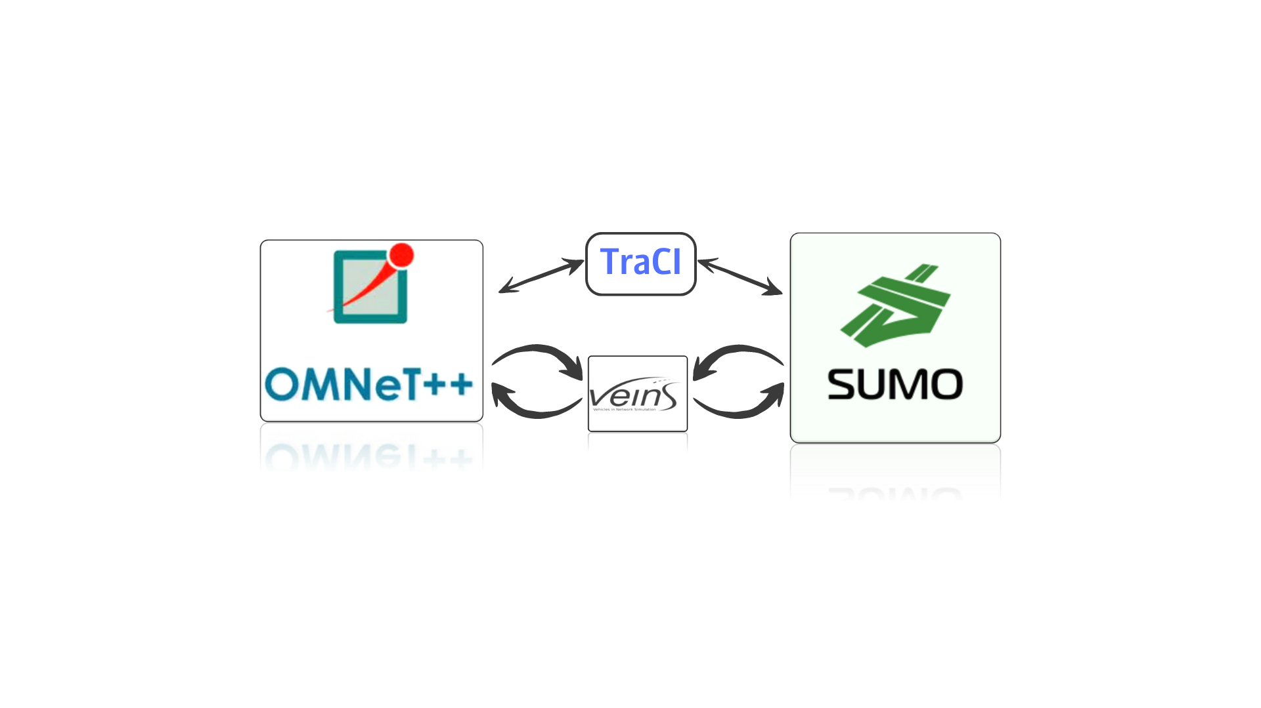
Software Tools – Veins and TraCI
Veins (Vehicles in Network Simulation) - Framework connecting SUMO and OMNeT++ for simulating vehicular communication and data exchange.
This Framework is responsible for passing messages, for the data itself, and for the transmission of the messages between the two simulators.
TraCI (Traffic Control Interface) - for bidirectional communication between SUMO and OMNeT++, allowing real-time information exchange.
TraCI produces a kind of ‘control’ that passes information between the two main simulators. It can use Python or C code to run TraCI.
Notes:
Very loss, need to be more accurate and focus on the right relevant things.

Slide 7

DSRC Protocol
Dedicated short-range communications (DSRC) is a technology for direct wireless communication and data exchange between vehicles (vehicle to vehicle communication), other road users (such as pedestrians, cyclists), and roadside infrastructure (such as traffic lights).
DSRC uses channels in the licensed 5.9GHz band based on IEEE standard 802.11p.

Slide 8
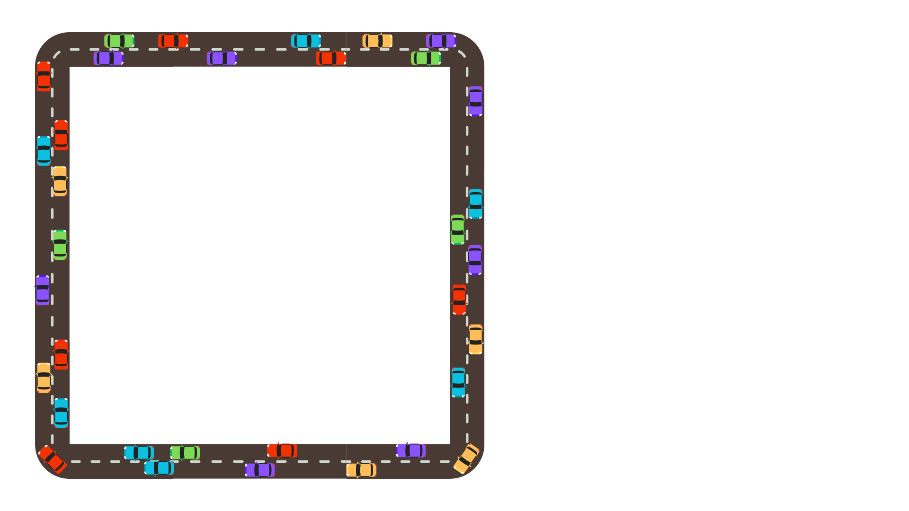
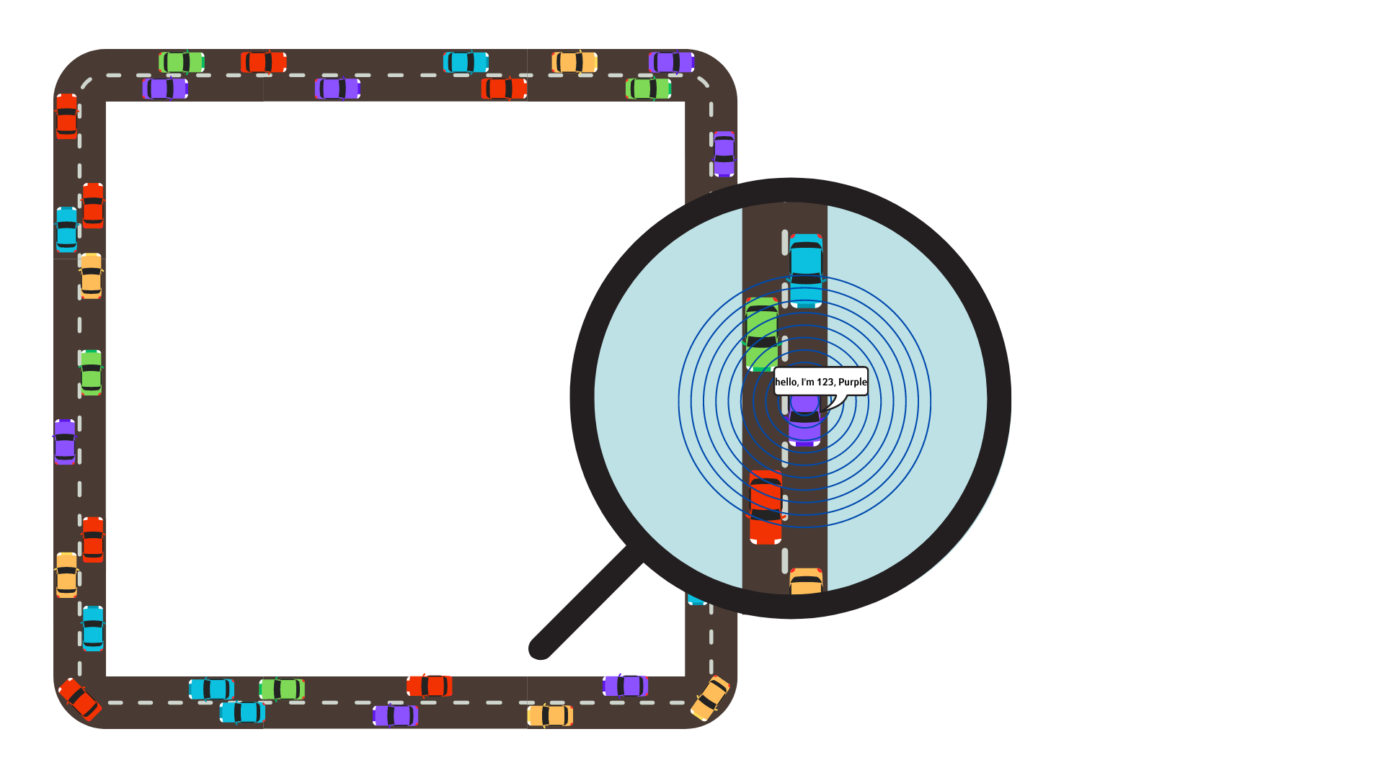
The Algorithm
Initial State:
A two-lane loop-shape road with n vehicles driving. Each vehicle has its own ID, a destination\route marked by color, and random location and speed.
Sending Broadcast Message:
Each vehicle sends a broadcast message within a radius of r, containing its information such as ID, destination, current location, and speed. Meanwhile, each vehicle listens to received messages from other vehicles.

Slide 9
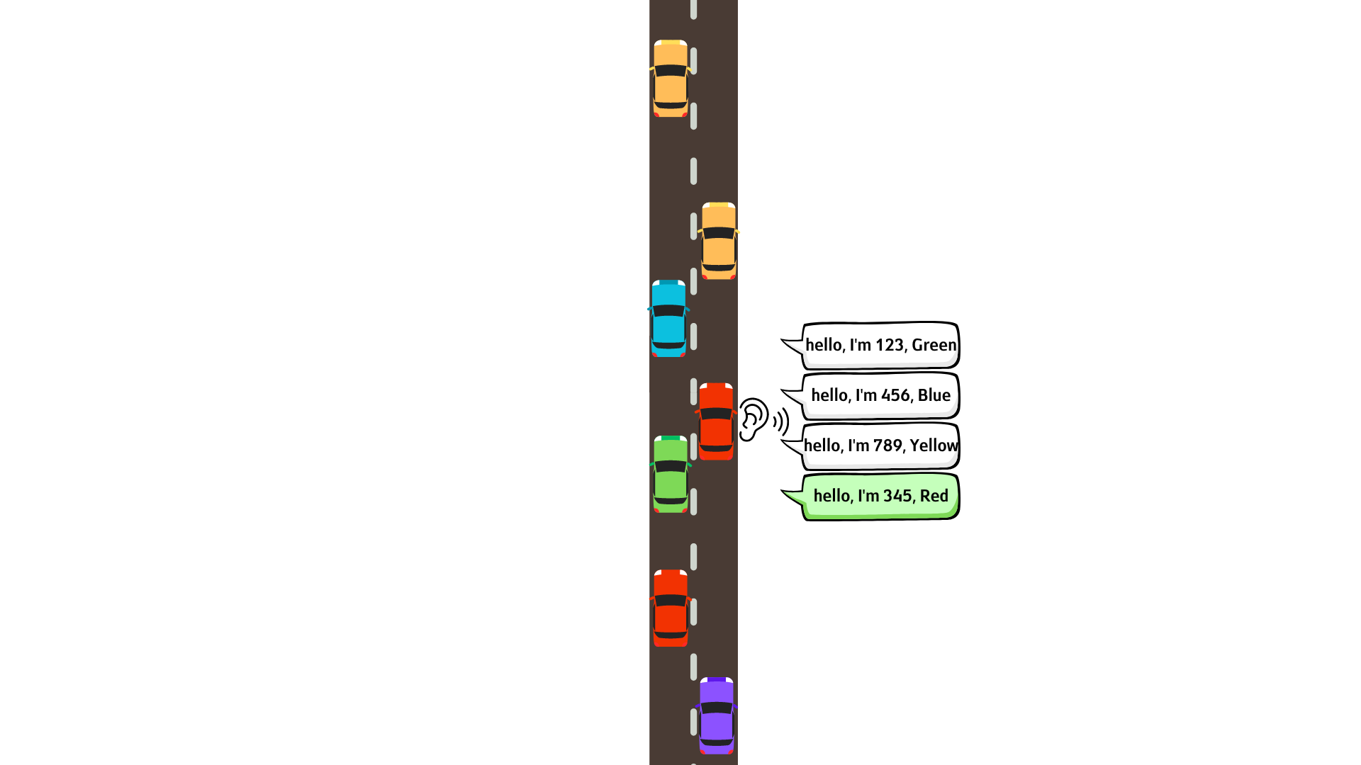
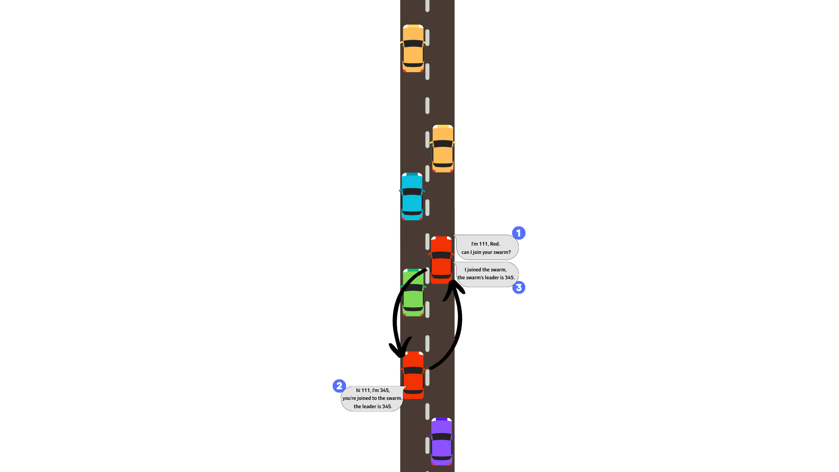
The Algorithm
Joining a Vehicle to My Swarm: When a vehicle receives a joining message, it joins the other vehicle into its own swarm. In this process, the vehicle decides which vehicle is defined as the new leader of the swarm and sends a response message with details such as the leader's ID, location and speed, and the number of vehicles in the swarm. All the vehicles in the swarm follow the leader defined and drive together as a unified swarm.
Deciding to Join a Swarm: When a vehicle receives information on another vehicle with the same destination, it sends it a unicast message with its own details and requests to join the other vehicle swarm.

Slide 10
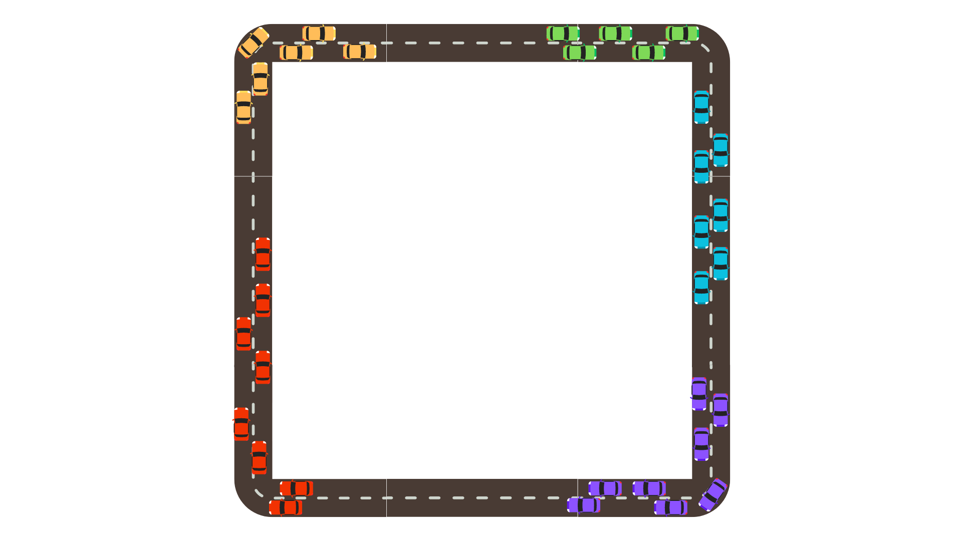
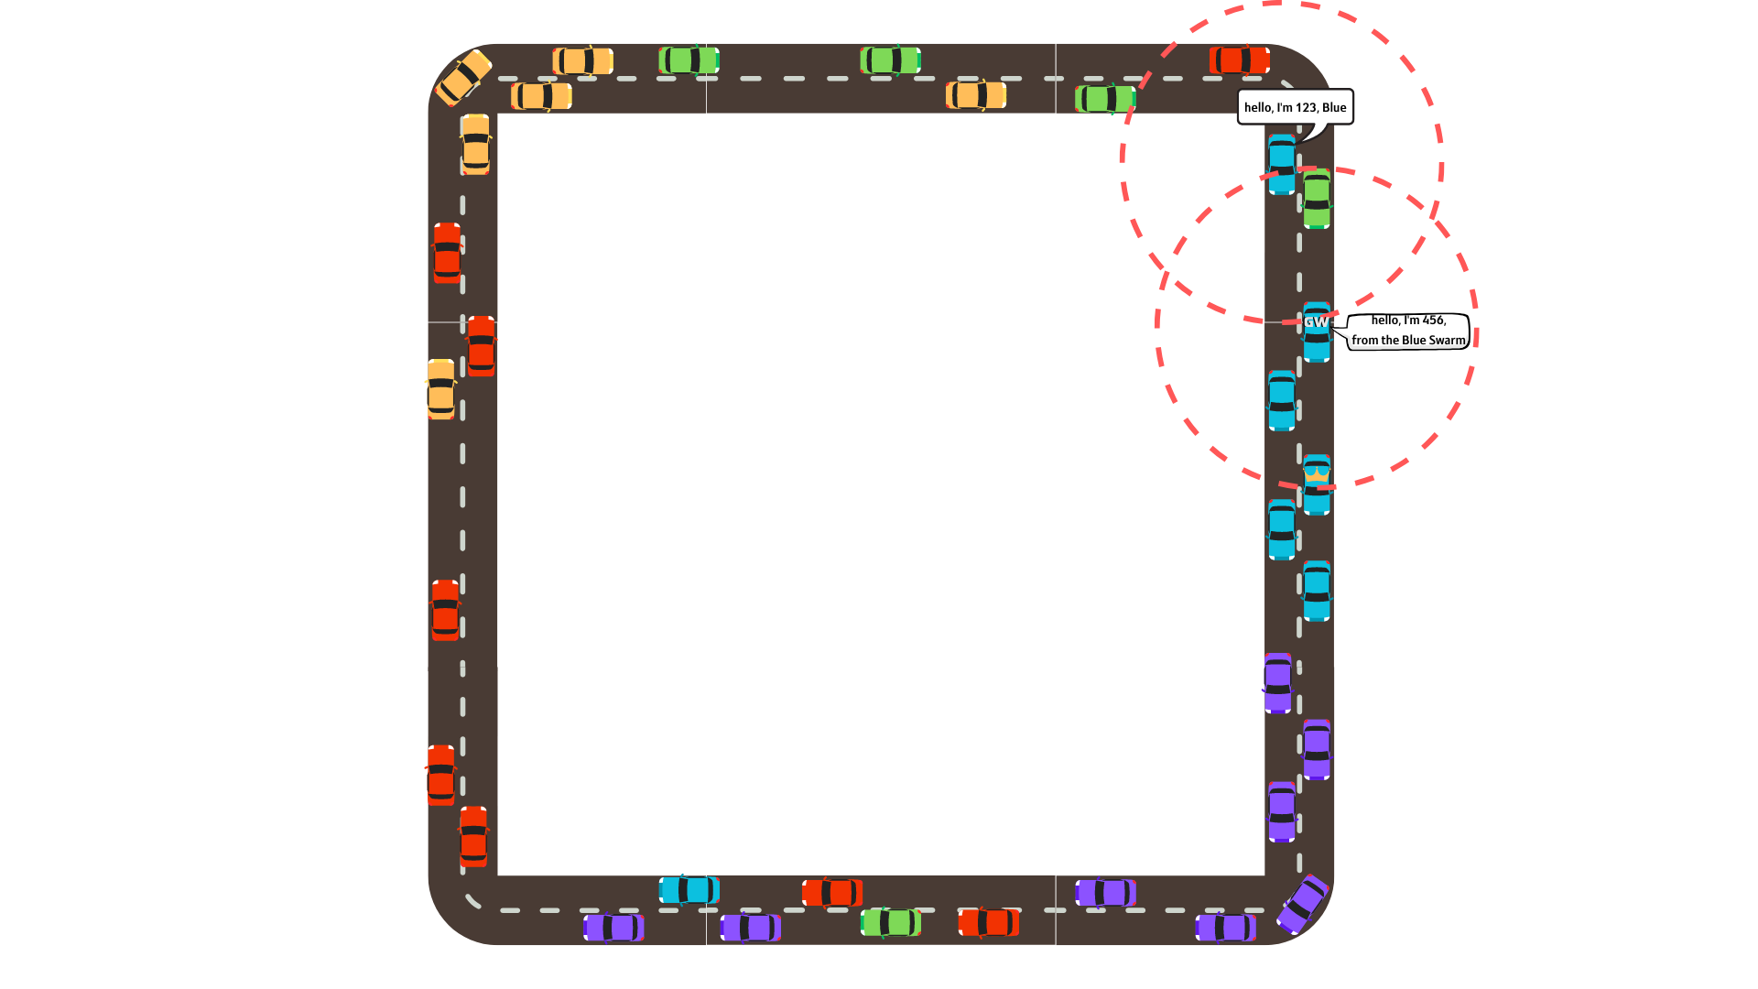
The Algorithm
While Not All the Vehicles in a Swarm: Vehicles that are not part of a swarm repeat stage #2 periodically. If a vehicle in a swarm, but not the leader, receives a message from another vehicle with the same destination it sends the message to the leader vehicle to proceed to stages #3 and #4 in front of the vehicle that needs to join the swarm.
All the Vehicles in Swarms! The Algorithm is Done!

Slide 11
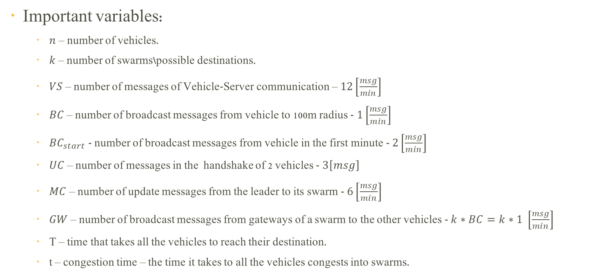
Solution Calculations
Important variables:
$n$ – number of vehicles.
$k$ – number of swarms\possible destinations.
$VS$ – number of messages of Vehicle-Server communication – $12\left[\frac{msg}{min}\right]$
$BC$ – number of broadcast messages from vehicle to 100m radius - $1\left[\frac{msg}{min}\right]$
$BC_{start}$ - number of broadcast messages from vehicle in the first minute - $2\left[\frac{msg}{min}\right]$
$UC$ – number of messages in the handshake of 2 vehicles - $3\left[msg\right]$
$MC$ – number of update messages from the leader to its swarm - $6\left[\frac{msg}{min}\right]$
$GW$ – number of broadcast messages from gateways of a swarm to the other vehicles - $k∗BC=k∗1 \left[\frac{msg}{min}\right]$
T – time that takes all the vehicles to reach their destination.
t – congestion time – the time it takes to all the vehicles congests into swarms.

Slide 12
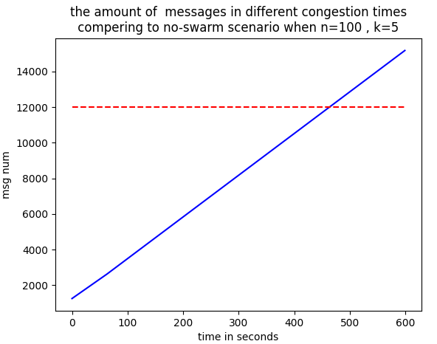
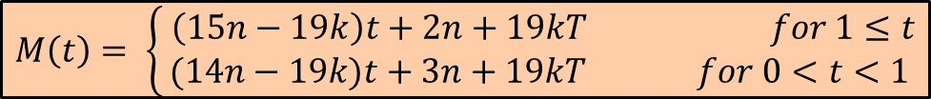
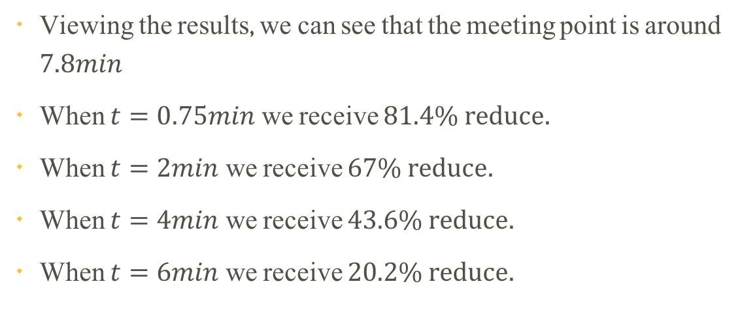

Solution Calculations
$$M_{no swarms}=n∙VS∙T$$
$$M\left(t\right)= \left\{\begin{aligned} \left(15n−19k\right)t+2n+19kT for 1≤t \\ (14n−19k)t+3n+19kT for 0<t<1\end{aligned}\right.$$
$$M\left(t\right)= \left\{\begin{aligned} n\left(VS∙t+BC_{start}∙1+BC\left(t−1\right)\right)+UC∙n+k∙\left(T−t\right)\left(MC+VS+BC\right) for 1≤t \\ n∙t∙\left(VS+BC_{start}\right)+UC∙n+k∙\left(T−t\right)\left(MC+VS+BC\right) for 0<t<1\end{aligned}\right.$$
Viewing the results, we can see that the meeting point is around $7.8min$
When $t=0.75min$ we receive $81.4\% reduce.$
When $t=2min$ we receive $67\% reduce.$
When $t=4min$ we receive $43.6\% reduce.$
When $t=6min$ we receive $20.2\% reduce.$

Slide 13

Challenges
Dealing with a complicated workspace that includes two different simulators.
Reverse Engineering the INET and VEINS modules in OMNeT++.
Calculating the equation to find the number of messages sent on the network.

Slide 14


Conclusions & Summary
For convergence time our algorithm is more efficient than a situation where the vehicles behave as individuals (in terms of the number of messages on the network)
In order to improve the obvious solution, our algorithm needs to congest in less than $7.5min$ .
The improvement our algorithm receives is significant – between $20−60\%.$
Compared to the work plan, we have shown a POC for solving the problem, but we’re still testing our algorithm.
For future work we would add the option of joining vehicles along the way, searching for shorter ways to reach the destination and a more realistic transportation network.

Slide 15
Thank You For Listening

