Slide 1

Autonomous Driving using Swarms
4th Year Project, Progress Presentation
Project Number: p-2023-003
Students: Maayan Maya Ben Gal, Noy Ella
Supervisors: Prof. Michael Segal

Slide 2
Introduction
Our project refers to autonomous vehicles.
Today, autonomous vehicles make decisions alone according to information from an outsourced server, our project wishes to minimalize communication with distance server and prevent RT communication issues.
swarms of vehicles is a group of vehicles that moves together and make decisions together using P2P communication.
The purpose of the project is to develop an algorithm that divides traffic into swarms based on the vehicle’s destination, in real-time.

Slide 3
Our Goal
Creating an algorithm that divides in real-time a traffic stream into swarms of vehicles, based on the vehicle’s destination, that will move together as one.
Make an efficient algorithm as possible – the division will happen in a minimal time, using P2P communication.
The vehicles should make choices as a swarm and mainly communicate un-dependently to an outsourced server.
The algorithm not only divides into swarms but also assigns positions to specific vehicles in the swarm.

Slide 4
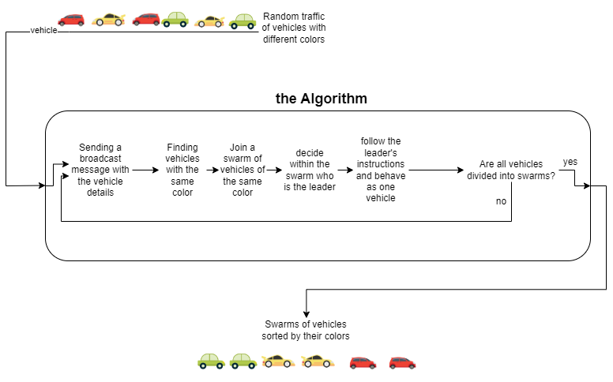
General Flow

Slide 5
Our Progress
Background research – semi-autonomous vehicles, usage of distance server for autonomous vehicles, creating vehicles swarms according to immediate location…
Learn the SUMO simulator and create a basic workspace and conditions.
Determine initial conditions – an endless straight road (circle road) with two lanes, and cars with different colors (destination) and initial speed.
Creating a general algorithm that divides the vehicles into swarms and assigns positions in the swarm.

Slide 6
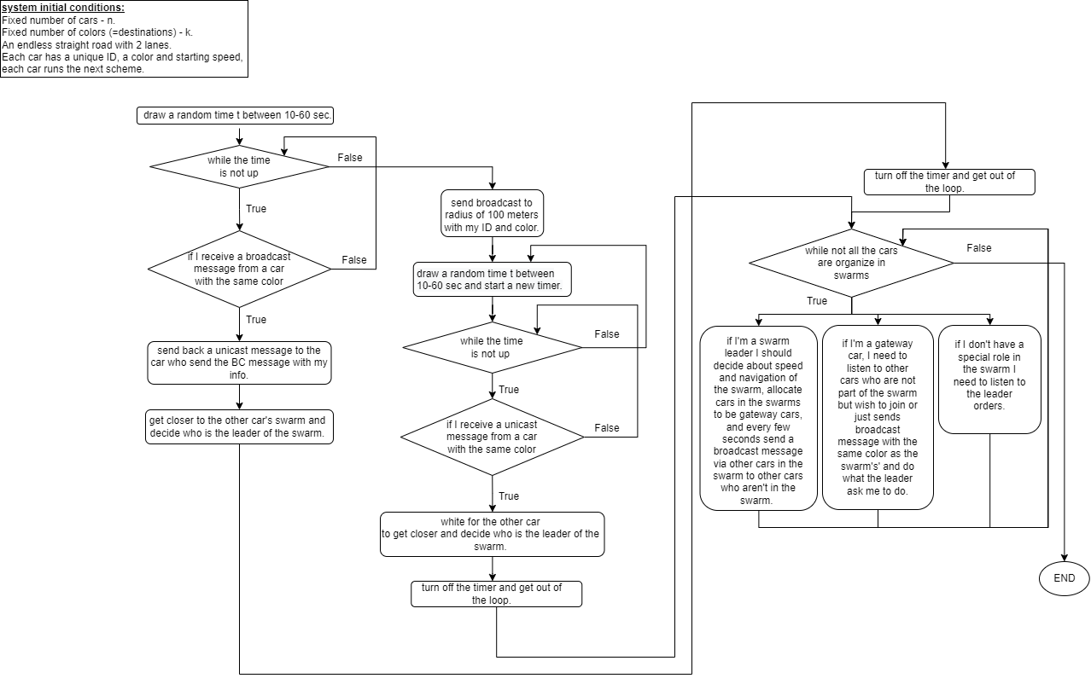
Results So Far

Slide 7
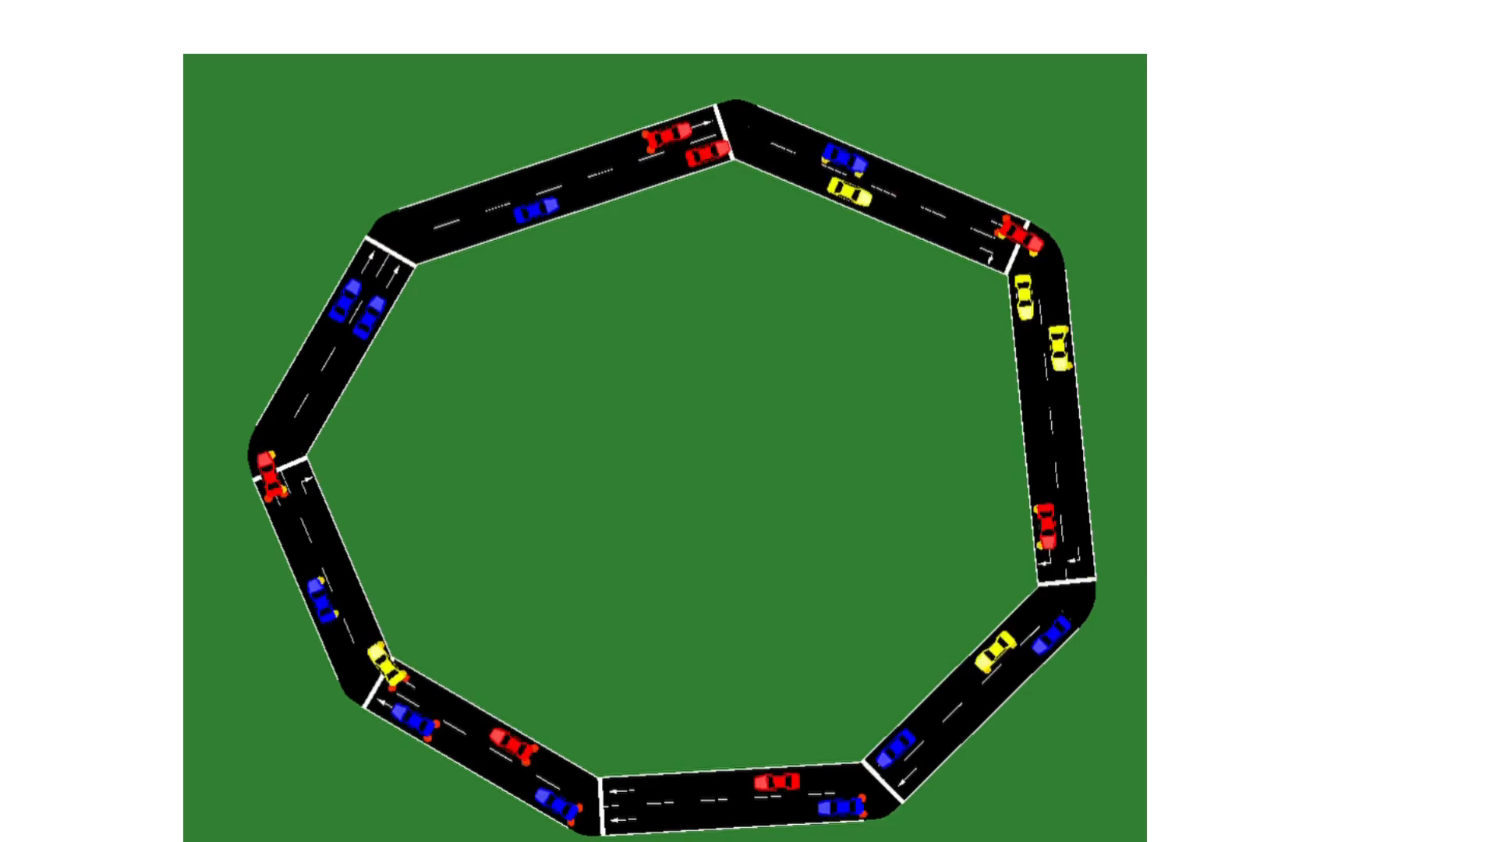
Results So Far

Slide 8
Looking Forward
Write the initial algorithm in python to implement on every vehicle.
Test the initial algorithm using SUMO.
Continue developing the algorithm according to the initial algorithm simulation.
Test the formatted algorithm on more complex conditions using SUMO.
Algorithm correction according to the results and retest.
Results evaluation and conclusions for future research.

