Slide 1

Experiential Learning Project Assessment-I on
“ Student Marksheet Automation (high volume)”
under the course
Python Programming Language (N-PCCCM304P)
Presented By
Maayli Tabhane (CM25090)
Under the Guidance of
Mrs. Mayuri Getme
Session:2026-27 (ODD )
Department of CSE(AI&ML)
S. B. JAIN INSTITUTE OF TECHNOLOGY MANAGEMENT AND
RESEARCH,NAGPUR
An Autonomous Institute, Affiliated to RTMNU, Nagpur
)

Slide 2
Contents
• Problem statement
• Objectives
• Algorithm
• Flowchart / pseudocode
• Understanding of Python logic
• Graphical representation and working
• GitHub account, repository creation, uploading code, meaningful commits, collaboration, individual contribution
• Result / expected output
S. B. Jain Institute of Technology Management and research

Slide 3
1. Problem Statement
• Preparing marksheets manually for a large number of students is time-consuming and repetitive.
• Calculating total marks, percentage, grades, and ranks manually can lead to errors.
• Managing student records becomes difficult as the number of students increases.
• Different subject marks need to be processed consistently for every student.
• Manual data entry and repeated calculations reduce efficiency and increase workload.
• The system should automatically process marks and generate accurate student results.
• It should handle high-volume student data efficiently using Python logic and structured records.
• The generated marksheet should clearly display total, percentage, grade, and rank.
• The project demonstrates how Python can automate repetitive academic result-processing tasks.
S. B. Jain Institute of Technology Management and research

Slide 4
2. Objective
• To develop an automated marksheet generation system for a large number of students.
• To store student details and subject marks in a structured format.
• To calculate total marks automatically for every student.
• To calculate percentage accurately using the obtained marks.
• To assign grades based on predefined percentage ranges.
• To determine student rank from the calculated performance.
• To reduce manual calculation and data-entry errors.
• To generate clear and printable marksheet information efficiently.
• To process multiple student records using loops and Python data structures.
• To understand the practical use of Python for high-volume academic data processing.
S. B. Jain Institute of Technology Management and research

Slide 5
3. Algorithm
• Start the program.
• Enter the number of students and the required subject details.
• Enter student name, roll number, and marks obtained in each subject.
• Store each student's information in a structured record.
• Calculate total marks by adding the marks of all subjects.
• Calculate percentage from total marks and maximum marks.
• Assign a grade according to the percentage range.
• Repeat the process for all student records.
• Sort or compare percentages to determine the rank of each student.
• Display the completed marksheet with total, percentage, grade, and rank.
• Stop the program.
S. B. Jain Institute of Technology Management and research

Slide 6
4. Flowchart / Pseudocode
START
1. Enter student details
and subject marks
2. Store student record
3. Calculate total
and percentage
4. Assign grade
5. Process all students
and determine rank
6. Generate marksheet
and display result
END
Pseudocode: Input → Store → Calculate → Grade → Rank → Generate Marksheet → Output
S. B. Jain Institute of Technology Management and research

Slide 7
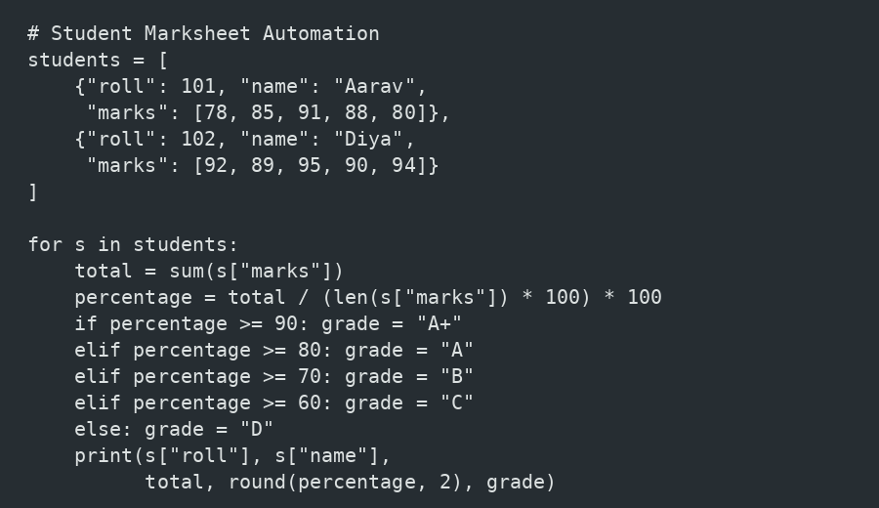
5. Understanding of python logic
The program uses lists/dictionaries to store student records, loops to process many students, sum() for total marks, conditional statements for grades, and formatted output for the final marksheet.
S. B. Jain Institute of Technology Management and research

Slide 8
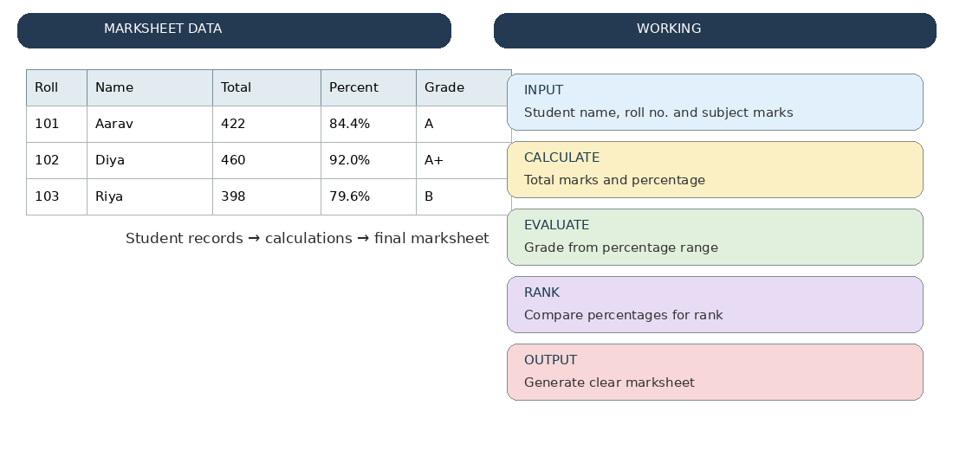
6. Graphical Representation and Working
Benefits: faster processing, consistent calculations, fewer manual errors, easy handling of high-volume records, and clear result generation.
S. B. Jain Institute of Technology Management and research

Slide 9
7. GitHub Account, Repository & Collaboration
• Create GitHub Account – Set up a personal GitHub account.
• Create Repository – Student Marksheet Automation (High Volume).
• Upload Code – Upload the Python source files and project documentation.
• Meaningful Commits – Save changes with clear messages such as 'Added grade calculation'.
• Collaboration – Share the repository and use branches or pull requests when working as a team.
• Individual Contribution – Each member contributes code, testing, documentation, or presentation work.
• Track Changes – Use GitHub history to monitor project updates and improvements.
• Maintain Version Control – Keep the latest working version of the marksheet automation project.
S. B. Jain Institute of Technology Management and research

Slide 10
8. Individual Contribution
• Problem Analysis – Studied the need for automating marksheet preparation for high-volume student records.
• Requirement Identification – Identified inputs such as student details and subject marks.
• Algorithm Design – Designed the steps for total, percentage, grade, and rank calculation.
• Python Coding – Implemented data storage, loops, calculations, conditions, and output generation.
• Testing – Tested the system with multiple student records and different mark ranges.
• Error Checking – Checked calculations and grade assignment to reduce incorrect results.
• GitHub Contribution – Uploaded project files and maintained meaningful commits.
• Documentation & PPT – Prepared project documentation, graphical representation, and presentation slides.
S. B. Jain Institute of Technology Management and research

Slide 11
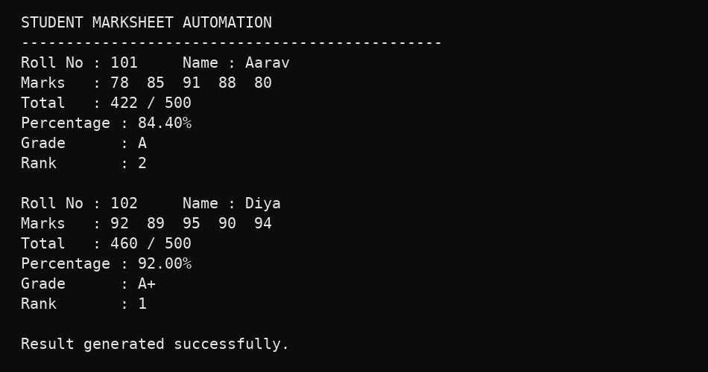
9. Result / Expected Output
The system automatically produces accurate totals, percentages, grades, and ranks for multiple students, reducing repetitive manual work and making high-volume marksheet preparation faster.
S. B. Jain Institute of Technology Management and research

Slide 12
Phase-2 Student Marksheet Automation
S. B. Jain Institute of Technology Management and research

Slide 13
Progress Work
70% Overall Progress
Core modules developed and integrated.
55% Coding
Calculations, grades and ranking implemented.
25% Testing
Multiple student records tested.
• Student data input and structured record storage implemented.
• Bulk processing for multiple student records completed.
• Total marks and percentage calculation automated.
• Grade assignment and rank calculation implemented.
• Printable marksheet output generated automatically.
• Remaining: complete testing and final deployment in Phase III.
S. B. Jain Institute of Technology Management and research

Slide 14
Code Implementation
Result Calculation
Bulk Processing & Ranking
def calculate_result(marks):
total = sum(marks)
percentage = total / len(marks)
if percentage >= 90: grade = "A+"
elif percentage >= 80: grade = "A"
elif percentage >= 70: grade = "B"
elif percentage >= 60: grade = "C"
else: grade = "D"
return total, percentage, grade
for student in students:
total, percentage, grade = calculate_result(
student["marks"])
student["total"] = total
student["percentage"] = percentage
student["grade"] = grade
students.sort(key=lambda x: x["percentage"],
reverse=True)
✓ Python Logic Used
Lists / dictionaries • loops • sum() • conditions • sorting
S. B. Jain Institute of Technology Management and research

Slide 15
Testing
✓ Student Input
Valid student details and marks are accepted correctly.
✓ Marks Validation
Invalid or out-of-range marks are rejected.
✓ Calculation
Total and percentage match manual calculations.
✓ Grade Assignment
Grade is assigned according to percentage range.
✓ Ranking
Students are ordered using calculated performance.
✓ High-Volume Data
Multiple records are processed consistently.
S. B. Jain Institute of Technology Management and research

Slide 16
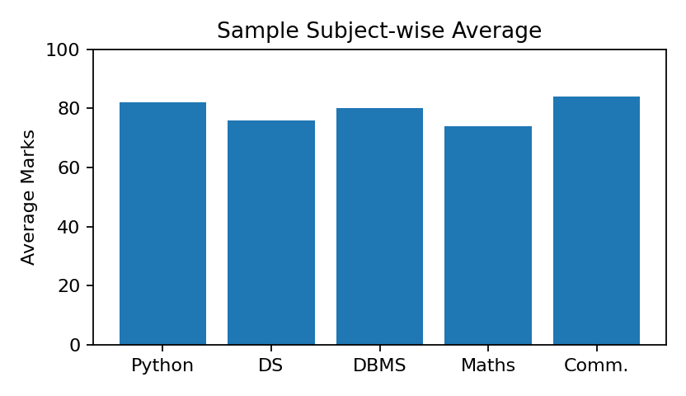
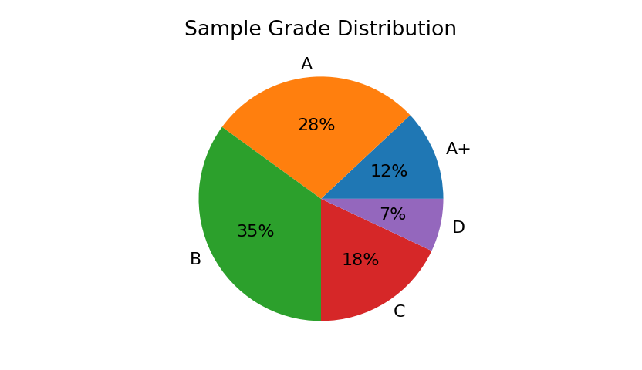
Result / Expected Output
Sample Output
================================
STUDENT MARKSHEET SYSTEM
================================
Name : Maayli Tabhane
USN : CM25090
Mathematics : 88
Python Programming : 92
Data Structures : 85
DBMS : 90
Communication : 86
Total : 441 / 500
Percentage : 88.20%
Grade : A
Rank : 2
Result : PASS
================================
Sample chart values are for demonstration; replace them with actual project test data if available.
S. B. Jain Institute of Technology Management and research

Slide 17
GitHub Account, Repository & Collaboration
1
Create Account
Set up a personal GitHub account.
2
Create Repository
Student-Marksheet-Automation
3
Upload Code
marksheet.py • students.csv • README.md
4
Meaningful Commits
Added grade calculation • Added ranking
5
Collaboration
Branches / pull requests for teamwork
6
Track Changes
Use commit history for phase-wise progress
S. B. Jain Institute of Technology Management and research

Slide 18
Individual Contribution
★ Problem Analysis
Studied automation needs for high-volume student records.
★ Algorithm Design
Designed total, percentage, grade and rank calculations.
★ Python Coding
Implemented data storage, loops, conditions and output.
★ Testing
Tested multiple student records and different mark ranges.
★ GitHub Contribution
Uploaded project files and maintained meaningful commits.
★ Documentation & PPT
Prepared documentation, graphical representation and slides.
S. B. Jain Institute of Technology Management and research

Slide 19
Thankyou

