Slide 1
SM - GROUP OF 5 PROJECT
MAAZ ANSAR (J001)
OJASVI JAIN (J022)
KAASHAN PANJWANI (J035)
SIDH SATAM (J042)
SOHAM MHATRE (J060)

Slide 2
TOPIC
Since environmental health is such an important issue now, We thought it best to use our knowledge to help this industry. We have designed a regression model to optimize the Electricity Consumption by predicting the average electricity consumed by a city.
Our topic is Electricity Consumption, its usage patterns and factors that affect it.

Slide 3
Details about our Data
6 independent variables, 960 observations
Average Electricity Consumption –
This is the dependent variable in our dataset. Measured in MWH. The readings are taken at every 15 min intervals from the suppliers. It is then averaged to calculate the energy consumption at every 30 minute interval.
Temperature –
Average air temperature. Calculated in ˚ C.
Humidity –
Average humidity of the region Calculated in %.
Windspeed –
Average windspeed. Calculated in mps.

Slide 4
Details about our Data
Weekend –
To determine whether the reading was taken on a weekend or not. 0 signifies weekday while 1 signifies weekend.
Region –
The data consists of Mumbai and Delhi electricity consumption.
TimeOfDay –
We divided the data into various times of the day
Morning – 5 AM to 12 PM
Afternoon – 12 PM to 6 PM
Evening – 6 PM to 10 PM
Night – 10 PM to 5 AM

Slide 5
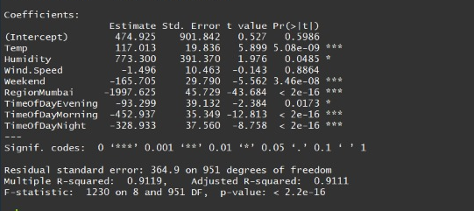
FIRST Regression model.

Slide 6
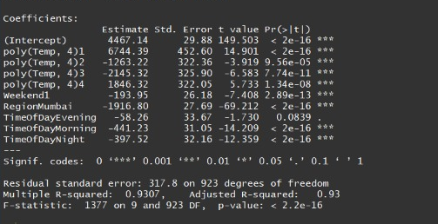
BEST FIT MODEL

Slide 7
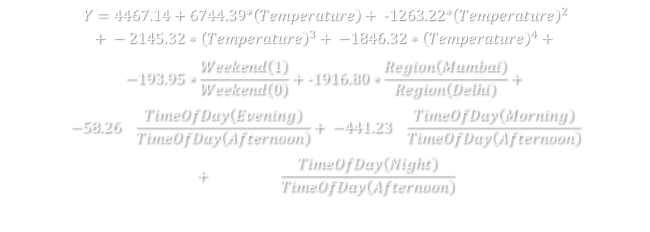
FINAL REGRESSION LINE
$$Y=4467.14+6744.39∗\left(Temperature\right)+ −1263.22∗{\left(Temperature\right)}^{2}$$
$$+ −2145.32∗{\left(Temperature\right)}^{3}+ −1846.32∗{\left(Temperature\right)}^{4}+$$
$$−193.95∗\frac{Weekend\left(1\right)}{Weekend\left(0\right)}+−1916.80∗\frac{Region\left(Mumbai\right)}{Region\left(Delhi\right)}+$$
$$−58.26∗\frac{TimeOfDay\left(Evening\right)}{TimeOfDay\left(Afternoon\right)}+ −441.23∗\frac{TimeOfDay\left(Morning\right)}{TimeOfDay\left(Afternoon\right)}$$
$$+ \text{−}397.52∗\frac{TimeOfDay\left(Night\right)}{TimeOfDay\left(Afternoon\right)}$$

Slide 8
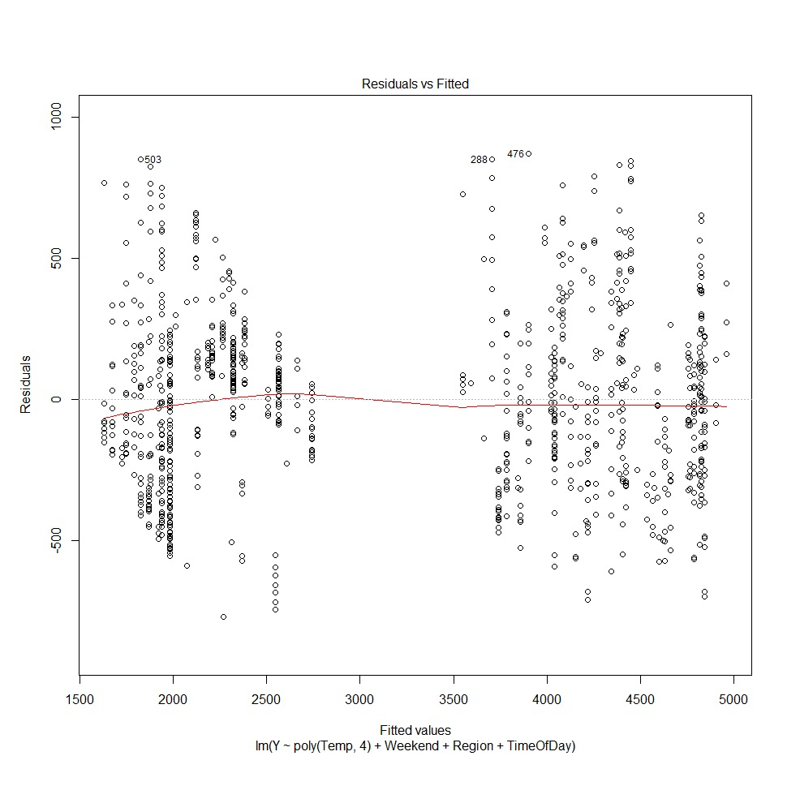
Assumptions
Linear Regression Model
Fitted values – Yhat.
Residuals – error (Y – Yhat)
If there exist any observable pattern (eg. a parabolic shape) in this plot, consider it as signs of non-linearity in the data. It means that the model doesn’t capture non-linear effects.
As the plot is almost linear, the model is considered a linear regression model

Slide 9
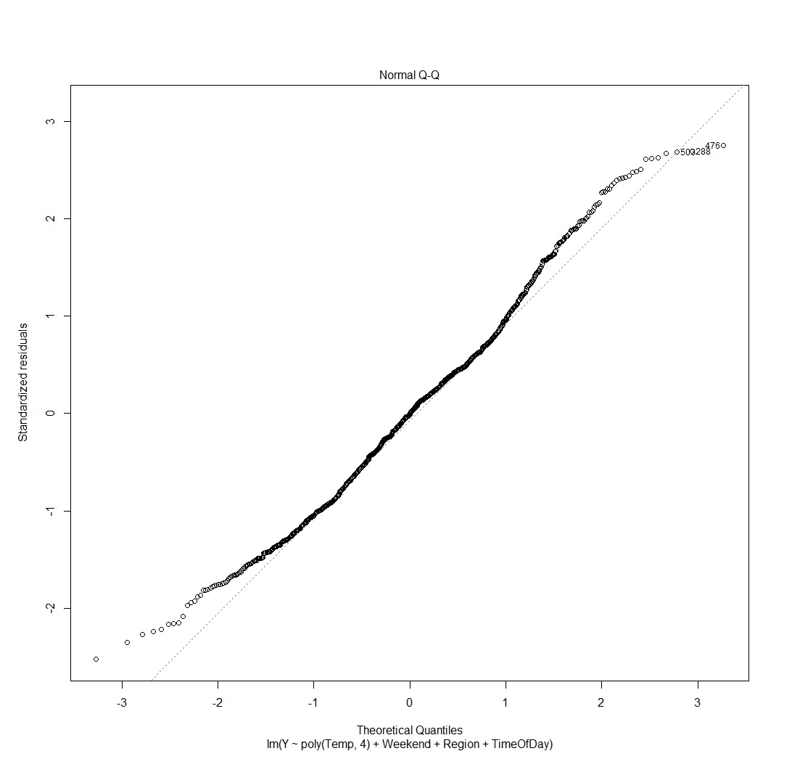
ASSUMPTIONS
NORMAL DISTRIBUTION OF ERRORS
If the error terms are non- normally distributed, confidence intervals may become too wide or narrow. Presence of non – normal distribution suggests that there are a few unusual data points which must be studied closely to make a better model.
Since our plot is closely fitted to the linear line, we assume that the error terms are normally distributed.

Slide 10
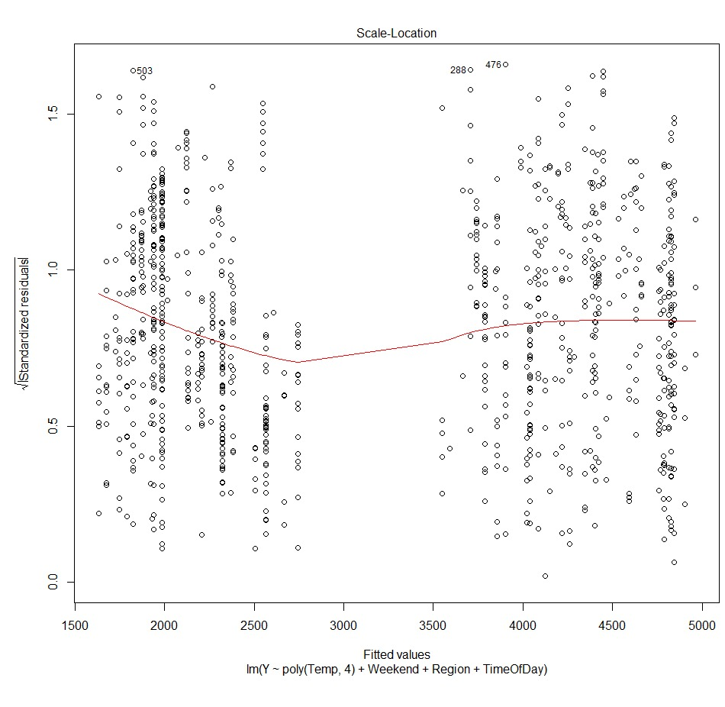
ASSUMPTIONS
HOMOSKEDASTICITY
The presence of constant variance in the error terms results in homoskedasticity.
Since there is no discernible pattern in the plot, it implies that the errors are normally distributed.
Hence, HOMOSCEDASTICITY is evident.

Slide 11
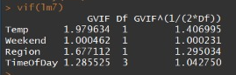
ASSUMPTION
MULTICOLLINEARITY
VIF value <= 5 suggests no multicollinearity whereas a value of >= 10 implies serious multicollinearity.
As all the VIF values are less than 5, there is no multicollinearity in the model.

Slide 12
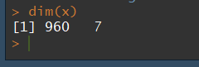
ASSUMPTION
THE NUMBER OF OBSERVATION SHOULD BE
GREATER THAN NUMBER OF
PARAMETERS.
Since the number of observations are 960 and the parameters are 7, this assumption is satisfied.

Slide 13
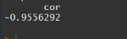
ASSUMPTION
CORRELATION
Independent variables should not be correlated to each other.
Here, we see that Humidity and Temperature are correlated and after checking the R2 value of 2 models excluding each respectively, we drop humidity.

Slide 14
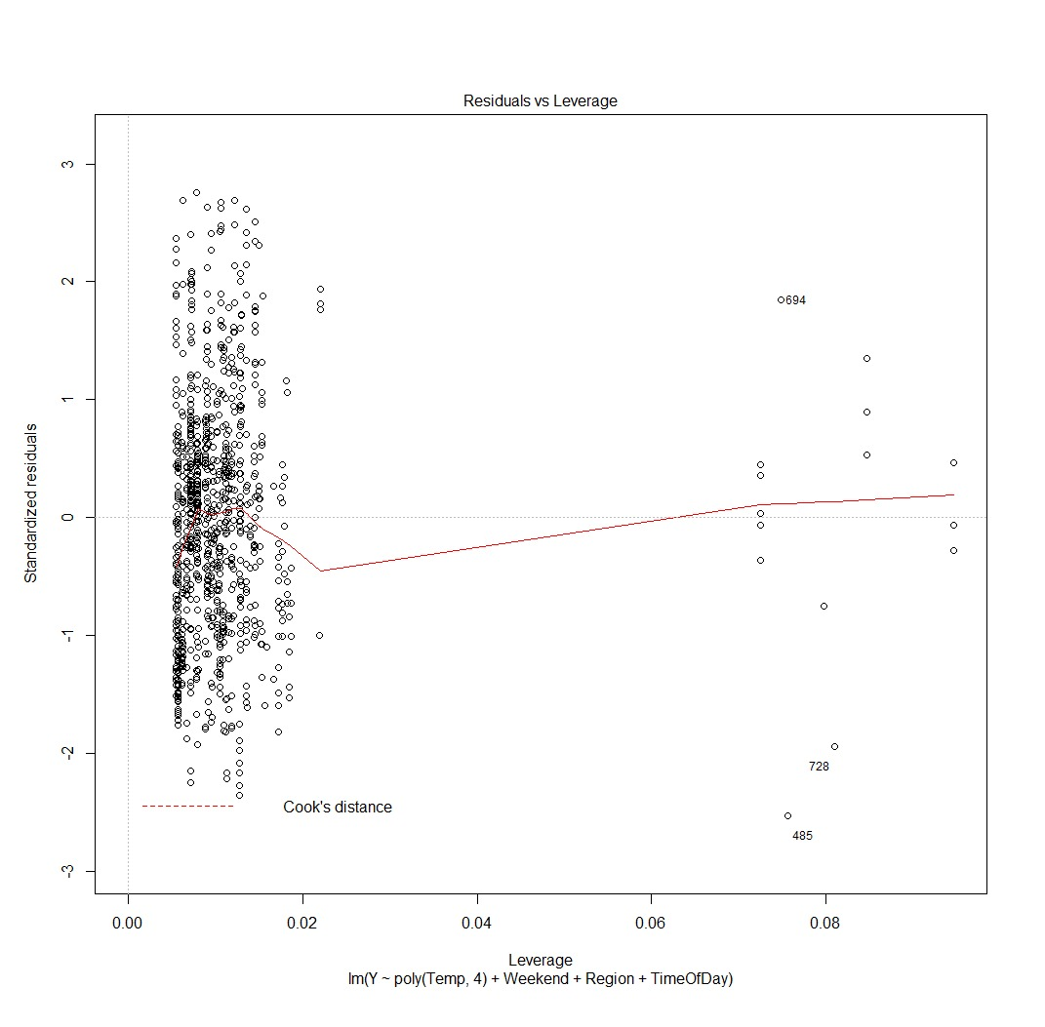
PROBLEMS
HIGH LEVERAGE POINT
The points which seem like outliers but have more influence than other points. Such influential points tends to have a sizable impact of the regression line.
In other words, adding or removing such points from the model can completely change the model statistics.
In our model, the high leverage point is 126 as seen in the code from the line:
which.max(hat.values(lm))

Slide 15
Problems
Outliers
An outlier is an observation point that is distant from other observations. An outlier may be due to variability in the measurement or it may indicate experimental error etc.
Outliers must be removed from the regression model as it can increase the error in the model.
Outliers are removed through observation from the Residual vs Fitted Plot

Slide 16
THANK YOU ☺

