Slide 1
Modern Database Management
Student Name

Slide 2
Index
About
Entity Relation Diagram
Database Queries
Database Security
Presentation Topics

Slide 3
About
This presentation is related to the development of database system. The topic on which the whole database is designed is an NGO working on climate causes with a global reach and a large number of volunteers is Greenpeace

Slide 4
NGO (Database)

Slide 5
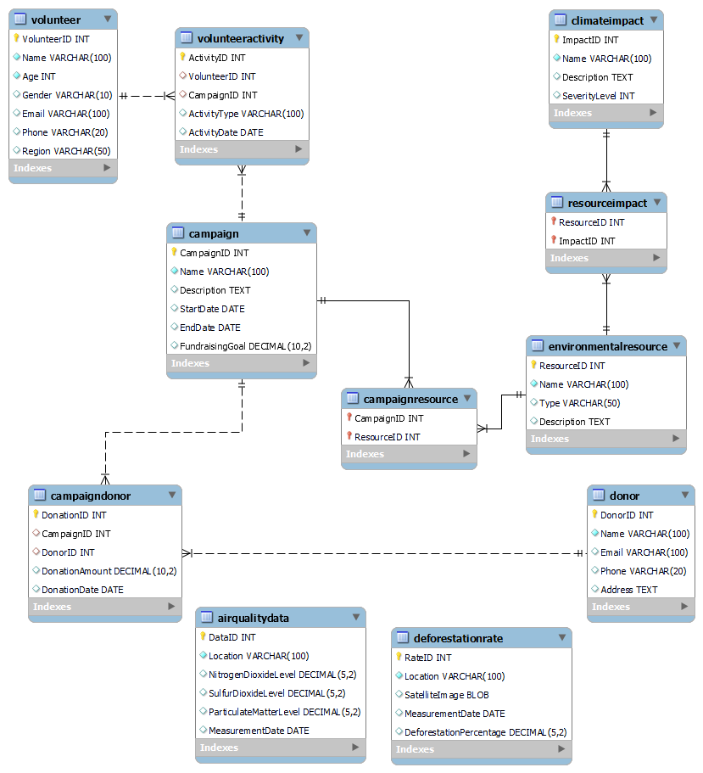
ERD
Entity relation diagram plays an important role in the creation of the database this diagram helps to maintain all the relations in the database. This entity relation diagram shows all the tables and relation which are been created in the database.

Slide 6
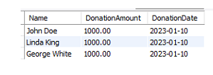
Question 1:
In first question Retrieve the top 10 donors who have made the largest donations in a specific campaign
This is the output of the question and this will done by select query and some joins are also used to get data from different tables.

Slide 7
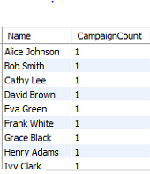
Question 2:
Retrieve the number of campaigns each volunteer has participated in
This is the output of the question and this will done by select query and some joins are also used to get data from different tables.

Slide 8

Question 3:
Retrieve the campaigns that are still accepting donations
This is the output of the question and this will done by select query and WHERE function is used in this question.

Slide 9

Question 4:
Retrieve the donors who have donated to multiple campaigns
This is the output of the question and this will done by select query and some joins are also used to get data from different tables.

Slide 10
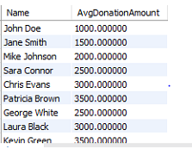
Question 5:
Retrieve the average donation amount per donor across all campaigns they have donated to
This is the output of the question and this will done by select query and some joins are also used to get data from different tables.

Slide 11
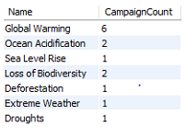
Question 6:
Retrieve the number of campaigns that have been affected by each climate impact
This is the output of the question and this will done by select query and some joins are also used to get data from different tables.

Slide 12
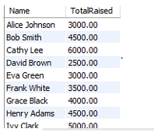
Question 7:
Retrieve the volunteers who have participated in campaigns that have raised more than a certain amount
This is the output of the question and this will done by select query and some joins are also used to get data from different tables.

Slide 13
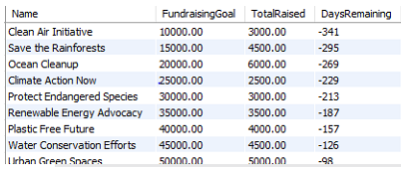
Question 8:
Retrieve the campaigns that have not yet met their fundraising goals and have less than a certain number of days remaining until the end date
This is the output of the question and this will done by select query and some joins are also used to get data from different tables.

Slide 14
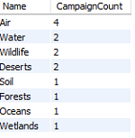
Question 9:
Retrieve the top 10 resources that have the greatest impact on climate change, based on the number of campaigns they have been associated with
This is the output of the question and this will done by select query and some joins are also used to get data from different tables.

Slide 15

Question 10:
Find the top 3 campaigns with the highest amount raised, along with the number of volunteers and donors who contributed to each campaign. Include the campaign name, the amount raised, the total number of volunteers, and the total number of donors in the result. Only include campaigns that have both volunteers and donors. Sort the result by the total number of volunteers in descending order.
This is the output of the question and this will done by select query and some joins are also used to get data from different tables.

Slide 16
Database Security
In the rapidly changing technology landscape, numerous professional fields require the storage of millions of records of data. This data is not limited to computer fields but also includes passenger data for trains and aircraft. To ensure data security, professional software is developed to efficiently store and protect this information. However, there are numerous ways data can be stolen, including by company staff, hackers, and crackers. Companies must protect their data and employees' information from internal or external threats. Companies are working to provide services to safeguard databases, resolve ethical issues, maintain customer trust, and reward customer satisfaction. It is the responsibility of every firm to maintain these security measures and protect their data from threats.

Slide 17
Thank You

