Slide 1
Project Presentation
By Maaz Adnan 22763
Hasan Shahab 22747
Talha Ahmed 22846

Slide 2
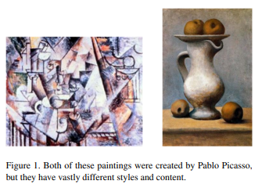
Problem Statement
Artist Identification Challenge
Identifying the artist of a painting is crucial for cataloguing art and detecting forgeries.
Art historians rely on their expertise and training for artist identification.
Complex problem due to diverse styles and changes in artistic approaches.
Existing approaches focus on explicit classification features, however that is difficult since an artist’s style changes over time

Slide 3
Related Work
Traditional Approaches
Artist identification has traditionally been performed by humans, relying on expertise.
Datasets like WikiArt and Artsy have been manually curated by volunteers and experts.
Feature-Based Approaches
Prior work focused on defining distinguishing features for artists and styles.
Generic image features used, including SIFT(Scale Invariant Feature Transform) and HOG(Histogram of oriented gradients) .
Art-Specific Approaches
Some studies focused on art-specific features like brushstrokes for style identification.
Examples include edge detection, clustering-based segmentation, and brushstroke analysis.
All these approaches are limited in their capacity as they focus on specific features known to an artist. We take a more general approach with three different models to try to classify art by artists

Slide 4
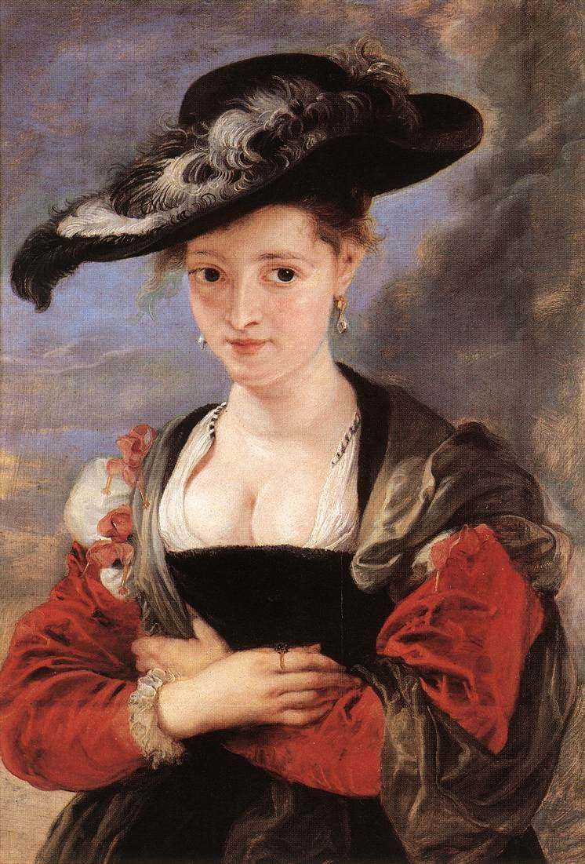
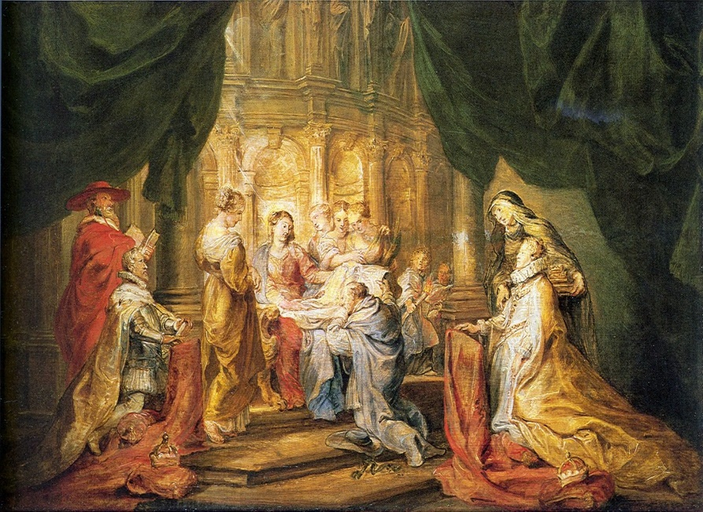
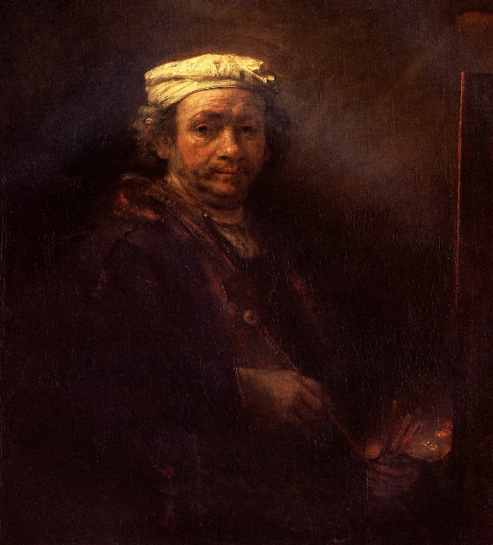
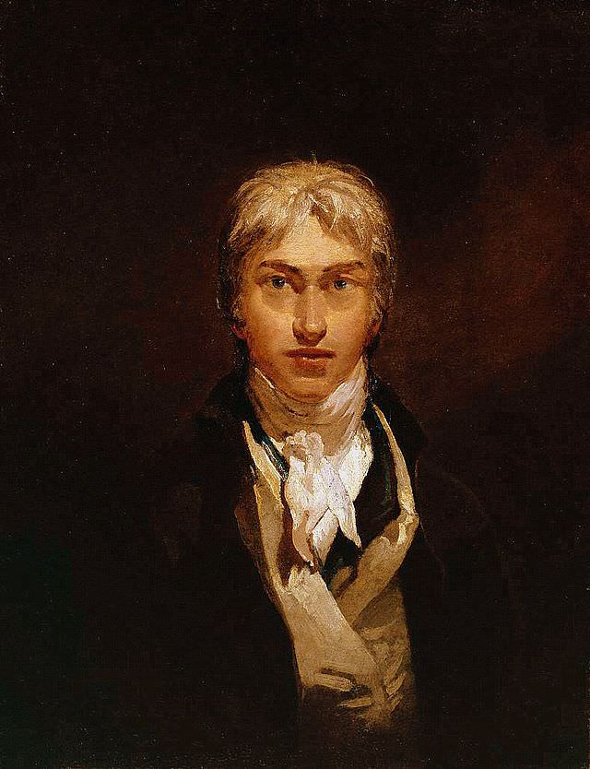
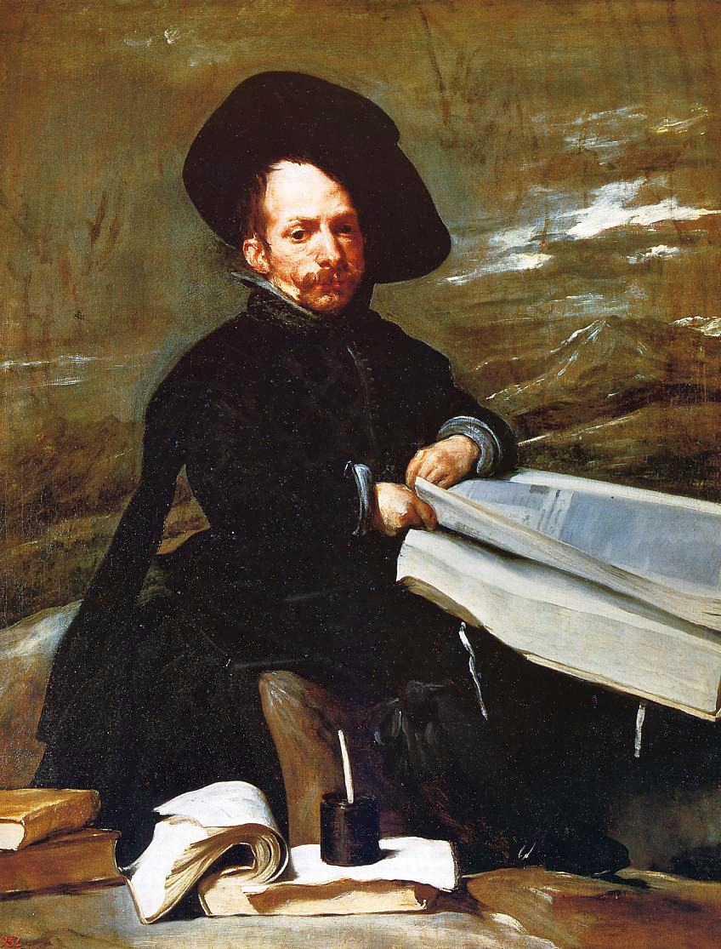
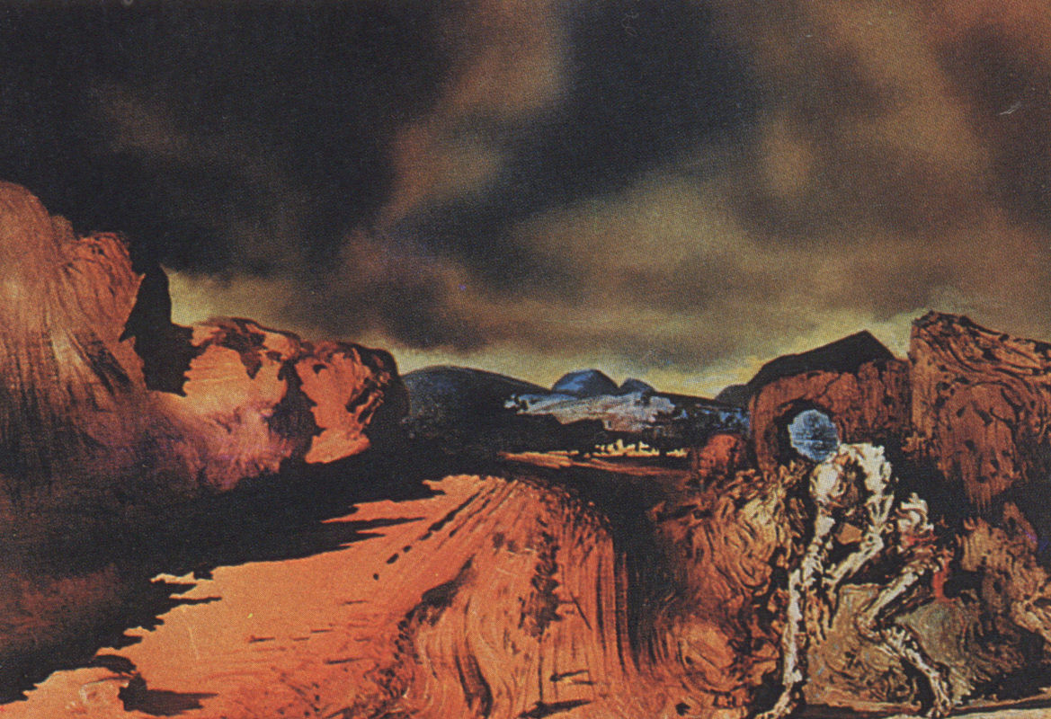
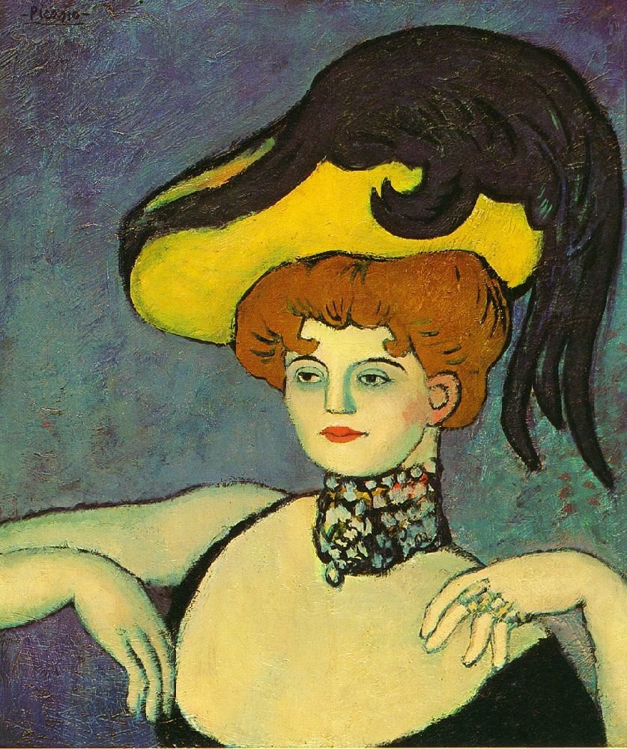
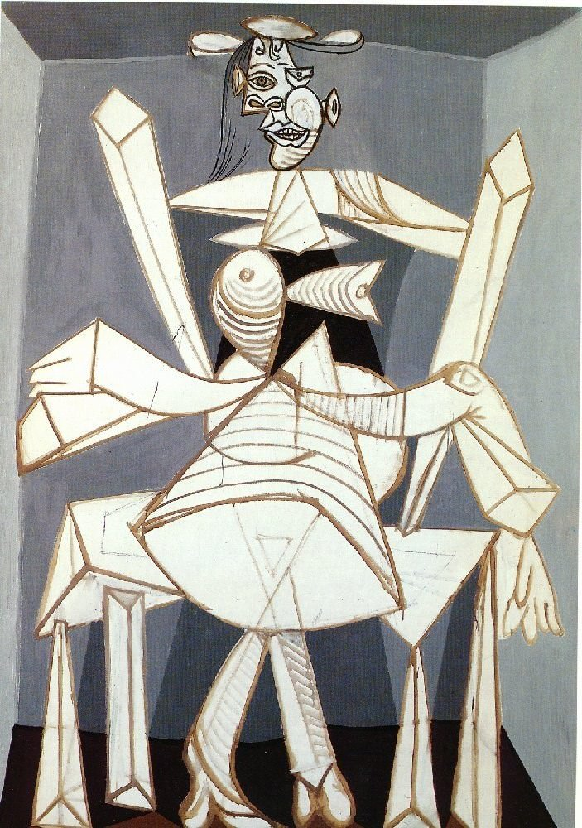
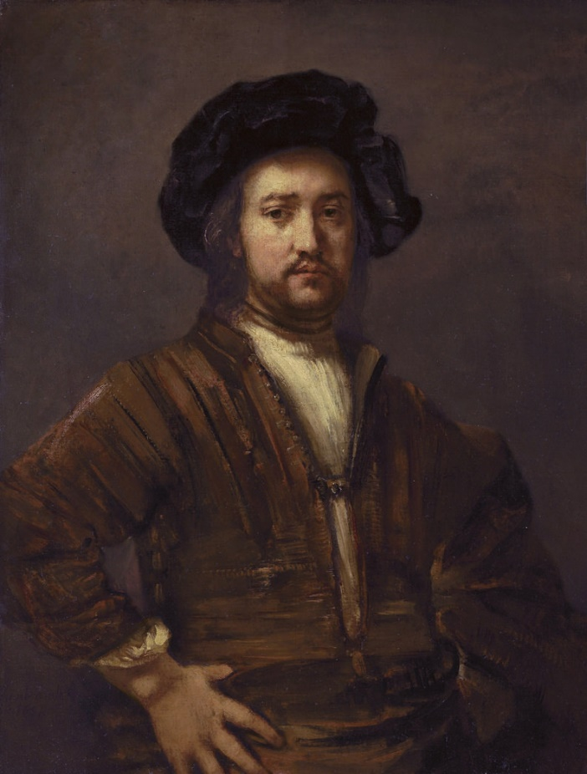
Dataset
Dataset Overview
Dataset obtained from Kaggle [Best Artworks of All Time | Kaggle].
Contains approximately 10,000 paintings by 50 artists.
Due to space and processing power constraints, we divided the set and chose 25 artists with more than 100 artworks.
Dataset divided according to 80 and 20 rule, 80% for testing 20% for testing
Dataset Preprocessing
Image modifications:
Zero-centering and normalization by using imagenet mean and SD values.
Resizing a with 256x256 pixels.
Random data augmentation during training:
Horizontal flipping.
Random section cropping [224 by 224] to introduce variety.
Consistent center cropping for test images.

Slide 5
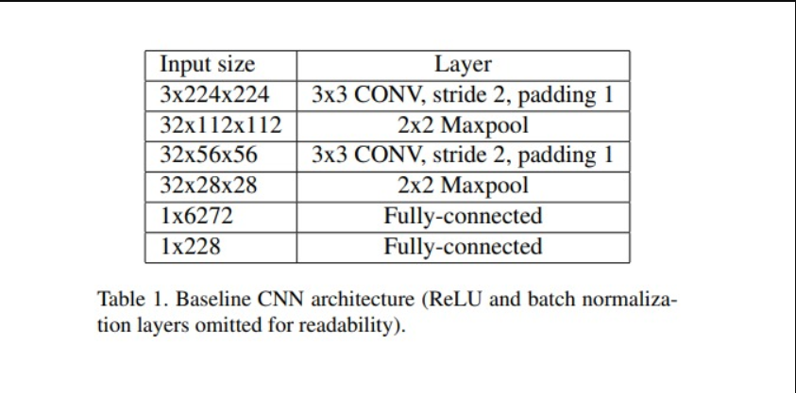
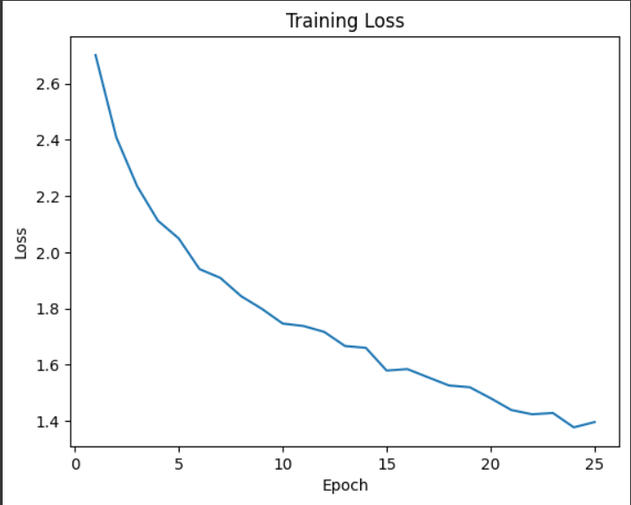
Architectures
Baseline CNN:
Simple architecture designed from scratch.
2 convolutional layers followed by a Relu layer.
2x2 after each convolution to downsample the image
Final fully connected layer
Training and Loss Function
Initial Learning rate = 0.001
Optimizer used is Adam Optimizer.
Number of Epochs is 25
Softmax classifier with cross-entropy loss used for training.
Loss function ensures maximizing the correct artist's score relative to others.
Results:
Accuracy of predicting the right artist = 0.5232
Accuracy of right artist being in top 3 predicted = 0.7355

Slide 6
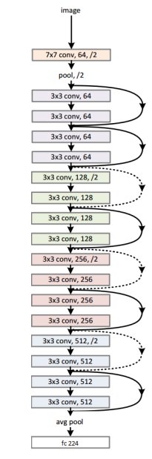
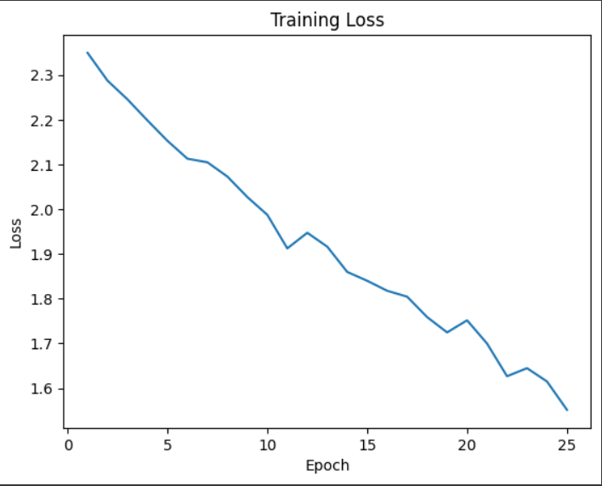
Architectures
Baseline Resnet trained from Scratch:
Resnet18 architecture with random weights.
Architecture as described in the picture.
Only final Fully Connected layer changed with classifications changed from 1000 to 25
Training and Loss Function
Initial Learning rate = 0.001
Optimizer used is Adam Optimizer.
Number of Epochs is 25
Softmax classifier with cross-entropy loss used for training.
Loss function ensures maximizing the correct artist's score relative to others.
Results:
Accuracy of predicting the right artist = 0.4814
Accuracy of right artist being in top 3 predicted = 0.7343

Slide 7
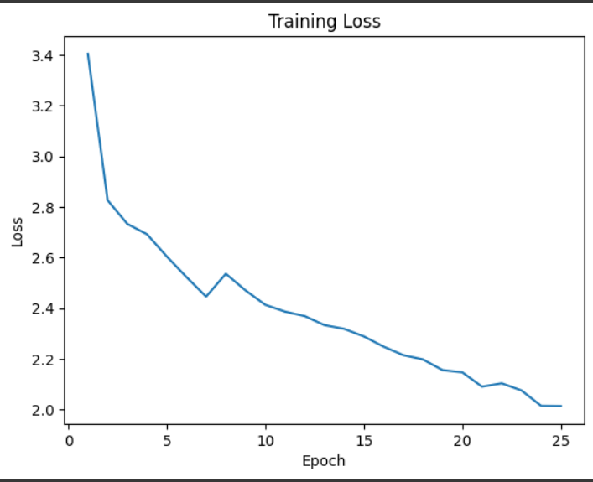
Architectures
Resnet with pre-trained weights:
Resnet18 architecture with pre trained weights from ImageNet Dataset.
Architecture as described in the picture.
Only final Fully Connected layer changed with classifications changed from 1000 to 25
Training and Loss Function
Initial Learning rate = 0.001
Optimizer used is Adam Optimizer.
Number of Epochs is 25
Softmax classifier with cross-entropy loss used for training.
Loss function ensures maximizing the correct artist's score relative to others.
Results:
Accuracy of predicting the right artist = 0.5317
Accuracy of right artist being in top 3 predicted =

Slide 8
Results
Performance Evaluation
Network performance evaluated and compared to prior work.
Significant improvement in classification accuracy.
Quantitative assessment of accuracy metrics.
Learned Feature Representation
Exploration and visualization of learned feature representation.
Understanding the features learned by the networks.
Identification of artist styles through the learned representations.

Slide 9
Conclusion
Key Findings
CNNs are powerful tools for artist identification.
Significantly better performance compared to existing approaches.
Learned feature representation captures artist styles effectively.
Potential applications in cataloguing art and detecting forgeries.
Future Directions
Further exploration of CNN architectures and training strategies.
Integration of additional data sources for improved generalization.
Application of artist identification in real-world scenarios.

