Slide 1
CONTACTSPRO
Submitted by: Omer Farooq,, maaz Hasan & tabish Muzaffar

Slide 2
Motivation behind project:
In our world time is one thing that is can never be compromised on. Realizing the importance of time we set out in search of a data structure that will give us results that can implement instructions such as insertion and search in the most efficient way possible.
We also wanted to find and create searching algorithms which displayed real time results of partially asked display queries.
In our search we came across the ”Trie” data structure.
Before we move on to how fast it actually is, we take a look at how it works.

Slide 3
Data Structure : TRIe
ROOT

Slide 4
ROOT
t

Slide 5
ROOT
t
a

Slide 6
ROOT
t
a
b

Slide 7
ROOT
t
a
b
i

Slide 8
ROOT
t
a
b
i
s

Slide 9
ROOT
t
a
b
i
s
h
Contact Detail

Slide 10
ROOT
t
m
o
a
a
b
m
a
i
z
e
s
h
r
Contact Detail
Contact Detail
Contact Detail

Slide 11
ROOT
t
m
o
a
a
r
i
u
m
b
m
a
i
z
e
Contact Detail
s
h
r
Contact Detail
Contact Detail
Contact Detail

Slide 12
ROOT
t
m
o
a
a
r
i
u
m
b
m
a
h
i
z
e
s
r
Contact Detail
h
r
e
Contact Detail
e
Contact Detail
Contact Detail
m
Contact Detail

Slide 13
ROOT
t
m
o
a
a
r
i
u
m
b
m
a
h
i
a
z
e
r
m
Contact Detail
s
h
r
a
e
Contact Detail
e
Contact Detail
Contact Detail
Contact Detail
Contact
Detail
m
If more than one contact with that name
Contact Detail

Slide 14
BIG (O) analysis
Time Complexity:
Insertion: O(C)
Search: O(C)
Display: O(LogN) where,
Deletion: O(1) Best case, O(C) Worst case C= length of the string.
Space Complexity
O(C*N) N=number of records

Slide 15
IMPLEMENTATION
We implemented the trie data structure to make a contact management system that we named ContactsPro.
We made three different Tries on the basis of the First name, the Last name and the Phone number of each data entry.
We made two different node classes. One for alphabets to store letters in names and another to store digits in phone numbers.

Slide 16
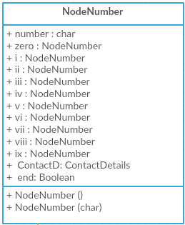
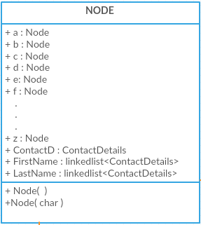
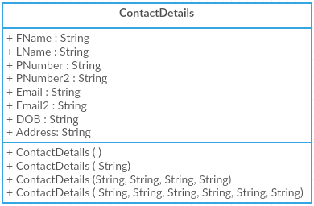
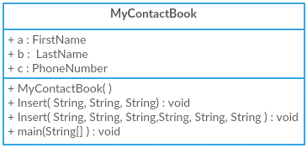
UML DIAGRAMS

Slide 17
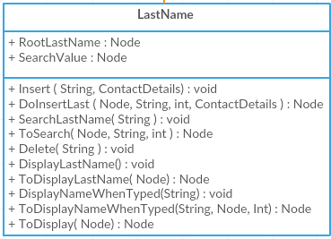
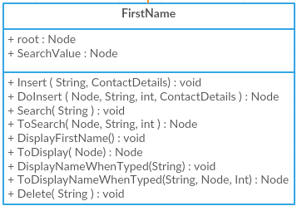
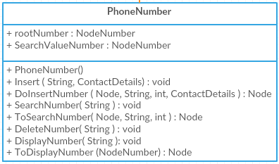
UML DIAGRAMS
We made three Tries for our contact manager on the basis of the first name, the last name and the phone number.

Slide 18
Other Applications OF TRIE data structure
Tries can and are used to make dictionaries.
Tries can be used in databases where speed is much more essential than space. In these the trie would be implemented using keys. This will allow operations like insertion, deletion and search to be done very efficiently. These operations would happen independent of the amount of data already present. Instead they would depend on the length of the key.
Tries can also be used to make a number of word games.

