Slide 1
CE301 PDO Presentation GPS Substitute For Buses Based On Image Recognition
Prepared by:
Muhammad Maaz
Project Supervisor : Dr. Stephen Sangwine
Second Assessor : Dr. Serafeim Perdikis
CSEE Department, University of Essex

Slide 2
Project Description
IDEA
The goal of this project was to apply image recognition in order to track the location of the bus without GPS aid.
Objective
The main objective was to perform accurate recognition of two similar objects.
Find a sustainable and self-supporting solution to identify bus location
Development & Tools
This project is developed in python, although C++ would have made huge difference.
OpenCV is used to process and recognize images
Tkinter is used to developed GUI of project.

Slide 3
Project Concepts
Accurate Recognition Methods
Labeled Recognition ( Not Feasible for this project )
Need neural network algorithms ( C-NN, R-CNN and Yolo )
High GPU and previously labelled data
Accuracy is correct most of the time once algorithm has applied
Feature Based Recognition ( Viable and Executed Approach for this project )
Identify Features in image like ( Corner , edges, contours, shapes)
Robust Algorithms are already available like ( SIFT, SURF and ORB)
ORB (ORB (Oriented FAST and Rotated BRIEF) is used in this project
Fast and does not need high GPUs which makes it more unique for bus

Slide 4
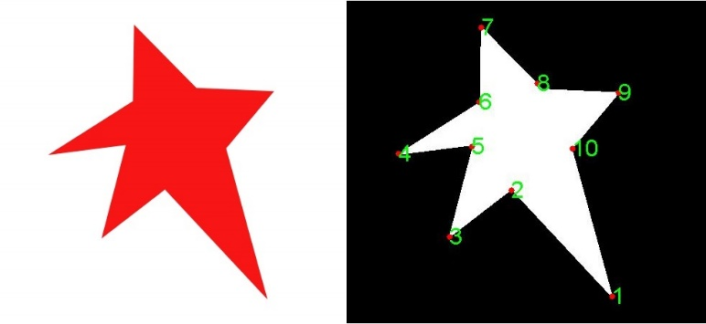
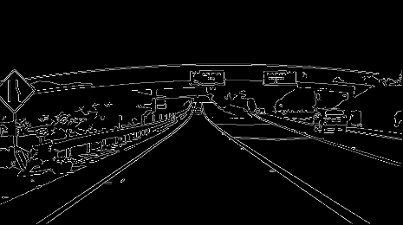

Project Concepts
Feature Based Recognition Key elements
Corners, Edges and Contours are IMPORTANT Key COMPONENTS in the image
All the algorithms try to find these in image as they are feature of that image
Corner
A corner can be defined as the intersection of two edges.
OpenCv has provided corner detection algorithms
Edge
An edge point is a point in an image with coordinates [x,y] at the location of a significant local intensity change in the image.
Intensity refers to the amount of light or the numerical value of a pixel
Contours
Contours can be explained simply as a curve joining all the continuous points (along the boundary), having same colours or intensity. The contours are a useful tool for shape analysis and object detection and recognition.
Fig 1.1 :Detected Corners
Fig 2.2 Edges
Fig 2.2 RANSAC

Slide 5
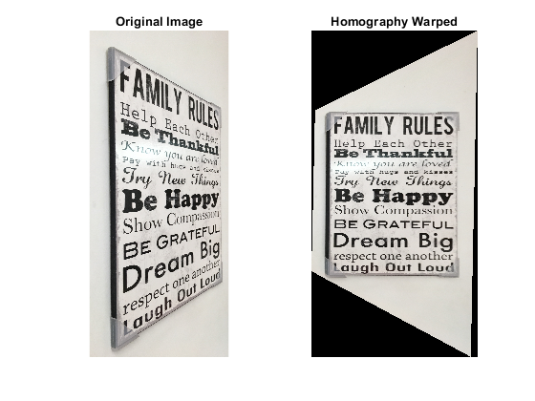
Project Concepts
Key points
A keypoint is calculated by considering an area of certain pixel intensities around it. These key point helped to identify objects in a image.
Descriptors
A descriptor is a finite vector which summarizes properties for the key point
Hemography
Homography is a transformation ( a 3×3 matrix ) that maps the points in one image to the corresponding points in the other image.
To explain better if the two images are taken from two different point of view, the features in that image are same but they flipped from one side to other. When matching the features it uses RANSAC to compute the correct matches.
Fig 2.3 Edges

Slide 6
Project Concepts
ORB Detection Mechanism
ORB use FAST( Features from Accelerated Segments Test) algorithm to calculate the keypoints.
FAST calculates keypoints by considering pixel brightness around a given area.
Further about fast calculation has been described in the report
In the next step it applies a Harris corner measure to find top N points among them.
ORB Matching Mechanism
ORB use BRIEF (Binary Robust Independent Elementary Features) to calculate the key descriptors
It is considered as faster method feature descriptor calculation and matching.
It also provides high recognition rate unless there is large in-plane rotation.

Slide 7
Project Implementation
Pre-process the Video
Start by saving every 10th frame of the video of the bus route
Predict the region of interest
Divide the image in four half
The ROI of interest is detected by applying the ORB feature detection algorithm
Save the region of interest in the bus directory
Apply second step Again for Live video
Using second step find the ROI again from the live video
Match the new detected ROI using ORB feature matching technique discussed earlier
Compare the structural similarity between them if ( similarity higher 70 ) match the region
This step still applied but the structural similarity ratio is very low during comparison
Tracking Location
The final objective is achieved as because of location tracking mechanism without GPS is very difficult.
One solution not implemented however labelling the data at the pre processing stage

Slide 8
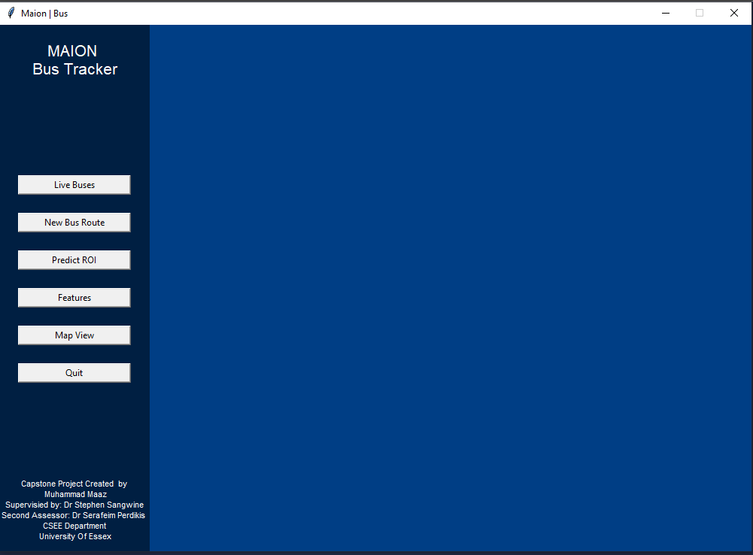
Demonstration
Final Result

Slide 9
Thank You
Question ?

