Slide 1
SEO

Slide 2
What is SEO?
SEO stands for Search Engine Optimization, which is the practice of increasing the quantity and quality of traffic to your website through organic search engine results.

Slide 3
Google Ranking Factors

Slide 4
Google
4-sep-1998→ Google
2010 → simple website → google top
2011 → panda operate → remove low quality content copy paste→ 200 words → de rank
2012 → Penguin operate → target Spanish backlinks
2013→ Hummingbird → LSI(Latent Semantic Indexing) keywords → semantic indexing → google want to know intend
2017 → Fred → Google link Quality
2018 → Possum → search update
9-July-2018→ Mobile Speed Updated Release

Slide 5
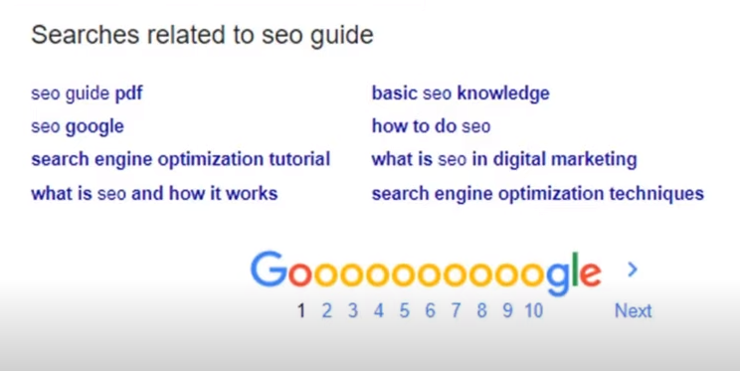
95% don’t click the next page

Slide 6
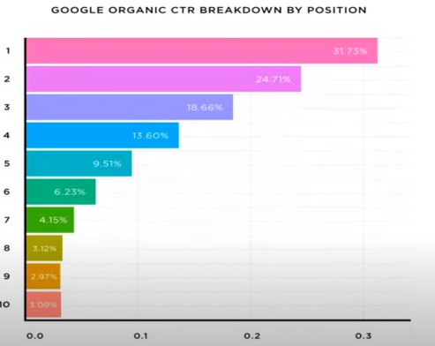
Google Organic CTR Breakdown by Position
Position
CTR (click through rate)

Slide 7
Search Engine Market Share Worldwide-April 2020
MARKETSHARE | STATISTA | STATCOUNTER
70.83% | 87.35% | 91.98%
12.61% | 5.53% | 2.55%
11.83% | 0.7% | 1.44%
2.30% | 2.83% | 1.66%
1.41% 0.42% | 0.76% N/A | 0.45% N/A
GOOGLE
BING
BAIDU
YAHOO
YANDEX
DUCKDUCKGO

Slide 8
What is E.A.T?
Expertise - Authority - Trustworthiness

Slide 9
Working of Search Engine
Crawls
Indexes
Ranks

Slide 10
Components of Search Engine
Web Crawler
Database
Search Interface

Slide 11
Web pages and websites

Slide 12
Advanced Google Search Techniques and Strategies

