Slide 1
Advertisement
AdSense(google)→for taking money from google.
AdWords(google)→post ads on websites, blogs etc.
Adverts(FB) →promote page, create ads, targeted ads.

Slide 2
AdWords
Keywords
Auction
PPC or cpti (cost/1000 impressions)
Text ads, video ads(yt), picture ads

Slide 3
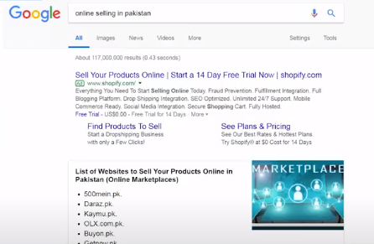
Types of advertisements
Search ads

Slide 4
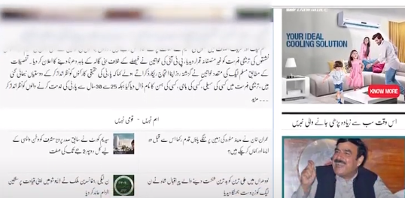
Display ads

Slide 5
Social Ads(fb,twitter,insta)
Only in social media platforms

Slide 6
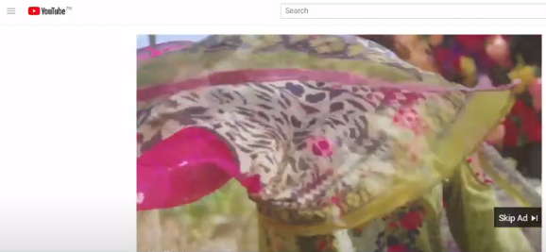
Video ads
Mostly on YouTube.

Slide 7
What are Search Ads
You pay on google AdWords.
Enter keywords.
Google show ads on google SE.
Charge in PPC or cpti.

Slide 8
Why to use search ads
Reach
Interested Users
Brand Presence
Client demand
Lead generation or sales boost

Slide 9
What are Display Ads
Display ads visible on top, bottom, right, left etc.
Why use ?
Reach
Visually appearing
When to use?
Brand awareness(zyada se zyada log apki product janay)
Visibility(logon ko apka brand nazar ata hai)
Brand recall(jo log janty hein unko dobara se recall)

Slide 10
What are Video Ads
Ads show in the form of video
Ppc or ppv
Why to use?
Engaging(agr content acha hai to user engage hoga)
When to use?
Awareness

Slide 11
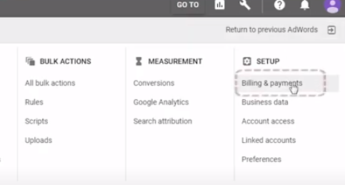
Create an Account on Google AdWords

Slide 12
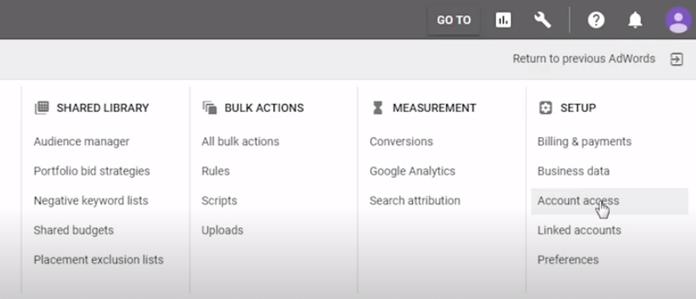
Give Access

Slide 13
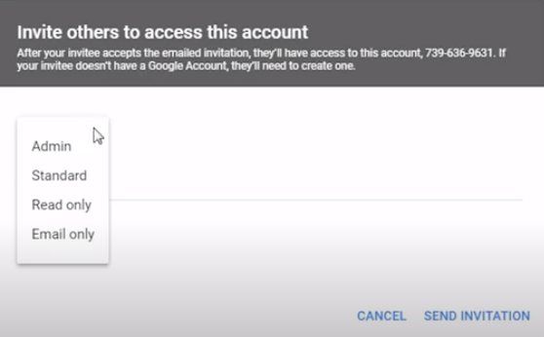

Slide 14
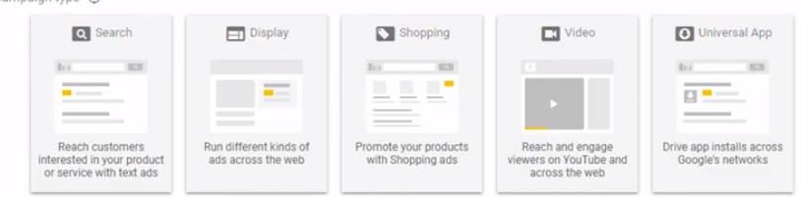
Search ads Campaign

