Slide 1
Freelancing

Slide 2

Fiverr

Slide 3
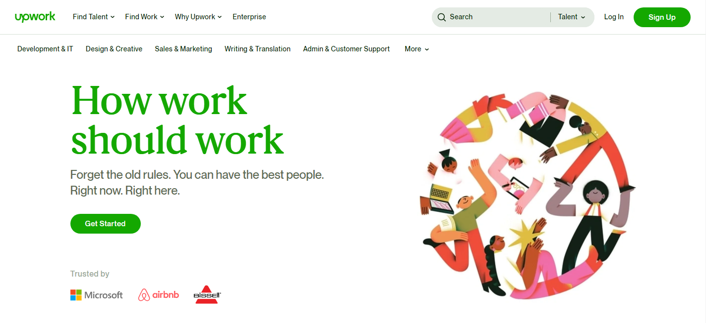
Upwork

Slide 4
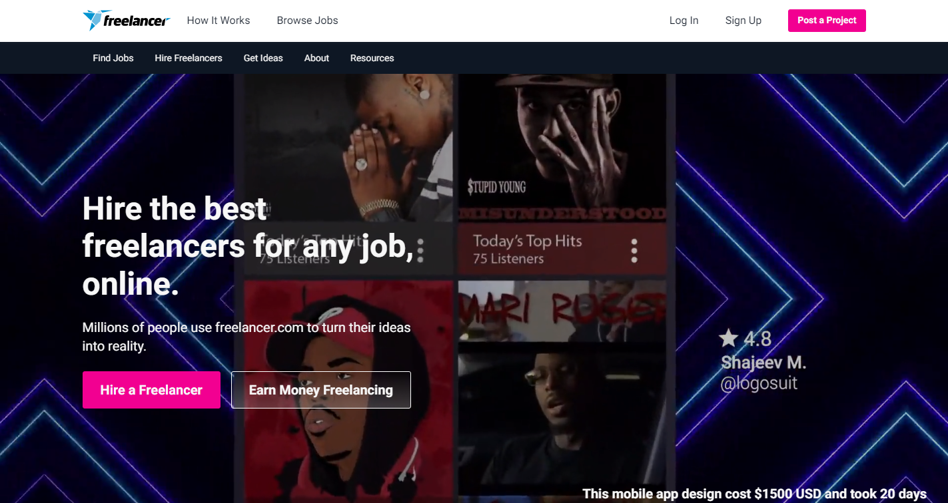
Freelancer

Slide 5
Fiverr
Gigs
10 buyers request/day

Slide 6
Upwork
Portfolio
10 connects/month
Give additional 10 connects if someone contact you back.

Slide 7
Freelancer
Complete your profile
Browse jobs that suit you
Write your best bid
Get awarded and earn
Contest

