Slide 1
What is Twitter
To send message, tweet and retweet.
You follow people or people follow you.
Anyone can reply, retweet and mention.
You can read anyone tweet.

Slide 2
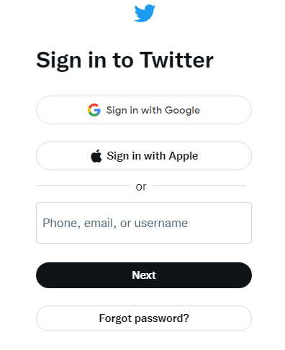
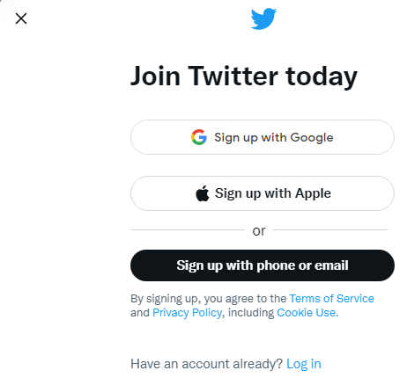
Create account

Slide 3
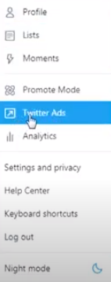
Twitter ads

