Slide 1
Cardioprotective Efficacy of IL-13 Following Hypoxia
Matt Borrelli
12/6/19

Slide 2
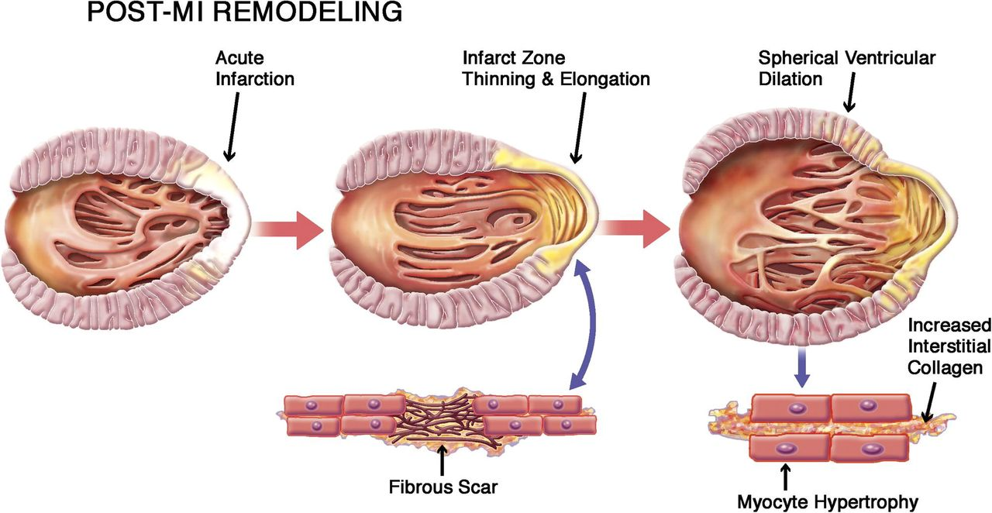

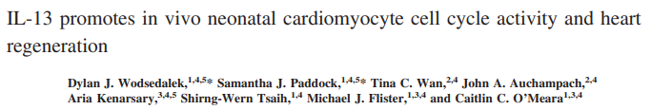
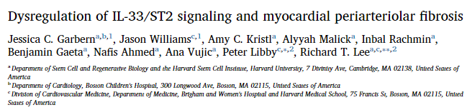
Introduction

Slide 3
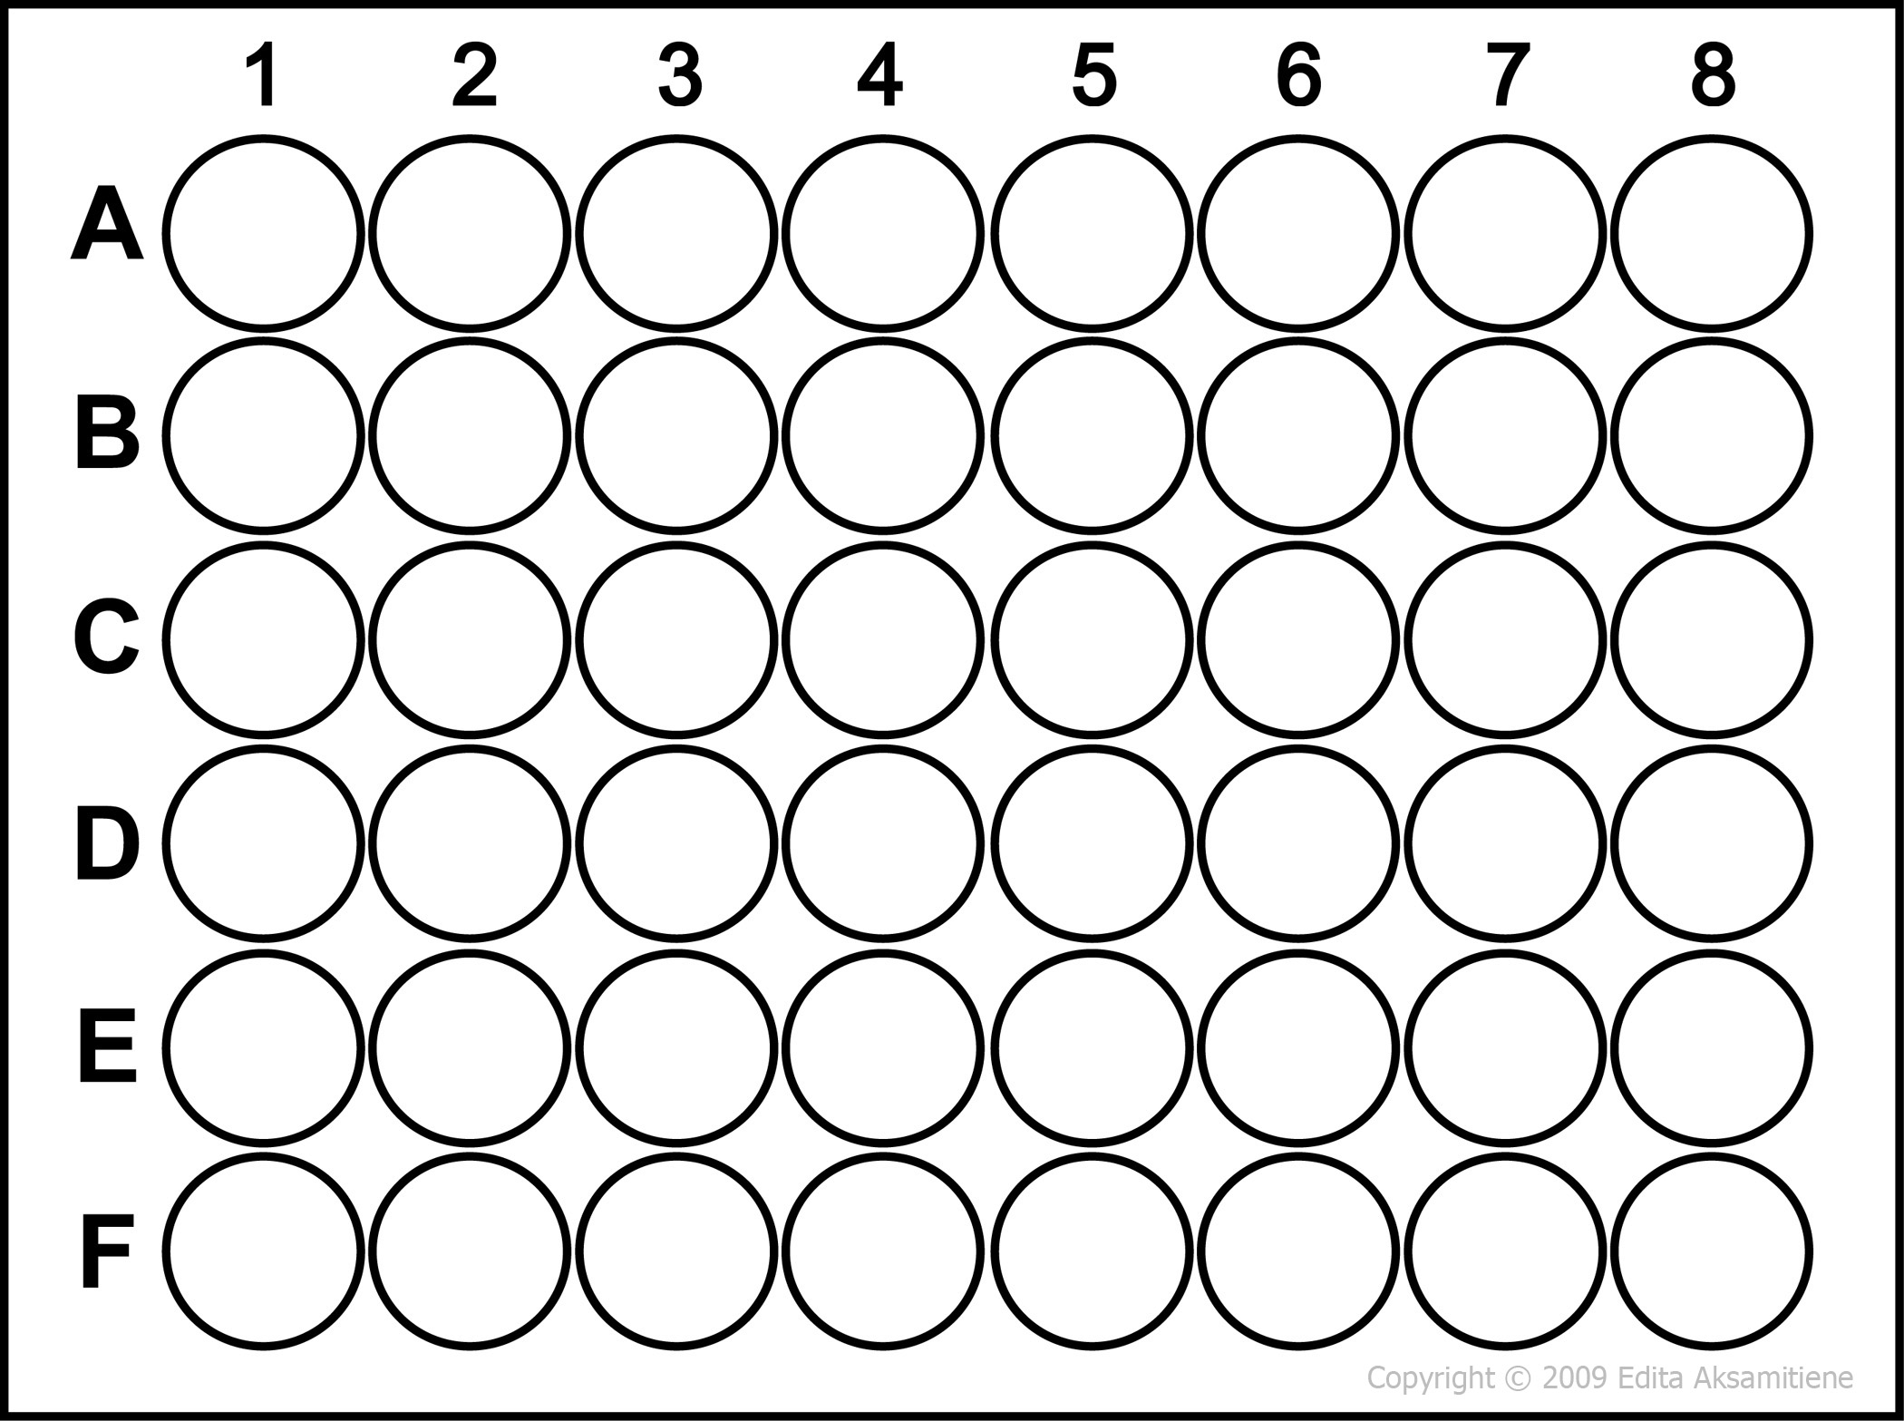
Data Generation – In Vitro Experiments
H9C2 CM
50,000 cells/well
Changeout
Hypoxic Media
Changeout
Media w/ Factors
Incubation
Incubation
72 hrs
3 hrs
Hypoxic
Atm.
Experimental Groups
Hypoxia Control
Control
IL-13 (100 ng/mL)
IL-33 (100 ng/mL)
TNF (20 ng/mL)
Incubate 24 hours
Track Apoptosis Count
@ 2 hr intervals

Slide 4
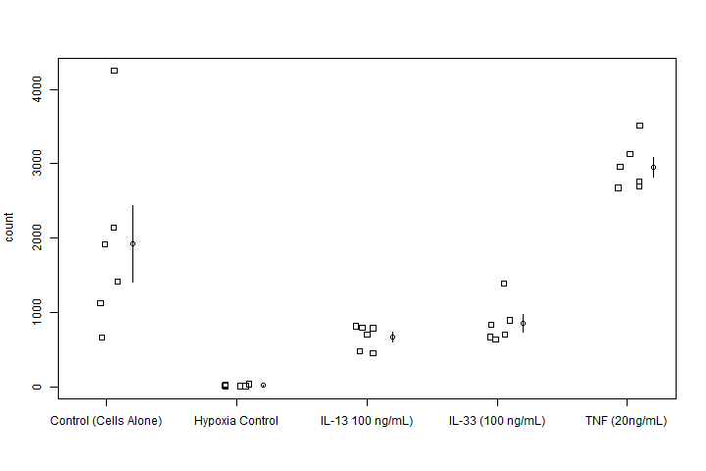
Results Indicate IL-33 and IL-13 are not Statistically Different
One-Way ANOVA
P-value = 6.085e-08
Reject Null – Groups are not the
same
Pair-wise t-test Results
IL-13 & IL-33 are statistically similar
Limitations:
Equal Variance Assumption violated by Control group
Table 1: Pairwise t-test p-values for group comparisons
 | Control | Hypoxia Control | IL-13 | IL-33
Hypoxia Control | 7.5e-05 | -- | -- | --
IL-13 | 0.0084 | 0.1410 | -- | --
IL-33 | 0.0257 | 0.0701 | 0.6035 | --
TNF | 0.0257 | 8.0e-08 | 6.0e-06 | 2.0e-05

Slide 5
References
Benjamin, E., et al. (2018) Circulation.
Konstarn, M., et al. (2011) JACC Cardiovasc. Imaging.
Wodsedalek, D., et al. (2019) Am. J. Physiol. Heart Circ. Physiol.
Veeraveedu, P. T., et al.(2019) Biochem. Pharmacol.
Carlson, D. L., et al. (2002) Am. J. Physiol. Heart. Circ. Physiol.

